Slide 1
Bideford Avenue
Utility Works – September 2023

Slide 2
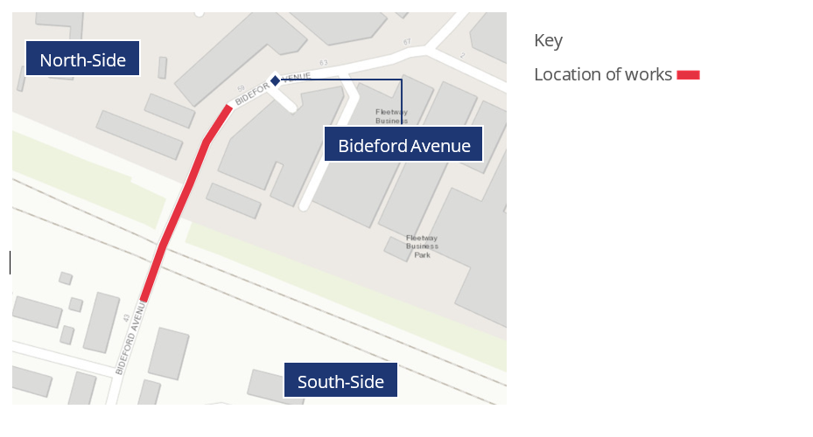
Utility works on Bideford Avenue
From 9 October to 3 November 2023, we will be carrying out utility works to strengthen the existing sewer pipe underneath Bideford Avenue. During these works we will be switching between different traffic management phases. ​​
The map below shows the approximate location of the traffic management on Bideford Avenue. This management will be lane and road closures. Please note we will keep access to Perivale station car park open apart from the one Sunday night shift. We will let you know the date closer to the time.

Slide 3
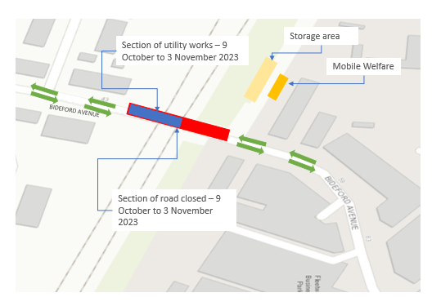
Phase One - From the 9 October to 12 October 2023
We will begin preparations to put in place the traffic management that will be used throughout these works.
During the day, we will be setting up our mobile welfare unit and have traffic management in place which will consist of a full day and night road closure on the south-side of Bideford Avenue.

Slide 4
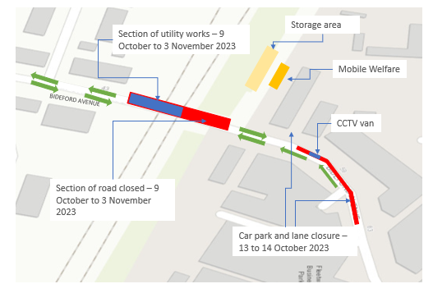
Phase Two - From the 13 October to 14 October 2023
We will be carrying out CCTV surveys to inspect the sewer prior to us lining it.
During the day and night, the south-side of Bideford Avenue will remain closed. There will also be a lane closure on the north side whilst our CCTV van and tankers are in place.

Slide 5
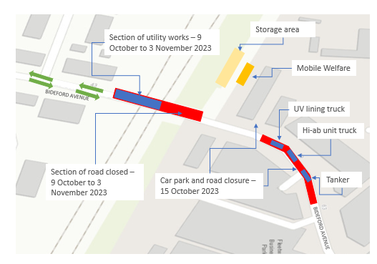
Phase Three - 15 October 2023
We will be starting works to insert the UV (ultra violet) lining which helps to repair the existing sewer pipe.
During the day and night, the south-side of Bideford Avenue will remain closed. On the north side there will be an overnight closure whilst we feed in the liner.

Slide 6
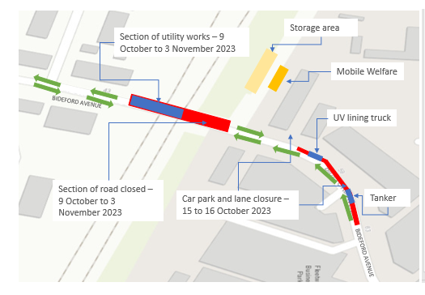
Phase Four – From the 15 to 16 October 2023
We will continue to insert the UV lining on Bideford Avenue.
During the day and night, the south-side of Bideford Avenue will remain closed. On the north side there will be an overnight closure that will be converted to single lane closure after liner is fed in to allow traffic to continue flowing.

Slide 7
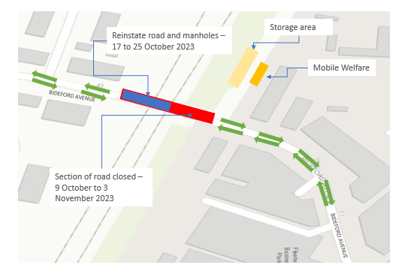
Phase Five – From the 17 to 27 October 2023
We will begin to reinstate the manholes dug up as part of the works.
During the day and night, the south-side of Bideford Avenue will remain closed. On the 17 October we will mobilise the new traffic management set up. On the 18 October we will begin reinstating the road and manholes until the 22 October. Finally, we will modify the manholes until the 25 October.

Slide 8
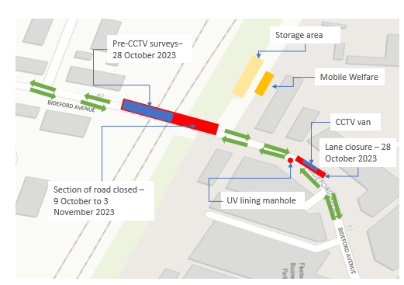
Phase Six – 28 October 2023
We will start our pre- CCTV surveys to ensure inspect the sewer prior to us lining it.
This will require a full road closure on the south side throughout the day and night and a lane closure on the north side of Bideford Avenue where our CCTV van will be in place.

Slide 9
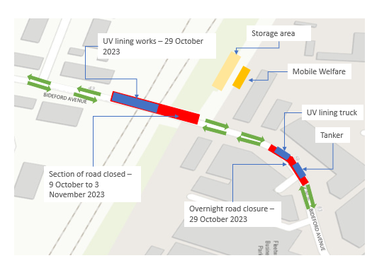
Phase Seven – 29 October 2023
We will begin overnight works for the UV lining. During the day and night, both the north and south side of Bideford Avenue will be closed. We will be using the Hi-ab machine and rigid lorry to complete this bit of work. This phase of work will be completed on Sunday nights, to allow for longer durations and full road closure for lining.

Slide 10
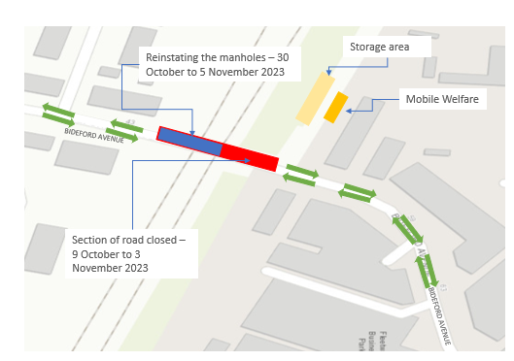
Phase Eight – From 30 October to 5 November 2023
We will begin the final phase of works which will be reinstating the manholes on the southern side. This will require the road to remain closed throughout the day and night on the south-side of Bideford Avenue.
On the 30 October we will begin to reinstate the manholes until the 3 November. We will then demobilize the location of works between the 4 and 5 November.

Slide 11
Thank you

