Slide 1

Image pack for Timeline Challenge: History of Coleshill
Images with information in notes section.
Notes:
HAYLEY ON CAMERA ON AND UNMUTE
Good morning and a warm welcome to today’s HS2 live webinar where we will be focusing on the most recent exciting archaeological finds at our site in Coleshill.

Slide 2
Iron Age
1200 – 550 BC

Slide 3
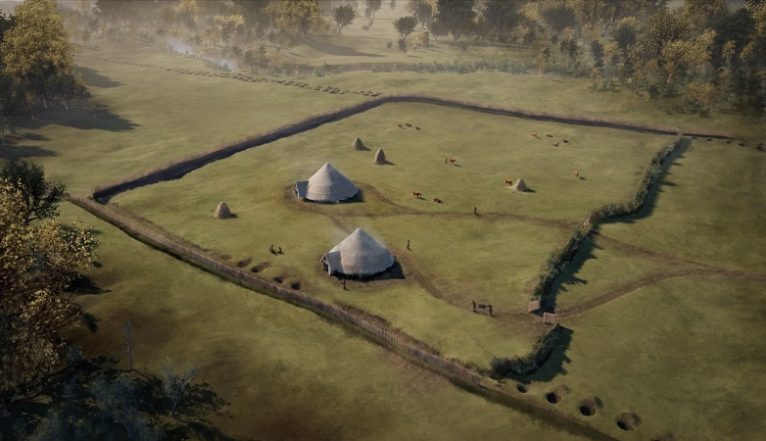
Notes:
Reconstruction of Iron Age settlement.
Two roundhouses were identified within a large rectangular enclosure, with a wide and deep ditch forming the boundary on three sides, and a hedgerow on the other side. This is where families lived and carried out domestic and agricultural activities. Livestock are likely to have grazed nearby, with the ditch and hedgerow preventing them from escaping.
Two parallel pit alignments formed a continuation of the landscape boundary. The pits were 2m in diameter with depths of up to 1.3m! These would have taken an enormous amount of time and effort to dig, probably by several members of the community working together.

Slide 4
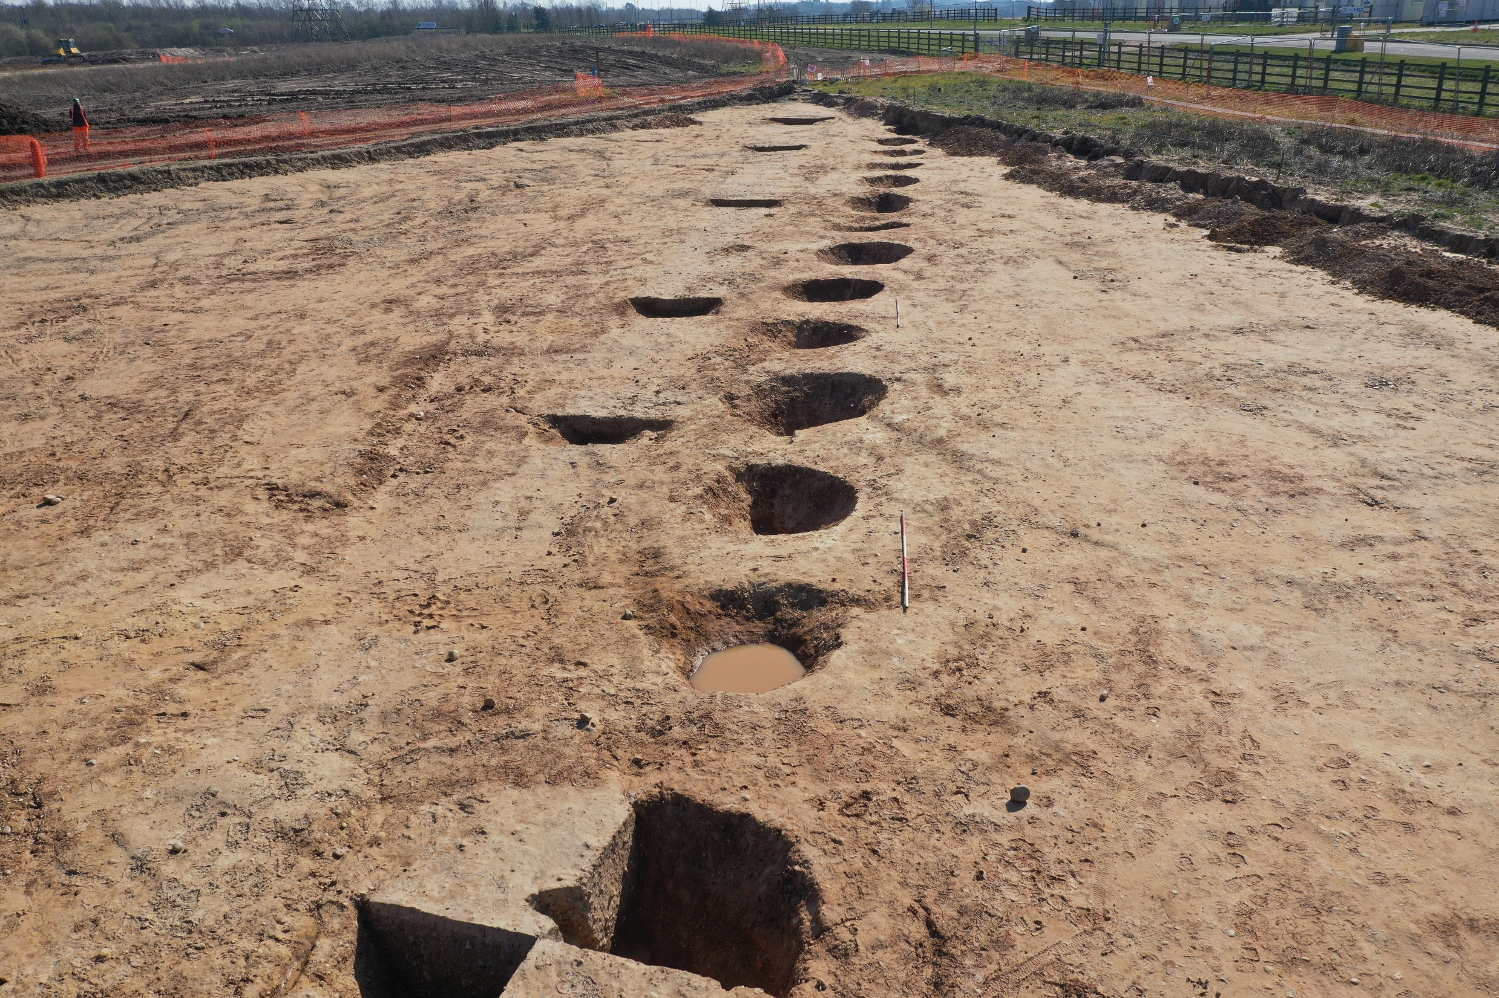
Notes:
Aerial photograph of archaeological feature: Iron Age ditch and pit alignment.
A line of 30 pits ran parallel to an Iron Age ditch, forming a huge boundary, which would have been visible from afar.
The pits were 2m in diameter with depths of up to 1.3m! These would have taken an enormous amount of time and effort to dig, probably by several members of the community working together.

Slide 5
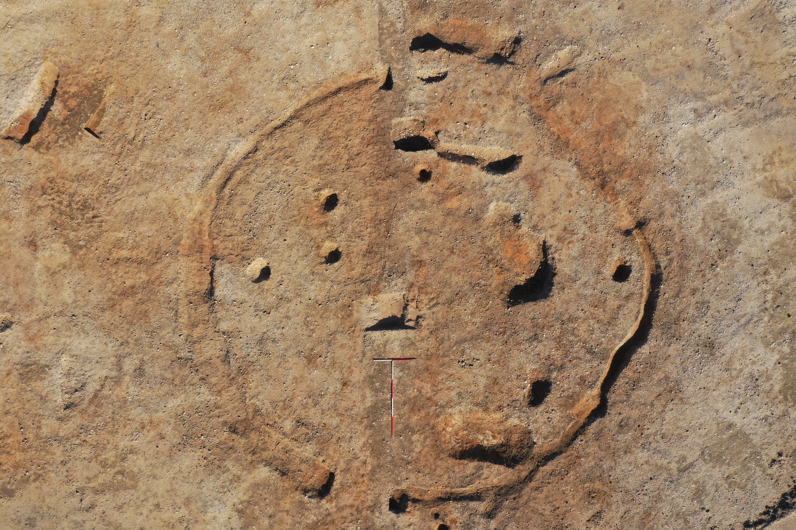
Notes:
Aerial photograph of archaeological feature: footprint of Iron Age roundhouse.
The outer drainage gully of the roundhouse can be seen forming a ring shape. The inner postholes would have held timber posts that supported the roof of the building.

Slide 6
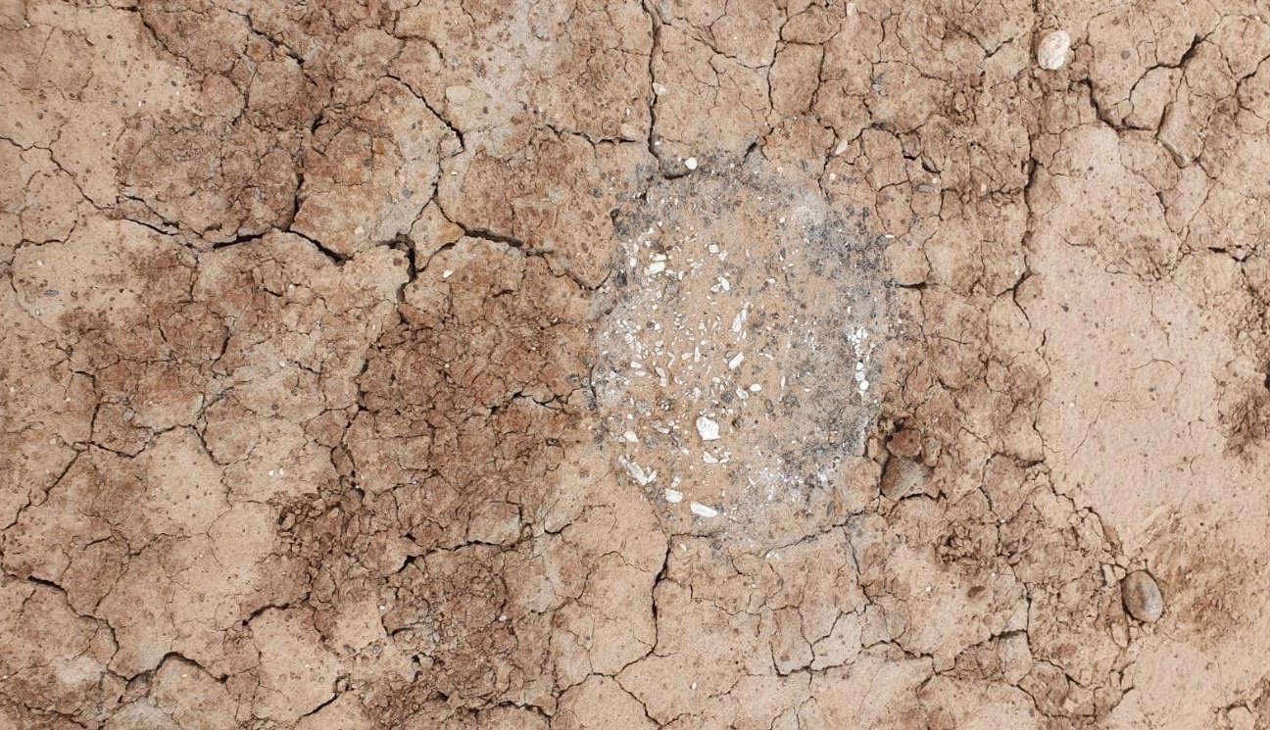
Notes:
Photograph of Iron Age cremation burial.
Within the Iron Age settlement, outside the enclosure, 20 cremation burials were uncovered, showing separation between areas for the living and the dead.
They were found further down the slope towards the River Cole and represent the place where the dead were laid to rest.

Slide 7
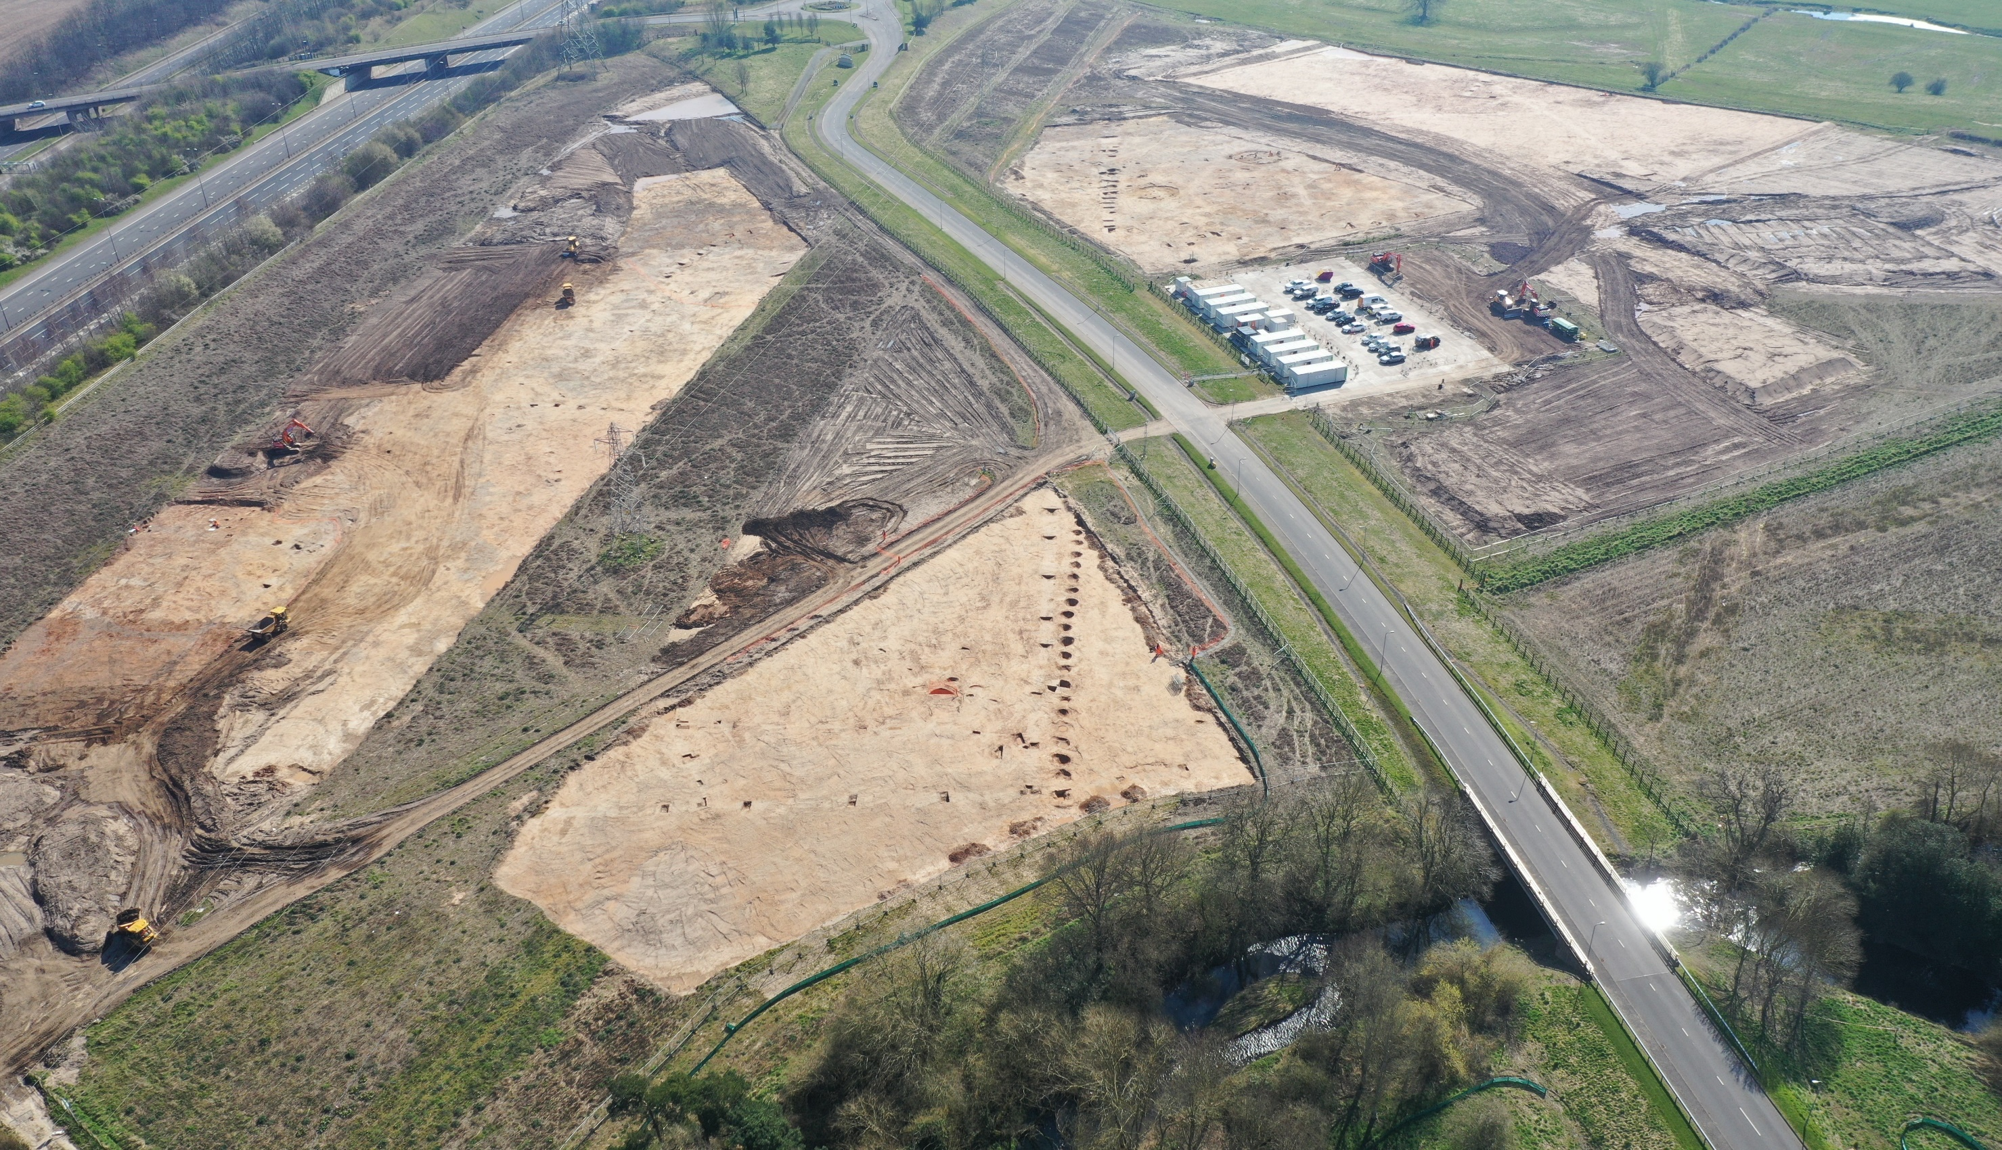
Notes:
Aerial photograph of Iron Age landscape.
Archaeologists have stripped large areas of topsoil to reveal archaeological features below, including two roundhouses (above compound), ditches and pit alignments (running vertically across centre of image).

Slide 8
Romano-British
43 – 410 AD

Slide 9
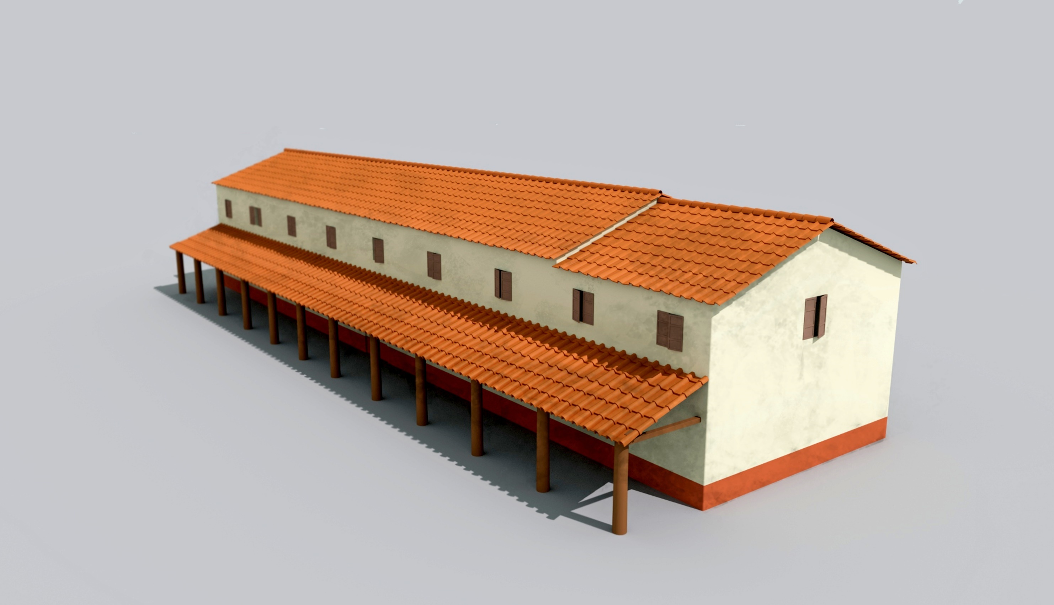
Notes:
Reconstruction of Roman building.
The land at Coleshill continued to be used for farming in the cross over to the Romano-British period.
Archaeologists found lots of Roman roof tiles, suggesting that the structure was an important building in the farming community, perhaps a farmer’s home or even a meeting place.
This reconstruction was based on the discovery of roof tiles and two parallel rows of large postholes, forming the main frame of the building, with another parallel row of much smaller postholes, forming a portico (porch) leading to the entrance of the building.

Slide 10
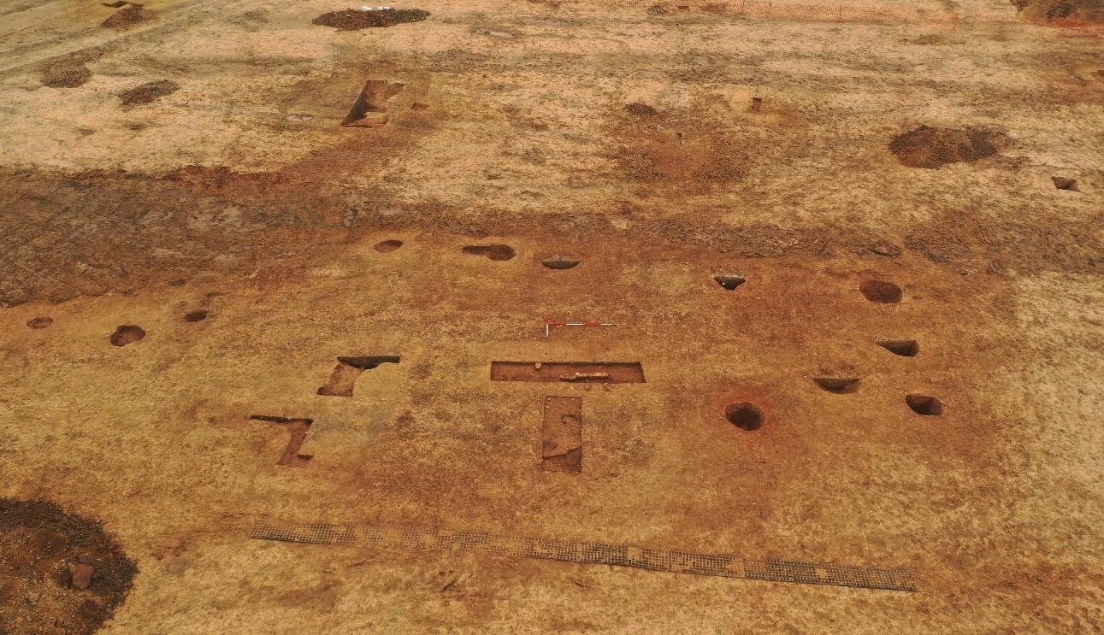
Notes:
Archaeological feature: footprint of Roman building.
Archaeologists discovered two parallel rows of large postholes, forming the main frame of the building, with another parallel row of much smaller postholes, forming a portico (porch) leading to the entrance of the building.
After the building was abandoned and collapsed, the roof tiles washed into the pits and ditches in the surrounding area. A Roman coin was discovered in one of the building’s postholes, and a complete Roman pot was found in another. These may have been deliberate deposits, perhaps offerings to the household gods.

Slide 11
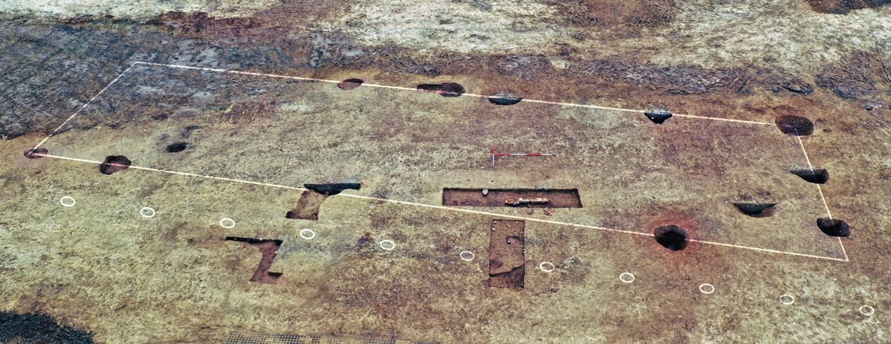
Notes:
Archaeological feature with highlighted footprint of Roman building.
Archaeologists discovered two parallel rows of large postholes, forming the main frame of the building, with another parallel row of much smaller postholes, forming a portico (porch) leading to the entrance of the building.

Slide 12
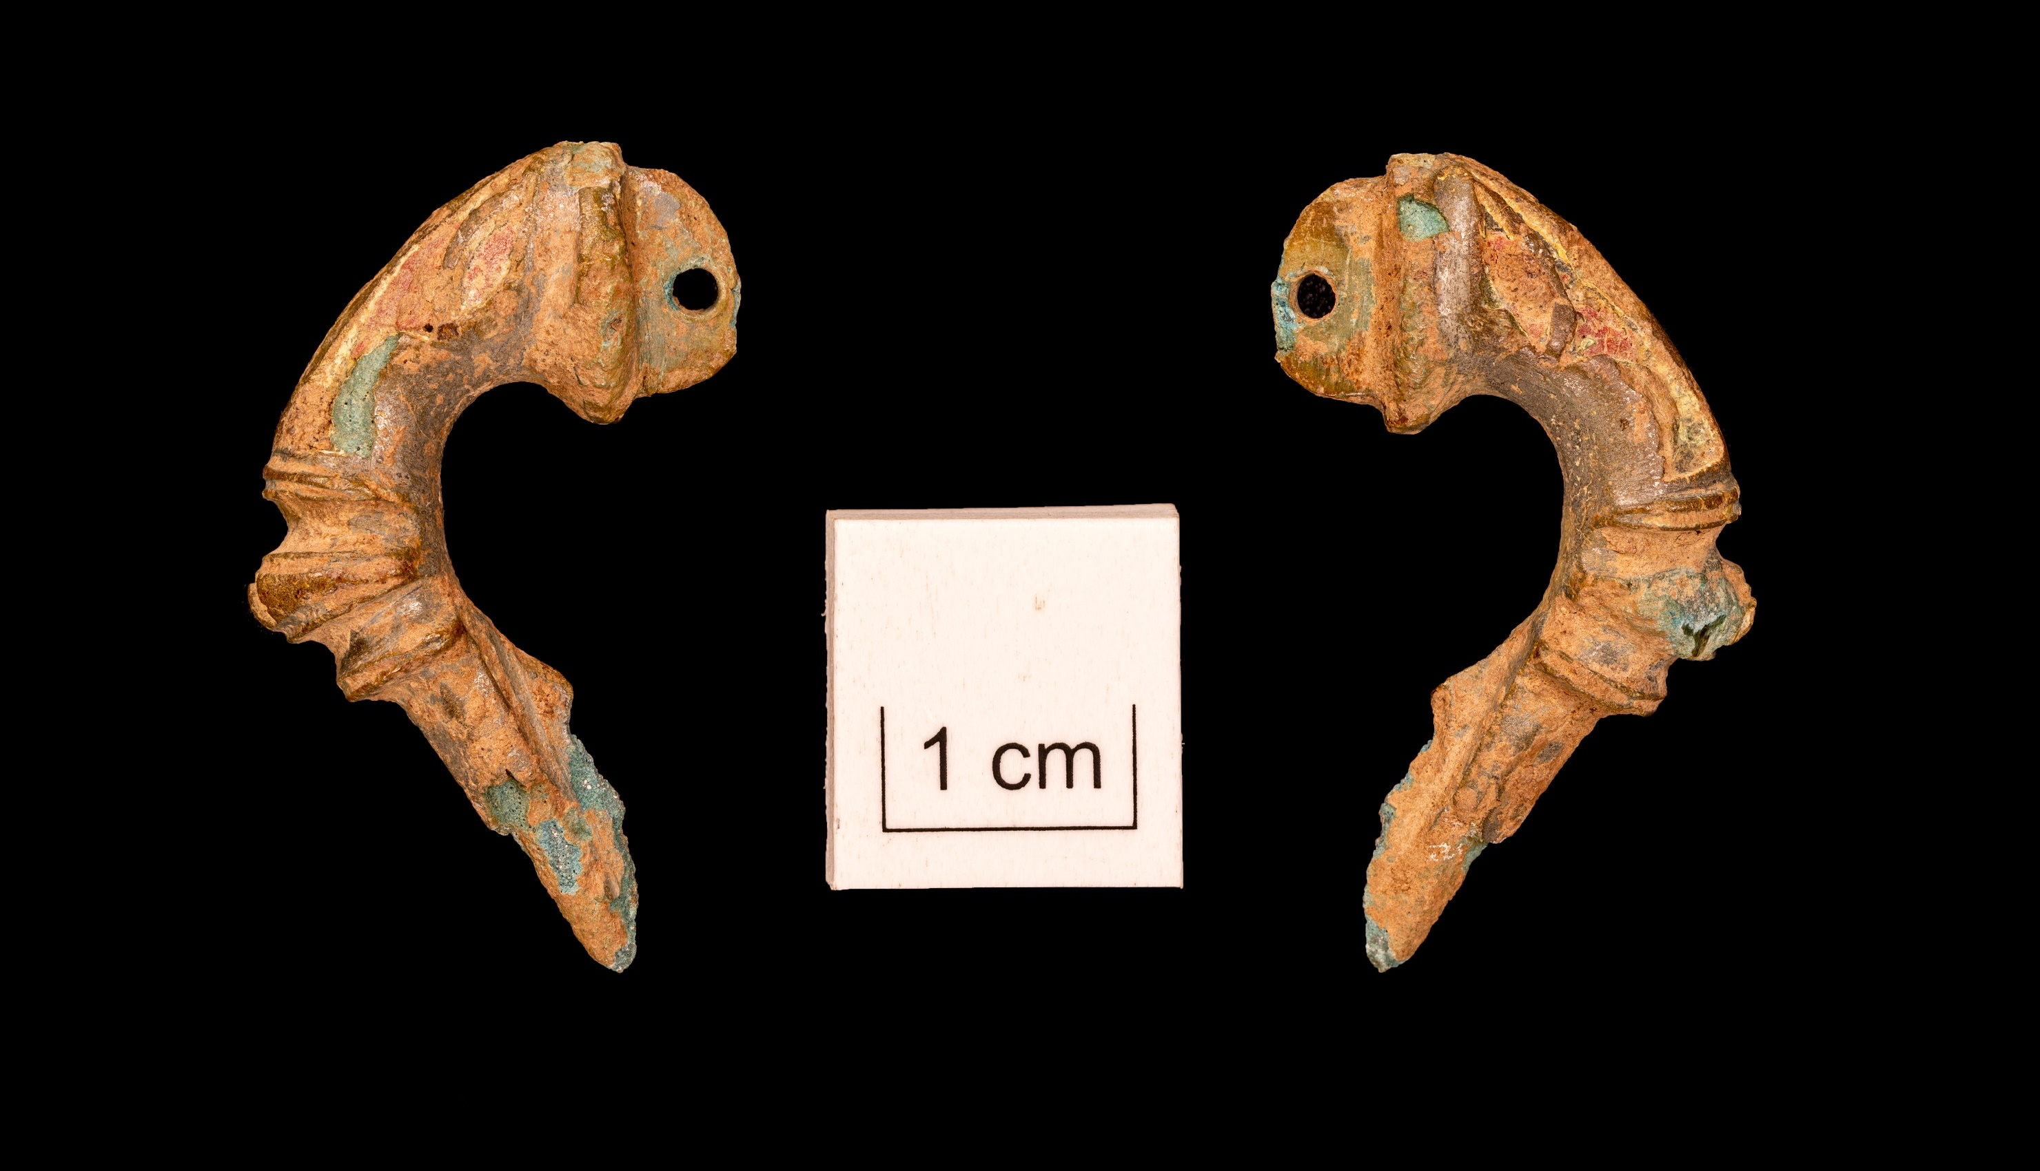
Notes:
Artefact: Roman brooch.
This little brooch would have been worn on the shoulder, as a dress fastener – the pin and part of the catch-plate are missing, but the decorative part survives. The brooch is of a type known as a ‘Trumpet’ brooch, because of the way the head expands into a trumpet-mouth shape. It dates to the 1st or 2nd century AD.

Slide 13
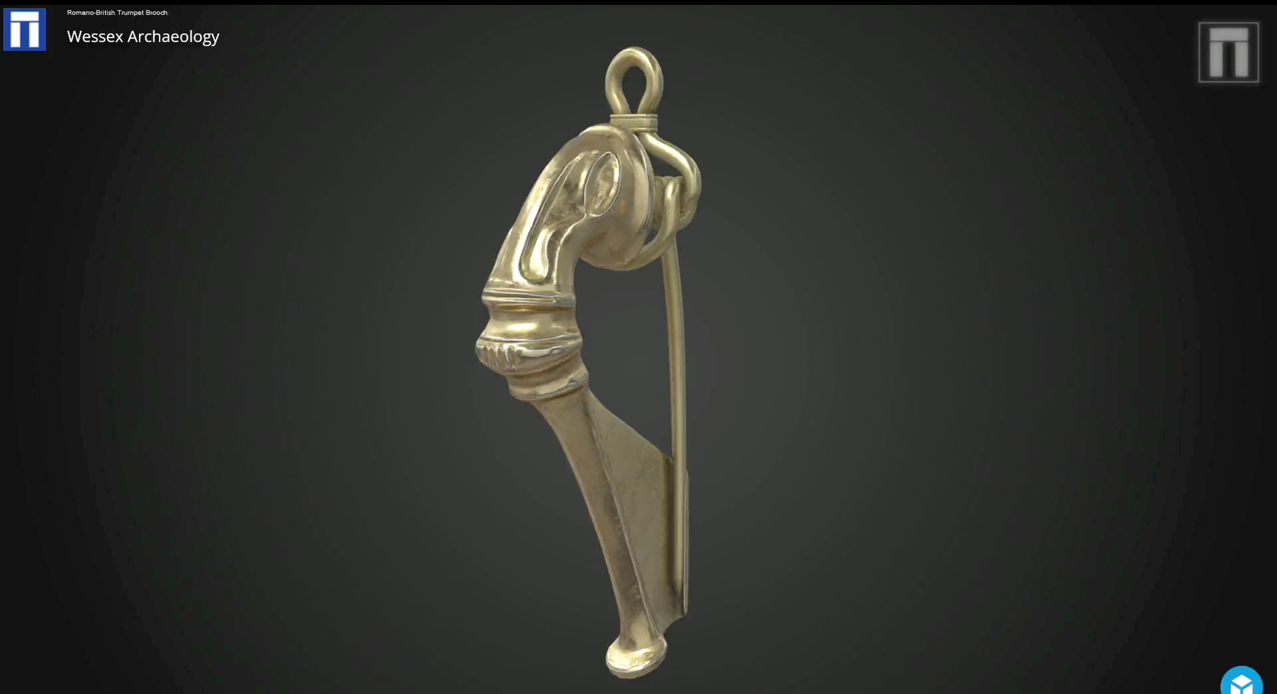
Notes:
Roman brooch reconstruction.
This reconstruction is based off the Roman brooch. The artefact was 3D scanned and then reconstructed to how it would have looked in its original state.

Slide 14
Medieval
1066 – 1485

Slide 15
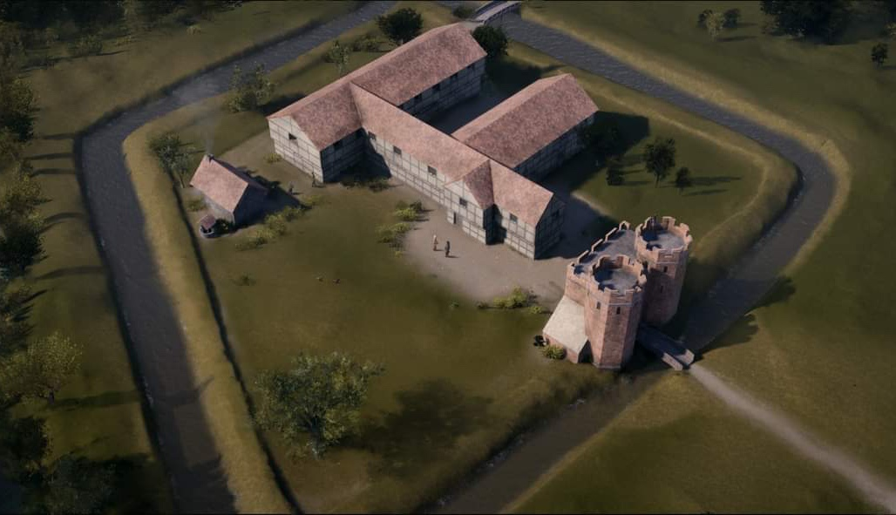
Notes:
Reconstruction of the Medieval Coleshill Hall
In 1284-5 King Henry II granted the Manor of Coleshill to the De Clinton family and it was around this time the first Coleshill Hall was constructed with a square moat surrounding it.
After the excavations were completed, archaeologists studied the results to determine how the original Coleshill Hall may have looked with its square moat. This reconstruction shows the earlier house in the late 15th century based on evidence found (postholes and walls) as well as the location of the gatehouse and square moat.

Slide 16
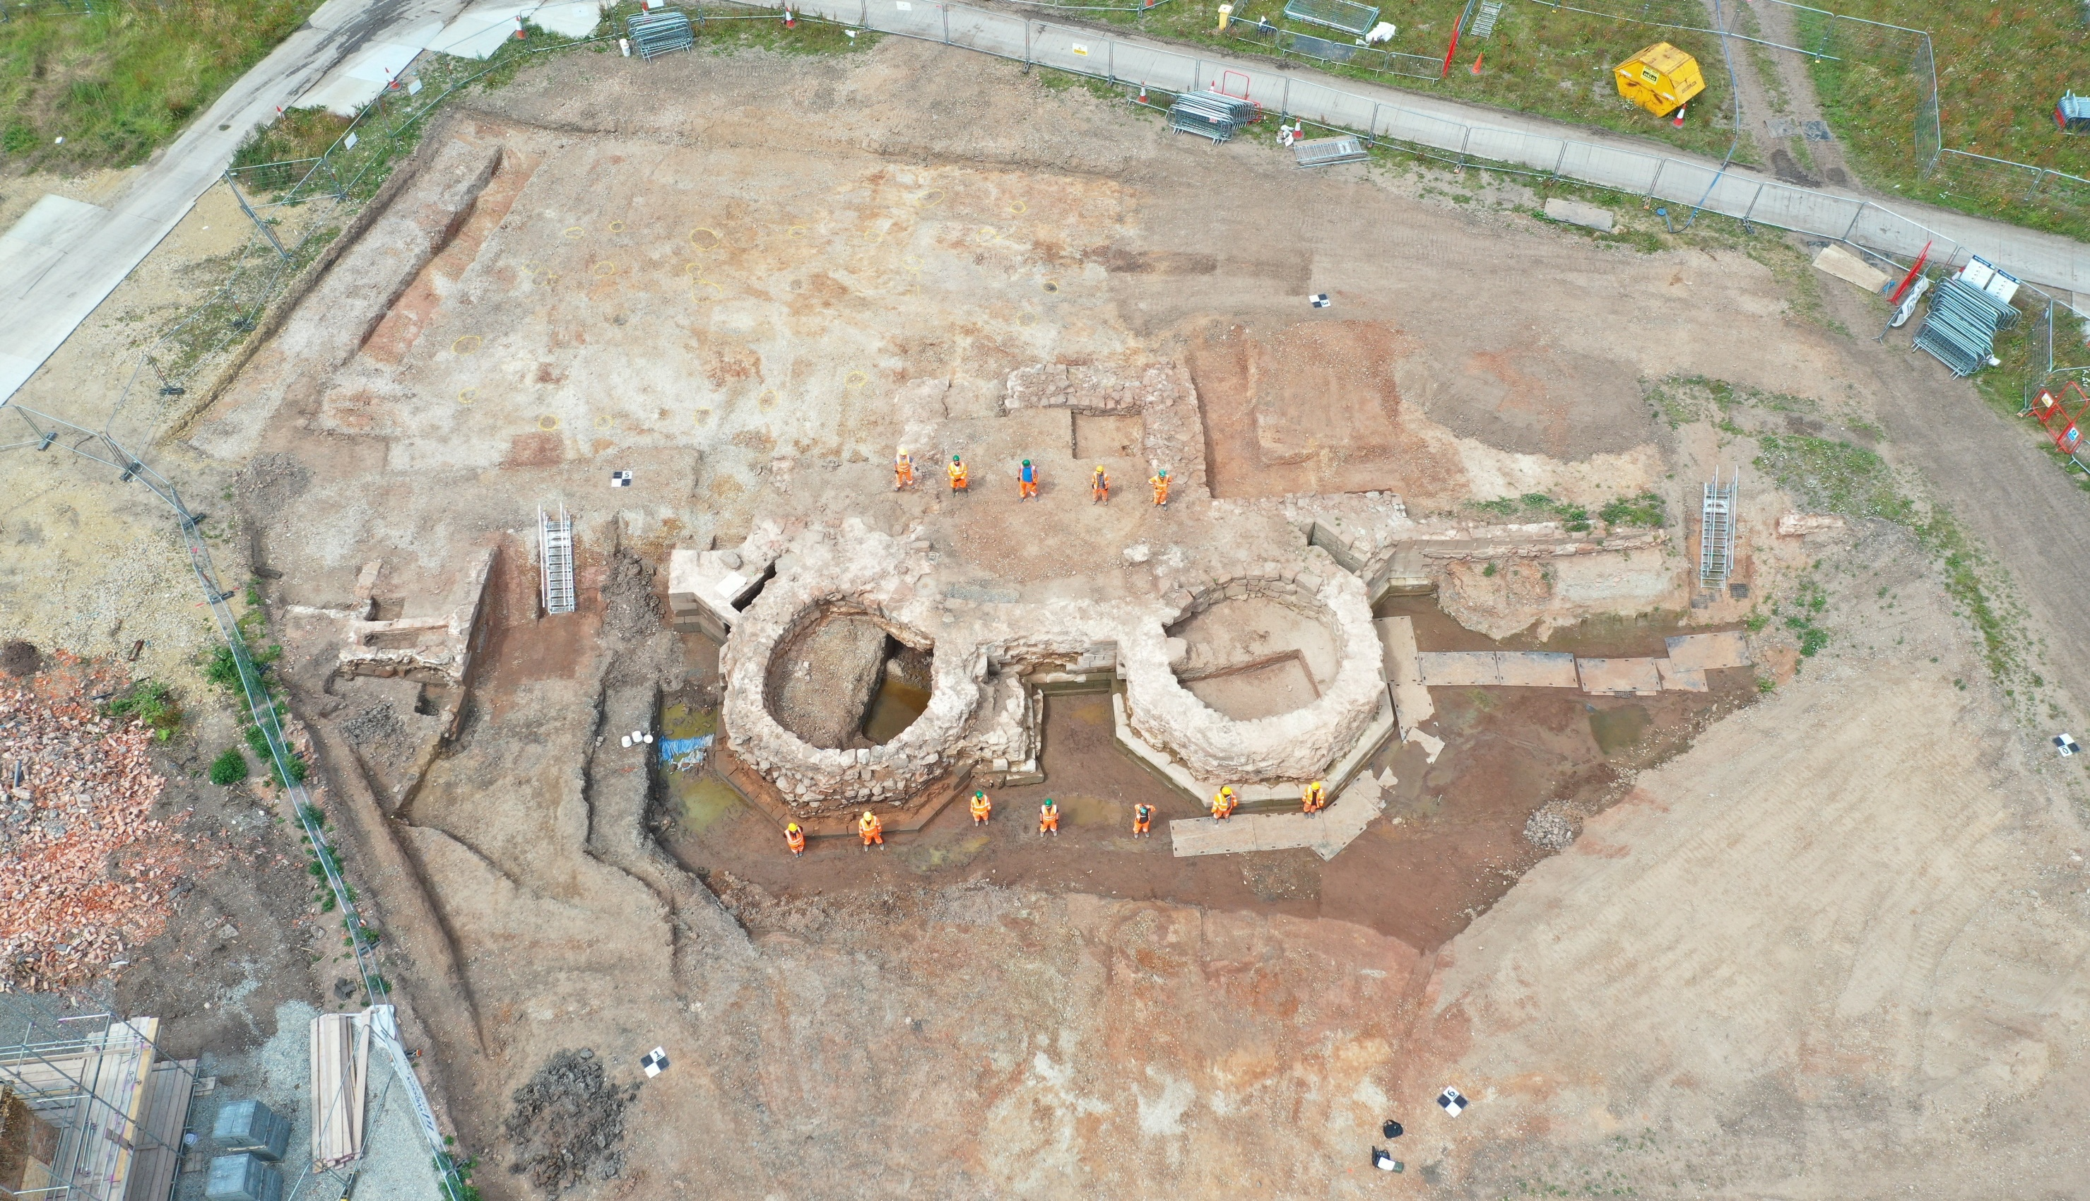
Notes:
Aerial photograph of gatehouse foundations.
This aerial image shows the team on site and gives a good idea as to the scale of the gatehouse remains. The gatehouse would have been the main point of entry to Coleshill Hall for distinguished guests. It may also have served as a defensive structure.

Slide 17
Notes:
Figure showing gatehouse foundations.
This figure shows a plan of the gatehouse from above and highlights structures, archaeology and excavated slots. Use the legend at the bottom of the figure to help spot the gatehouse remains.

Slide 18
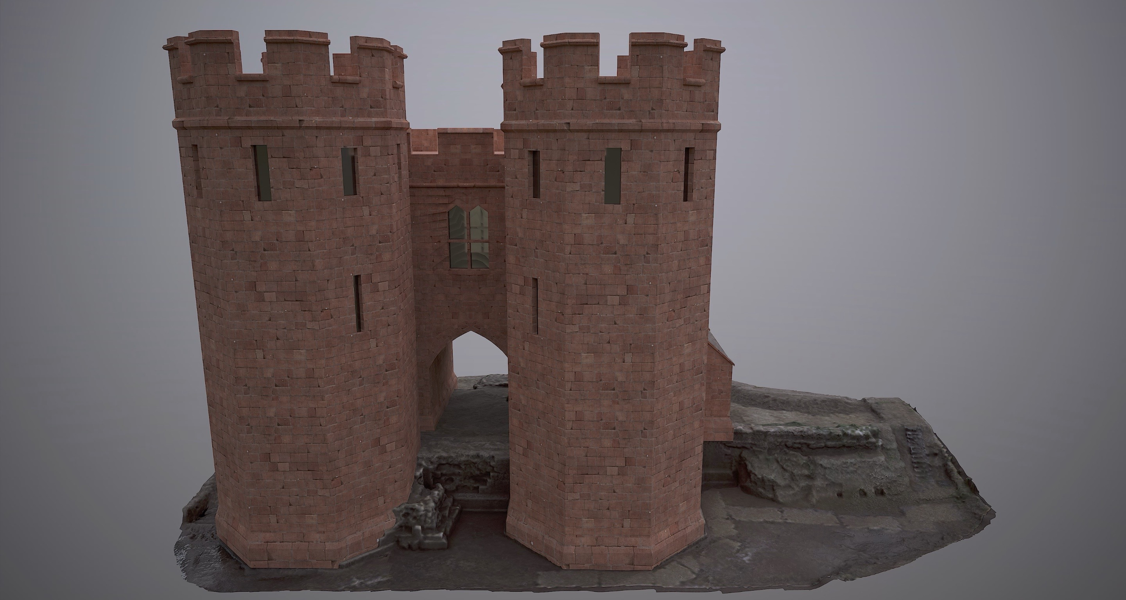
Notes:
Reconstruction of the Medieval gatehouse.
This reconstruction is based on the excavated foundations of the gatehouse, contemporary comparisons (Maxstoke Castle gatehouse) and historical evidence that mentions an upper chamber.

Slide 19
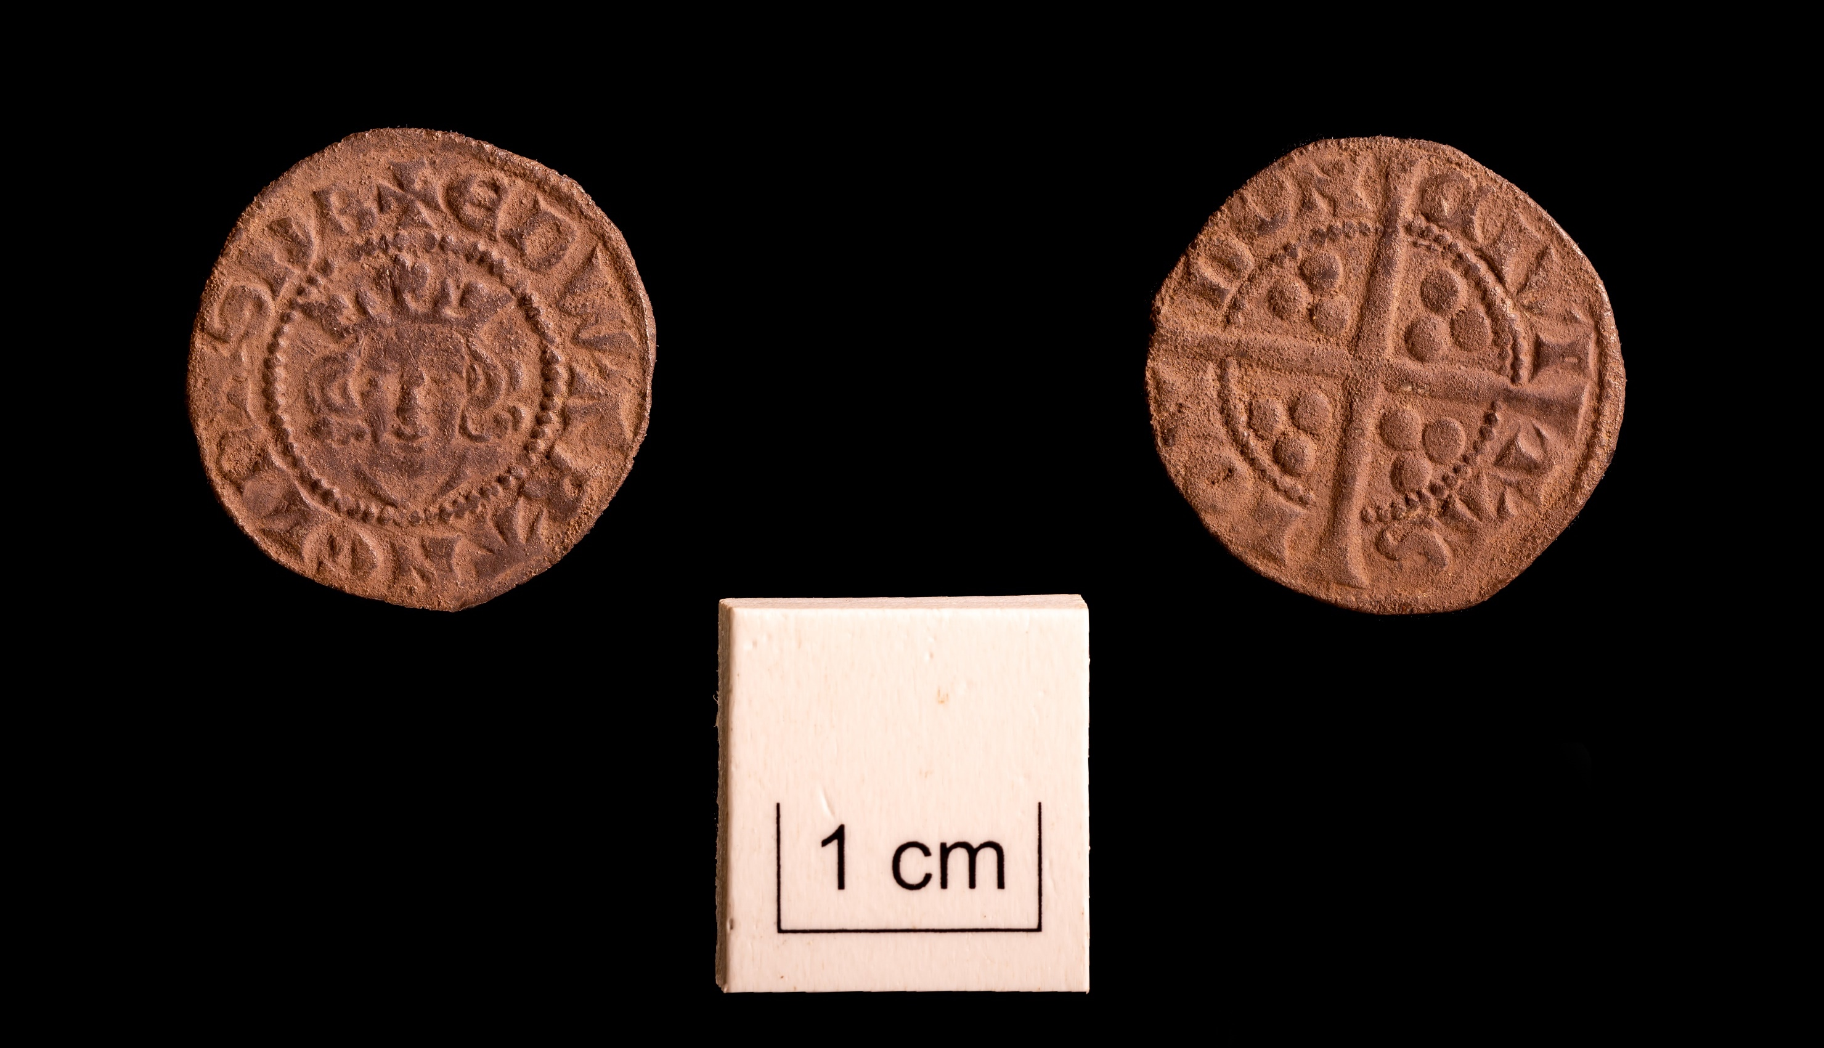
Notes:
Artefact: silver coin
Penny of Edward I or II – this is a transitional type spanning the two reigns. Coins are good dating tools for archaeologists, but also tell us something about the economic life of the inhabitants of Coleshill Manor.

Slide 20
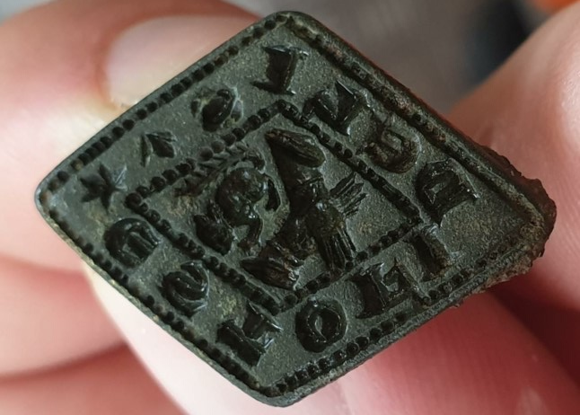
Notes:
Artefact: seal matrix.
This little seal matrix, which dates to the 13th or 14th century, would have been used to authorize documents or to ‘sign’ correspondence, by impressing a personal crest into melted wax. It means that someone at Coleshill was literate and able to write – not such a common ability at this time. The design features a squirrel over clasped hands within a border containing the legend ESTO FIDELIS – ‘be faithful’.

Slide 21
Tudors & Stuarts 1485 – 1714

Slide 22
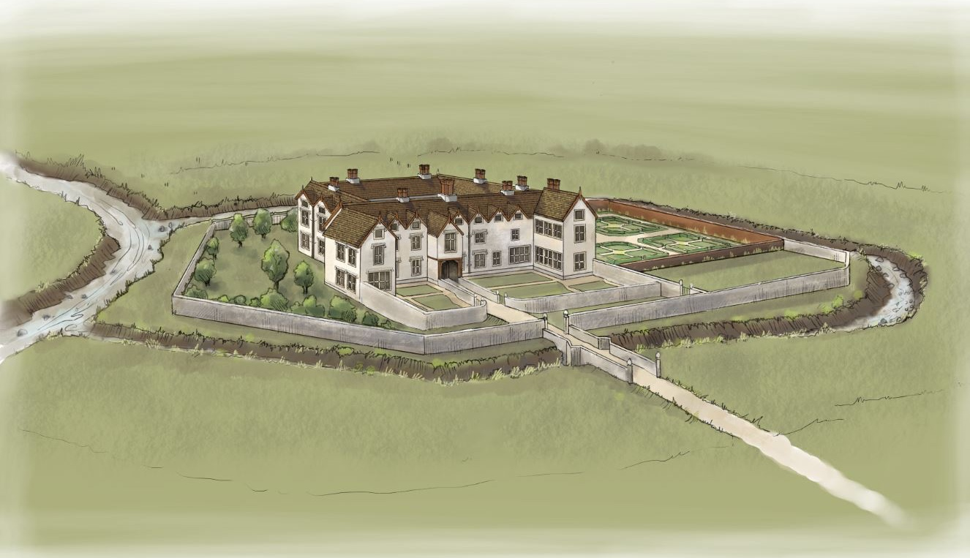
Notes:
Reconstruction of the later Coleshill Hall
This is an artist's impression of how the second hall may have looked in the 1700's. This was created before excavations started and is based on contemporary drawings.
Coleshill Hall was given to Simon Digby by the king (Henry VII) when its former owner, Simon de Montford, committed treason and was hanged at the Tower of London in 1495.
The Digby family continued to rise in power when Robert Digby married Irish heiress, Lady Lettice FitzGerald, in 1598. It was around this time that the original Colehill Hall was demolished and the new house was constructed with opulent formal gardens and an octagonal moat. This would have demonstrated the Digby’s wealth and status.

Slide 23
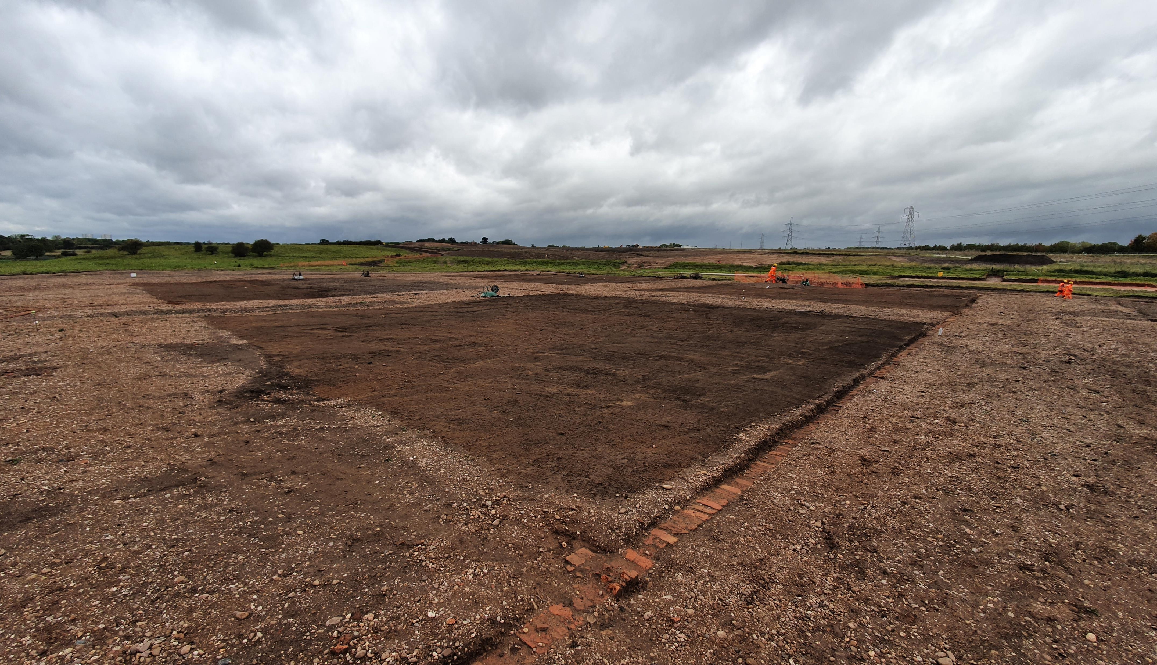
Notes:
Photograph of garden remains.
This image shows the garden remains from ground level. You can see four squares of darker earth which make up the main flower beds of the formal gardens. The flower beds were divided by gravel footpaths.

Slide 24
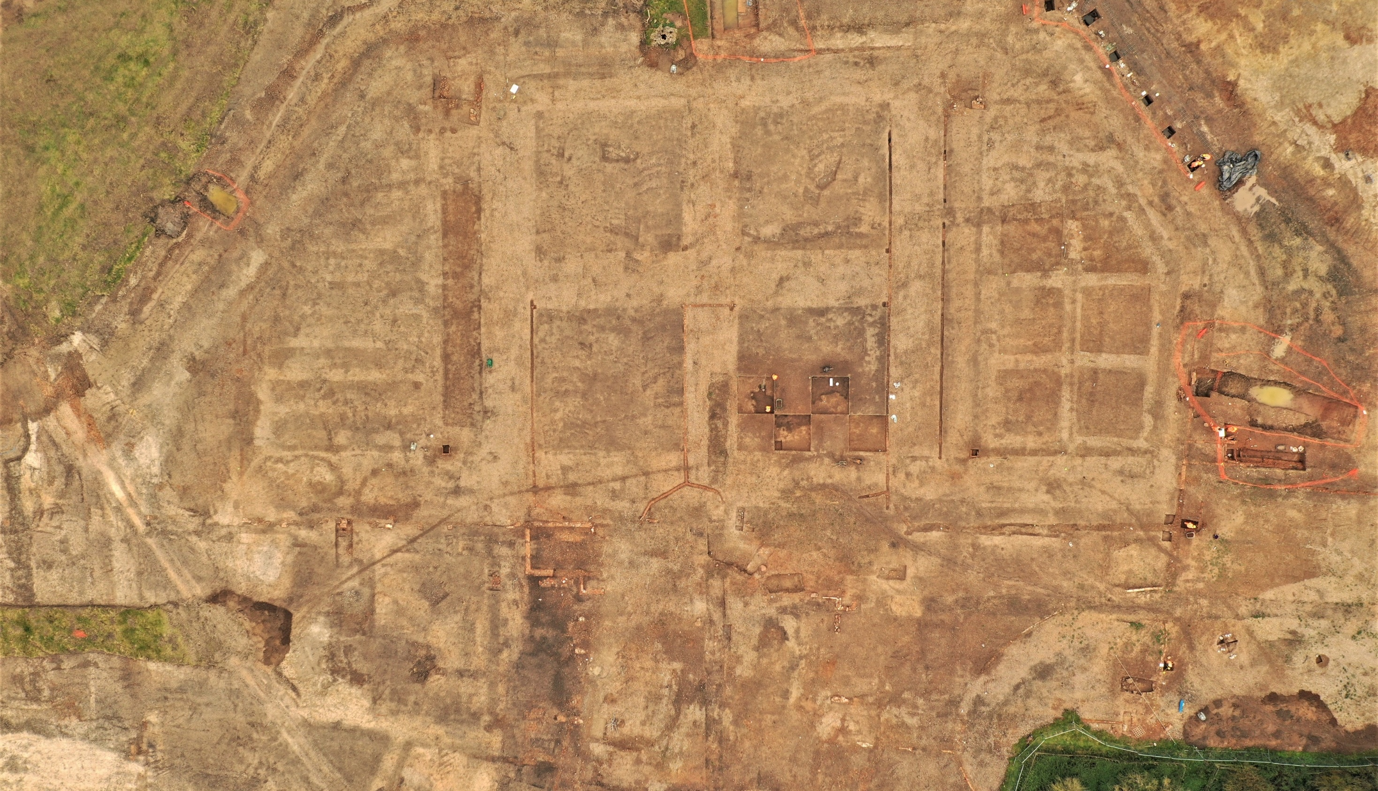
Notes:
Aerial photograph of Coleshill Hall and garden remains.
You can see the ornamental moat framing four central squares of darker earth and six smaller squares to the right. These are the flower beds of the formal gardens and they were divided by gravel footpaths.
The house remains are in the centre of the bottom half of the image. The house was purposefully demolished in the 19th century and not much remains of the foundations.

Slide 25
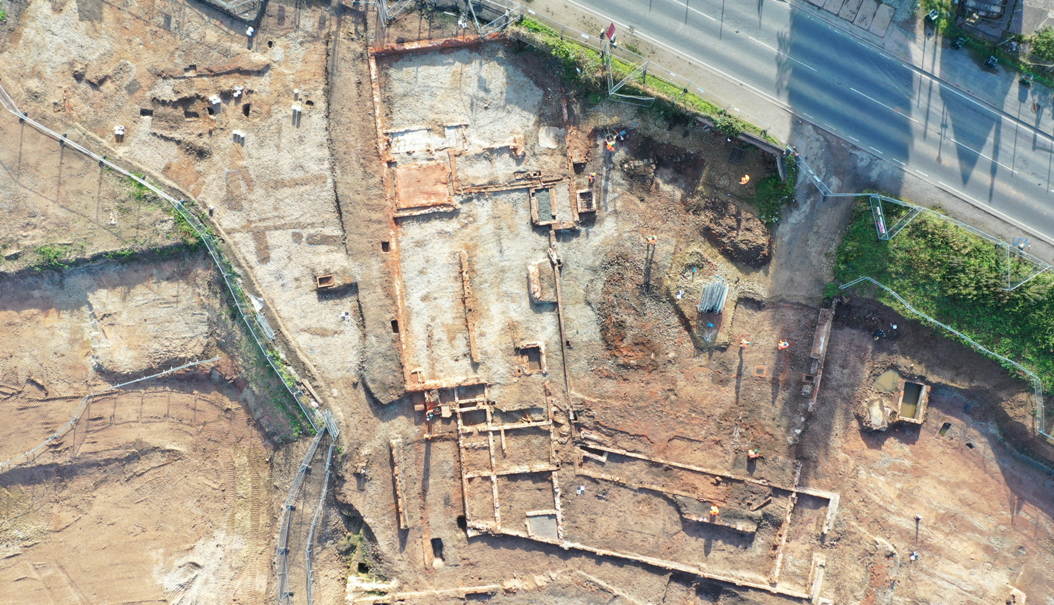
Notes:
Aerial photograph of Coleshill Hall additional buildings.
This image shows the foundations of additional buildings associated with Coleshill Hall. These were perhaps stables, farms or cottages.

Slide 26
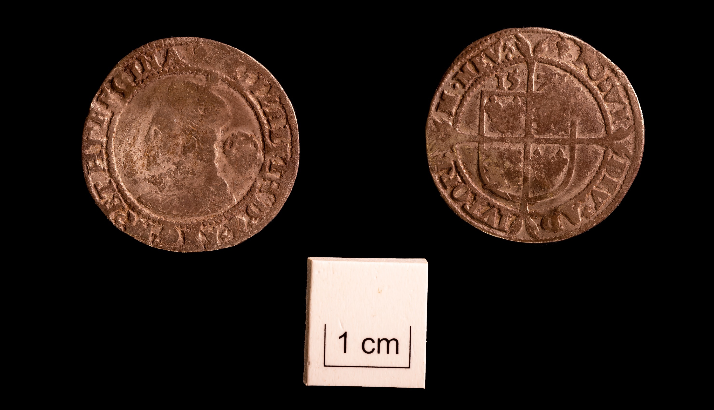
Notes:
Artefact: silver coin
Sixpence of Elizabeth I, issued in 1573. Coins are good dating tools for archaeologists, but also tell us something about the economic life of the inhabitants of Coleshill Manor.

