Slide 1

Image pack for Introduction to Archaeology through Equipment
Images with information in notes section.
Notes:
HAYLEY ON CAMERA ON AND UNMUTE
Good morning and a warm welcome to today’s HS2 live webinar where we will be focusing on the most recent exciting archaeological finds at our site in Coleshill.

Slide 2
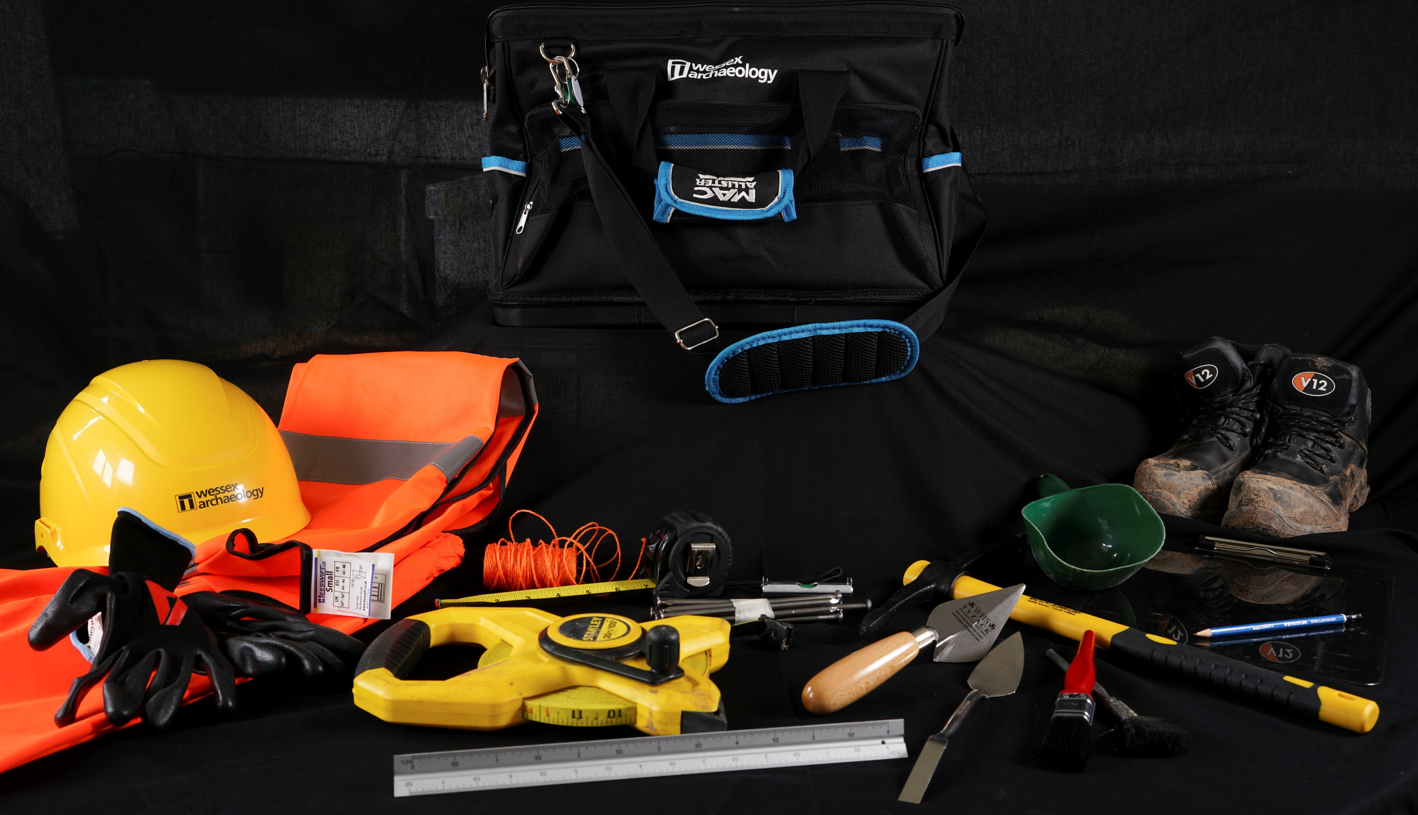

Slide 3
Excavating tools

Slide 4
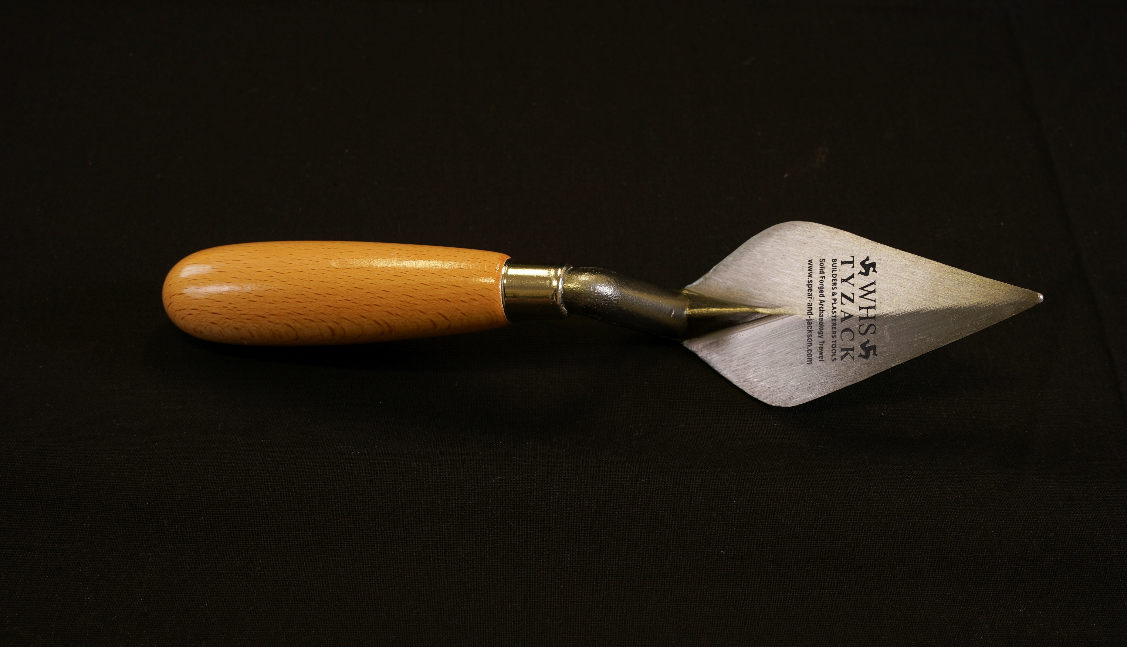
Notes:
Excavating tool: Trowel
To carefully scrape away earth layer by layer.

Slide 5
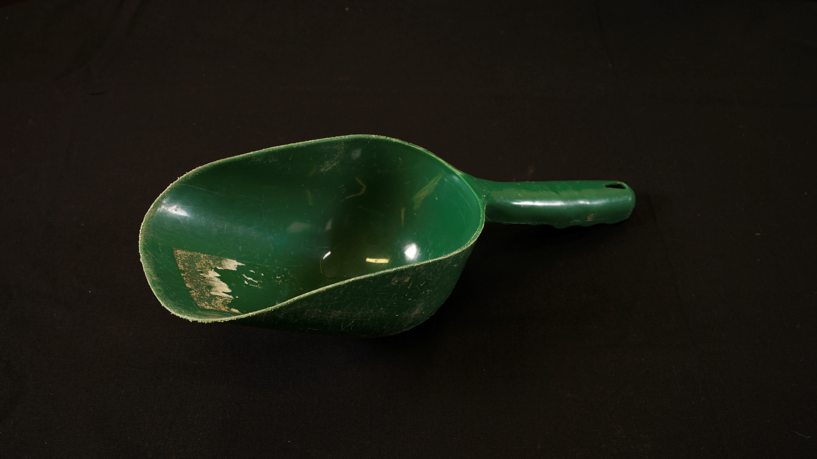
Notes:
Excavating tool: Shovel
To dig away large sections of earth.

Slide 6
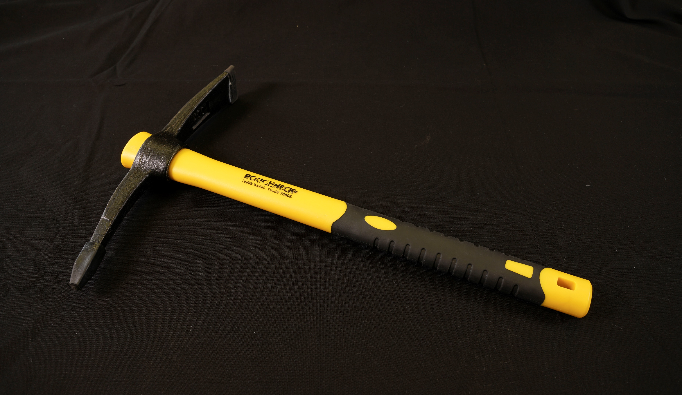
Notes:
Excavating tool: Mattock
To break up hard ground to make it easier to dig.

Slide 7
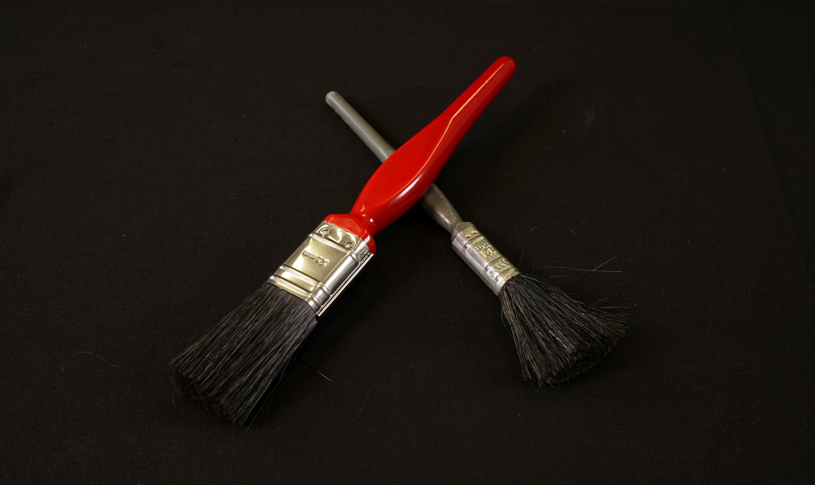
Notes:
Excavating tool: Paint brushes
To brush away earth from archaeological features.

Slide 8
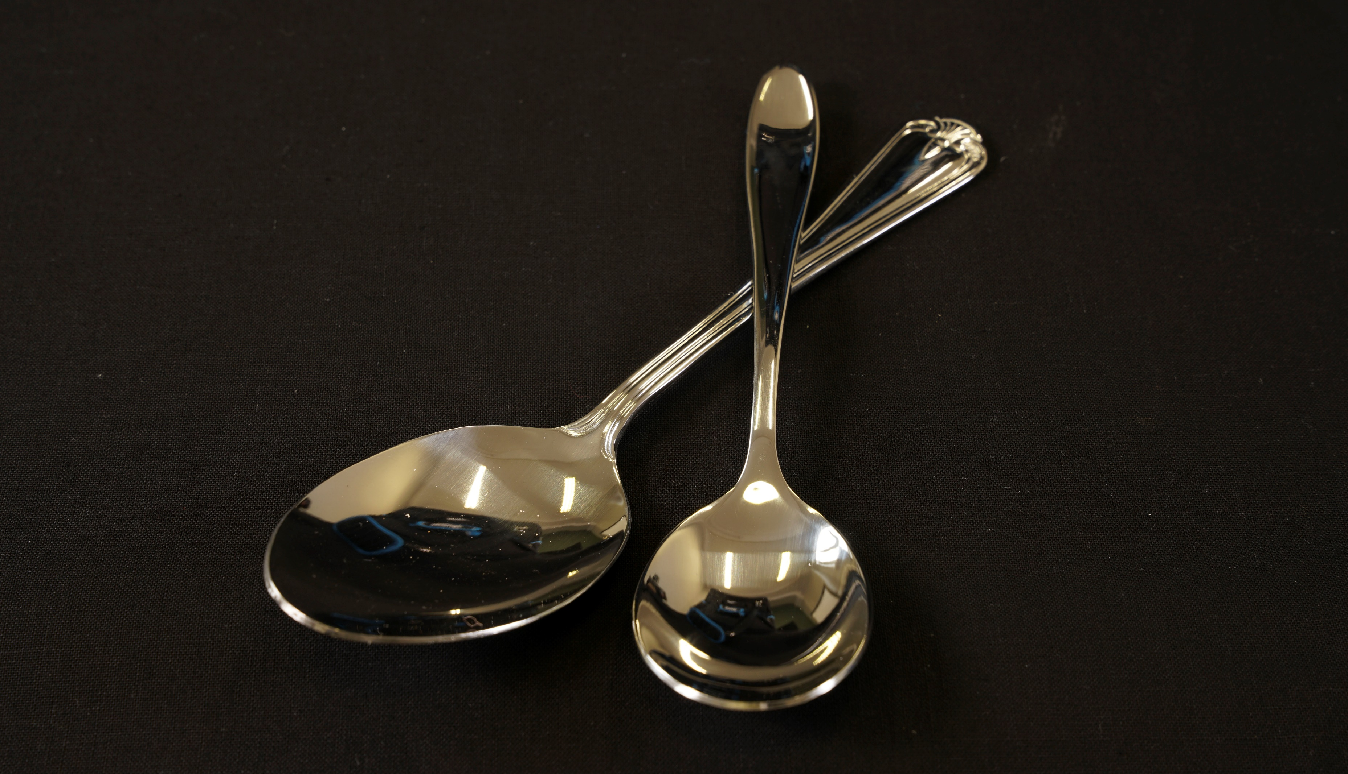
Notes:
Excavating tool: Spoons
To excavate small features that cannot be reached by a trowel.

Slide 9
Recording equipment
Notes:
Recording equipment:

Slide 10
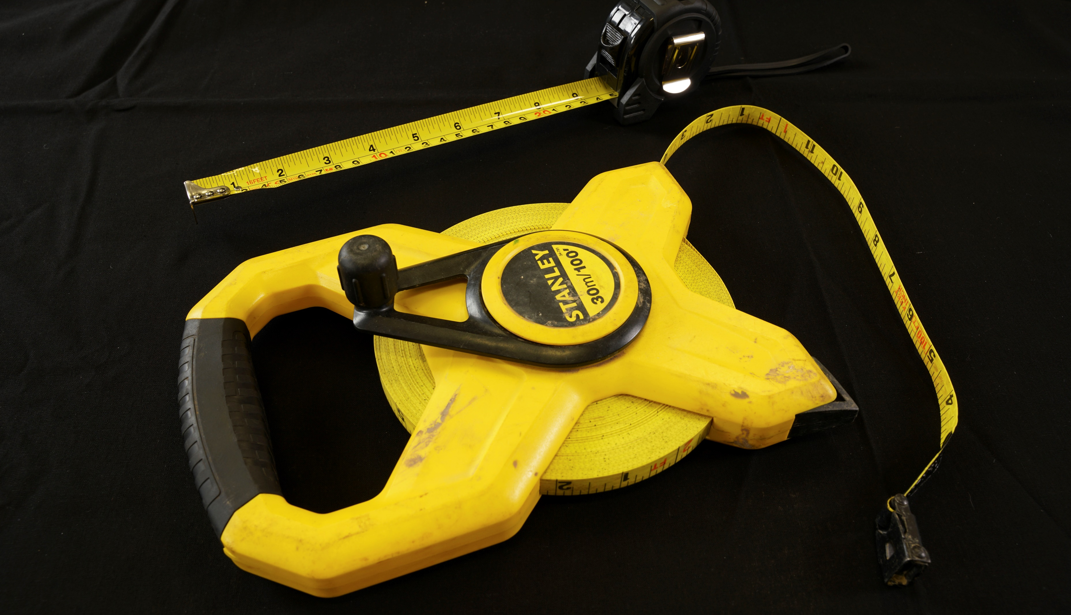
Notes:
Recording equipment: Tape measure
To measure features, so that they can be recorded accurately.

Slide 11
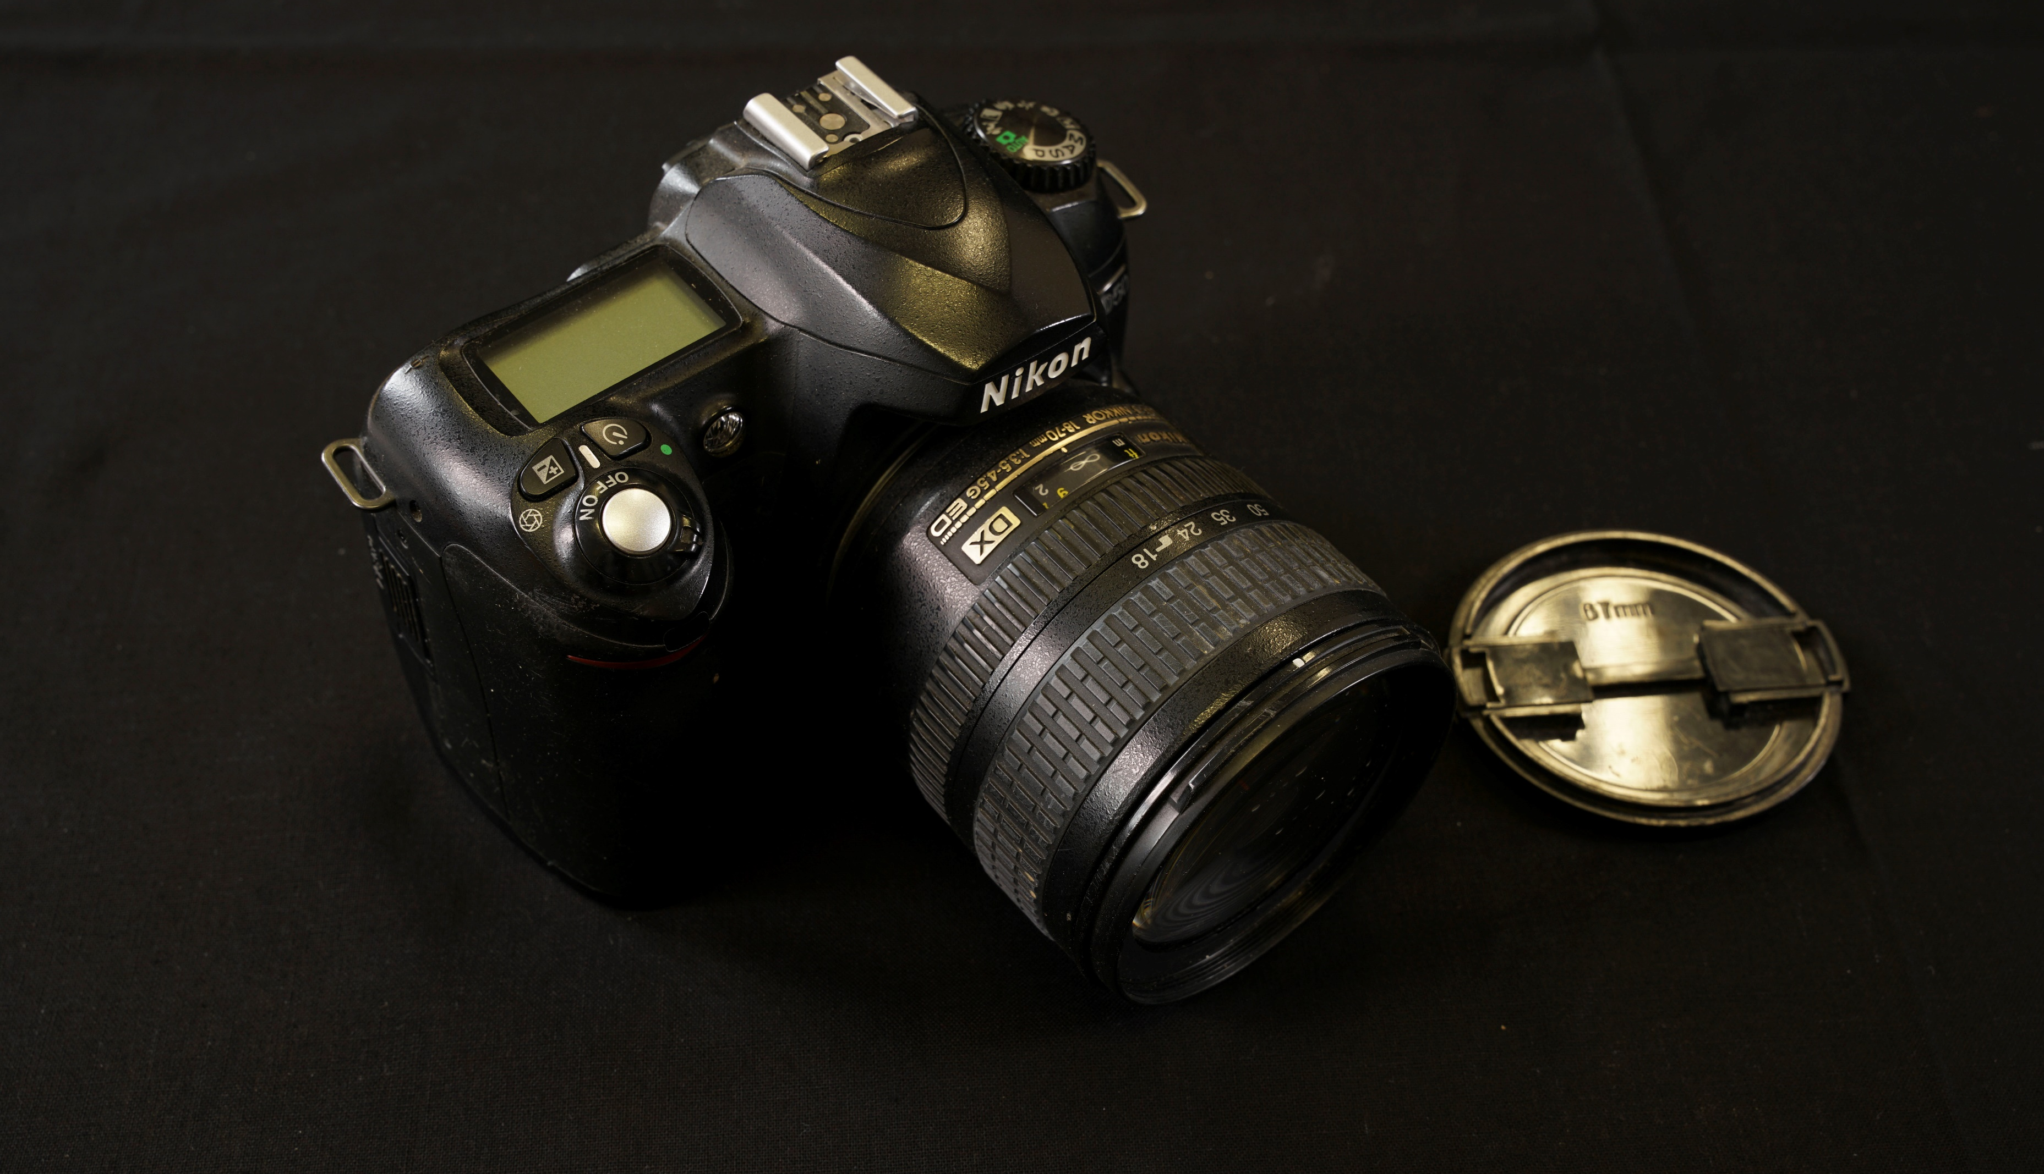
Notes:
Recording equipment: Camera
To take photos of excavations and features to create a record of the archaeology.

Slide 12
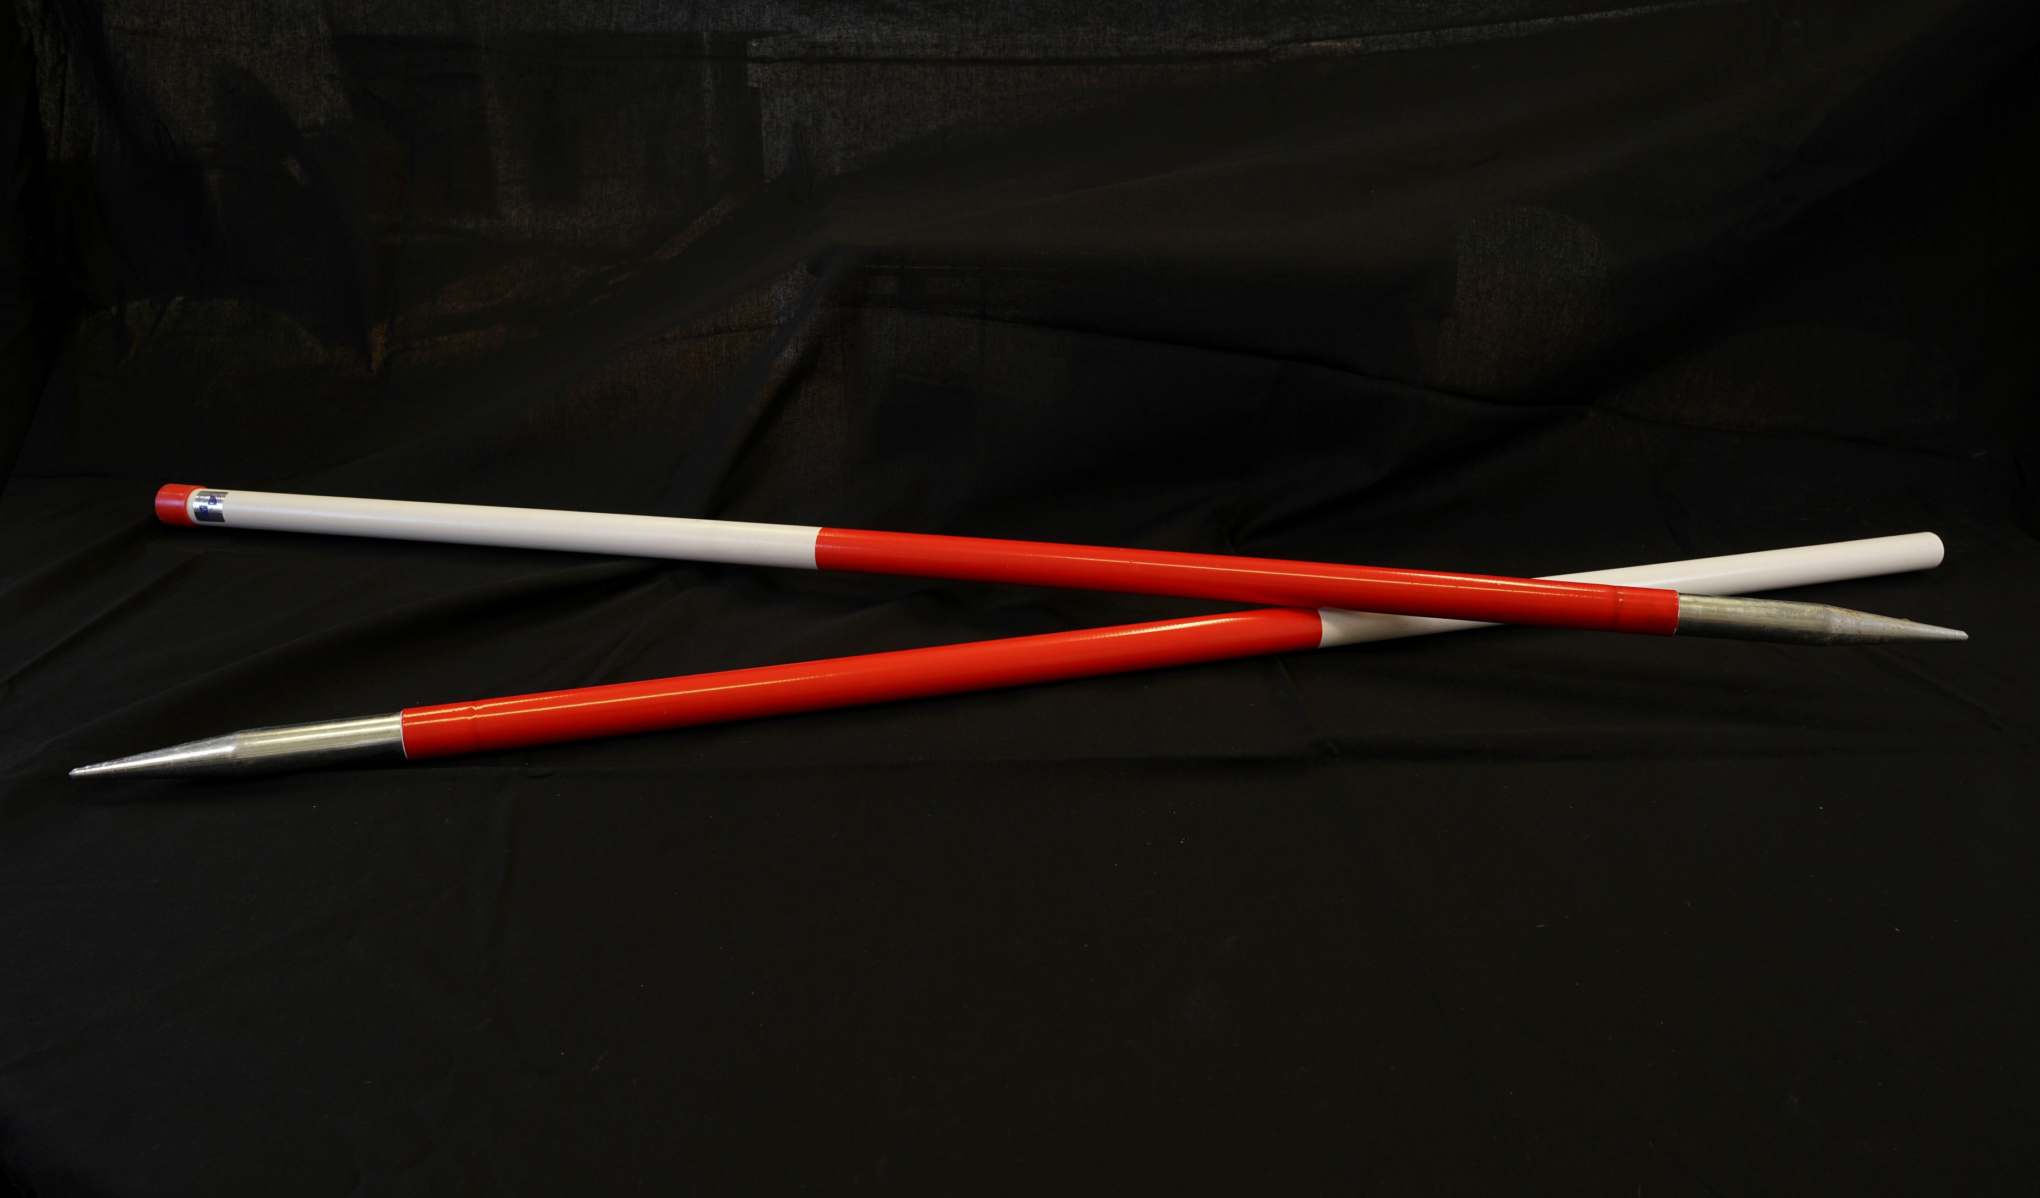
Notes:
Recording equipment: Scale bar
Used in photographs so the viewer can get a sense of the size of features or artefacts.

Slide 13
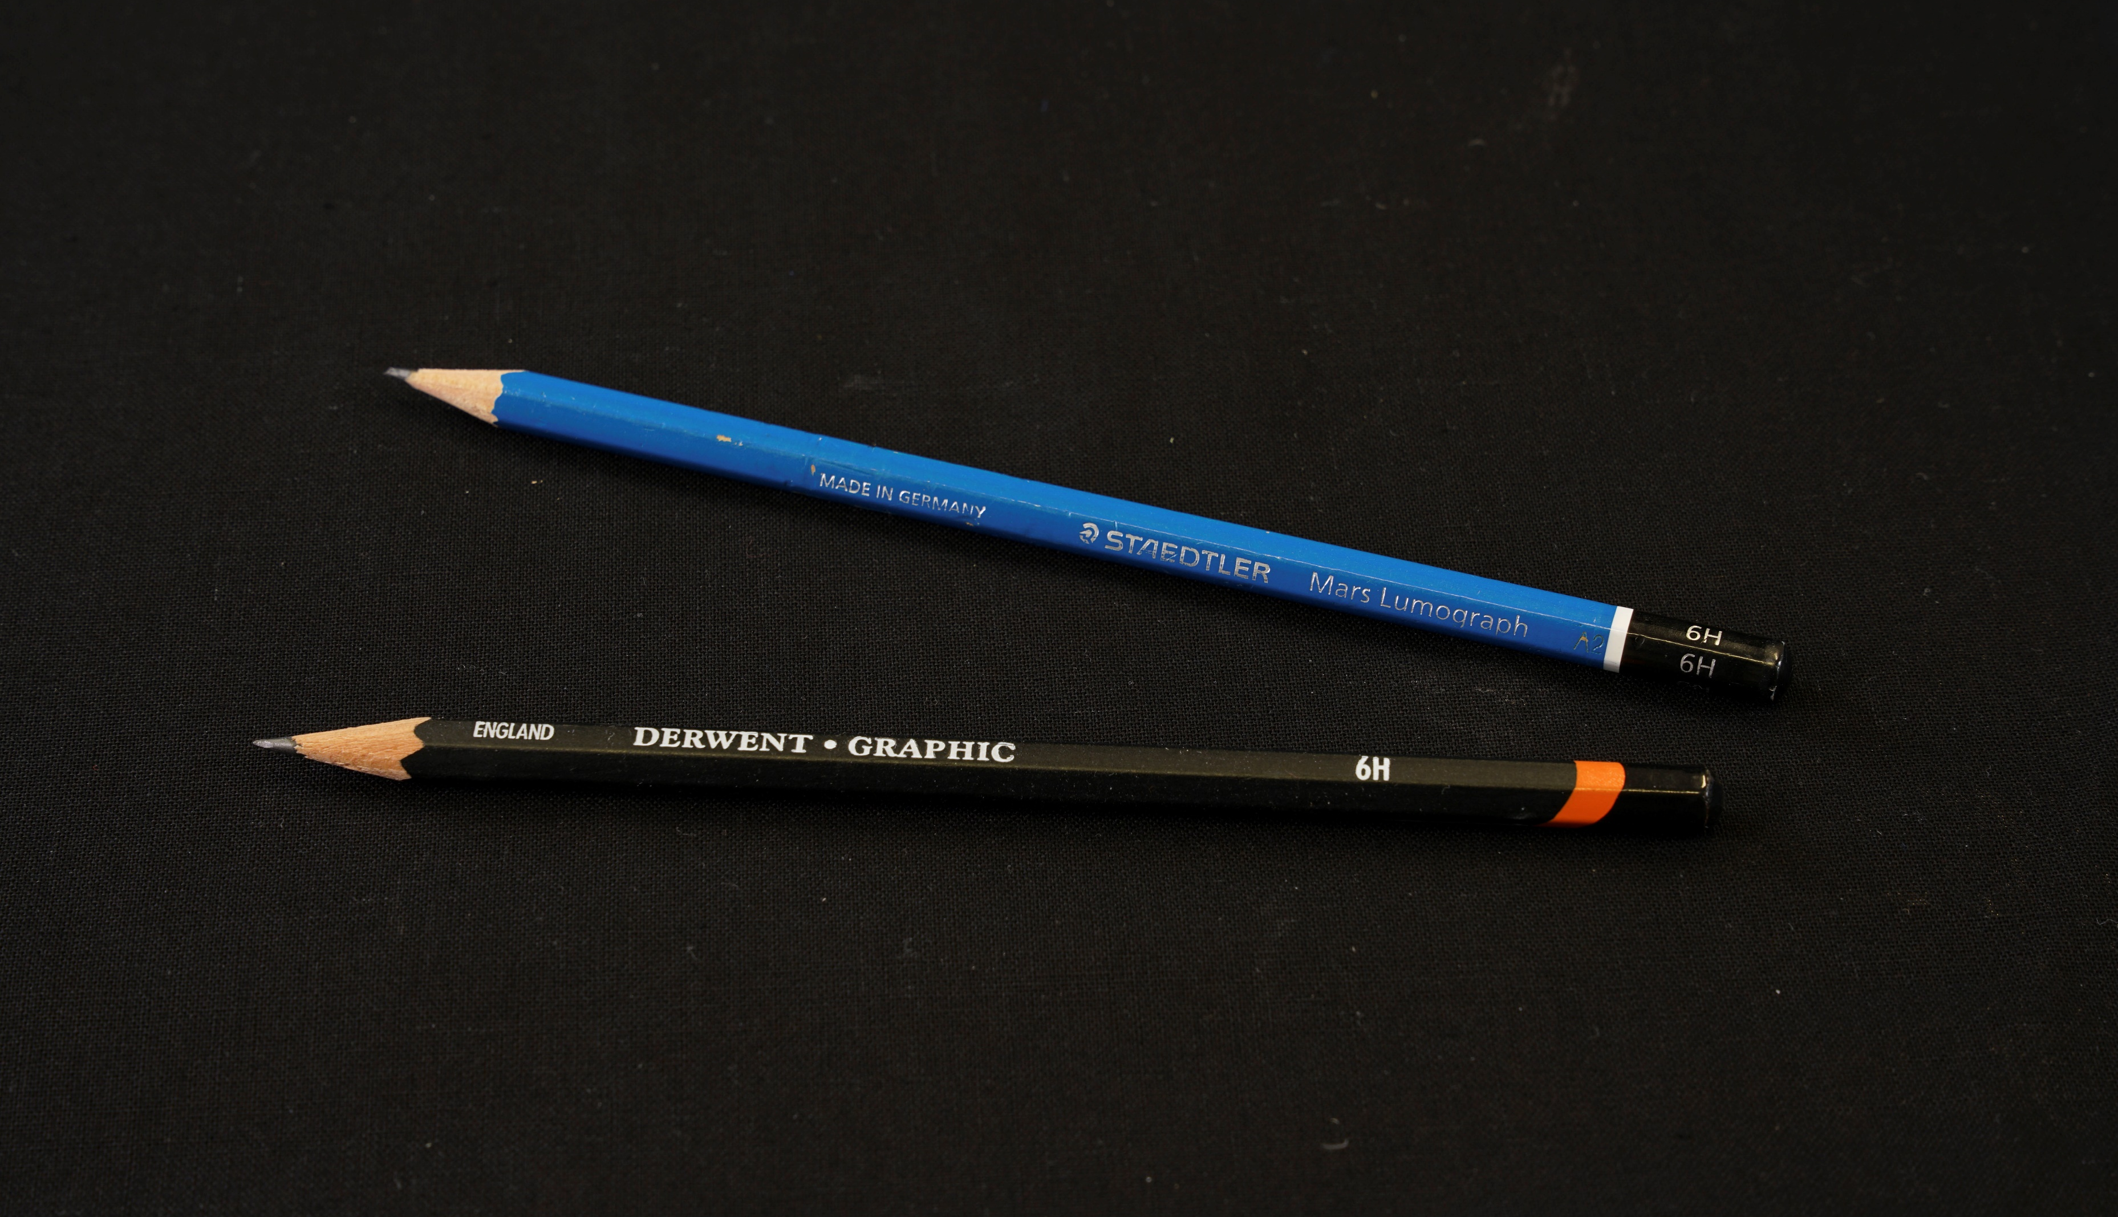
Notes:
Recording equipment: 6B pencils
For drawing features onto waterproof recording sheets while on site. The pencil must be hard to mark the sheets made of drafting film.

Slide 14
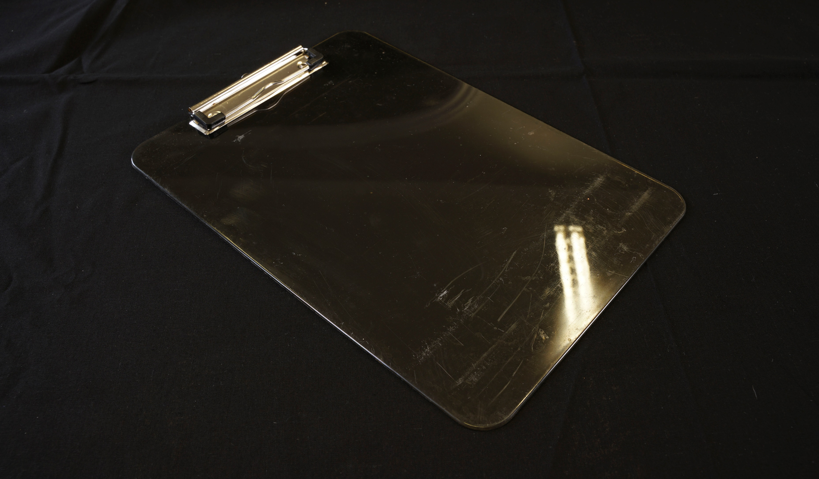
Notes:
Recording equipment: Clipboards
To rest recording sheets or other documents on while taking notes on site.

Slide 15
Personal Protective Equipment (PPE)
Notes:
PPE: Goggles

Slide 16
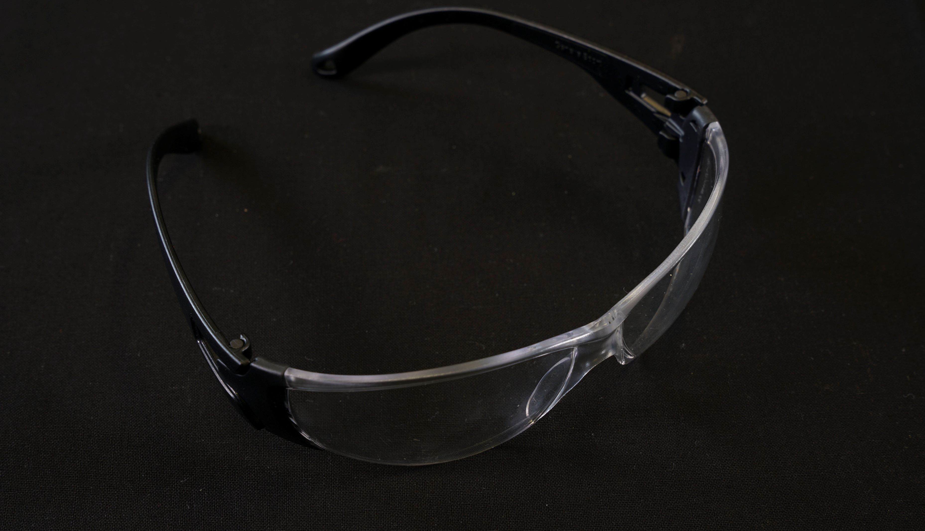
Notes:
PPE: Goggles
To protect eyes from dirt and other objects while excavating.

Slide 17
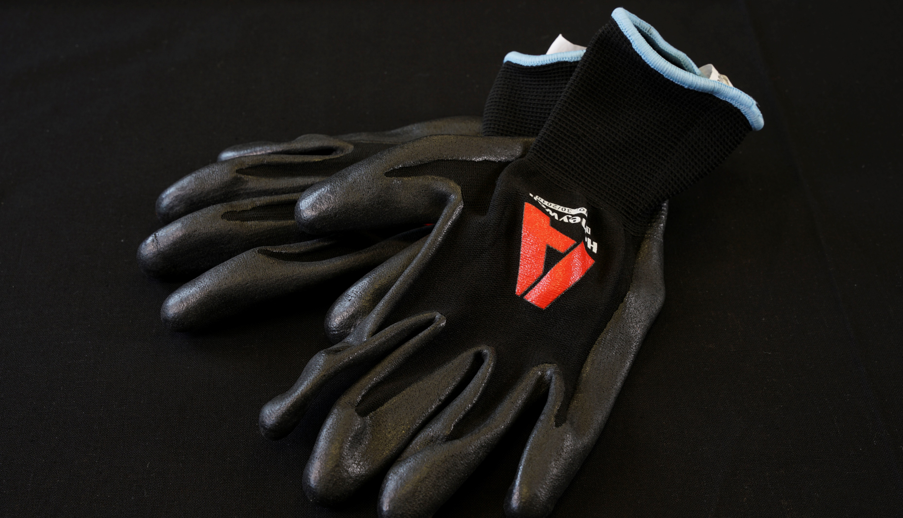
Notes:
PPE: Gloves
To protect hands from sharp objects while excavating.

Slide 18
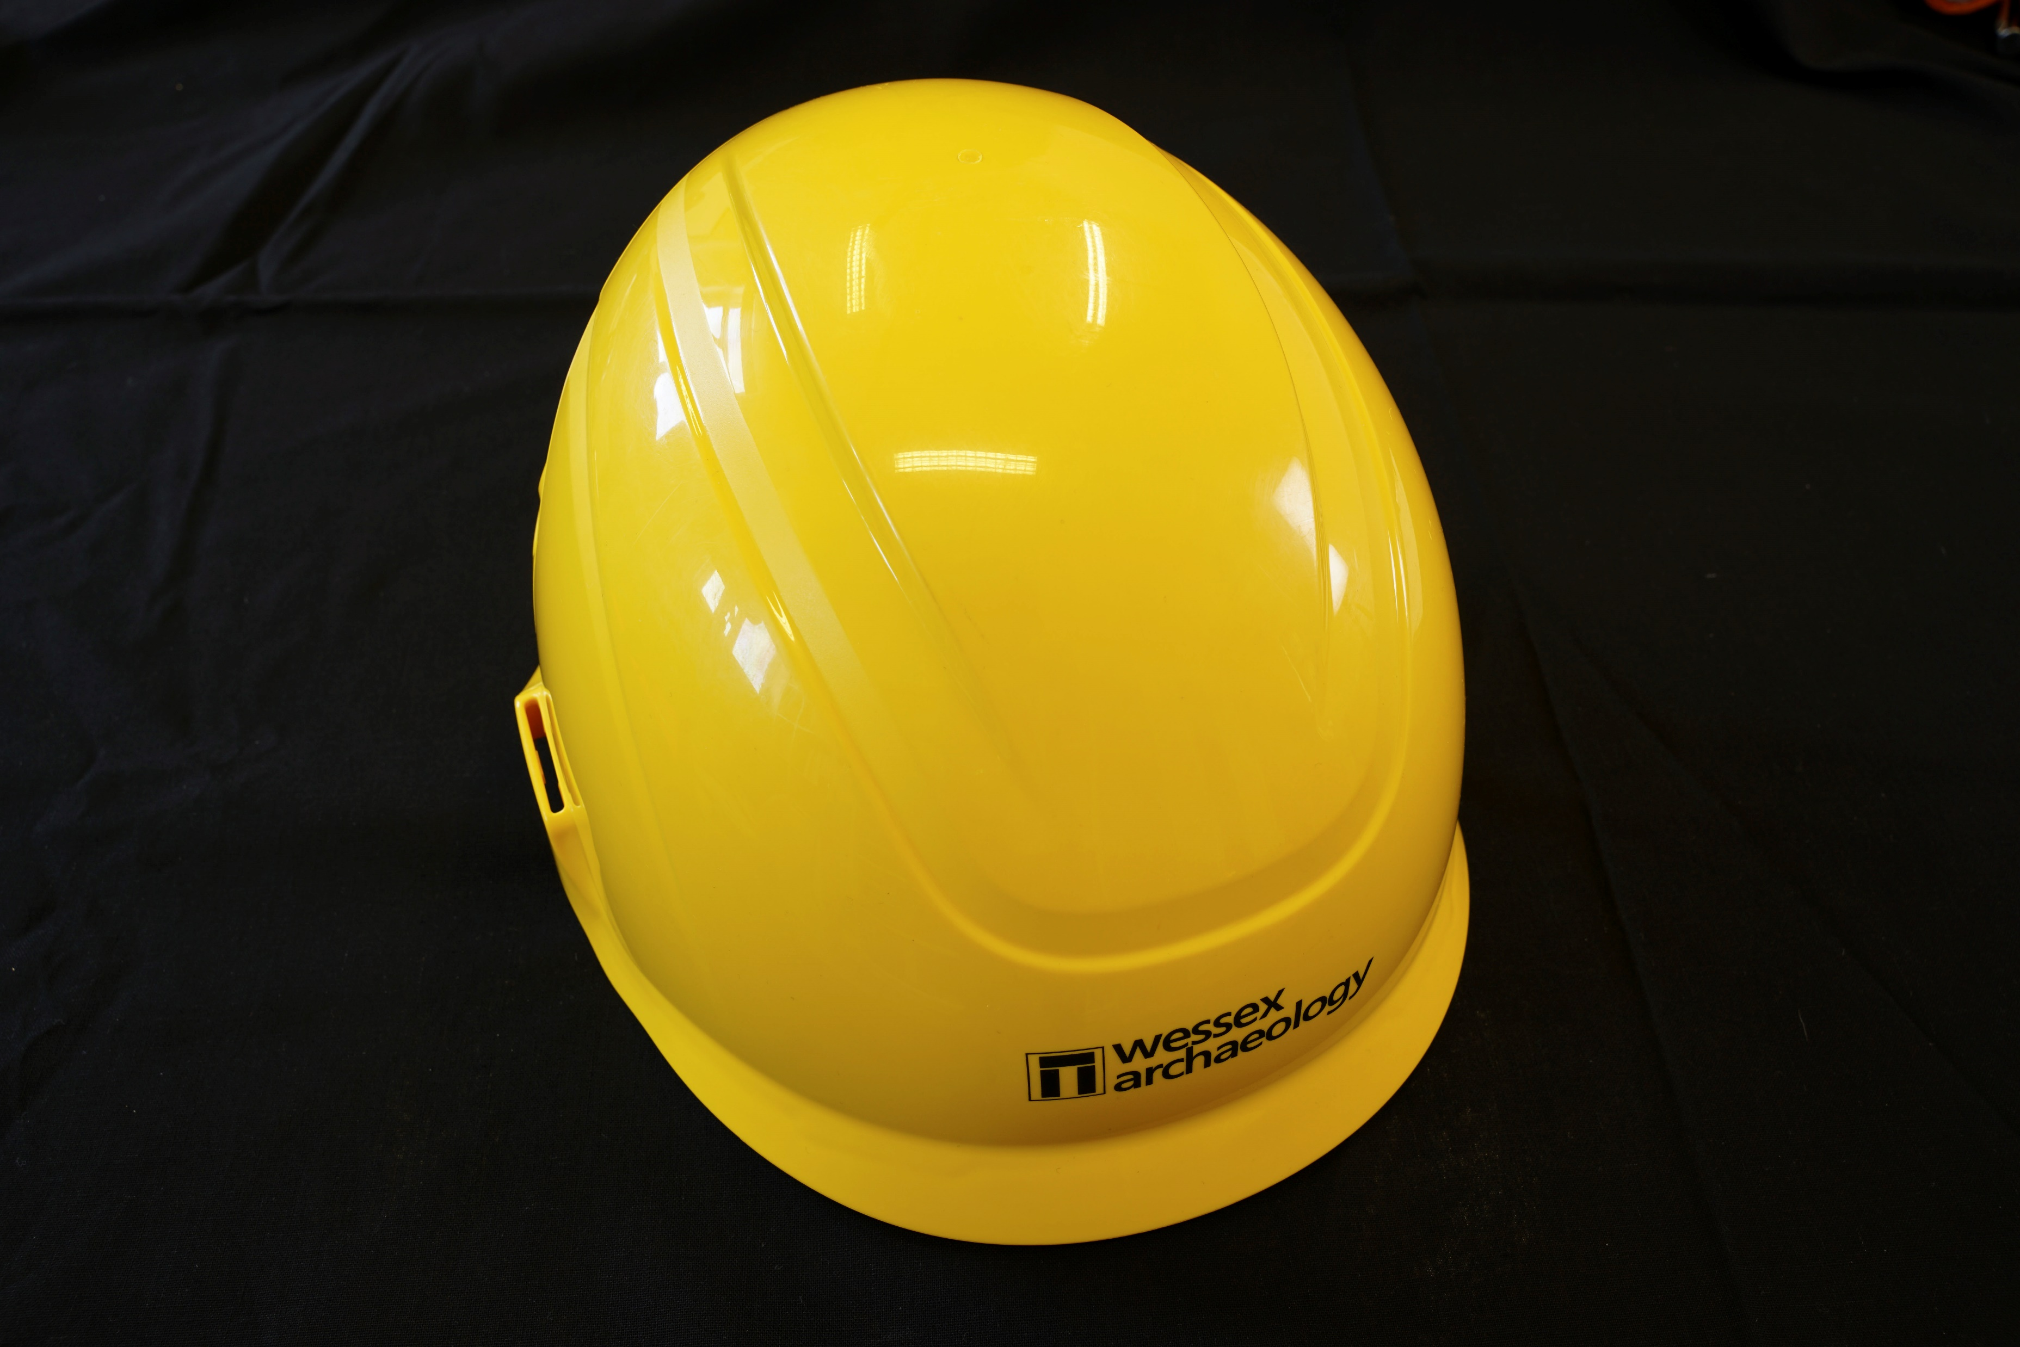
Notes:
PPE: Hardhat
To protect a person’s head from hitting features or from falling debris while working on site.

Slide 19
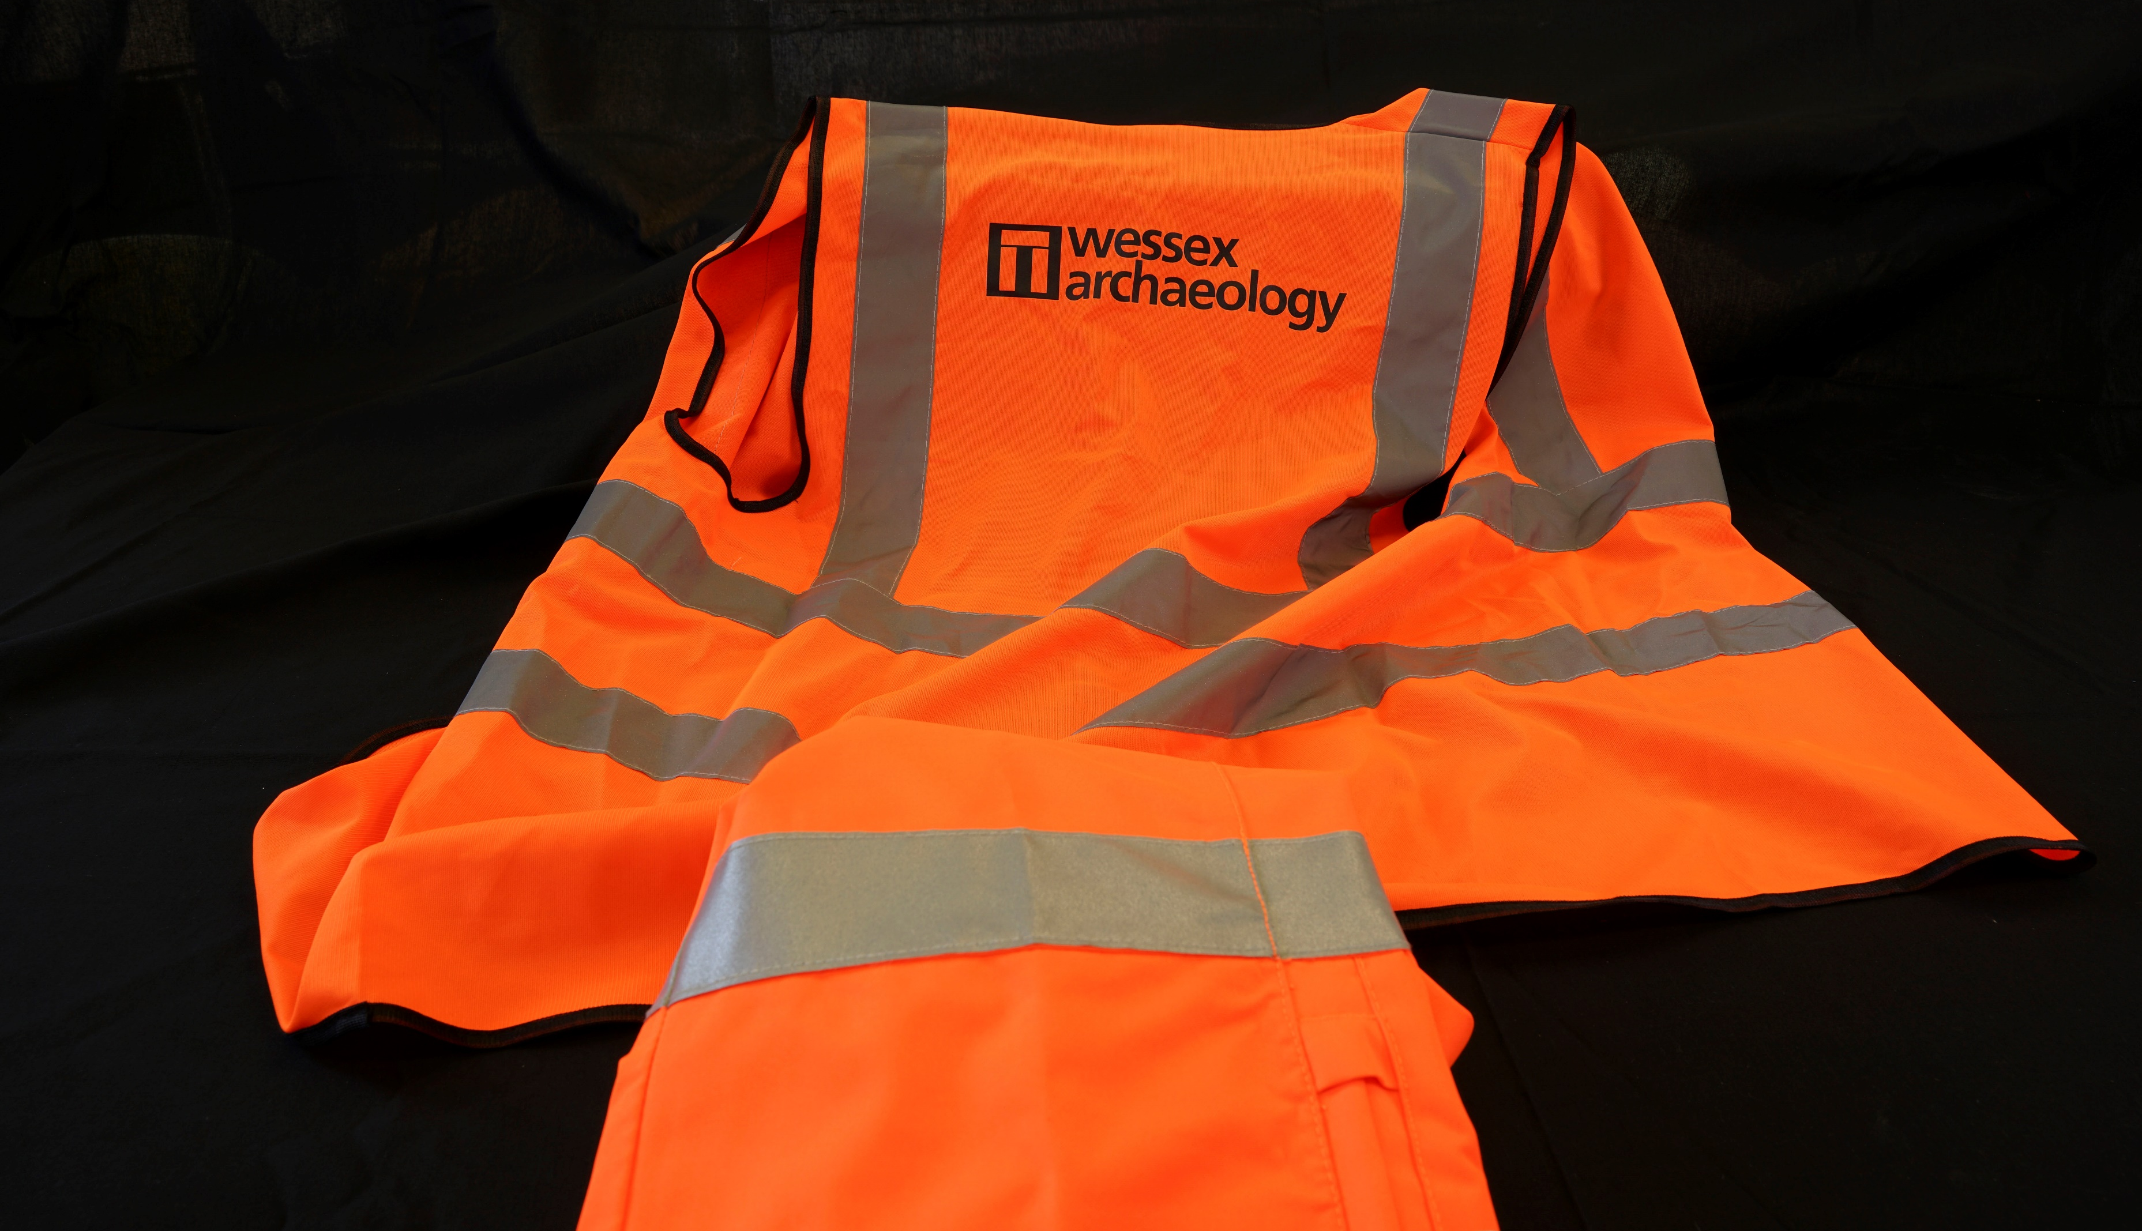
Notes:
PPE: Hi-vi clothing
To protect the body during excavations and so archaeologists can be seen easily. There could be large machinery on archaeology sites. The clothing also keeps archaeologists warm and dry (if waterproof).

Slide 20
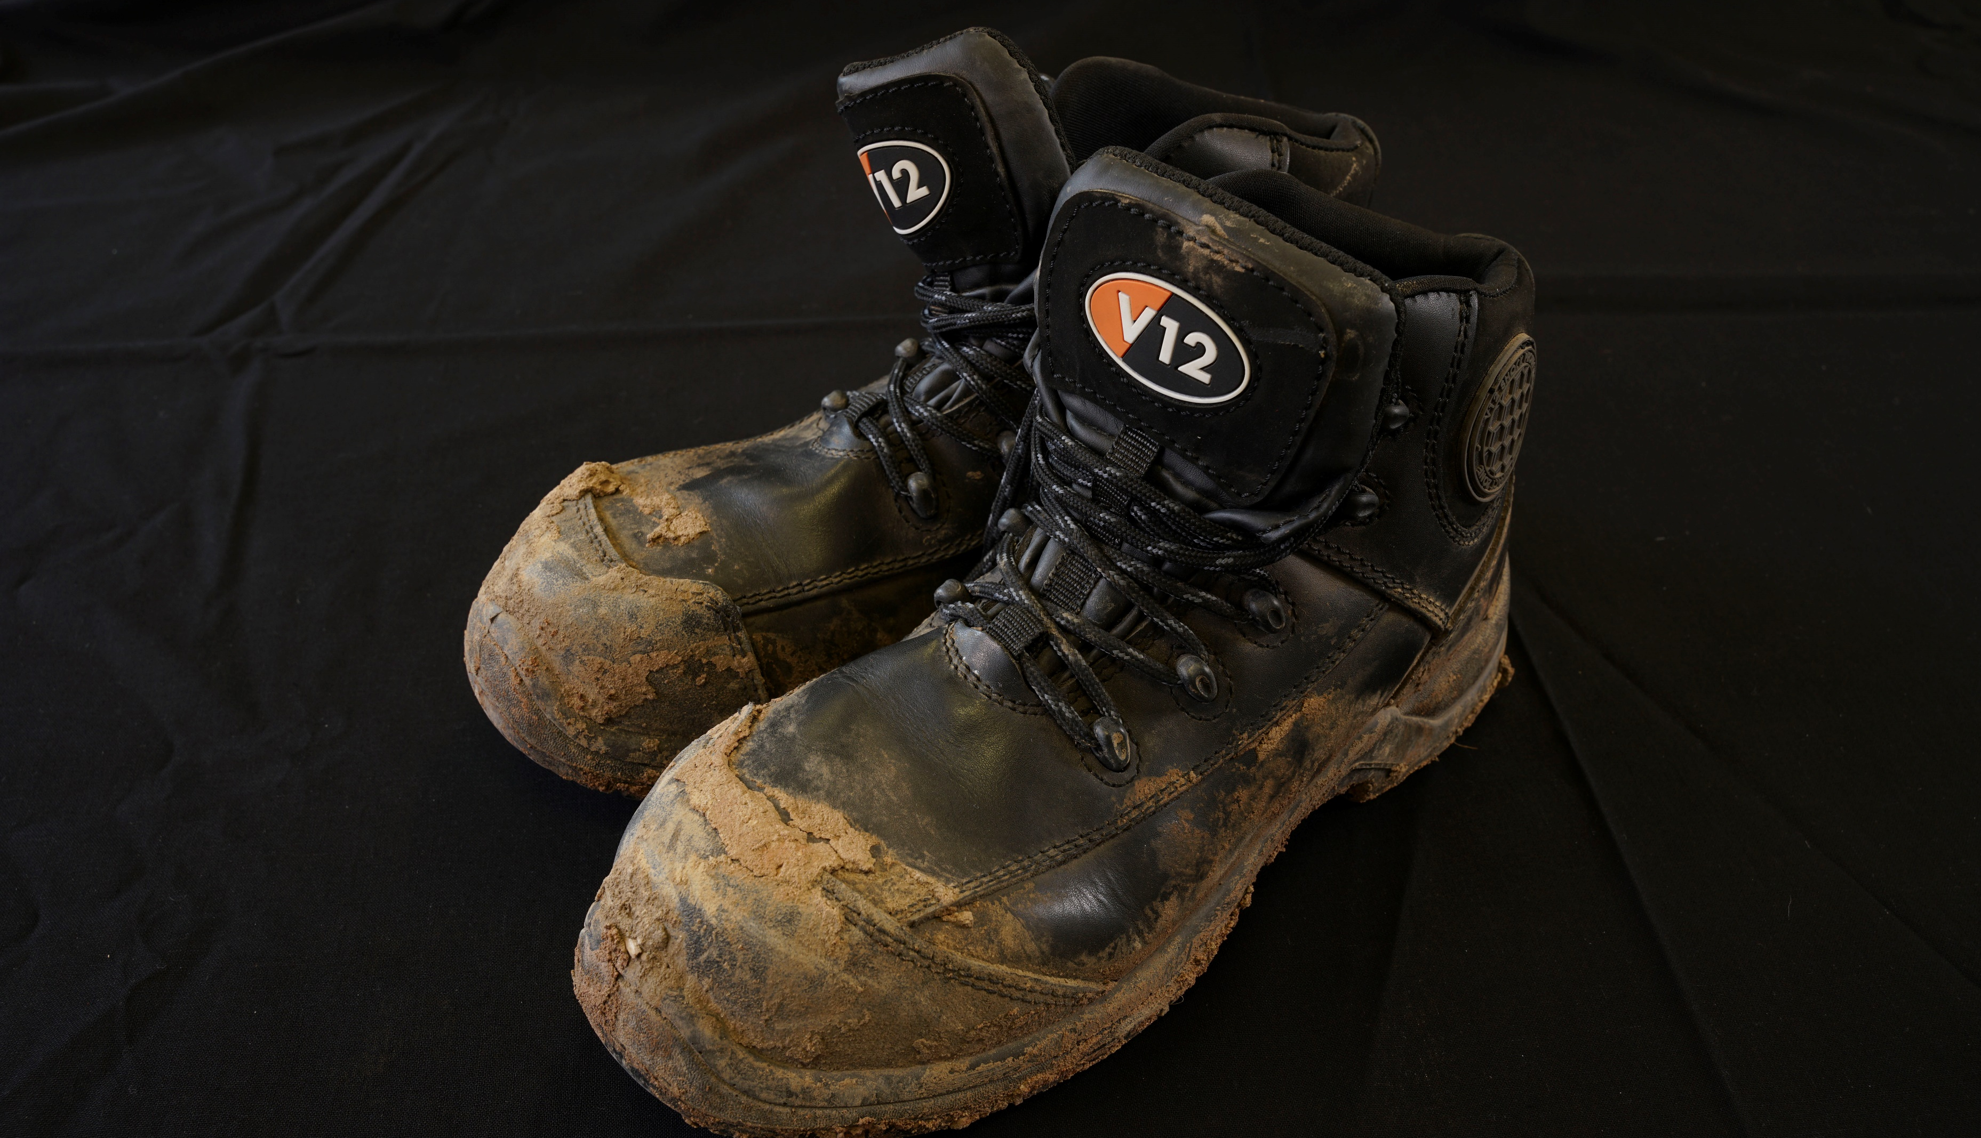
Notes:
PPE: Steel toe-capped boots
To protect feet from equipment and falling objects or debris while excavating.

Slide 21
Post-excavation analysis

Slide 22
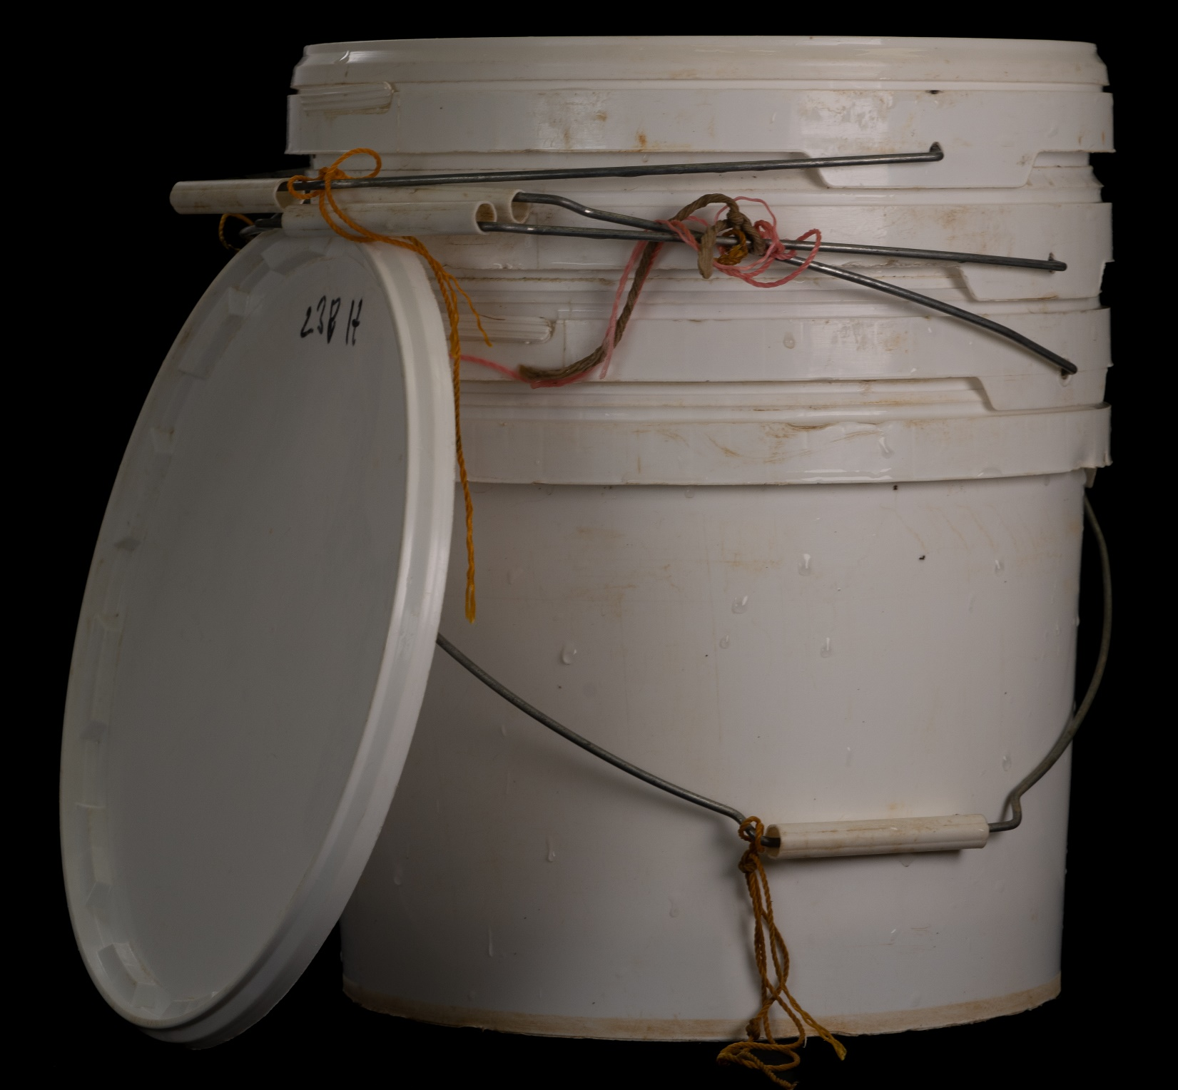
Notes:
Post-excavation analysis: Buckets
To collect, transfer and store soil samples.

Slide 23
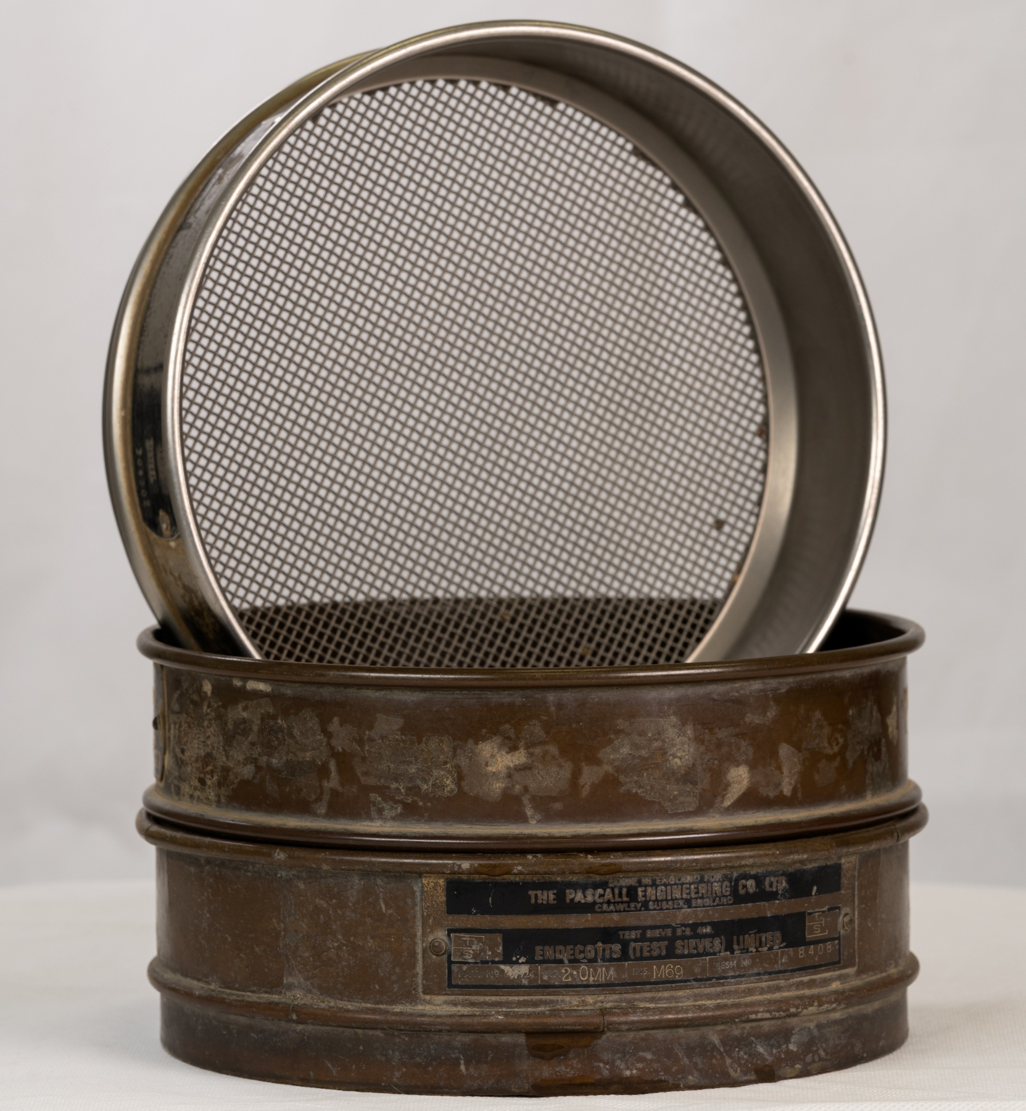
Notes:
Post-excavation analysis: Sieve
To process environmental soil samples into small and larger material. Small material is looked at under a microscope by an environmental archaeologist.

Slide 24
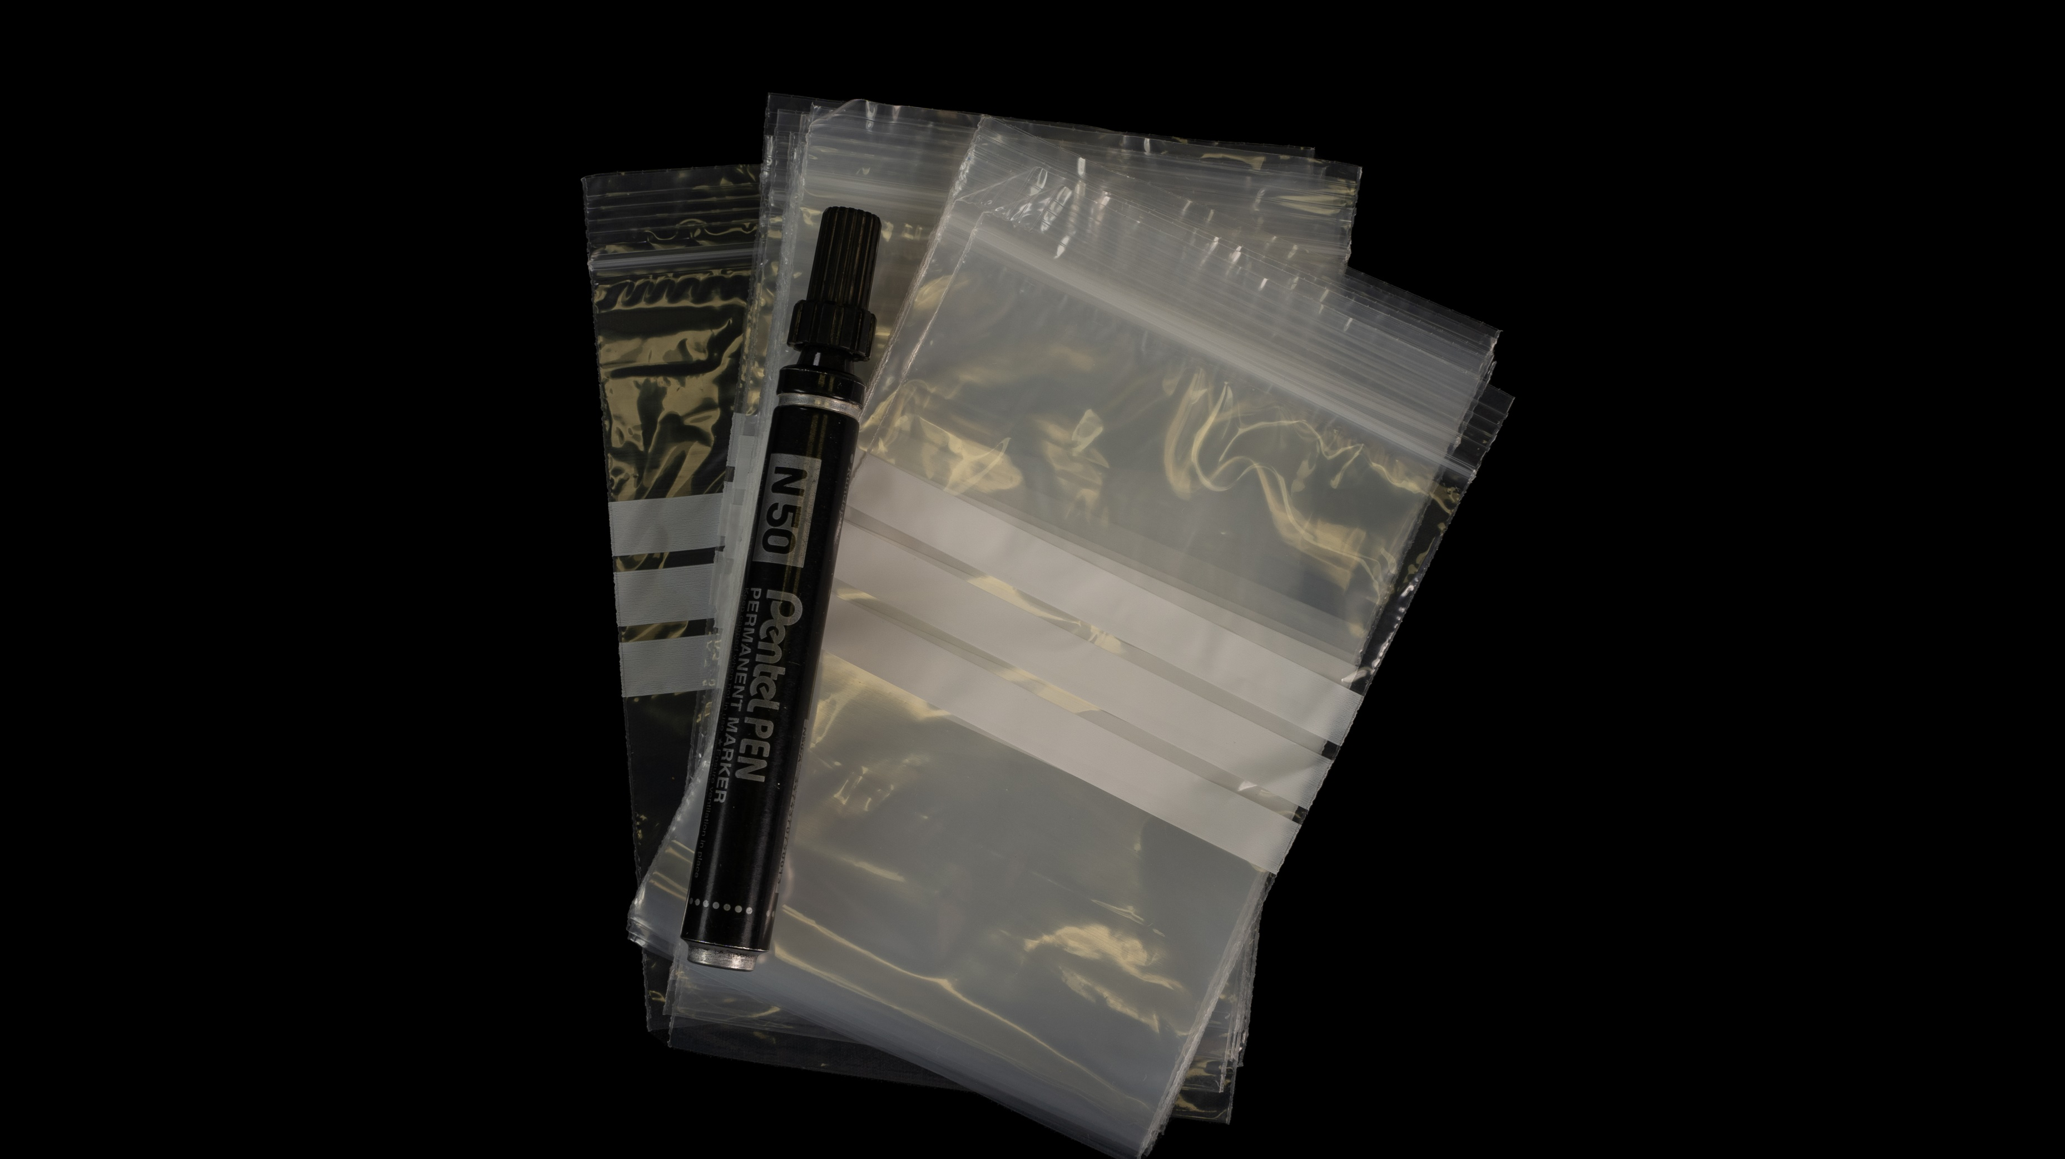
Notes:
Post-excavation analysis: Grip seal bags
To contain artefacts from site so that they can be transferred for processing.

Slide 25
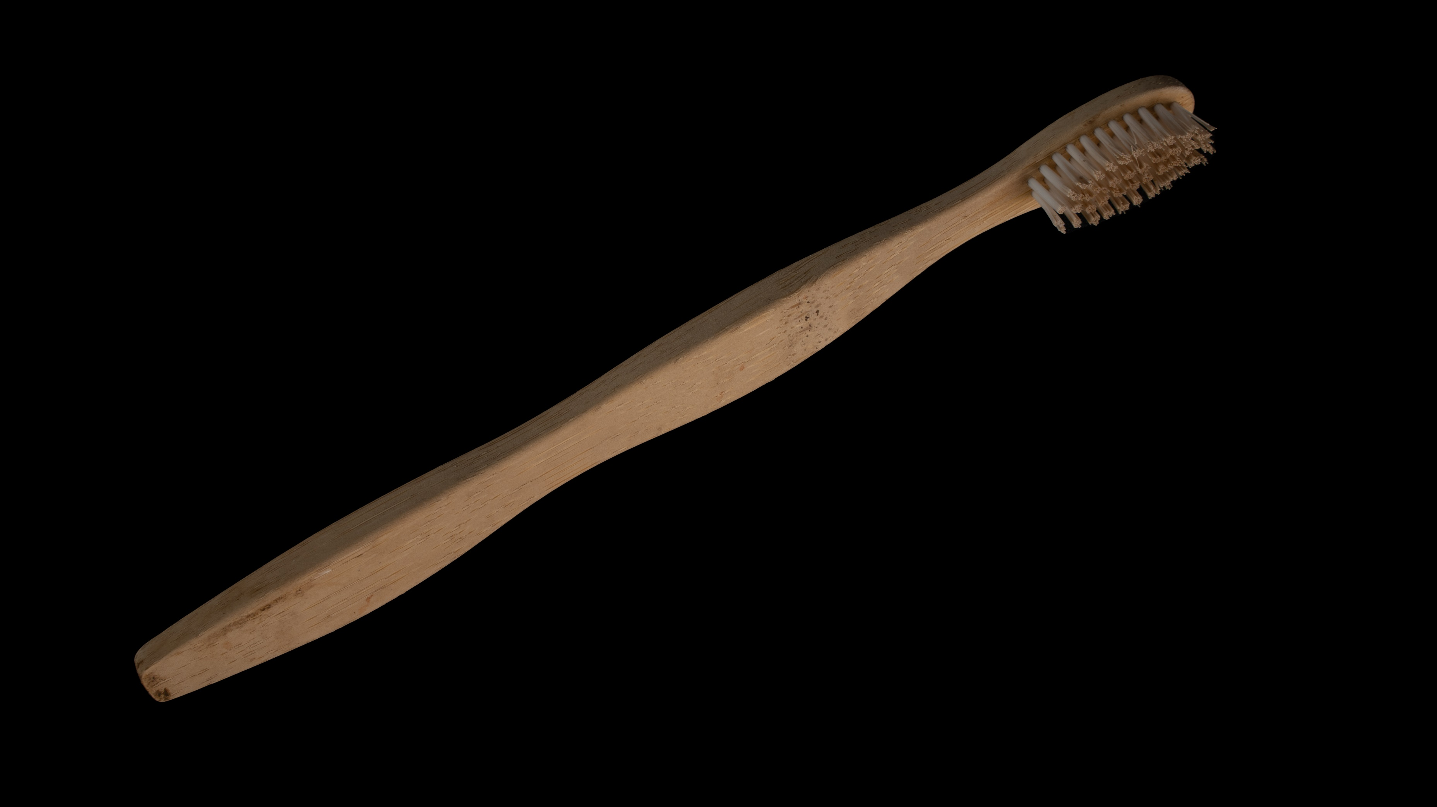
Notes:
Post-excavation analysis: Toothbrush
To gently clean dirt away from artefacts using a toothbrush and water.

Slide 26
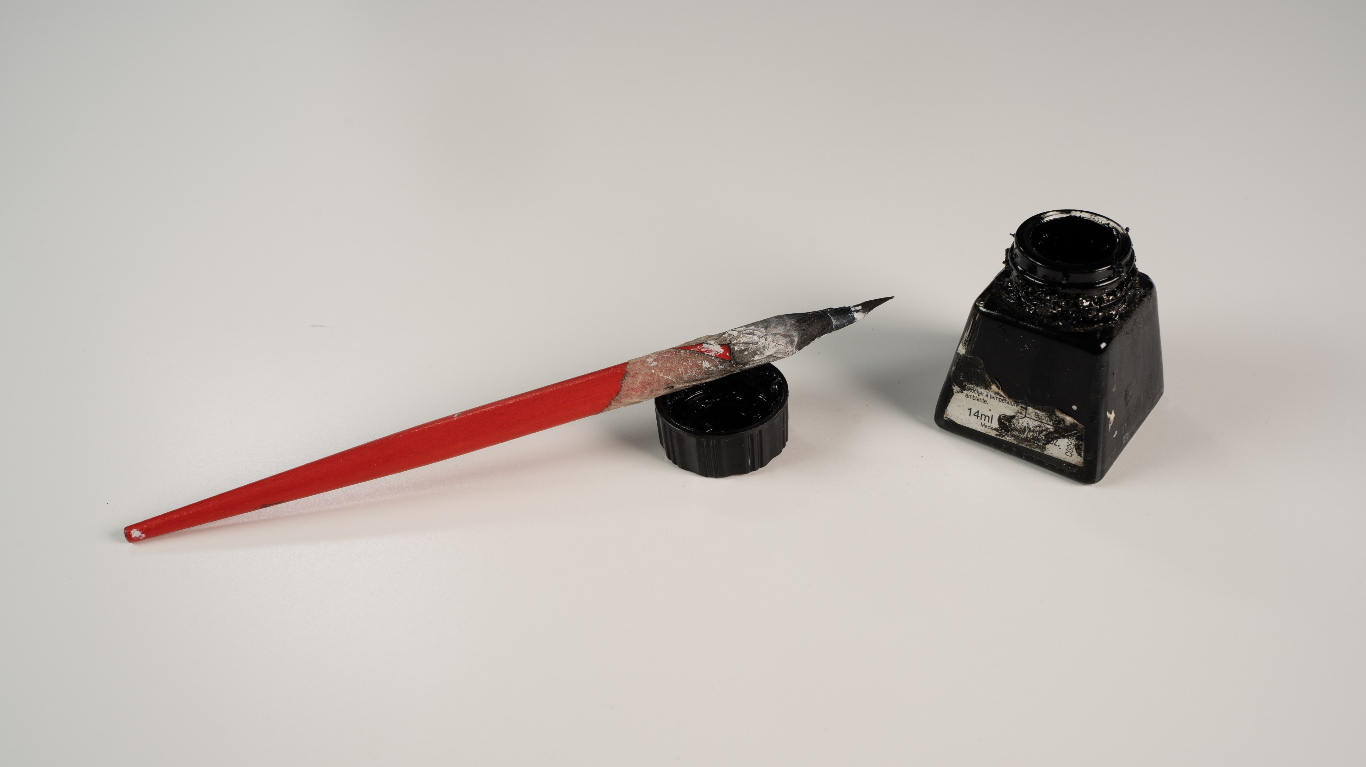
Notes:
Post-excavation analysis: Ink
To mark artefacts with a unique number so that they can always be traced back to where they were found.

