Slide 1
EPIC ENGINEERING: WELCOME TO THE TEAM PURPOSE
Notes:
Presenter Notes
Introduce EPIC Engineers Workshop in developed in partnership with HS2

Slide 2
Introduction to EPIC Engineers
Welcome to EPIC Engineers
Today’s workshop will be dedicated to STEM learning based around transport infrastructure, brought to you in partnership with HS2.
Today you will be completing the Engineering Challenge: Tunnel Structures activity.
Notes:
Welcome
This slide introduces the workshop and this session’s activity.

Slide 3
HS2 Introduction Video
Notes:
Welcome
This slide will embed the HS2 Introduction video.

Slide 4
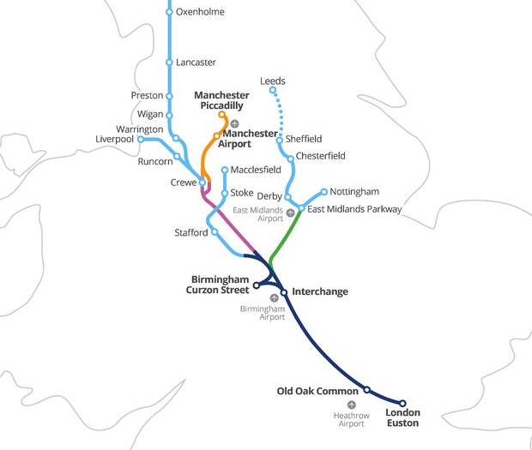

What is High Speed 2?
High Speed Two (HS2) is the new high speed railway we are building. It will connect 8 of Britain’s 10 largest cities, including Birmingham, Leeds, London and Manchester.
It is the first new railway built north of London for 120 years.
Notes:
Welcome
This slide shows the proposed HS2 route. Try to start from the city nearest in location to your students.

Slide 5
When is it being built?
HS2 is being built in three phases, but the whole network will be complete in the 2040s.
How old will you be when it is finished?
2009
2017
2020
2029-2033
2034
2035-2041
HS2 Ltd
set up
Parliamentary approval for Phase One
Construction begins
Phase One completion
Phase 2a completion
Phase 2b completion

Slide 6
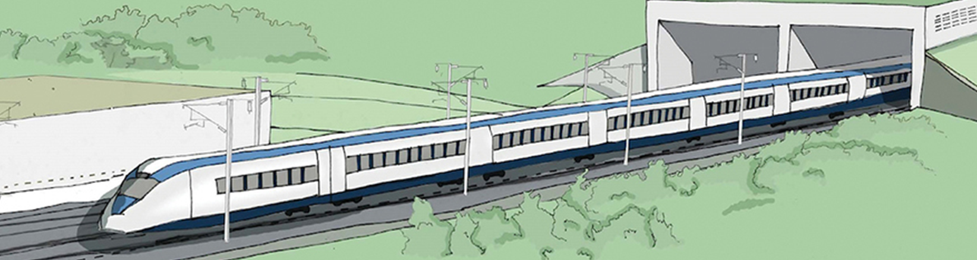
Engineering Challenge: Tunnel Structures
In this activity, you will be building your own cut and cover tunnel. Will it collapse or will it stand?
Notes:
Engineering Challenge: Tunnel Structures
Introduce the Tunnel Structures activity by explaining that each team will be building it’s own train tunnel. But why do we build tunnels? Explain to your students that trains find it very difficult to go uphill and so tunnels must be built through them.
Show your students the cut and cover tunnel on the board. This is where the hillside is cut away, a tunnel structure is built from steel reinforced concrete and then the hill is covered back over.
Make sure that you show the students the tunnel structure on the board (the concrete part sticking out of the hill).

Slide 7
Tunnel Structures student introduction video
Notes:
Introduction Video
Play this video to introduce the activity.

Slide 8
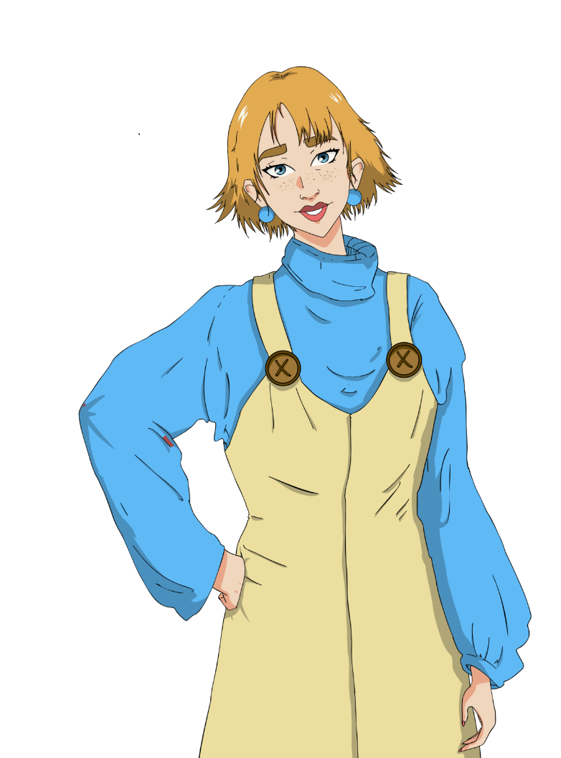



Who builds tunnels?
Building any large structure is a team effort. When a new tunnel is designed and built, it’s a team effort, including Civil Engineers, Environmental Advisors and BIM Technicians and Construction Plant Operators.
Notes:
Tunnel structures
Explain to your students that there are many jobs roles involved in building a tunnel.
Civil Engineers manage the project and survey the ground
Environmental advisors survey they wildlife and habitats around the site and ensure that it is mitigated for and that impacts are minimal.
Buildings Information Modeling (BIM) Technicians create the drawings of the site and structure.
Construction Plant Operators and Tunneling Operatives build the tunnel.

Slide 9

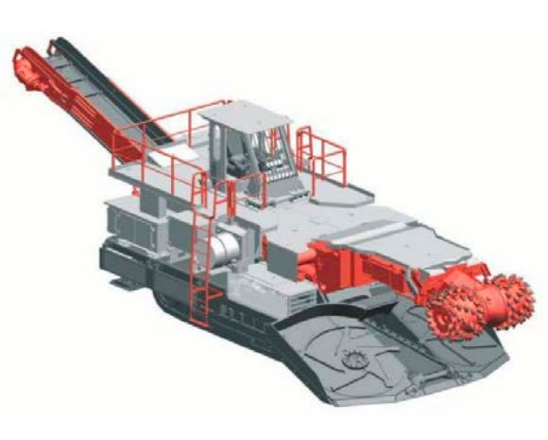
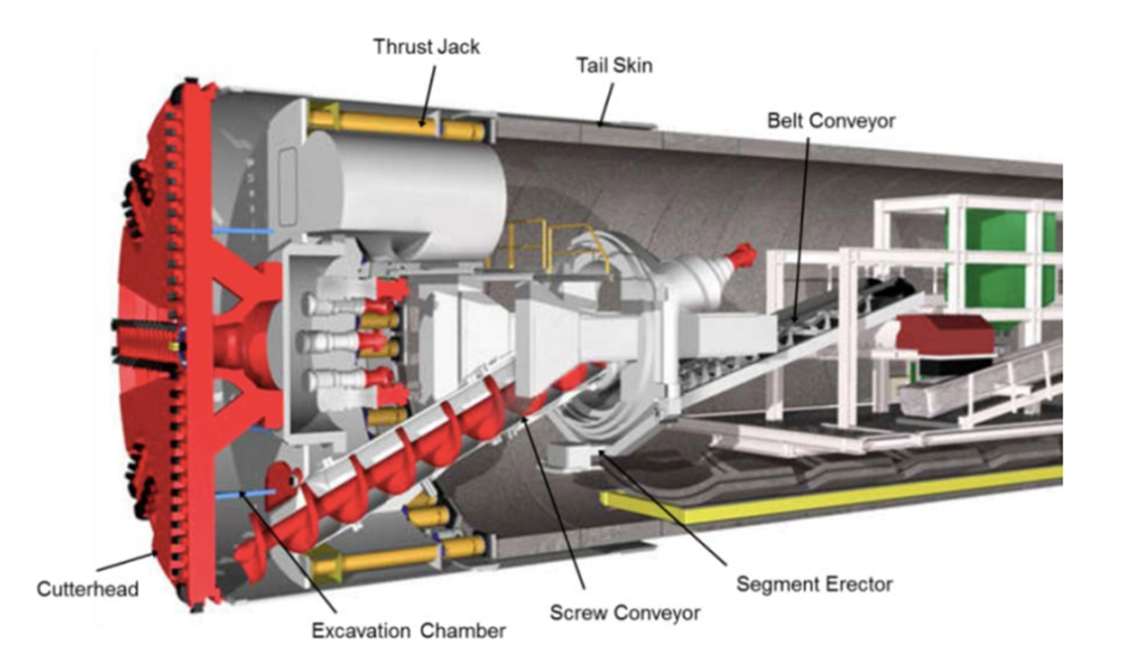
What do Construction Plant Operators do?
Construction Plant Operators do the actual building, operating machines such as diggers excavators, road headers and tunnel boring machines to excavate the tunnel.
Notes:
Tunnel Structures
Introduce Adnan, a Construction Plant Operator. Adnan might use a road header (left) or a tunnel boring machine (right) to excavate and build the tunnel.
Roadheader
The roadheader drives forward into the tunnel face using its crawler tracks and excavates the earth using its cutter head.
Tunnel Boring Machine
The tunnel boring machine excavates the tunnel using its front rotating cutter head. It pushes itself forward using hydraulic rams and builds the tunnel at the same time as it excavates, using pre-cast tunnel segments.
Please note

Slide 10
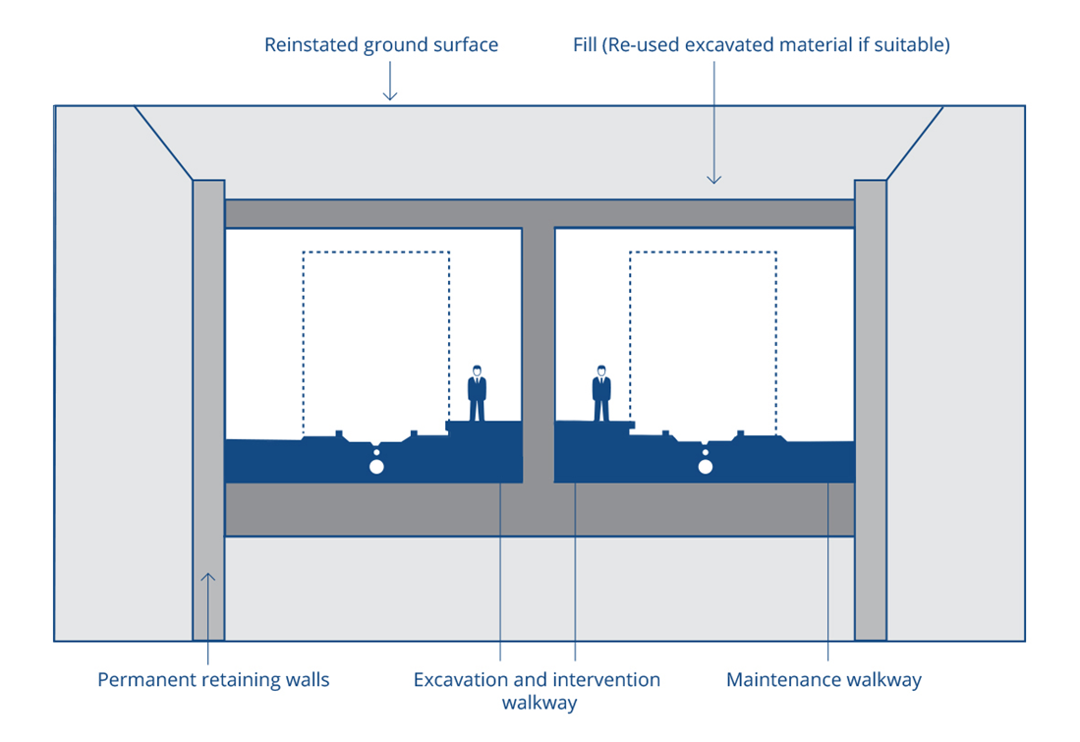
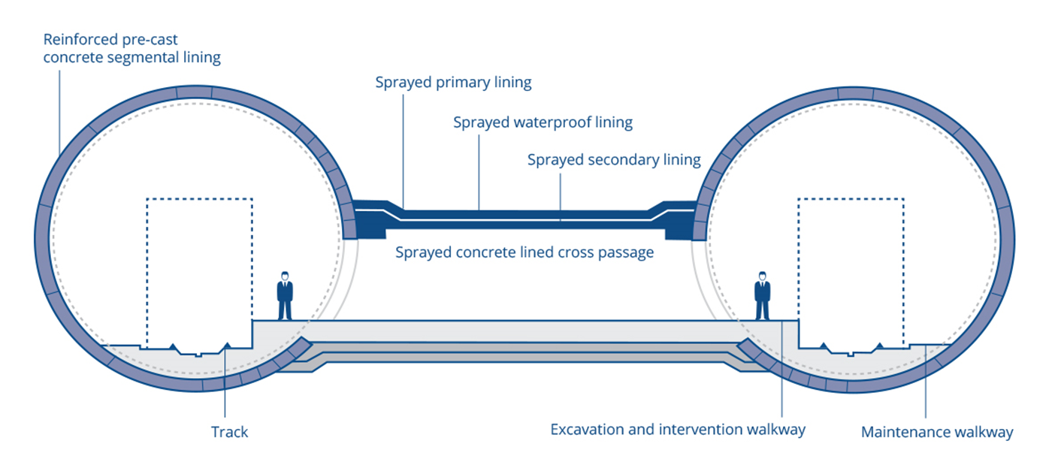
Types of tunnel
Notes:
Tunnel structures
This shows the two different types of tunnel – the left is bored using a tunnel boring machine and is supported by tunnel lining segments.
The right is excavated as a cut and cover tunnel and is supported using a steel reinforced concrete tunnel structure. It would be excavated using a roadheader.

Slide 11

The challenge
Together with your team, you must design a prototype tunnel structure to span 400mm and fit the train. Your design should be strong and lightweight, using as few materials as possible.
You will have:
40 x 400mm paper straws
Scissors
Masking tape
Focus on your essential skills of teamwork, problem solving and staying positive
Notes:
The challenge:
Introduce the challenge and method of testing. Explain to your students that they must only work with the materials that they have and that their tunnel must be 400mm long, be the correct fit for the train to pass through it and survive the sand bag being put on top of it.
The lightest tunnel that survives will be the winner.
Emphasize that the room must be spotless and tidy by the end.

Slide 12

Essential skills – problem solving
The ability to find a solution to a complex situation or challenge.
I can come up with different ways to solve a problem
I can use pros and cons to pick the best way of solving a simple problem
I can carry out research to better understand complex problems
I can evaluate different solutions for a complex problem and pick the best one
Notes:
The challenge
Introduce the three essential skills used in this challenge: problem solving, teamwork and staying positive.

Slide 13
Essential skills – teamwork
Working cooperatively with others towards achieving a shared goal.
I help with different jobs in my team and take responsibility for finishing my job
I help make decisions and make my own suggestions
I recognise the value of others’ ideas and make useful contributions myself
Notes:
The challenge
Introduce the three essential skills used in this challenge: problem solving, teamwork and staying positive.

Slide 14
Essential skills – staying positive
The ability to use tactics to overcome setbacks and achieve goals.
I keep trying when something goes wrong and think about what happened
I can come up with ideas for changing difficult situations to positive opportunities
In difficult situations I choose the best way to move forward instead of giving up
Notes:
The challenge
Introduce the three essential skills used in this challenge: problem solving, teamwork and staying positive.

Slide 15
Designing structures & resisting forces
Compression
Tension
Torsion
Notes:
The challenge
Give these optional hints during the introduction or making period of the activity.
Hint 1) An idea demonstration here is to use a toilet roll tube or card tube made from a sheet of A4. Demonstrate the structure’s resistance to each force in different directions. This will give students a good hint on how to use their straws wisely.
An egg box can also be used to reassure students that the same material can resist all of these forces in a different configuration.

Slide 16
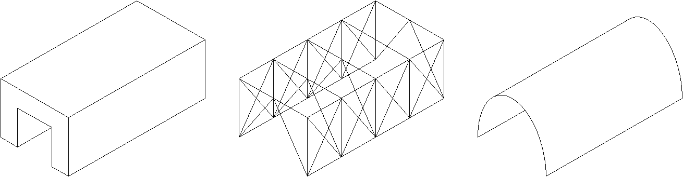
Types of structure
Mass Frame Shell
Notes:
The challenge
Give these optional hints during the introduction or making period of the activity.
Hint 2) These are the different types of structure – mass, frame and shell. Whilst mass structures are solid, like stone bridges, frames are lightweight and composed of beams and ties. Shell structures rely on a stiff outer wall.
Explain to students that they do not have bricks or a sheet material – therefore a frame is the best kind of structure.

Slide 17


Planning
You have 10 minutes to make your plan. Use the isometric paper provided to sketch your structure.
Notes:
Designing a tunnel structure
Ensure that students plan quietly.
Ensure that they have rulers and pencils.
Encourage them not to start making until they have a good quality plan.

Slide 18
Making
You have 50 minutes to make your structure.
Notes:
Designing a tunnel structure
Students now have 50 minutes to make their tunnel structure.
Make sure that each group is on task.
Some groups may find it difficult to start their model. Encourage them to make a rectangular base frame first, then build upwards.
Students should only be building frames. If students try to bend their straws into arcs or turn them into panels they will not create a successful tunnel.

Slide 19
Tidy up!
You have 2 minutes to tidy up the room.
Replace all tools and unused materials.
Recycle any rubbish.
Sit at your tables in silence.
Use your Essential Skills of teamwork and aiming high
Notes:
Tidy-up time
Students should now tidy up. Ensure that all waste straws are recycled or reused where possible. Some students will likely not tidy. Ask everyone to freeze and make the people still sat down do some tidying.

Slide 20
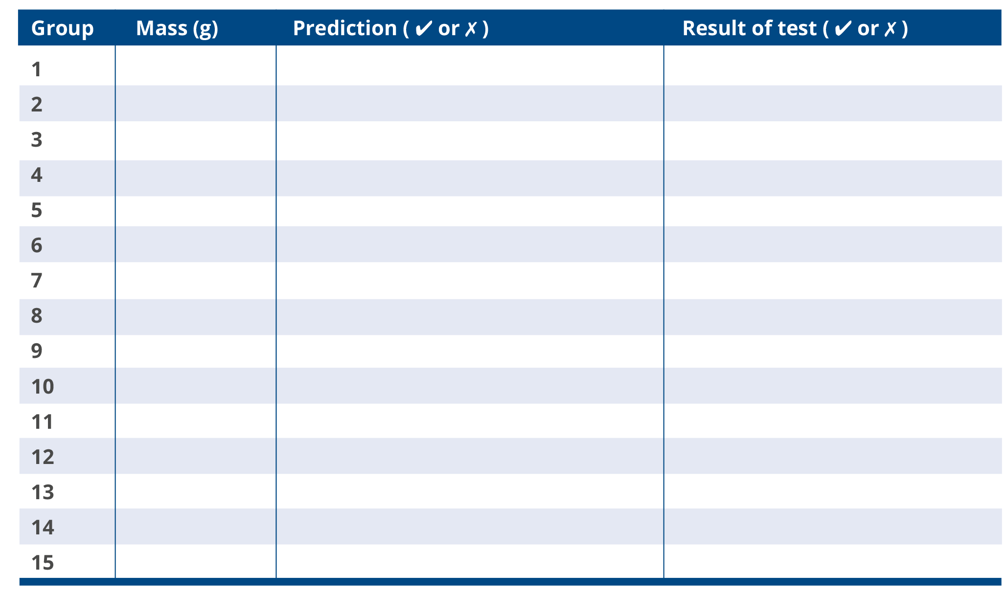
Testing
Notes:
Testing
Students should fill out the table in their booklet during testing. Ensure that students are quiet during the testing and respectful of each other's efforts even if they are unsuccessful.
Note that we are measuring mass here (in Grams) rather than weight (in Newtons). There will be science teachers watching so make sure that you always say mass!

Slide 21
Evaluation
Complete the evaluation in your student booklet.
What made this activity challenging?
How did you overcome these challenges?
Notes:
Evaluation/Plenary and Reflection
Students should evaluate their tunnel structure using the booklet.

Slide 22
Winning team
We will now reveal the winning team.
You will receive a commendation from your school for all of your efforts in showing off your Essential Skills.
Notes:
Reflection
Guide students to reflect on their Essential Skills and their learning across the day.
Ensure that you complete a proper plenary.
Examples could be to question students on how they improved their Essential Skills, or whether they are now more or less inclined towards a STEM career than at the beginning of the session.

Slide 23
EPIC Engineers Careers video
Notes:
EPIC Engineers Careers Video
Play this careers video to inspire your students about their future education and careers pathways.

Slide 24

Keep on using your essential skills!
From all the team, thank you for using your essential skills across today’s activity.
If you want to keep on using your essential skills and are thinking about a stem career, you can look at the following websites:
www.hs2.org.uk/education
www.skillsbuilder.org/
https://neonfutures.org.uk/
www.ice.org.uk
www.goconstruct.org
https://routesintorail.org/
Notes:
Reflection
This screen should be left on at the end of the session if students wish to copy down any of the links.

