Slide 1
EPIC ENGINEERING: WELCOME TO THE TEAM PURPOSE
Notes:
Welcome
Introduce EPIC Engineers Workshop, developed in partnership with HS2

Slide 2
Introduction to EPIC Engineers
Welcome to EPIC Engineers
Today’s workshop will be dedicated to STEM learning based around transport infrastructure, brought to you in partnership with HS2.
Today you will be completing the Stations of the Future activity.
Notes:
Welcome
This slide introduces the workshop and this session’s activity.

Slide 3
HS2 Introduction Video
Notes:
Welcome
This slide will embed the HS2 Introduction video.

Slide 4
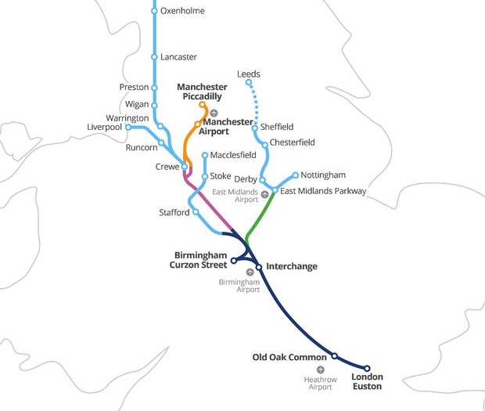

What is High Speed 2?
High Speed Two (HS2) is the new high speed railway we are building. It will connect 8 of Britain’s 10 largest cities, including Birmingham, Leeds, London and Manchester.
It is the first new railway built north of London for 120 years.
Notes:
Welcome
This slide shows the proposed HS2 route. Try to start from the city nearest in location to your students.

Slide 5
When is it being built?
HS2 is being built in three phases, but the whole network will be complete in the 2040s.
How old will you be when it is finished?
2009
2017
2020
2029-2033
2034
2035-2041
HS2 Ltd
set up
Parliamentary approval for Phase One
Construction begins
Phase One completion
Phase 2a completion
Phase 2b completion

Slide 6
Stations of the Future
When designing new buildings, it is important that they work not only for now, but well into the future. What will a station built for 2050 be like?
In this session you will:
Role-play some STEM careers.
Design a station for use in 2050.
Share your ideas with others.
Notes:
Stations of the Future
This is the start of the first activity, Stations of the Future. Use the text on the slide to introduce the activity and learning objectives. See the activity guide for the inventory to this activity.

Slide 7
SOTF student introduction video
Notes:
Introduction Video
Play this video to introduce the activity.

Slide 8
Joining the team
You will be producing a design proposal for a train station to be built in 2050.
Read the job descriptions in your booklet, and decide who will take on which role in your design team.
What makes you suitable for this role?
Notes:
Joining the team
Your students are to complete Challenge 1: Joining the team questions a) and b).
Ask students to read the job descriptions for each job role and to decide which one they will do in their team with their teammates. They should then answer question b) considering how their interests and skills match with their job role.

Slide 9
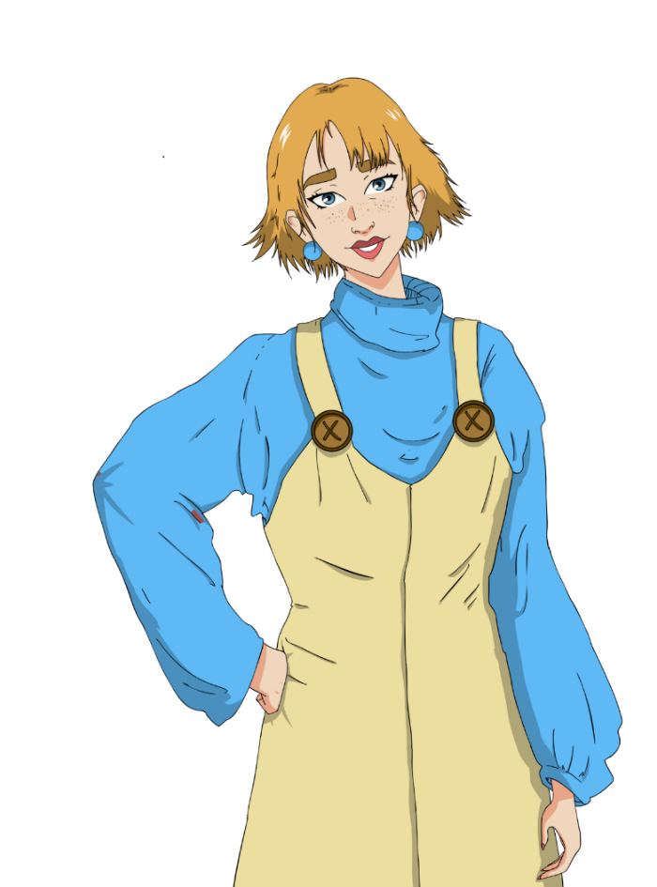
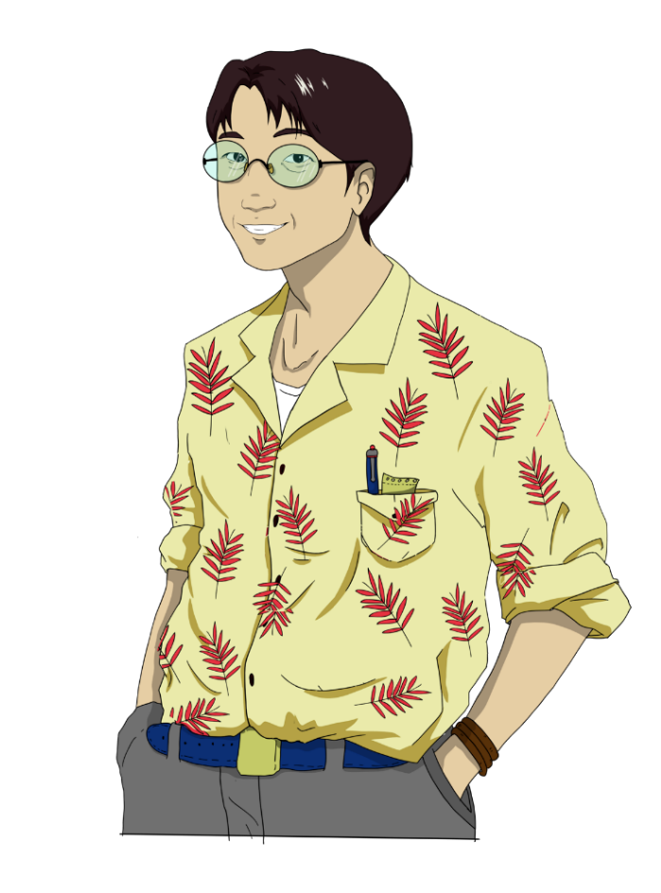


Civil Engineer
You will be responsible
for deciding on the material and structure
of the building.
CX Designer
You will be responsible
for ensuring that the station works for everybody and is on
trend for 2050.
BIM Technician
You will be responsible
for communicating the floorplan of the station.
Environmental Advisor
You will be responsible
for making sure that
the station has a
minimal impact on
the environment.
Notes:
Joining the team
Introduce each job role.

Slide 10
Civil Engineer
There are many types of engineering careers; from Civil and Structural Engineers to Mechanical, Electrical and Geotechnical.
Civil Engineers deal with the design and construction of built structures, including railways, airports, roads, bridges, dams, pipelines, canals and other such projects.
A key skill of an engineer is to match the right materials and construction to the right project, with Civil Engineers often working with reinforce concrete, brick and other materials. Civil Engineers also must work with others, taking advice from experts such as Environmental Advisors or GIS Technicians, or creating models with CAD Technicians.
The usual route for becoming a chartered engineer is to study civil engineering at degree level, after A-Levels. There are also B-Tec and apprenticeship routes.
Notes:
Joining the team
Use this slide for optional additional information on Civil Engineering

Slide 11
Environmental Advisor
Their job is to design solutions to limit the environmental impact of engineering projects. Working closely with Ecologists, who study the natural environment, they advise Civil Engineers on issues such as noise and chemical pollution and habitat loss.
Working on HS2, Environmental Advisors are responsible for the creation of green corridors and maintaining or replacing habitats along the route, such as meadows, wetland and woodlands. Environmental Advisors are also overseeing the creating of green bridges and bat barns, to help maintain bat populations as well as other woodland creatures.
Environmental Advisors will usually enter the profession from having a degree in environmental science, biology, chemistry or geology.
Notes:
Joining the team
Use this slide for optional additional information on Environmental Advisory

Slide 12
Building Information Modelling(BIM) Technician
BIM Technicians produce the models and drawings during the design and construction phase of design. Using computer aided design, they can produce realistic and testable 2D and 3D models of buildings.
BIM Technicians work closely with Civil Engineers, using digital data manipulation to plan and test construction and they work with Customer Experience Designers to ensure that the building works for all customers.
BIM Technicians will enter the profession using many different routes from computer aided engineering degree, to a degree in architecture or quantity surveying.
Notes:
Joining the team
Use this slide for optional additional information on BIM Technicians

Slide 13
Customer Experience (CX) Designer
Their job is to ensure that businesses put customers first, ensuring that the whole system is designed around the needs and comfort of the people who use the business’s products or services, as well as its employees and other stakeholders.
CX Designers work collaboratively with those involved at every stage of a customer’s journey, from Graphic and Interior Designers to Web Developers and station staff. They also have to be aware of future trends, to make sure that a building built in ten years’ time will be relevant for the people using it.
As this is a new and diverse area, people come into it from a variety of backgrounds. Some may come from a product design background, whereas others have user experience or app design degrees.
Notes:
Joining the team
Use this slide for optional additional information on Customer Experience Design

Slide 14
HS2 EPIC AR App
You will now use the EPIC AR App to research your job role and add to your job description.
You should include two extra pieces of information that help to explain what your job involves.
The password is 9999.
SCREENSHOTS?
Notes:
HS2 EPIC App
Students can have 15 minutes to research their job role using the HS2 EPIC App.
Allow students 15 minutes to explore the app and to find two extra pieces of information for their job description.

Slide 15
Creating your proposal
Imagine it is the year 2050. What will life be like? Taking on the role of a Civil Engineer, Customer Experience Designer, Environmental Advisor or BIM Technician, you will create a design proposal for a station of the future for a site in your town or city.
You should include:
An annotated map of a futuristic station.
A front elevation drawing, showing the outside of the station building.
You will present this in a conference style presentation and be marked on your essential skills.
You should focus on your Creativity, Teamwork and Listening and Presenting
Notes:
Activity instructions/Creating your proposal
Introduce the Stations of the Future activity, where students must create a design for a train station to be opened in the year 2050. Outline the key criteria and essential skills.
Assess whether students can differentiate between labelling and annotation and explain any misconceptions.
The reason for choosing 2050 is that this would be a realistic date for the opening of a train station if we were to decide to build a new railway today.
The following slides are to help inspire your students. Use them to show examples and to get your students thinking about their designs. When you are confident that they are ready to start, let them start. Make sure that you tell them how long they have.

Slide 16
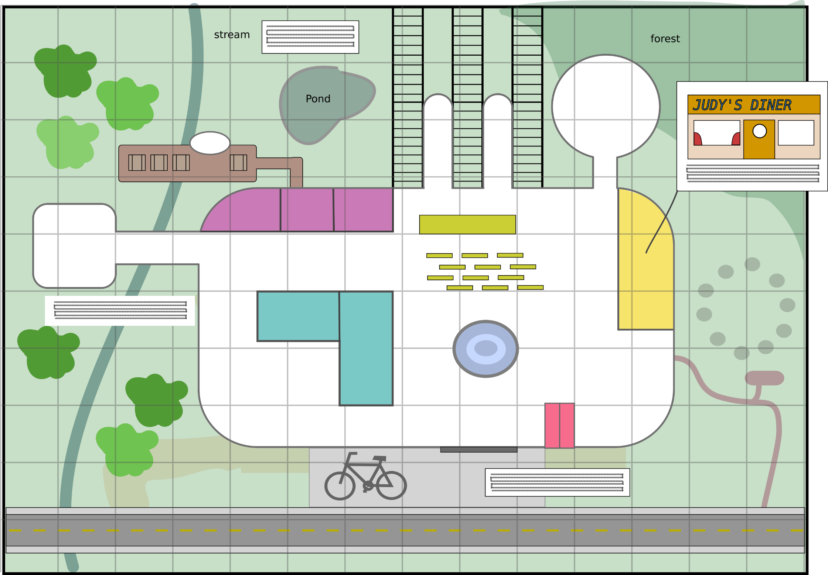


-
Think about how you can mitigate for the environmental impact of the station on the site.
Plan how people will travel sustainably to and from your station and how your station is powered.a
Notes:
Activity instructions/Creating your proposal
Here is an example design of a train station for you students. You can see in the diagram a waiting area, shops and restaurants, a fountain, ticket machines, bicycle parking landscaped areas outside of the station and a hydroelectric power supply.
Students should follow the advice from the team members on the screen. You could put these slides up during the time when students are working, with a brief introduction.

Slide 17

-
Use annotations and additional sketches to explain your ideas.
Include a floor plan map of the station, including main features of the building.
Think about how your station occupies the site. Think about the local geology and other geographical features
Notes:
Activity instructions/Creating your proposal
Here is an example design of a train station for you students. You can see in the diagram a waiting area, shops and restaurants, a fountain, ticket machines, bicycle parking landscaped areas outside of the station and a hydroelectric power supply.
Students should follow the advice from the team members on the screen. You could put these slides up during the time when students are working, with a brief introduction.

Slide 18

-
-
Use sketches to show internal spaces, signs and furniture.
Make sure that your sketches present your ideas clearly
Notes:
Activity instructions/Creating your proposal
Here is an example design of a train station for you students. You can see in the diagram a waiting area, shops and restaurants, a fountain, ticket machines, bicycle parking landscaped areas outside of the station and a hydroelectric power supply.
Students should follow the advice from the team members on the screen. You could put these slides up during the time when students are working, with a brief introduction.

Slide 19

-
Don’t forget to make your station futuristic and trendy too!
Make sure that your station is easy to use for everyone.
Notes:
Activity instructions/Creating your proposal
Here is an example design of a train station for you students. You can see in the diagram a waiting area, shops and restaurants, a fountain, ticket machines, bicycle parking landscaped areas outside of the station and a hydroelectric power supply.
Students should follow the advice from the team members on the screen. You could put these slides up during the time when students are working, with a brief introduction.

Slide 20

Essential skills – creativity
The use of imagination and the generation of new ideas.
I can use my imagination to come up with ideas linked to starting points.
I can combine ideas or concepts to create new ones.
I can explain how considering different perspectives can support creativity.
I can explain how to maximise creativity when working creatively.
Notes:
Activity instructions/Creating your proposal
Introduce the four essential skills used in this challenge: creativity, teamwork, listening and speaking.

Slide 21
Essential skills – teamwork
Working cooperatively with others towards
achieving a shared goal.
I help with different jobs in my team and take responsibility for finishing my job.
I help make decisions and make my own suggestions.
I recognise the value of others’ ideas and make useful contributions myself.
Notes:
Activity instructions/Creating your proposal
Introduce the four essential skills used in this challenge: creativity, teamwork, listening and speaking.

Slide 22
Essential skills - listening
The ability to listen and understand information
I can listen to extended talk and identify the key information I need.
I can take part and respond to group discussion.
I can analyse how a speaker uses language gesture to engage an audience.
I can ask probing and relevant questions to check and build my understanding.
Notes:
Activity instructions/Creating your proposal
Introduce the four essential skills used in this challenge: creativity, teamwork, listening and speaking.

Slide 23
Essential skills - speaking
The oral transmission of information or ideas.
I can use formal language, tone and expression when I am presenting.
I can change my language depending on the purpose and audience.
I can structure my language in a way that makes my communication clear and engaging and use examples for my points.
I can anticipate responses from the audience and plan for them.
Notes:
Activity instructions/Creating your proposal
Introduce the four essential skills used in this challenge: creativity, teamwork, listening and speaking.

Slide 24

Futuristic thoughts
It’s important that we think about the future when designing new public buildings.
What will it be like?
Automation & digitisation: What will our relationship to technology be like in the future? Will we be technologically enhanced cyborgs, or will we co-exist with robots who check our tickets and serve us space-food?
Changing mobility patterns: How will we get to and from stations? Driverless cars or hoverboards? Will we have motorised luggage? Where will we dock and park our technologies in stations of the future?
Notes:
Activity instructions/Creating your proposal
The next three slides are extra hints and explanations for your students. Use these as appropriate during the making activity.
This section is for inspiration. You may wish to use other techniques for inspiring students, such as a visualisation.

Slide 25
Futuristic thoughts
Sustainable architecture: How will sustainable technologies be incorporated into our buildings? How will we power our stations? Consider sustainable materials such as a grass roof or plant walls, or incorporating gardens, beehives or nesting for bats and birds.
Leisure & food: What type of shops? What types of food? How will people relax in the future?
Digital communication: What will we use? Smart phone connection, holograms, cyborg technology, virtual reality, augmented reality?
Notes:
Activity instructions/Creating your proposal
This section is for inspiration. You may wish to use other techniques for inspiring students, such as a guided visualisation.

Slide 26
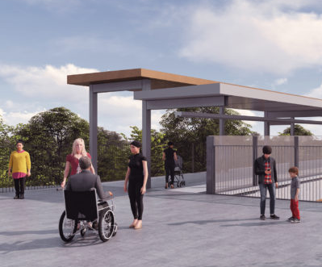
Customers of the future
Your station has to work for different people, including staff and customers.
Consider the needs of:
Children, elderly people, pregnant people, disabled people
  Visually impaired
  Hearing impaired
  Mobility impaired
  Neurodiverse
People of different religions and faiths
Transgender people
Notes:
Activity instructions/Creating your proposal
Explain to students that stations must meet the needs of all people. How could the requirements of these people impact on the design of the station? They should consider all people in the list above. Students should ensure that their stations are fully accessible and inclusive to all. You could mention Universal Design principles at this point.

Slide 27
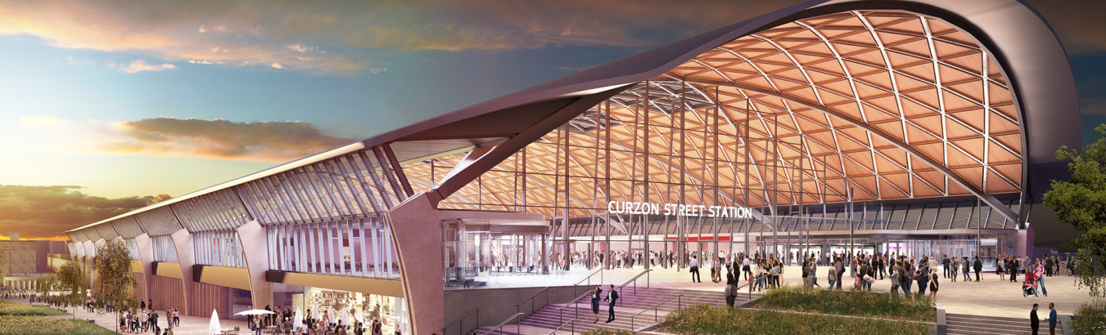
Design vision for a new HS2 Curzon Street station
Notes:
Activity instructions/Creating your proposal
These are concept deigns for the new stations. You could comment on use of materials, types of structure, use of natural light, incorporation of green spaces etc.

Slide 28
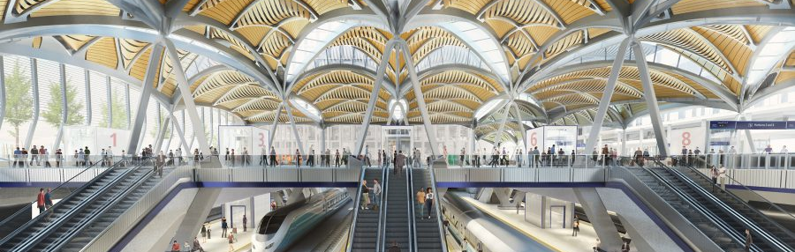
Concept image of Euston station redevelopment
Notes:
Activity instructions/Creating your proposal
These are concept deigns for the new stations. You could comment on use of materials, types of structure, use of natural light, incorporation of green spaces etc.

Slide 29
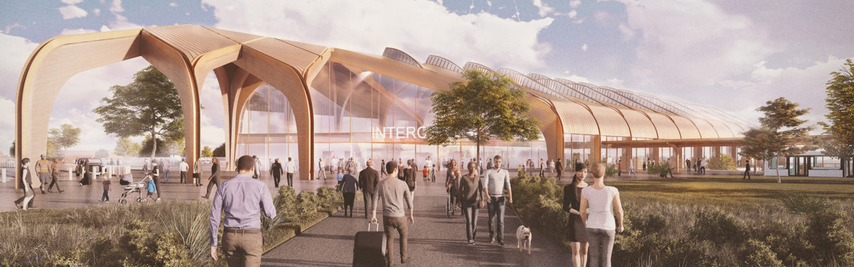
Concept image Birmingham Interchange Station
Notes:
Activity instructions/Creating your proposal
These are concept deigns for the new stations. You could comment on use of materials, types of structure, use of natural light, incorporation of green spaces etc.

Slide 30
Presenting your ideas
In the next session you will present your ideas. Keeping your blueprint on your table, two team members will walk around the room to see the ideas of other groups. Two team members will stay to explain the idea to the other teams. Halfway through the session, swap around.
Evaluate your ideas
When instructed, answer the evaluation questions in your booklet. Have you surprised yourself with your essential skills?
Notes:
Presentations
Students now have five minutes to present their work in a conference-style presentation.
Two students from each group will remain at their table, whilst the other two will circulate to other group's tables. Swap movers and presenters after two and a half minutes, taking a total of five minutes.
Allow students time to discuss what they have seen if timings allow.

Slide 31
Winning team
We will now reveal the winning team.
You will receive a commendation from your school for all of your efforts in showing off your essential skills.
Notes:
Reflection
Guide students to reflect on their essential skills and their learning across the day.
Ensure that you complete a proper plenary.
Examples could be to question students on how they improved their essential skills, or whether they are now more or less inclined towards a STEM career than at the beginning of the session.

Slide 32
Careers video
TUNNEL STRUCTURES
Notes:
Careers Video
Play this careers video to inspire your students about their future education and careers pathways.

Slide 33

Keep on using your essential skills!
From all the team, thank you for using your essential skills across today’s activity.
If you want to keep on using your essential skills and are thinking about a stem career, you can look at the following websites:
`
www.hs2.org.uk/education
www.skillsbuilder.org/
https://neonfutures.org.uk/
www.ice.org.uk
www.goconstruct.org
https://routesintorail.org/
Notes:
Reflection
This screen should be left on at the end of the session if students wish to copy down any of the links.

