Slide 1
EPIC ENGINEERING: WELCOME TO THE TEAM PURPOSE
Notes:
Welcome
Introduce EPIC Engineers Workshop, developed in partnership with HS2

Slide 2
Introduction to EPIC Engineers
Welcome to EPIC Engineers
Today’s workshop will be dedicated to STEM learning based around transport infrastructure, brought to you in partnership with HS2.
Today you will be completing the Rail Rush! activity.
Notes:
Welcome
This slide introduces the workshop and this session’s activity.

Slide 3
HS2 Introduction Video
Notes:
Welcome
This slide will embed the HS2 Introduction video.

Slide 4
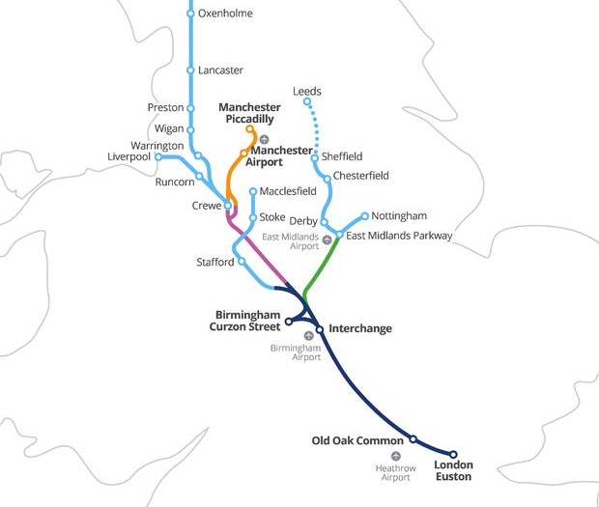

What is High Speed 2?
High Speed Two (HS2) is the new high speed railway we are building. It will connect 8 of Britain’s 10 largest cities, including Birmingham, Leeds, London and Manchester.
It is the first new railway built north of London for 120 years.
Notes:
Welcome
This slide shows the proposed HS2 route. Try to start from the city nearest in location to your students.

Slide 5
When is it being built?
HS2 is being built in three phases, but the whole network will be complete in the 2040s.
How old will you be when it is finished?
2009
2017
2020
2029-2033
2034
2035-2041
HS2 Ltd
set up
Parliamentary approval for Phase One
Construction begins
Phase One completion
Phase 2a completion
Phase 2b completion

Slide 6
Rail Rush!
Now that you have learned how to build stations and tunnels, it’s now time to build your own rail company.
In this session you will:
Design and build your own rail service.
Discover the relationship between transport services, communities and the environment.
In this activity, you will be using the essential skills of staying positive and aiming high.
Notes:
Cut-out game pieces/Rail Rush! introduction
Introduce the objectives of this session.
If the students have to cut out their game pieces, give them 10 minutes to do this now.

Slide 7
Rail Rush student introduction video
Notes:
Introduction Video
Play this video to introduce the activity.

Slide 8

Essential skills – staying positive
The ability to use tactics to overcome setbacks and achieve goals.
I keep trying when something goes wrong, and think about what happened.
I can come up with ideas for changing difficult situations to positive opportunities.
In difficult situations I choose the best way to move forward instead of giving up.
Notes:
Rail Rush! introduction
Introduce the two essential skills used in this challenge: staying positive and aiming high.

Slide 9
Essential skills – aiming high
The ability to set clear, tangible goals + devise a robust route to achieving them.
I can prioritise different tasks to help me achieve my goal.
I can create a plan to achieve a simple goal, breaking down tasks and securing resources independently.
I can reflect on my skill set with accuracy and identify opportunities to improve further.
Notes:
Rail Rush! introduction
Introduce the two essential skills used in this challenge: staying positive and aiming high.

Slide 10
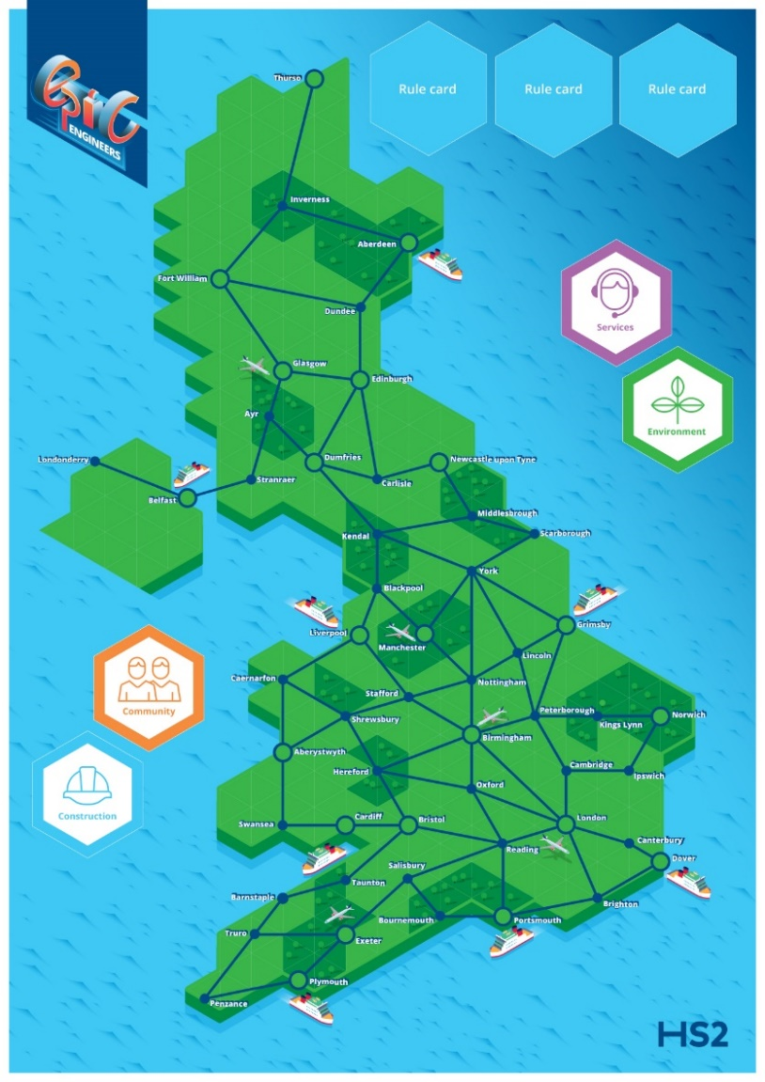
Rail Rush!
Rail Rush! is a four player railway-building game where players compete to build a rail service whilst getting the highest number of points.
Notes:
Rail Rush! introduction
Introduce an outline how the game works, emphasizing the aim of the game, which is to collect the most points.

Slide 11
Setting up
To start the game, each player will need:
1 x set of cut-out pieces
1 x scorecard
Separate the card deck into the four smaller decks (construction, community, environment and service) and place these on their spaces on the board.
Rule card positions remain empty.
Notes:
Rail Rush! introduction
Ask your students to set up their boards, by separating the card deck into four and placing the cards face-down on the board. Students should also make sure that they know ho is going first.

Slide 12
How the game works
The aim of the game is to be the player who has collected the most points whilst growing their rail network.
You can collect track points, environment points, service points or community points. You can also win bonus points which appear during the game.
Players record their points on their score card.
The game ends when the first player lays all of their track.
Notes:
The Rules
Explain the rules of the game. You could use the text of the student booklet or ask students to read it in silence.

Slide 13
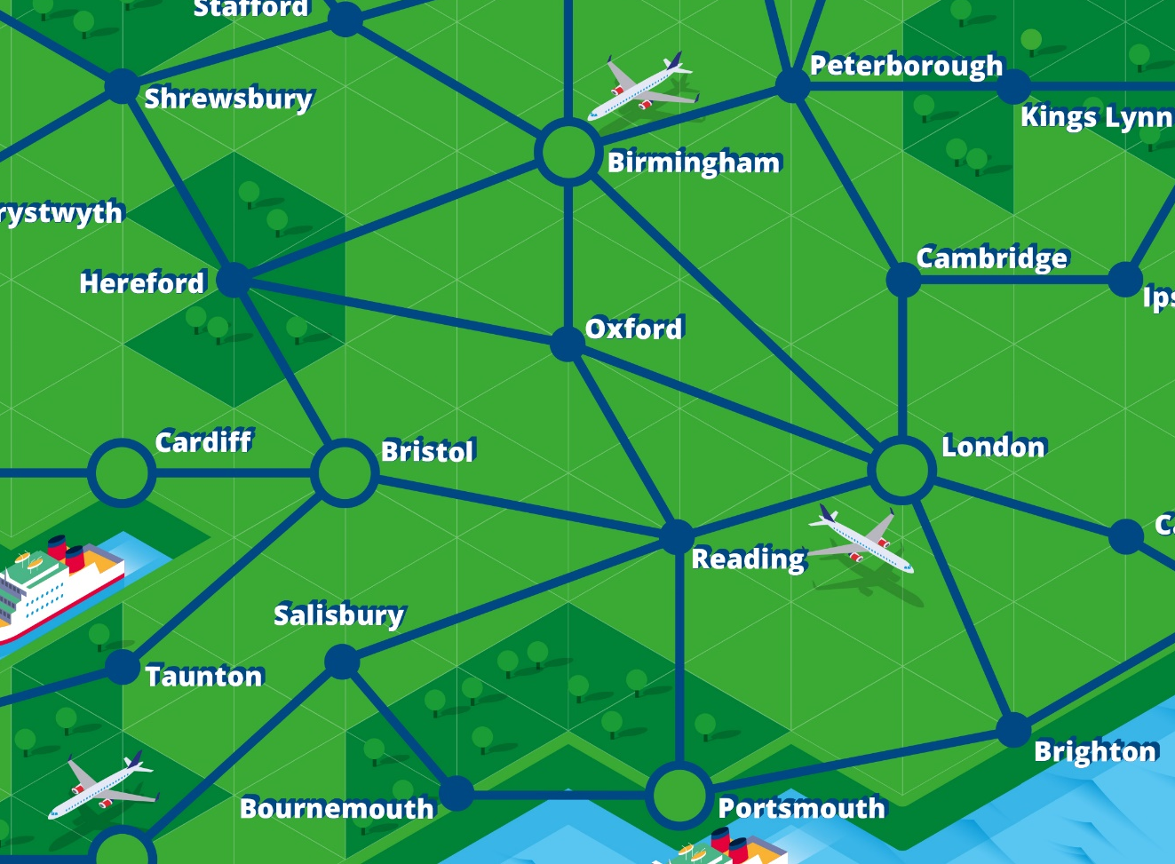
Starting the game
In the first round, in turn, each player must build two starter stations anywhere on the board, followed by one length of track, which must join to at least one station. Start with the youngest player, then work clockwise.
Notes:
The Rules
This slide shows players how to make their first moves. Explain that they may place their first two stations anywhere on the board, however track must always connect to a station.

Slide 14
Playing the game
The game then runs as following:
Each turn you may pick as many cards as you have stations. You can choose a mix of cards from each of the four decks.
Reveal your cards. Place any rule cards on the rule card spaces. Record any points that you have gained, replacing the cards at the bottom of their respective decks.
Build and track or stations if cards instruct you to.
Change player.
Notes:
The Rules
Explain the turn procedure above.

Slide 15
Rule cards
Rule cards will appear from time to time in all four decks. These can change the rules of the game.
Only three rule cards can be in play at any time.
The player who picks a fourth rule card must replace an in play rule card by placing their rule over an. existing rule
Examples of rule cards include:
Bonus points for having stations on ports or airports.
Bonus points for longest continuous track.
Restricted building on national parks.
Notes:
The Rules
Explain that rule cards alter the rules of the game and can reward players with bonus points.
Ask the students if they have any questions.
Once all questions are answered, they may start.

Slide 16
Ending the game
The game ends when the first player uses all of their track. Then, add up your track points, environment points, service points, community points and bonus points using their scorecard. The winner has the highest score.
Notes:
The Rules
Explain to players how the game is ended. Emphasize that it is not just the longest track that will win.

Slide 17
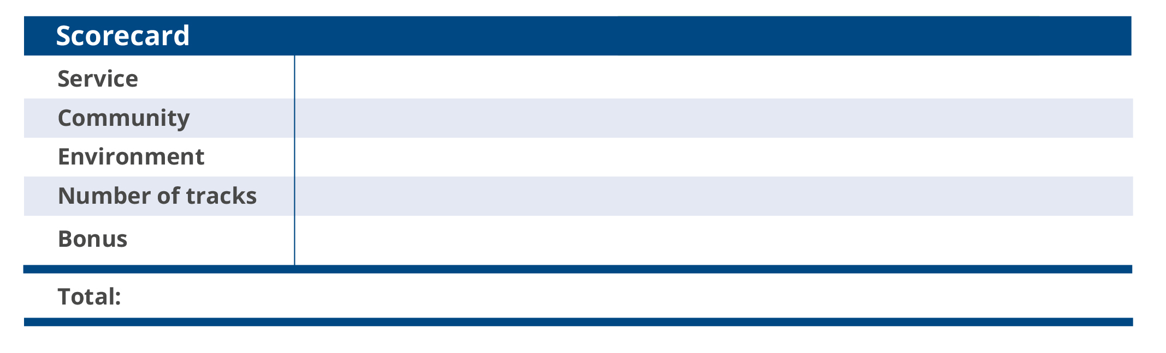
Using your scorecard
Tick the boxes on your scorecard whenever you earn points or lay a piece of track.
Notes:
The Rules/Rail Rush!
This scorecard is found in the printed booklets and should be used by students during the game.
Ask the students if they have any questions.
Once all questions are answered, they may start.
Ensure that you allow students five minutes before the end of the playing period to take their last turns and to decide the winner.

Slide 18
Game over
Add up your scores and carefully tidy away. Please place all cards neatly back into the deck, grouped accordingly.
Which essential skills helped you to win the games?
Was it better to have the longest track or to care about the service, the environment and local communities?
Notes:
Tidy Up Time/Plenary
The game is now over and students must tidy up. Make sure that all equipment is put away carefully. Do not begin to collect in the rail rush equipment until students have tidied their tables fully as otherwise cards may be left behind.
In your closing remarks, ask your students what they learned from the game. Ask students about their individual strategies for winning. Ask for a show of hands of those who won and ask for a round of applause for the winners.

Slide 19
Reflection
It’s nearly the end of the day, so it’s time to re-evaluate your Essential Skills and think about how you have improved your learning.
Complete the reflection task in your student booklets.
Notes:
Reflection
Guide students to reflect on their Essential Skills and their learning across the day.
Ensure that you complete a proper plenary.
Examples could be to question students on how they improved their Essentials Skills or whether they are now more or less inclined towards a STEM career than at the beginning of the session.

Slide 20
Careers video
Notes:
EPIC Engineers Careers Video
Play this careers video to inspire your students about their future education and careers pathways.

Slide 21

Keep on using your essential skills!
From all the team, thank you for using your essential skills across today’s activity.
If you want to keep on using your essential skills and are thinking about a stem career, you can look at the following websites:
`
www.hs2.org.uk/education
www.skillsbuilder.org/
https://neonfutures.org.uk/
www.ice.org.uk
www.goconstruct.org
https://routesintorail.org/
Notes:
Reflection
This screen should be left on at the end of the session if students wish to copy down any of the links.

