Slide 1
EPIC ENGINEERING: WELCOME TO THE TEAM PURPOSE
Notes:
Welcome
Introduce EPIC Engineers Workshop, developed in partnership with HS2

Slide 2
Introduction to EPIC Engineers
Welcome to EPIC Engineers
Today’s workshop will be dedicated to STEM learning based around transport infrastructure, brought to you in partnership with HS2.
Over today’s session, you will learn to:
Describe the STEM careers available in transport infrastructure.
Describe the skills useful in a STEM working environment.
Understand how railway infrastructure is developed to satisfy present and future needs.
Notes:
Welcome
This slide introduces the learning objectives for the session.
Presenter should assess students understanding of the terms ‘STEM’ and ‘infrastructure’ using questioning, and address any misconceptions.

Slide 3
Introduction video
Notes:
Welcome
This slide will embed the HS2 Introduction video.

Slide 4
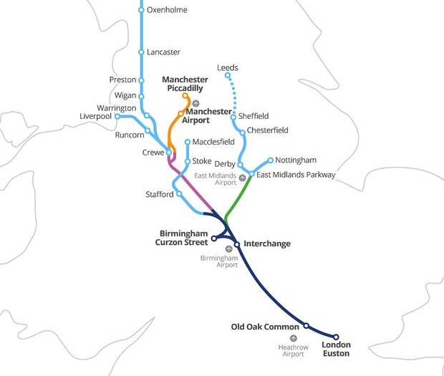

What is High Speed 2?
High Speed Two (HS2) is the new high speed railway we are building. It will connect 8 of Britain’s 10 largest cities, including Birmingham, Leeds, London and Manchester.
It is the first new railway built north of London for 120 years.
Notes:
Welcome
This slide shows the proposed HS2 route. Try to start from the city nearest in location to your students.

Slide 5
When is it being built?
HS2 is being built in three phases, but the whole network will be complete in the 2040s.
How old will you be when it is finished?
2009
2017
2020
2029-2033
2034
2035-2041
HS2 Ltd
set up
Parliamentary approval for Phase One
Construction begins
Phase One completion
Phase 2a completion
Phase 2b completion

Slide 6
Plan for the day
Today there will be six activities:
Welcome To the Team: Introduction
Stations of The Future
Tunnel Building: Cut & Cover Tunnel Challenge
Rail Rush Board Game
Reflection
Your breaks and lunchtime will be at the usual times.
Notes:
Welcome
This slide lists the days activities. Adjust this depending on which activities you are including.

Slide 7
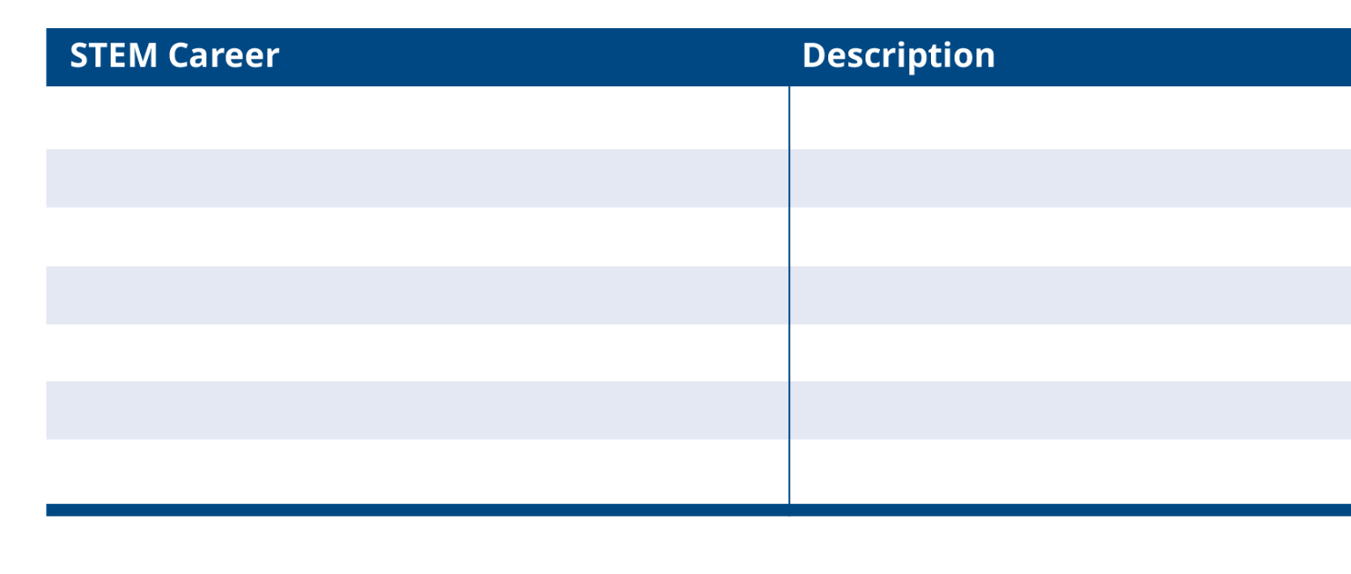
Starter: What is a STEM career?
Before we start, lets think about the
many types of STEM careers.
How many STEM careers can you
name? List them down on the first
page of your booklet.
Notes:
Stem Careers
Students are to name STEM careers. They should write their list on p2 of their booklet, in the section ‘Starter: STEM Careers’.
Allow students 2-3 minutes. Circulate around the room to check that students are on task.

Slide 8
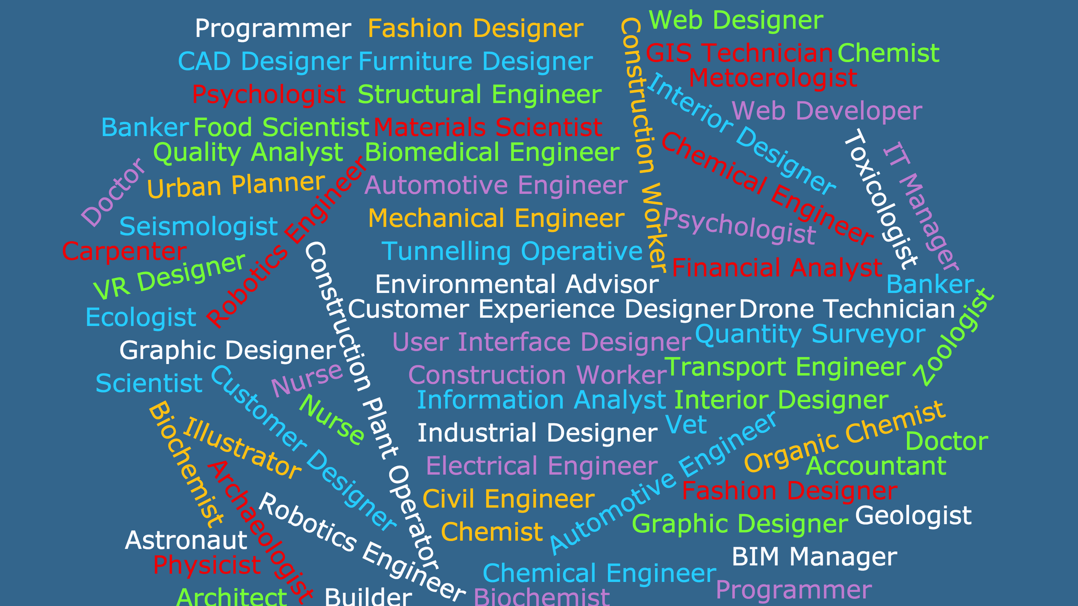
Notes:
Stem careers
This page shows a word cloud of STEM careers. The ones that we will focus on are highlighted.
There are many more, such as: graphic designer, transport engineer, geologist, archaeologist etc. that could also be connected to HS2.

Slide 9

Introduction to Skills Builder essential skills
In this first session, we are going to think about your essential skills.
These are the skills that we will use across today’s workshop, and are useful in STEM careers and further education. You will be rewarded across the day for showing these skills.
Notes:
Essential skills
Introduce the essential skills.
Explain to students how you will reward them across the day. This should interlock with their schools reward system.

Slide 10

Introducing essential skills
Notes:
Essential skills
Quickly introduce each essential skill. Use examples where necessary.

Slide 11

Essential skills - listening
The ability to listen and understand information
I can listen to extended talk and identify the key information I need.
I can take part and respond to group discussion.
I can analyse how a speaker uses language gesture to engage an audience.
I can ask probing and relevant questions to check and build my understanding.
Notes:
Essential skills
Quickly introduce each essential skill. These statements follow the skills builder steps relevant to the activities. Note that some steps are missed here as these would not be demonstrable in this activity. If a student has demonstrated some of these they will be low in the table, most of them they will be in the middle of the table, and all of them high.
You do not have to introduce all essential skills at this point. You can return to these slides later.

Slide 12
Essential skills - speaking
The oral transmission of information or ideas.
I can use formal language, tone and expression when I am presenting.
I can change my language depending on the purpose and audience.
I can structure my language in a way that makes my communication clear and engaging and use examples for my points.
I can anticipate responses from the audience and plan for them.
Notes:
Essential skills
Quickly introduce each essential skill. These statements follow the skills builder steps relevant to the activities. Note that some steps are missed here as these would not be demonstrable in this activity. If a student has demonstrated some of these they will be low in the table, most of them they will be in the middle of the table, and all of them high.
You do not have to introduce all essential skills at this point. You can return to these slides later.

Slide 13
Essential skills – problem solving
The ability to find a solution to a complex situation or challenge.
I can come up with different ways to solve a problem.
I can use pros and cons to pick the best way of solving a simple problem.
I can carry out research to better understand complex problems.
I can evaluate different solutions for a complex problem and pick the best one.
Notes:
Essential skills
Quickly introduce each essential skill. These statements follow the skills builder steps relevant to the activities. Note that some steps are missed here as these would not be demonstrable in this activity. If a student has demonstrated some of these they will be low in the table, most of them they will be in the middle of the table, and all of them high.
You do not have to introduce all essential skills at this point. You can return to these slides later.

Slide 14
Essential skills – creativity
The use of imagination and the generation of new ideas.
I can use my imagination to come up with ideas linked to starting points.
I can combine ideas or concepts to create new ones.
I can explain how considering different perspectives can support creativity.
I can explain how to maximise creativity when working creatively.
Notes:
Essential skills
Quickly introduce each essential skill. These statements follow the skills builder steps relevant to the activities. Note that some steps are missed here as these would not be demonstrable in this activity. If a student has demonstrated some of these they will be low in the table, most of them they will be in the middle of the table, and all of them high.
You do not have to introduce all essential skills at this point. You can return to these slides later.

Slide 15
Essential skills – staying positive
The ability to use tactics to overcome setbacks and achieve goals.
I keep trying when something goes wrong, and think about what happened.
I can come up with ideas for changing difficult situations to positive opportunities.
In difficult situations I choose the best way to move forward instead of giving up.
Notes:
Essential skills
Quickly introduce each essential skill. These statements follow the skills builder steps relevant to the activities. Note that some steps are missed here as these would not be demonstrable in this activity. If a student has demonstrated some of these they will be low in the table, most of them they will be in the middle of the table, and all of them high.
You do not have to introduce all essential skills at this point. You can return to these slides later.

Slide 16
Essential skills – aiming high
The ability to set clear, tangible goals + devise a robust route to achieving them.
I can prioritise different tasks to help me achieve my goal.
I can create a plan to achieve a simple goal, breaking down tasks and securing resources independently.
I can reflect on my skill set with accuracy and identify opportunities to improve further.
Notes:
Essential skills
Quickly introduce each essential skill. These statements follow the skills builder steps relevant to the activities. Note that some steps are missed here as these would not be demonstrable in this activity. If a student has demonstrated some of these they will be low in the table, most of them they will be in the middle of the table, and all of them high.
You do not have to introduce all essential skills at this point. You can return to these slides later.

Slide 17
Essential skills – leadership
Supporting, encouraging and motivating others to achieve a shared goal.
I can make sure that everyone has a job and can help my teammates when they need me.
I use my understanding of my teammates’ strengths to help achieve team goals.
I can see when disagreements are are developing and can use strategies to resolve these.
Notes:
Essential skills
Quickly introduce each essential skill. These statements follow the skills builder steps relevant to the activities. Note that some steps are missed here as these would not be demonstrable in this activity. If a student has demonstrated some of these they will be low in the table, most of them they will be in the middle of the table, and all of them high.
You do not have to introduce all essential skills at this point. You can return to these slides later.

Slide 18
Essential skills – teamwork
Working cooperatively with others towards
achieving a shared goal.
I help with different jobs in my team and take responsibility for finishing my job.
I help make decisions and make my own suggestions.
I recognise the value of others’ ideas and make useful contributions myself.
Notes:
Essential skills
Quickly introduce each essential skill. These statements follow the skills builder steps relevant to the activities. Note that some steps are missed here as these would not be demonstrable in this activity. If a student has demonstrated some of these they will be low in the table, most of them they will be in the middle of the table, and all of them high.
You do not have to introduce all essential skills at this point. You can return to these slides later.

Slide 19
Self-assess your essential skills
Which ones do you have?
Which is your strongest?
Which would you most like to improve?
How could you do this?
Notes:
Essential Skills
Question students on which essential skill they will improve, and how they will improve it.

Slide 20
Stations of the Future
When designing new buildings, it is important that they work not only for now, but well into the future. What will a station built for 2050 be like?
In this session you will:
Role-play some STEM careers.
Design a station for use in 2050.
Share your ideas with others.
Notes:
Stations of the Future
This is the start of the first activity, Stations of the Future. Use the text on the slide to introduce the activity and learning objectives. See the activity guide for the inventory to this activity.

Slide 21
SOTF student introduction video
Notes:
Introduction Video
Play this video to introduce the activity.

Slide 22
Joining the team
You will be producing a design proposal for a train station to be built in 2050.
Read the job descriptions in your booklet, and decide who will take on which role in your design team.
What makes you suitable for this role?
Notes:
Joining the team
Your students are to complete Challenge 1: Joining the team questions a) and b).
Ask students to read the job descriptions for each job role and to decide which one they will do in their team with their teammates. They should then answer question b) considering how their interests and Essential Skills match with their job role.

Slide 23
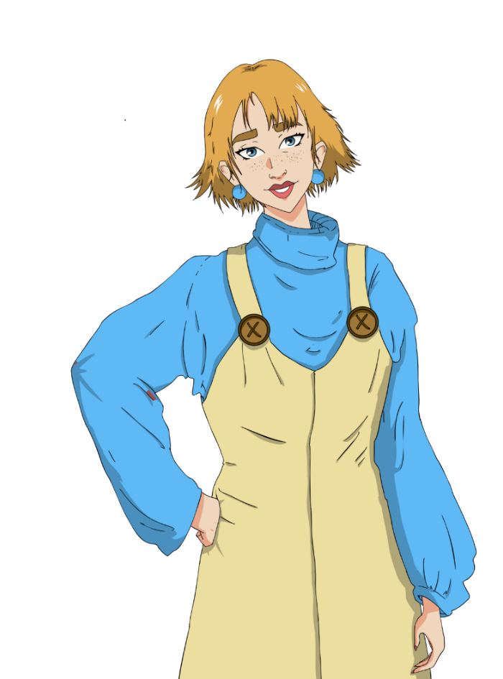
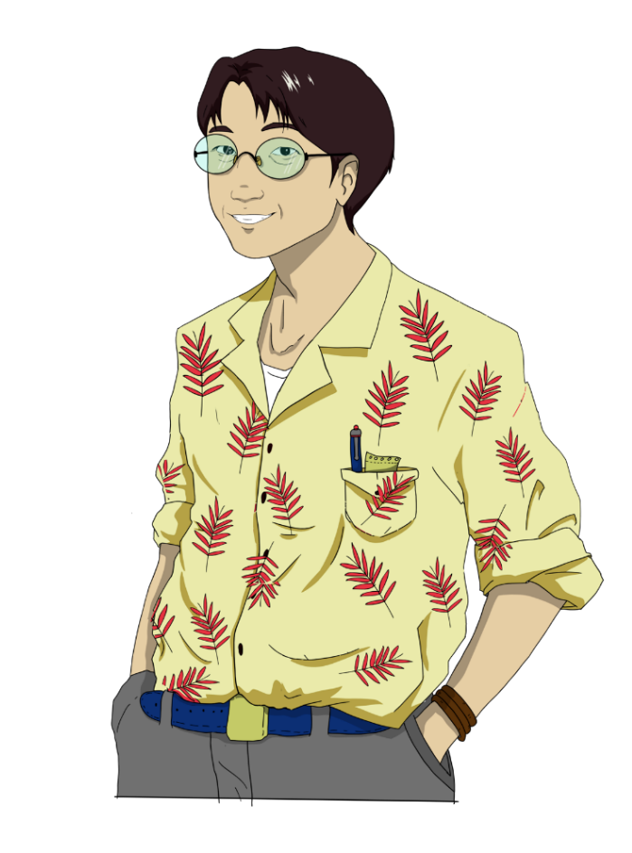


Civil Engineer
You will be responsible
for deciding on the material and structure
of the building.
CX Designer
You will be responsible
for ensuring that the station works for everybody and is on
trend for 2050.
BIM Technician
You will be responsible
for communicating the floorplan of the station.
Environmental Advisor
You will be responsible
for making sure that
the station has a
minimal impact on
the environment.
Notes:
Joining the Team
Introduce each job role.

Slide 24
Civil Engineer
There are many types of engineering careers; from Civil and Structural Engineers to Mechanical, Electrical and Geotechnical.
Civil Engineers deal with the design and construction of built structures, including railways, airports, roads, bridges, dams, pipelines, canals and other such projects.
A key skill of an engineer is to match the right materials and construction to the right project, with Civil Engineers often working with reinforce concrete, brick and other materials. Civil Engineers also must work with others, taking advice from experts such as Environmental Advisors or GIS Technicians, or creating models with CAD Technicians.
The usual route for becoming a chartered engineer is to study civil engineering at degree level, after A-Levels. There are also B-Tec and apprenticeship routes.
Notes:
Joining the Team
Use this slide for optional additional information on Civil Engineering

Slide 25
Environmental Advisor
Their job is to design solutions to limit the environmental impact of engineering projects. Working closely with Ecologists, who study the natural environment, they advise Civil Engineers on issues such as noise and chemical pollution and habitat loss.
Working on HS2, Environmental Advisors are responsible for the creation of green corridors and maintaining or replacing habitats along the route, such as meadows, wetland and woodlands. Environmental Advisors are also overseeing the creating of green bridges and bat barns, to help maintain bat populations as well as other woodland creatures.
Environmental Advisors will usually enter the profession from having a degree in environmental science, biology, chemistry or geology.
Notes:
Joining the Team
Use this slide for optional additional information on Environmental Advisory

Slide 26
Building Information Modelling(BIM) Technician
BIM Technicians produce the models and drawings during the design and construction phase of design. Using computer aided design, they can produce realistic and testable 2D and 3D models of buildings.
BIM Technicians work closely with Civil Engineers, using digital data manipulation to plan and test construction and they work with Customer Experience Designers to ensure that the building works for all customers.
BIM Technicians will enter the profession using many different routes from computer aided engineering degree, to a degree in architecture or quantity surveying.
Notes:
Joining the Team
Use this slide for optional additional information on BIM Technicians

Slide 27
Customer Experience (CX) Designer
Their job is to ensure that businesses put customers first, ensuring that the whole system is designed around the needs and comfort of the people who use the business’s products or services, as well as its employees and other stakeholders.
CX Designers work collaboratively with those involved at every stage of a customer’s journey, from Graphic and Interior Designers to Web Developers and station staff. They also have to be aware of future trends, to make sure that a building built in ten years’ time will be relevant for the people using it.
As this is a new and diverse area, people come into it from a variety of backgrounds. Some may come from a product design background, whereas others have user experience or app design degrees.
Notes:
Joining the Team
Use this slide for optional additional information on Customer Experience Design

Slide 28
Creating your proposal
Imagine it is the year 2050. What will life be like? Taking on the role of a Civil Engineer, Customer Experience Designer, Environmental Advisor or BIM Technician, you will create a design proposal for a station of the future for a site in your town or city.
You should include:
An annotated map of a futuristic station.
A front elevation drawing, showing the outside of the station building.
You will present this in a conference style presentation and be marked on your essential skills.
You should focus on your Creativity, Teamwork and Listening and Presenting
Notes:
Activity Instructions/Creating your proposal
Introduce the Stations of the Future activity, where students must create a design for a train station to be opened in the year 2050. Outline the key criteria and Essential Skills.
Assess whether students can differentiate between labelling and annotation and explain any misconceptions.
The reason for choosing 2050 is that this would be a realistic date for the opening of a train station if we were to decide to build a new railway today.
The following slides are to help inspire your students. Use them to show examples and to get your students thinking about their designs. When you are confident that they are ready to start, let them start. Make sure that you tell them how long they have.

Slide 29
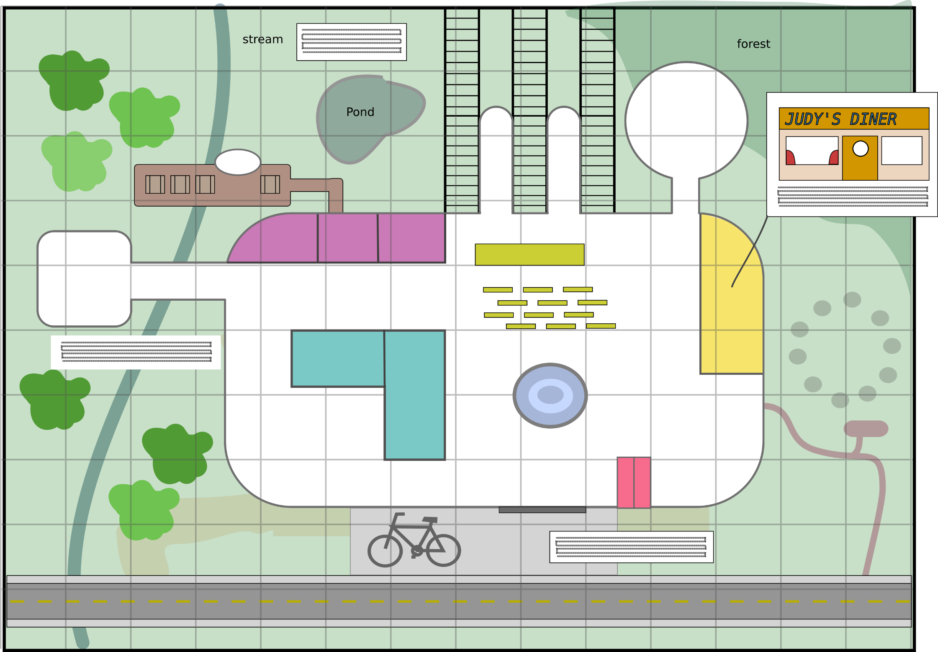


-
Think about how you can mitigate for the environmental impact of the station on the site.
Plan how people will travel sustainably to and from your station and how your station is powered.a
Notes:
Activity Instructions/Creating your proposal
Here is an example design of a train station for you students. You can see in the diagram a waiting area, shops and restaurants, a fountain, ticket machines, bicycle parking landscaped areas outside of the station and a hydroelectric power supply.
Students should follow the advice from the team members on the screen. You could put these slides up during the time when students are working, with a brief introduction.

Slide 30

-
Use annotations and additional sketches to explain your ideas.
Include a floor plan map of the station, including main features of the building.
Think about how your station occupies the site. Think about the local geology and other geographical features
Notes:
Activity Instructions/Creating your proposal
Here is an example design of a train station for you students. You can see in the diagram a waiting area, shops and restaurants, a fountain, ticket machines, bicycle parking landscaped areas outside of the station and a hydroelectric power supply.
Students should follow the advice from the team members on the screen. You could put these slides up during the time when students are working, with a brief introduction.

Slide 31

-
Use sketches to show internal spaces, signs and furniture.
Make sure that your sketches present your ideas clearly
Notes:
Activity Instructions/Creating your proposal
Here is an example design of a train station for you students. You can see in the diagram a waiting area, shops and restaurants, a fountain, ticket machines, bicycle parking landscaped areas outside of the station and a hydroelectric power supply.
Students should follow the advice from the team members on the screen. You could put these slides up during the time when students are working, with a brief introduction.

Slide 32

-
Don’t forget to make your station futuristic and trendy too!
Make sure that your station is easy to use for everyone.
Notes:
Activity Instructions/Creating your proposal
Here is an example design of a train station for you students. You can see in the diagram a waiting area, shops and restaurants, a fountain, ticket machines, bicycle parking landscaped areas outside of the station and a hydroelectric power supply.
Students should follow the advice from the team members on the screen. You could put these slides up during the time when students are working, with a brief introduction.

Slide 33

Futuristic thoughts
It’s important that we think about the future when designing new public buildings.
What will it be like?
Automation & digitisation: What will our relationship to technology be like in the future? Will we be technologically enhanced cyborgs, or will we co-exist with robots who check our tickets and serve us space-food?
Changing mobility patterns: How will we get to and from stations? Driverless cars or hoverboards? Will we have motorised luggage? Where will we dock and park our technologies in stations of the future?
Notes:
Activity Instructions/Creating your proposal
The next three slides are extra hints and explanations for your students. Use these as appropriate during the making activity.
This section is for inspiration. You may wish to use other techniques for inspiring students, such as a visualisation.

Slide 34
Futuristic thoughts
Sustainable architecture: How will sustainable technologies be incorporated into our buildings? How will we power our stations? Consider sustainable materials such as a grass roof or plant walls, or incorporating gardens, beehives or nesting for bats and birds.
Leisure & food: What type of shops? What types of food? How will people relax in the future?
Digital communication: What will we use? Smart phone connection, holograms, cyborg technology, virtual reality, augmented reality?
Notes:
Activity Instructions/Creating your proposal
This section is for inspiration. You may wish to use other techniques for inspiring students, such as a visualisation.

Slide 35
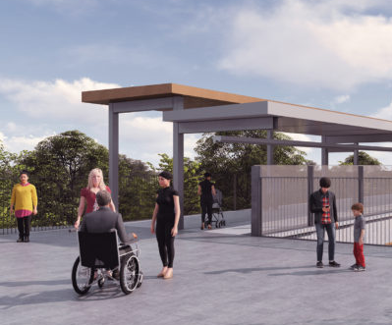
Customers of the future
Your station has to work for different people, including staff and customers.
Consider the needs of:
Children, elderly people, pregnant people, disabled people
  Visually impaired
  Hearing impaired
  Mobility impaired
  Neurodiverse
People of different religions and faiths
Transgender people
Notes:
Activity Instructions/Creating your proposal
Explain to students that stations must meet the needs of all people. How could the requirements of these people impact on the design of the station? They should consider all people in the list above. Students should ensure that their stations are fully accessible and inclusive to all. You could mention Universal Design principles at this point.

Slide 36
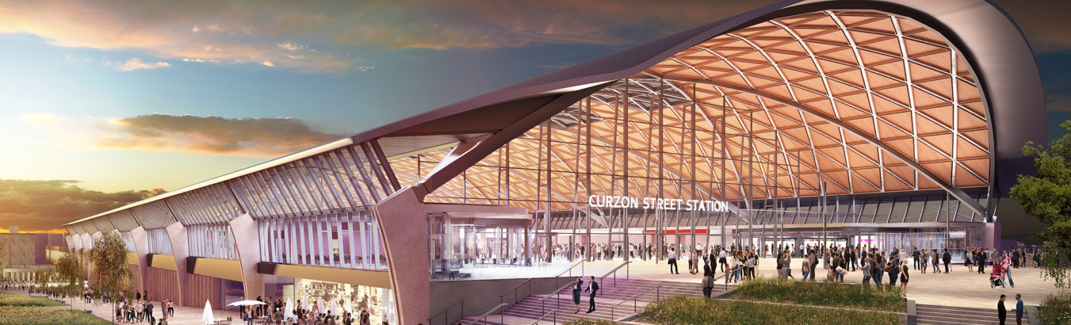
Design vision for a new HS2 Curzon Street station
Notes:
Activity Instructions/Creating your proposal
These are concept deigns for the new stations. You could comment on use of materials, types of structure, use of natural light, incorporation of green spaces etc.

Slide 37
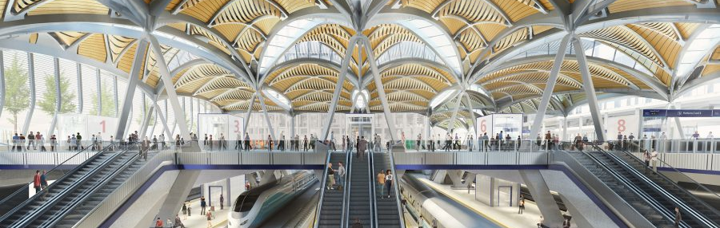
Concept image of Euston station redevelopment
Notes:
Activity Instructions/Creating your proposal
These are concept deigns for the new stations. You could comment on use of materials, types of structure, use of natural light, incorporation of green spaces etc.

Slide 38
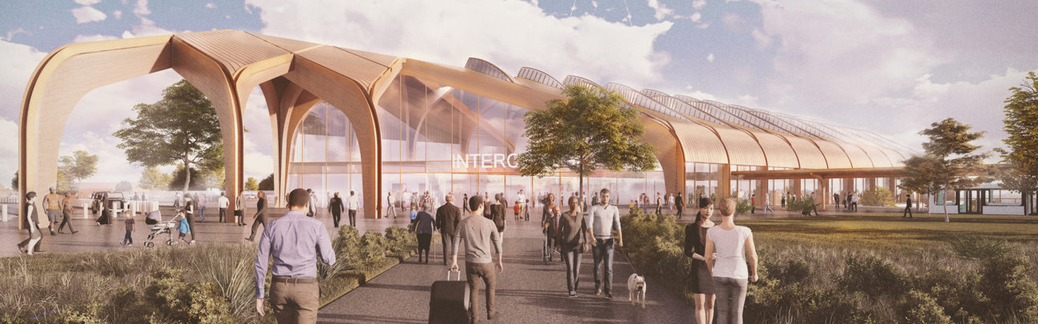
Concept image Birmingham Interchange Station
Notes:
Activity Instructions/Creating your proposal
These are concept deigns for the new stations. You could comment on use of materials, types of structure, use of natural light, incorporation of green spaces etc.

Slide 39
Presenting your ideas
In the next session you will present your ideas. Keeping your blueprint on your table, two team members will walk around the room to see the ideas of other groups. Two team members will stay to explain the idea to the other teams. Halfway through the session, swap around.
Evaluate your ideas
When instructed, answer the evaluation questions in your booklet. Have you surprised yourself with your essential skills?
Notes:
Presentations
Students now have five minutes to present their work in a conference-style presentation.
Two students from each group will remain at their table, whilst the other two will circulate to other group's tables. Swap movers and presenters after two and a half minutes, taking a total of five minutes.
Allow students time to discuss what they have seen if timings allow.

Slide 40
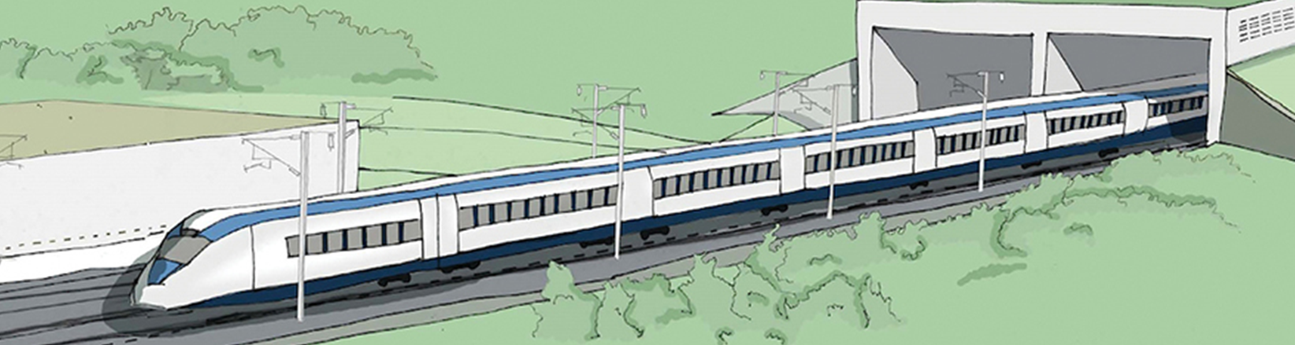
Engineering Challenge: Tunnel Structures
In this activity, you will be building your own cut and cover tunnel. Will it collapse or will it stand?
Notes:
Engineering Challenge: Tunnel Structures
Introduce the Tunnel Structures activity by explaining that each team will be building it’s own train tunnel. But why do we build tunnels? Explain to your students that trains find it very difficult to go uphill, and so tunnels must be built through them.
Show your students the cut and cover tunnel on the board. This is where the hillside is cut away, a tunnel structure is built from steel reinforced concrete and then the hill is covered back over.
Make sure that you show the students the tunnel structure on the board (the concrete part sticking out of the hill).

Slide 41
Tunnel Structures student introduction video
Notes:
Introduction Video
Play this video to introduce the activity.

Slide 42

Who builds tunnels?
Building any large structure is a team effort. When a new tunnel is designed and built, it’s a team effort, including Civil Engineers, Environmental Advisors and BIM Technicians and Construction Plant Operators.
Notes:
Tunnel Structures
Explain to your students that there are many jobs roles involved in building a tunnel.
Civil Engineers manage the project and survey the ground
Environmental advisors survey they wildlife and habitats around the site and ensure that it is mitigated for and that impacts are minimal.
Buildings Information Modeling (BIM) Technicians create the drawings of the site and structure.
Construction Plant Operators and Tunneling Operatives build the tunnel.

Slide 43

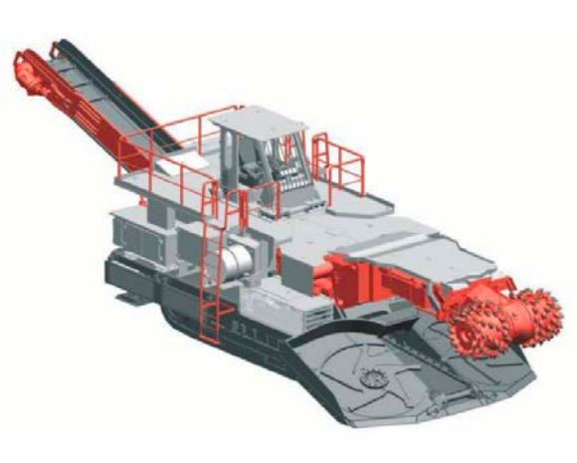
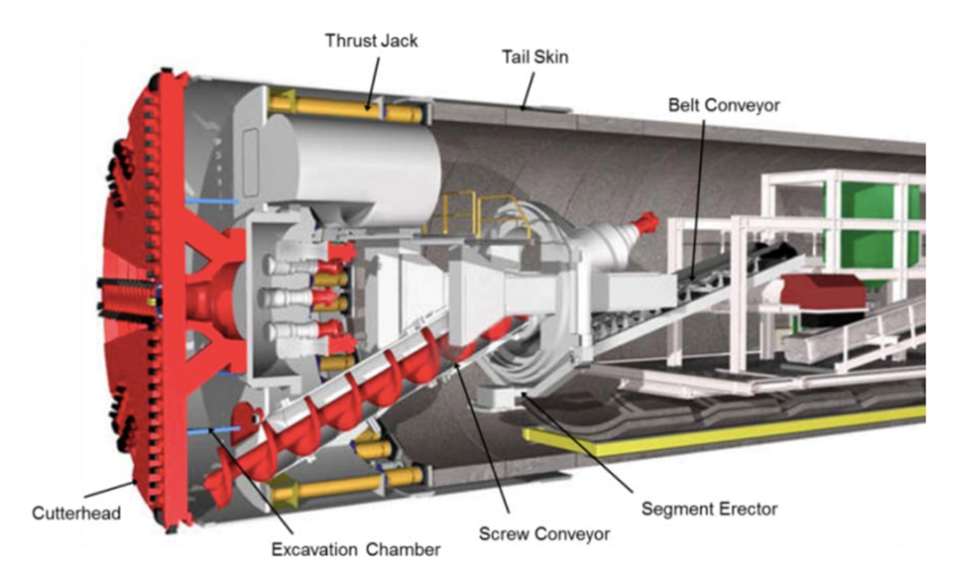
What do Construction Plant Operators do?
Construction Plant Operators do the actual building, operating machines such as diggers excavators, road headers and tunnel boring machines to excavate the tunnel.
Notes:
Tunnel Structures
Introduce Adnan, a Construction Plant Operator. Adnan might use a road header (left) or a tunnel boring machine (right) to excavate and build the tunnel.
Roadheader
The roadheader drives forward into the tunnel face using its crawler tracks and excavates the earth using its cutter head.
Tunnel Boring Machine
The tunnel boring machine excavates the tunnel using its front rotating cutter head. It pushes itself forward using hydraulic rams and builds the tunnel at the same time as it excavates, using pre-cast tunnel segments.
Please note

Slide 44
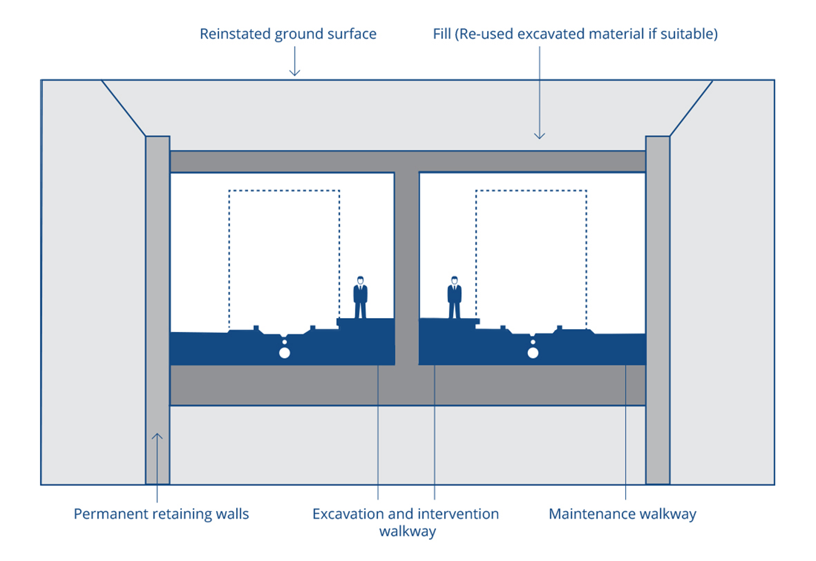
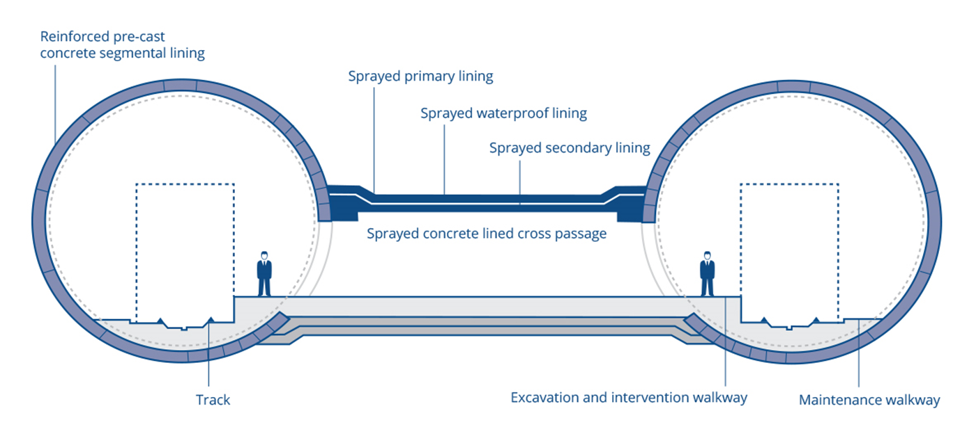
Types of tunnel
Notes:
Tunnel structures
This shows the two different types of tunnel – the left is bored using a tunnel boring machine and is supported by tunnel lining segments.
The right is excavated as a cut and cover tunnel and is supported using a steel reinforced concrete tunnel structure. It would be excavated using a roadheader.

Slide 45

The challenge
Together with your team, you must design a prototype tunnel structure to span 400mm and fit the train. Your design should be strong and lightweight, using as few materials as possible.
You will have:
40 x 400mm paper straws
Scissors
Masking tape
Focus on your essential skills of teamwork, problem solving and staying positive
Notes:
The challenge
Introduce the challenge and method of testing. Explain to your students that they must only work with the materials that they have and that their tunnel must be 400mm long, be the correct fit for the train to pass through it and survive the sand bag being put on top of it.
The lightest tunnel that survives will be the winner.
Emphasize that the room must be spotless and tidy by the end.

Slide 46
Designing structures & resisting forces
Notes:
The Challenge
Give these optional hints during the introduction or making period of the activity.
Hint 1) An idea demonstration here is to use a toilet roll tube or card tube made from a sheet of A4. Demonstrate the structure’s resistance to each force in different directions. This will give students a good hint on how to use their straws wisely.
An egg box can also be used to reassure students that the same material can resist all of these forces in a different configuration.

Slide 47
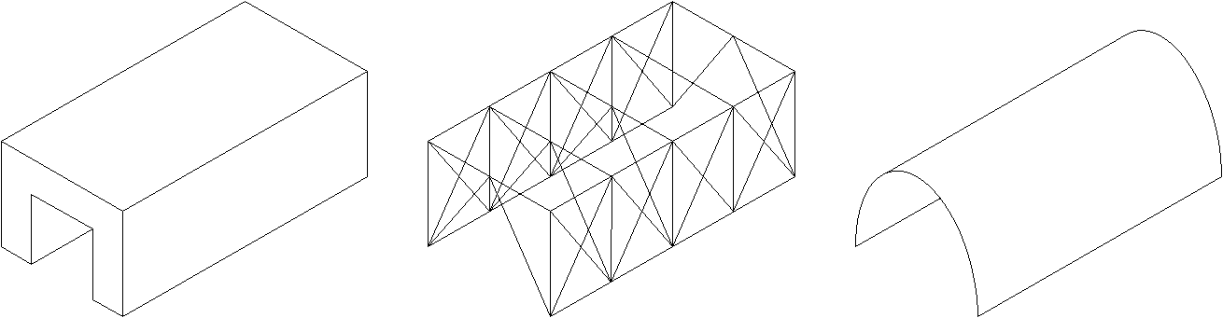
Types of structure
Mass Frame Shell
Notes:
The Challenge
Give these optional hints during the introduction or making period of the activity.
Hint 2) These are the different types of structure – mass, frame and shell. Whilst mass structures are solid, like stone bridges, frames are lightweight and composed of beams and ties. Shell structures rely on a stiff outer wall.
Explain to students that they do not have bricks or a sheet material – therefore a frame is the best kind of structure.

Slide 48


Planning
You have 10 minutes to make your plan. Use the isometric paper provided to sketch your structure.
Notes:
Designing a Tunnel Structure
Ensure that students plan quietly.
Ensure that they have rulers and pencils.
Encourage them not to start making until they have a good quality plan.

Slide 49
Making
You have 50 minutes to make your structure.
Notes:
Designing a Tunnel Structure
Students now have 50 minutes to make their tunnel structure.
Make sure that each group is on task.
Some groups may find it difficult to start their model. Encourage them to make a rectangular base frame first, then build upwards.
Students should only be building frames. If students try to bend their straws into arcs or turn them into panels they will not create a successful tunnel.

Slide 50
Tidy up!
You have 2 minutes to tidy up the room.
Replace all tools and unused materials.
Recycle any rubbish.
Sit at your tables in silence.
Use your Essential Skills of teamwork and aiming high
Notes:
Tidy-up time
Students should now tidy up. Ensure that all waste straws are recycled or reused where possible. Some students will likely not tidy. Ask everyone to freeze and make the people still sat down do some tidying.

Slide 51
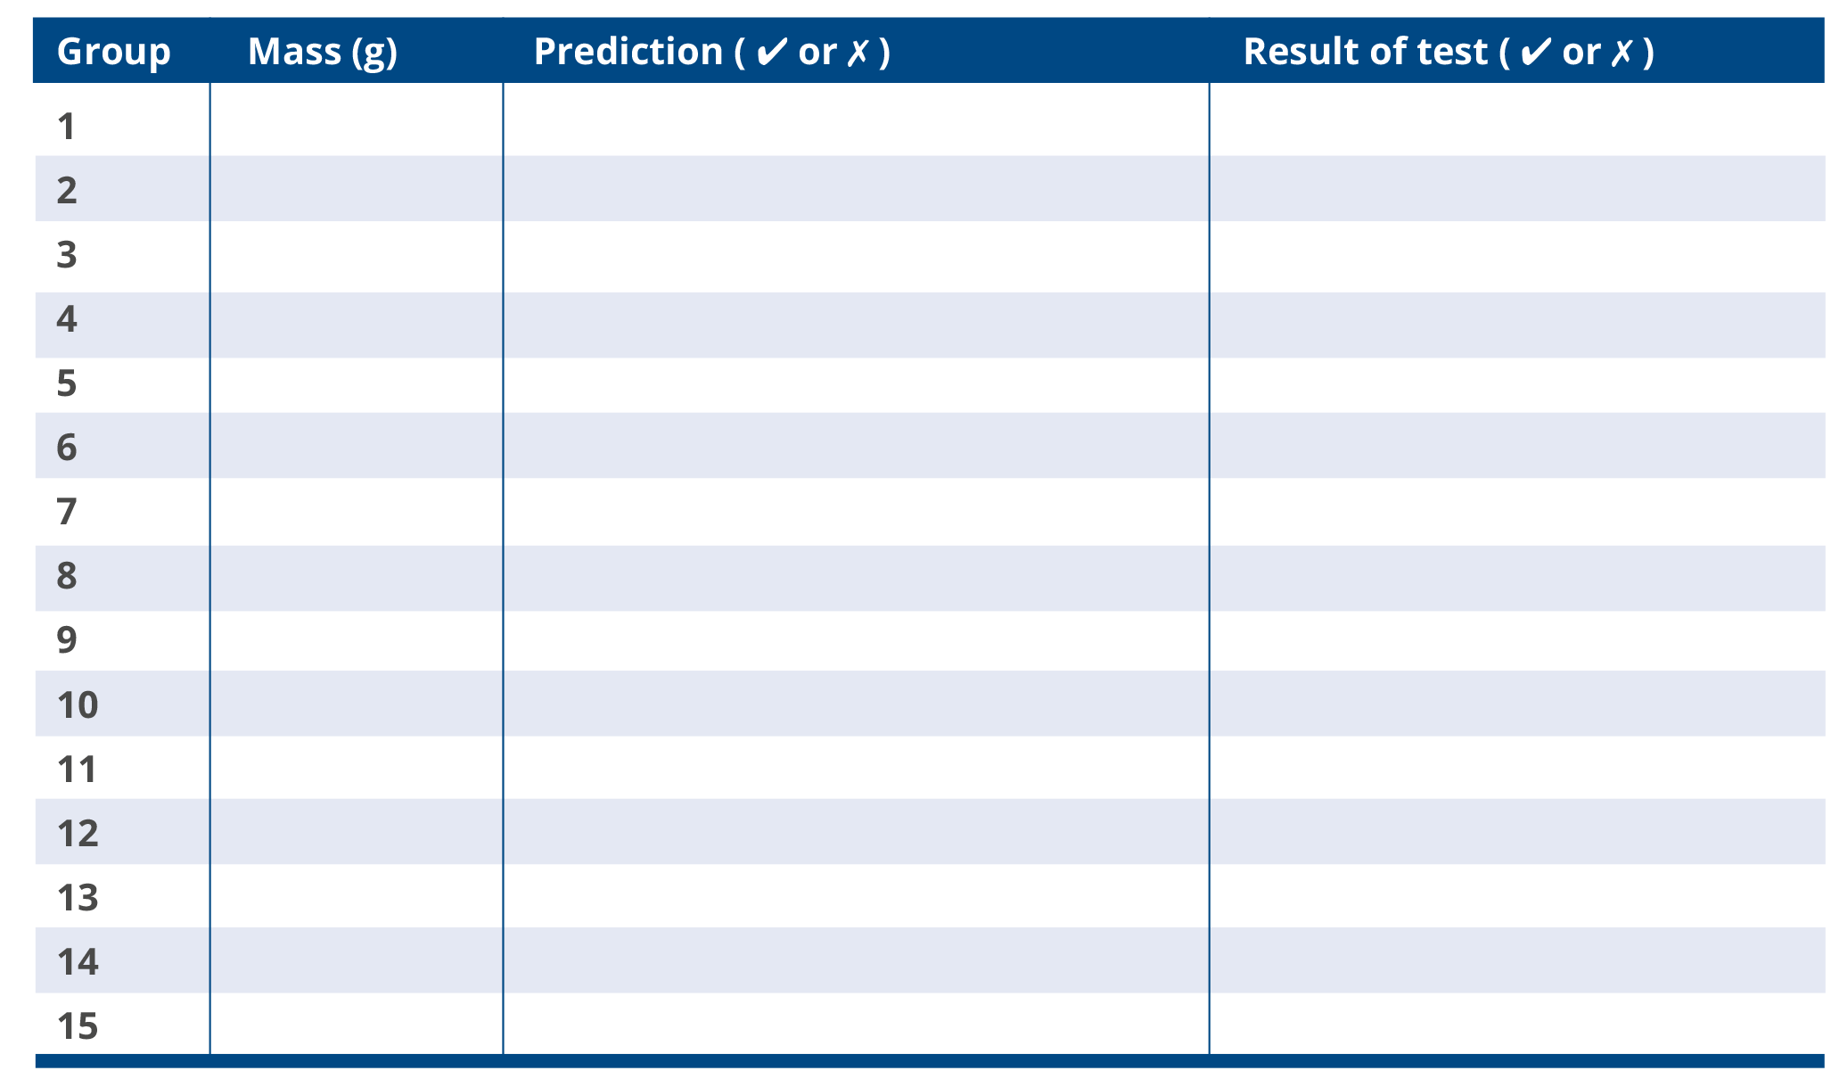
Testing
Notes:
Testing
Students should fill out the table in their booklet during testing. Ensure that students are quiet during the testing and respectful of each other's efforts even if they are unsuccessful.
Note that we are measuring mass here (in Grams) rather than weight (in Newtons). There will be science teachers watching so make sure that you always say mass!

Slide 52
Evaluation
Complete the evaluation in your student booklet.
What made this activity challenging?
How did you overcome these challenges?
Notes:
Evaluation/Plenary and Reflection
Students should evaluate their tunnel structure using the booklet.

Slide 53
Rail Rush!
Now that you have learned how to build stations and tunnels, it’s now time to build your own rail company.
In this session you will:
Design and build your own rail service.
Discover the relationship between transport services, communities and the environment.
Notes:
Cut-out Game pieces/Rail Rush Introduction
Introduce the objectives of this session.
If the students have to cut out their game pieces, give them 10 minutes to do this now.

Slide 54
Rail Rush student introduction video
Notes:
Introduction Video
Play this video to introduce the activity.

Slide 55
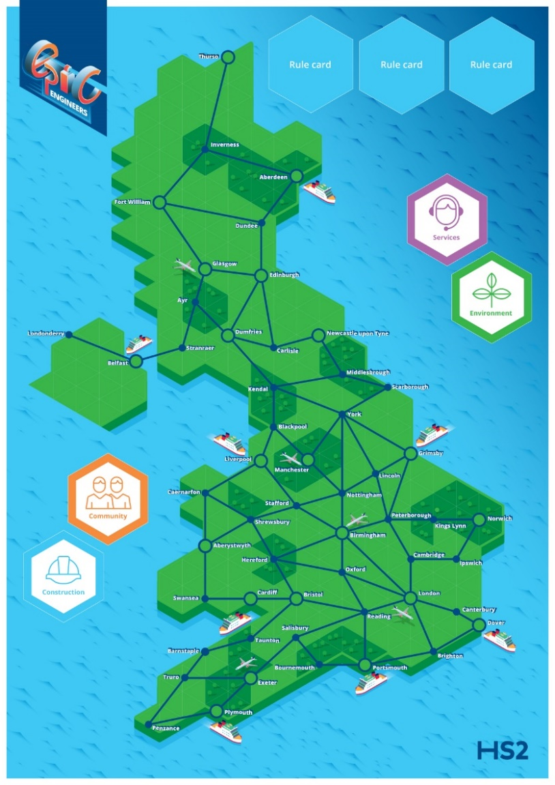
Rail Rush!
Rail Rush! is a four player railway-building game where players compete to build a rail service whilst getting the highest number of points.
Notes:
Rail Rush Introduction
Introduce an outline how the game works, emphasizing the aim of the game, which is to collect the most points.

Slide 56
Setting up
To start the game, each player will need:
1 x set of cut-out pieces
1 x scorecard
Separate the card deck into the four smaller decks (construction, community, environment and service) and place these on their spaces on the board.
Rule card positions remain empty.
Notes:
Rail Rush Introduction
Ask your students to set up their boards, by separating the card deck into four and placing the cards face-down on the board. Students should also make sure that they know ho is going first.

Slide 57
How the game works
The aim of the game is to be the player who has collected the most points whilst growing their rail network.
You can collect track points, environment points, service points or community points. You can also win bonus points which appear during the game.
Players record their points on their score card.
The game ends when the first player lays all of their track.
Notes:
The Rules
Explain the rules of the game. You could use the text of the student booklet or ask students to read it in silence.

Slide 58
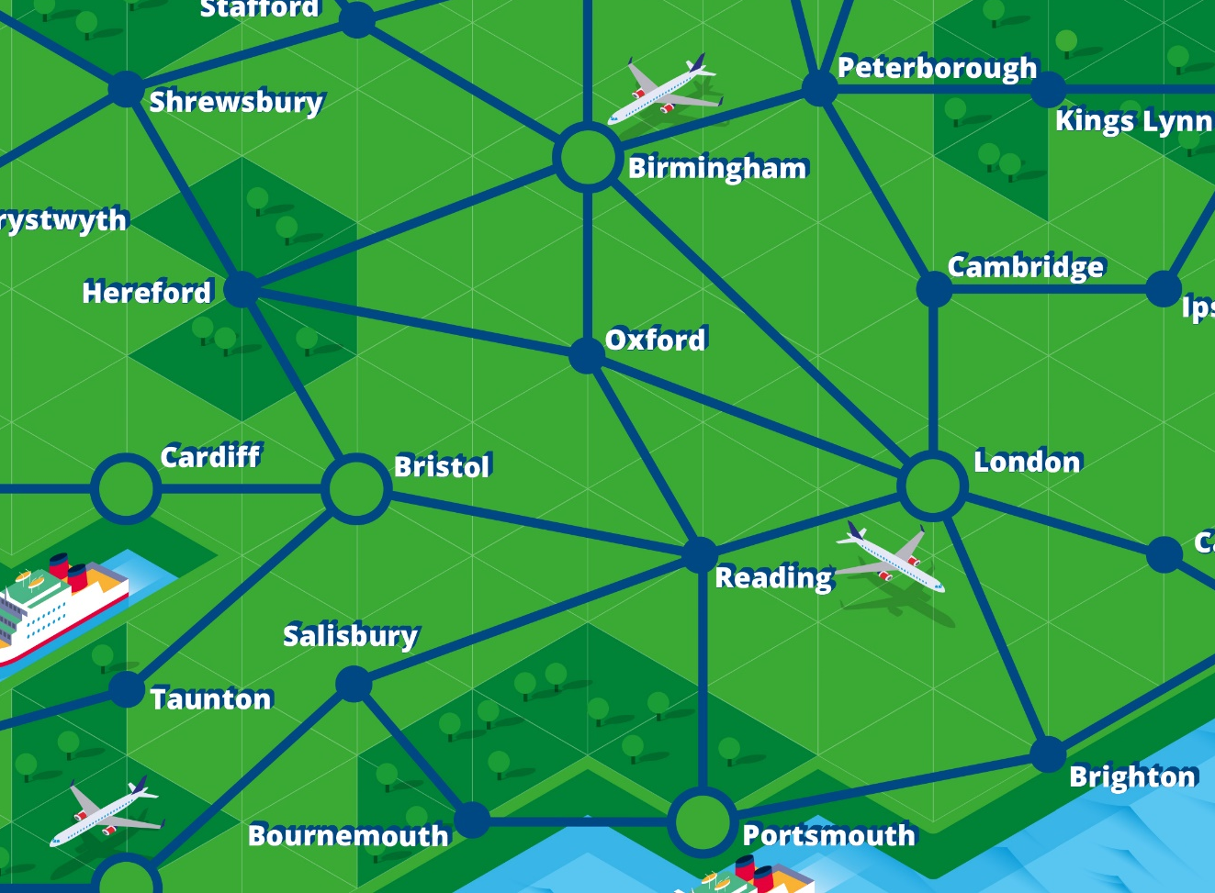
Starting the game
In the first round, in turn, each player must build two starter stations anywhere on the board, followed by one length of track, which must join to at least one station. Start with the youngest player, then work clockwise.
Notes:
The Rules
This slide shows players how to make their first moves. Explain that they may place their first two stations anywhere on the board, however track must always connect to a station.

Slide 59
Playing the game
The game then runs as following:
Each turn you may pick as many cards as you have stations. You can choose a mix of cards from each of the four decks.
Reveal your cards. Place any rule cards on the rule card spaces. Record any points that you have gained, replacing the cards at the bottom of their respective decks.
Build and track or stations if cards instruct you to.
Change player.
Notes:
The Rules
Explain the turn procedure above.

Slide 60
Rule cards
Rule cards will appear from time to time in all four decks. These can change the rules of the game.
Only three rule cards can be in play at any time.
The player who picks a fourth rule card must replace an in play rule card by placing their rule over an. existing rule
Examples of rule cards include:
Bonus points for having stations on ports or airports.
Bonus points for longest continuous track.
Restricted building on national parks.
Notes:
The Rules
Explain that rule cards alter the rules of the game and can reward players with bonus points.
Ask the students if they have any questions.
Once all questions are answered, they may start.

Slide 61
Ending the game
The game ends when the first player uses all of their track. Then, add up your track points, environment points, service points, community points and bonus points using their scorecard. The winner has the highest score.
Notes:
The Rules
Explain to players how the game is ended. Emphasize that it is not just the longest track that will win.

Slide 62
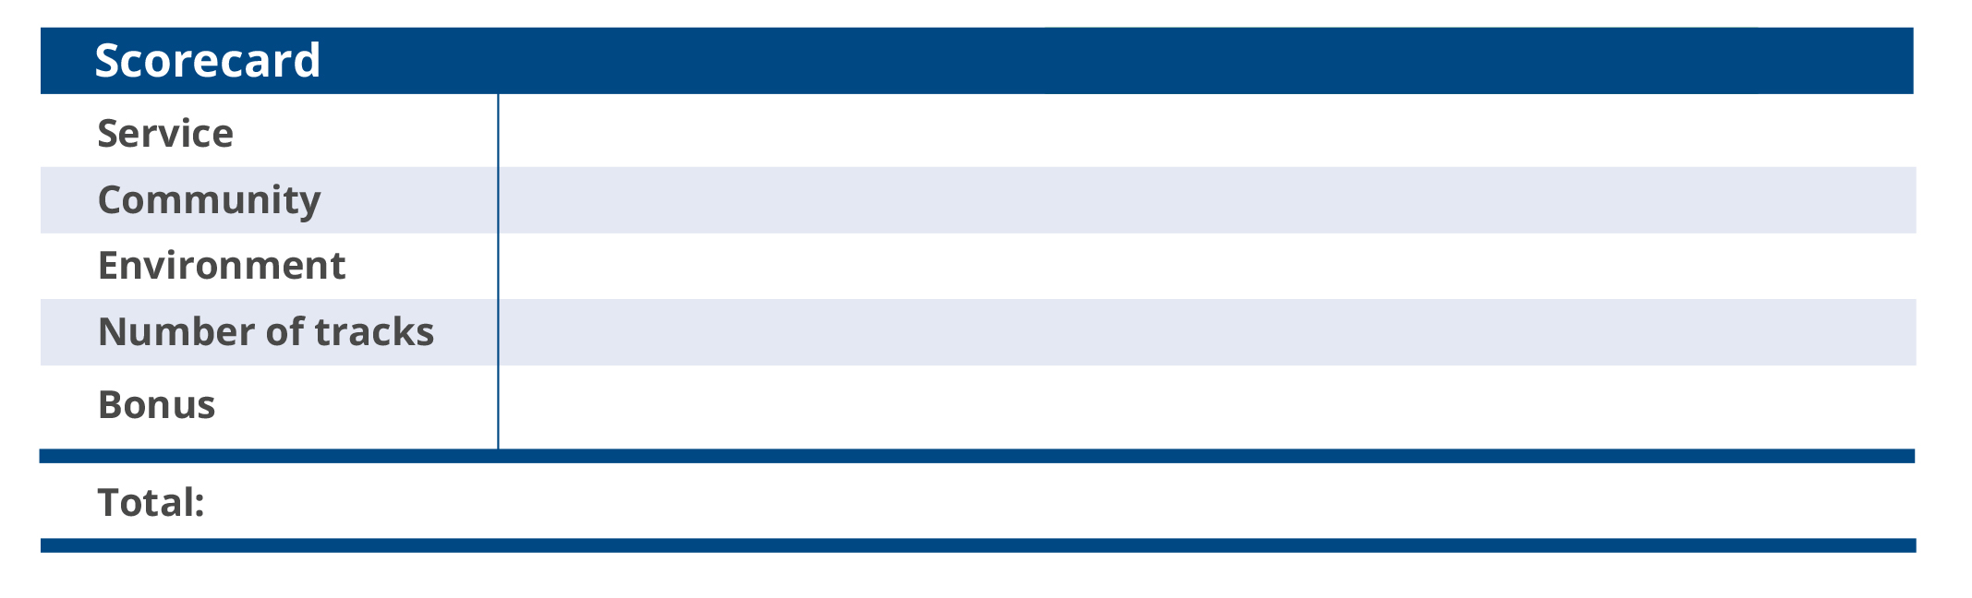
Using your scorecard
Tick the boxes on your scorecard whenever you earn points or lay a piece of track.
Notes:
The Rules/Rail Rush
This scorecard is found in the printed booklets and should be used by students during the game.
Ask the students if they have any questions.
Once all questions are answered, they may start.
Ensure that you allow students five minutes before the end of the playing period to take their last turns and to decide the winner.

Slide 63
Game over
Add up your scores and carefully tidy away. Please place all cards neatly back into the deck, grouped accordingly.
Which essential skills helped you to win the games?
Was it better to have the longest track or to care about the service, the environment and local communities?
Notes:
Tidy Up Time/Plenary
The game is now over and students must tidy up. Make sure that all equipment is put away carefully. Do not begin to collect in the rail rush equipment until students have tidied their tables fully as otherwise cards may be left behind.
In your closing remarks, ask your students what they learned from the game. Ask students about their individual strategies for winning. Ask for a show of hands of those who won and ask for a round of applause for the winners.

Slide 64
EPIC careers skills
In this activity, you will be interviewed to become an apprentice Civil Engineer, Environmental Advisor, Customer Experience Designer, Buildings Information Modelling Technician or Construction Plant Operator.
Use the space in your booklet to plan your answers to the interview questions. You could use examples of activities you have been part of today.
How have you used your essential skills today?
Notes:
EPIC careers skills extension
Introduce the Careers Skills activity from the booklet.
You could expand this activity into a role play, where students use the booklet to record each others answers.

Slide 65
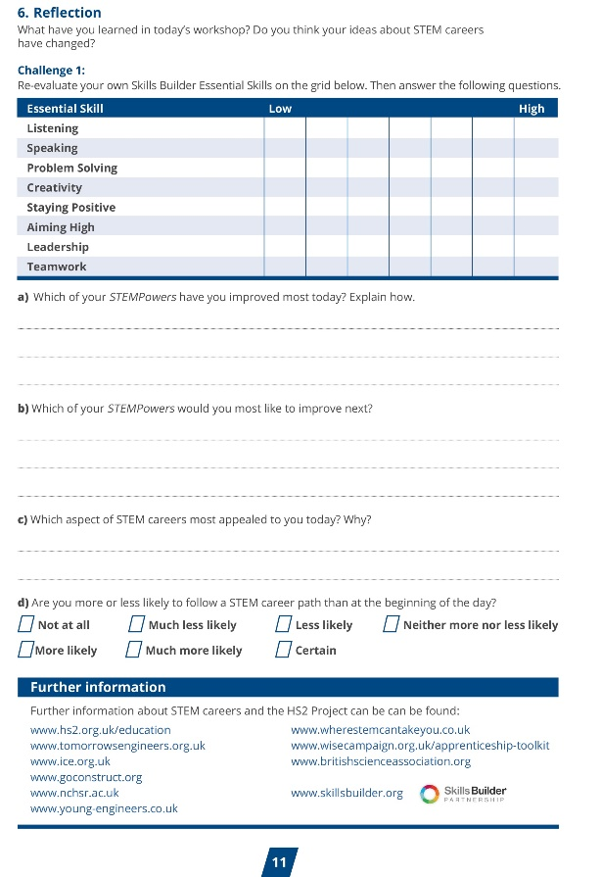
Reflection
It’s nearly the end of the day, so it’s time to
re-evaluate your essential skills and think about how you have improved your learning.
Complete the reflection task in your student booklets.
Notes:
Reflection
Guide students to reflect on their essential skills and their learning across the day.
Ensure that you complete a proper plenary.
Examples could be to question students on how they improved their STEM Power, whether they are now more or less inclined towards a STEM career than at the beginning of the session.

Slide 66
Winning team
We will now reveal the winning team.
You will receive a commendation from your school for all of your efforts in showing off your essential skills.
Notes:
Reflection
Guide students to reflect on their essential skills and their learning across the day.
Ensure that you complete a proper plenary.
Examples could be to question students on how they improved their essential skills, whether they are now more or less inclined towards a STEM career than at the beginning of the session.

Slide 67
Placeholder for Careers video
Notes:
EPIC Engineers Careers Video
Play this careers video to inspire your students about their future education and careers pathways.

Slide 68

Keep on using your essential skills!
From all the team, thank you for using your essential skills across today’s activity.
If you want to keep on using your essential skills and are thinking about a stem career, you can look at the following websites:
`
www.hs2.org.uk/education
www.skillsbuilder.org/
https://neonfutures.org.uk/
www.ice.org.uk
www.goconstruct.org
https://routesintorail.org/
Notes:
Reflection
This screen should be left on at the end of the session if students wish to copy down any of the links (these should be in their booklets anyway).

