Slide 1
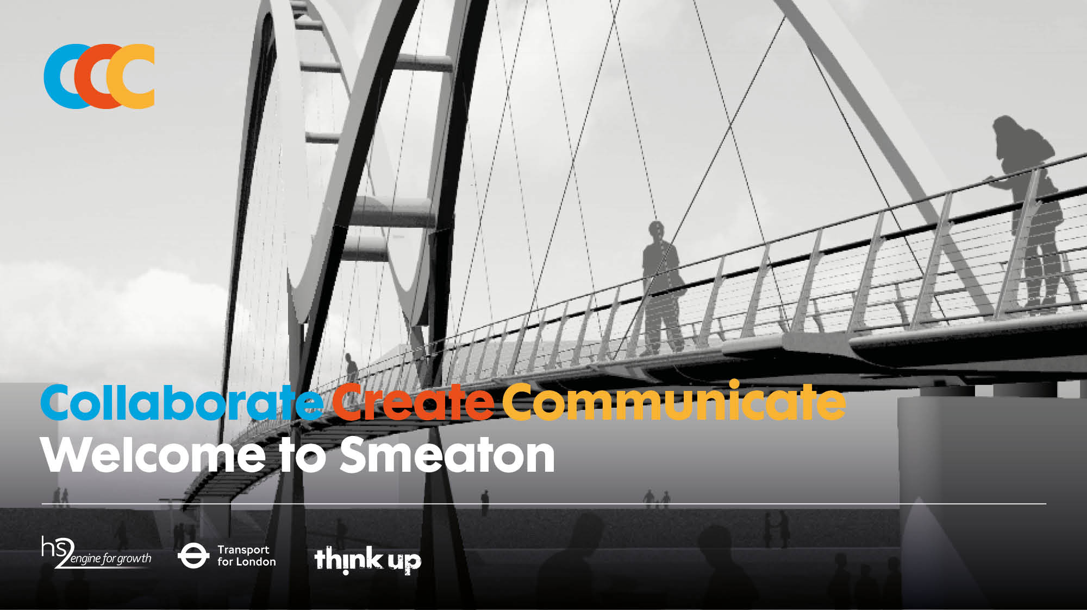

Slide 2

(Cover image © Expedition Engineering)

Slide 3
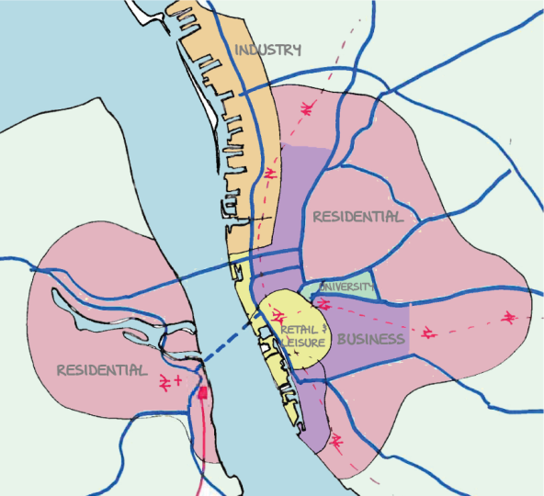




Starter
Workshop objectives
Identify and understand the need for links between infrastructure and communities
Investigate different options for river crossings
Employability skills
Summarising; Brainstorming; Note-taking.
Use the map and information on Resources 1.1 to 1.3 to learn about Smeaton. Answer the questions on 1.3.
ZoomRail
Image courtesy of Think Up

Slide 4
Introduction to Smeaton
Resource 1.3 questions:
What benefits are there to high-speed rail?
Why is Zoom Rail coming to Smeaton?
Why was the station built on the west side of the river?
Can you see any issues with the placement of the station?
Are there any similarities between Smeaton and your local area?
Are there any big projects going on in your local area like the ones in Smeaton? If so, what do you think about those local projects?
Extension:
Research the UK government’s plans for a new high-speed rail network.

Slide 5
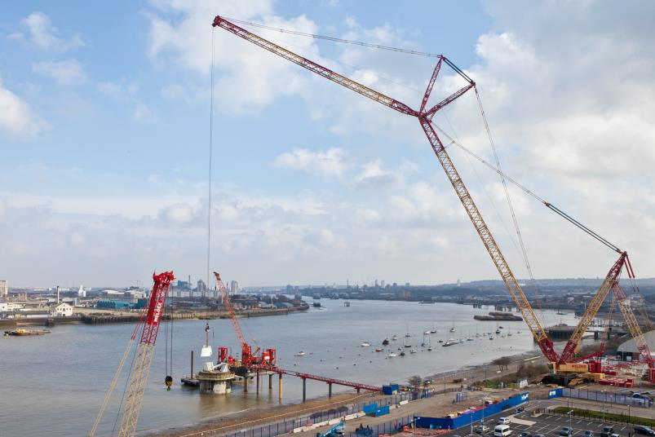
Workshop 1 challenge
In order to connect communities from across the river with each other, and with the new station, a river crossing is being proposed.
Your challenge is to decide which type of river crossing, if any, the people of Smeaton would want to be built.
© Transport for London

Slide 6
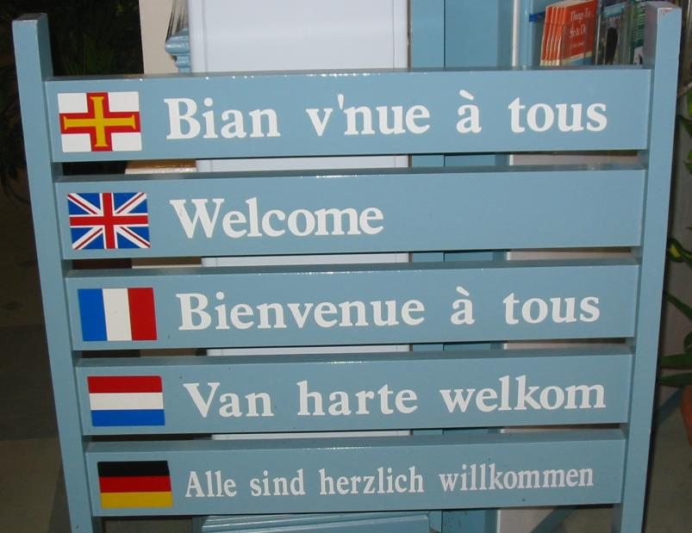
Stakeholders’ views
The people of Smeaton are very diverse, so we are going to split them into stakeholder groups.
A stakeholder is anyone affected by a project.
For example, the Smeaton Tourism Board is a stakeholder in the project because they will be affected by the choice of a new crossing.
Can you think of any other stakeholder groups?
Image by Man vyi, licensed under Public domain

Slide 7
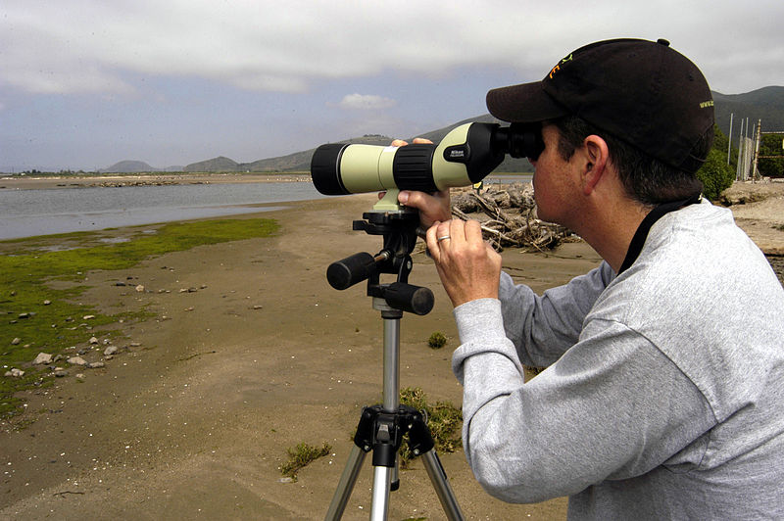
Role-playing a stakeholder
You will role-play these stakeholder groups:
Group A - Ecologists’ Alliance
Group B - Confederation of Businesses
Group C – Smeaton Housing Coalition
Group D – Smeaton Tourism Board
Group E – Smeaton City Council
Follow the Stakeholder sheet instructions on resources 1.4.1 – 1.4.5. Brainstorm what the stakeholder concerns and hopes are for the new crossing.
Make sure you note down what you find, you will be presenting it later!
Image by the U.S. Navy, is in the Public Domain

Slide 8
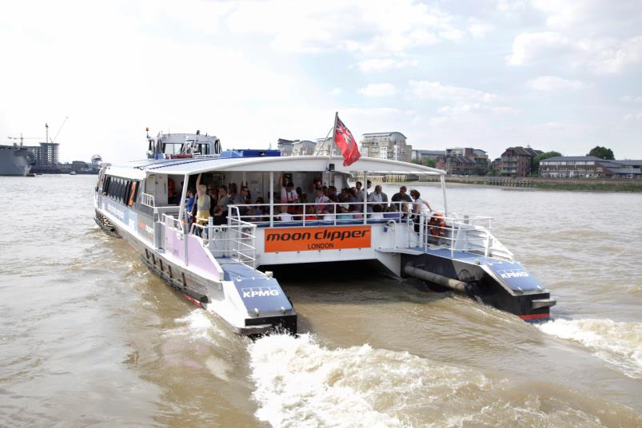
Types of crossing
You will research different types of river crossing.
What types of river crossing can you think of?
© Transport for London

Slide 9
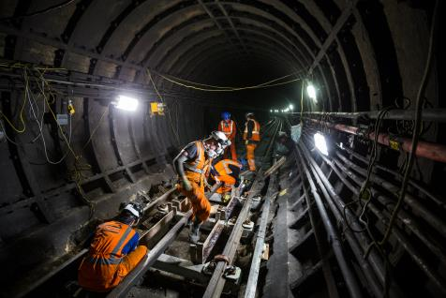
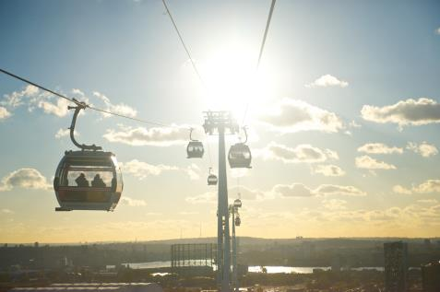
Task 1 - Types of river crossing
The crossing types you will research are:
Cable car
Ferry
Suspension bridge
Concrete viaduct
Tunnel
Follow the instructions on Resources 1.5.1 – 1.5.5 to find the advantages and disadvantages of your crossing.
You have 15 minutes.
You will be presenting this information to the class at the end of the workshop.
© Transport for London
© Transport for London

Slide 10
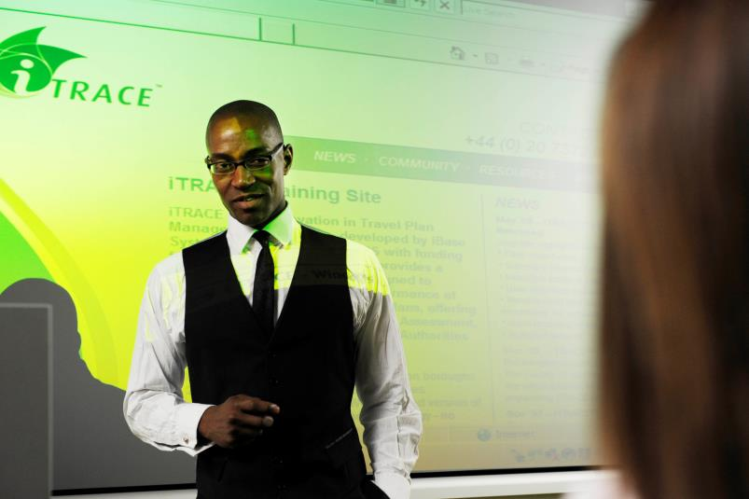
Your presentation
You have 5 minutes to prepare your presentation.
Use the A3 sheets and Post-it notes provided.
Make sure everyone in your group has an opportunity to speak.
© Transport for London

Slide 11
During the presentations
While the presentations are going on, think about two things:
Do any stakeholders agree? If so, what on?
Do any stakeholders disagree? If so, what on?

Slide 12

Workshop roundup
Which type of river crossing, if any, would the people of Smeaton want built?
Vote by going to the areas of the room for different crossings.
If you don’t want a crossing then stay in the middle.
VOTE NOW!
Image by Leslie Landrachuk, is in the Public Domain

Slide 13
Workshop roundup - Concessions
Now a majority decision has been made.
But there will be some people in the minority with a different view.
Can you think of two concessions to the minority view that can be factored in to the design of the crossing?

Slide 14

Understanding the environment and the community

Slide 15
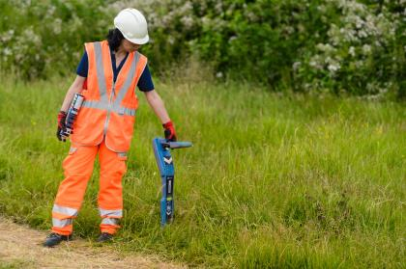
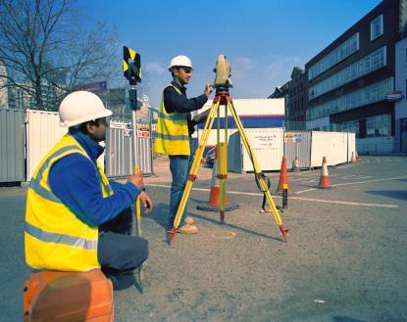

Starter
What sort of people do you need to build a river crossing?
Workshop objectives
Evaluate environmental factors, existing site conditions and identify constraints resulting from these
Identify a type for the proposed crossing
Employability skills
Negotiation; communication.
© HS2 Ltd
© Transport for London

Slide 16
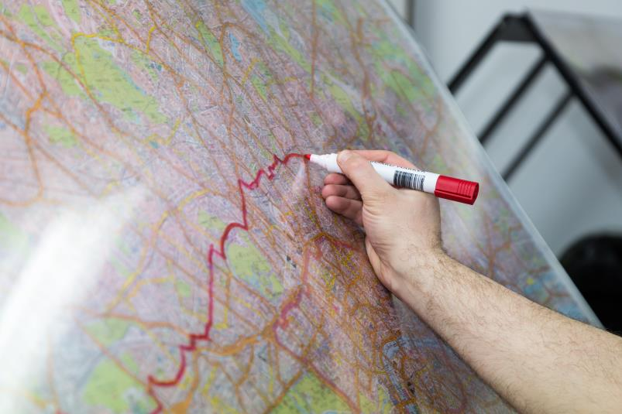
Your project
Representatives of Zoom Rail, Transport for Smeaton and an independent environmental consultant are collaborating on a detailed proposal for the Smeaton Crossing.
Over the next five workshops you will be taking on the roles of these representatives.
You will create a proposal for the Smeaton crossing.
© Transport for London

Slide 17
Project roles
Project Director – Zoom Rail (runs project)
Transport Planner – Transport for Smeaton (integration with existing transport networks)
Quantity Surveyor – Zoom Rail (cost)
Civil Engineer – Zoom Rail (design)
Community Manager – Transport for Smeaton (relationships with stakeholders)
Environmental Consultant – independent (environmental impact)
Read the role descriptions on Resource 2.1 and agree your role in the team.

Slide 18
The brief
Read the brief on Resource 2.2 carefully.
Discuss in your groups making sure that everyone understands.

Slide 19

Evaluating the crossing
You are about to receive costing information about the different types of crossing. Either you’ll receive Resources 2.4, 2.7 and 2.8.1 or 2.4 and 2.8.2 depending on your mathematical ability.
Work out the cost and capacity of each crossing.
With your brief in mind, choose a crossing type for Smeaton.
Although cost is a key driver you should think about the stakeholder views from Workshop 1.
CC0 Image is in the Public Domain

Slide 20
Workshop roundup
Find someone whose job role you don’t know.
Using only yes or no questions about their duties find out what their job role is.

Slide 21


Slide 22

Starter
Think of a famous building that most people will know the name of.
Without saying the name of the building describe it to your partner, see if they can guess the name.
Workshop objectives
Preliminary sketch proposals
Produce a plan and cross-section of the proposed crossing
Gain an understanding of different materials
Employability skills
Team working; brainstorming.

Slide 23
Designing your crossing
Having chosen your crossing, you need to design how it will look, and how it will attach to the existing infrastructure. This is an opportunity to make compromises to minority -held views.
Use the plans and cross-sections on Resources 3.1 – 3.11 to design your crossing.
Spend:
5 minutes recapping your brief
5 minutes discussing ideas
10 minutes sketching ideas
Afterwards your team will have a design team meeting
where you will choose a design.
Image courtesy of Expedition Engineering

Slide 24
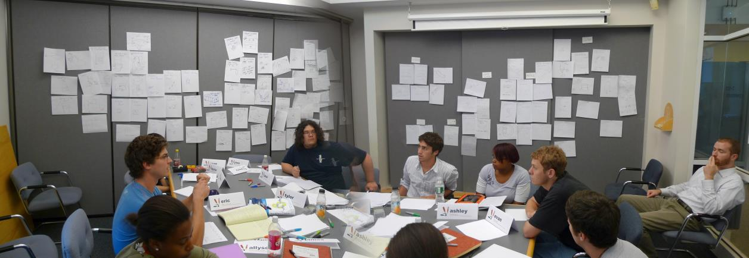
Design team meeting
You now have 10 minutes to decide on a design.
Remember your job role!
The project director has the final say!
Image by Juhan Sonin, licensed under CC BY 2.0

Slide 25
Workshop roundup
Write down two advantages and one disadvantage of your design.

Slide 26
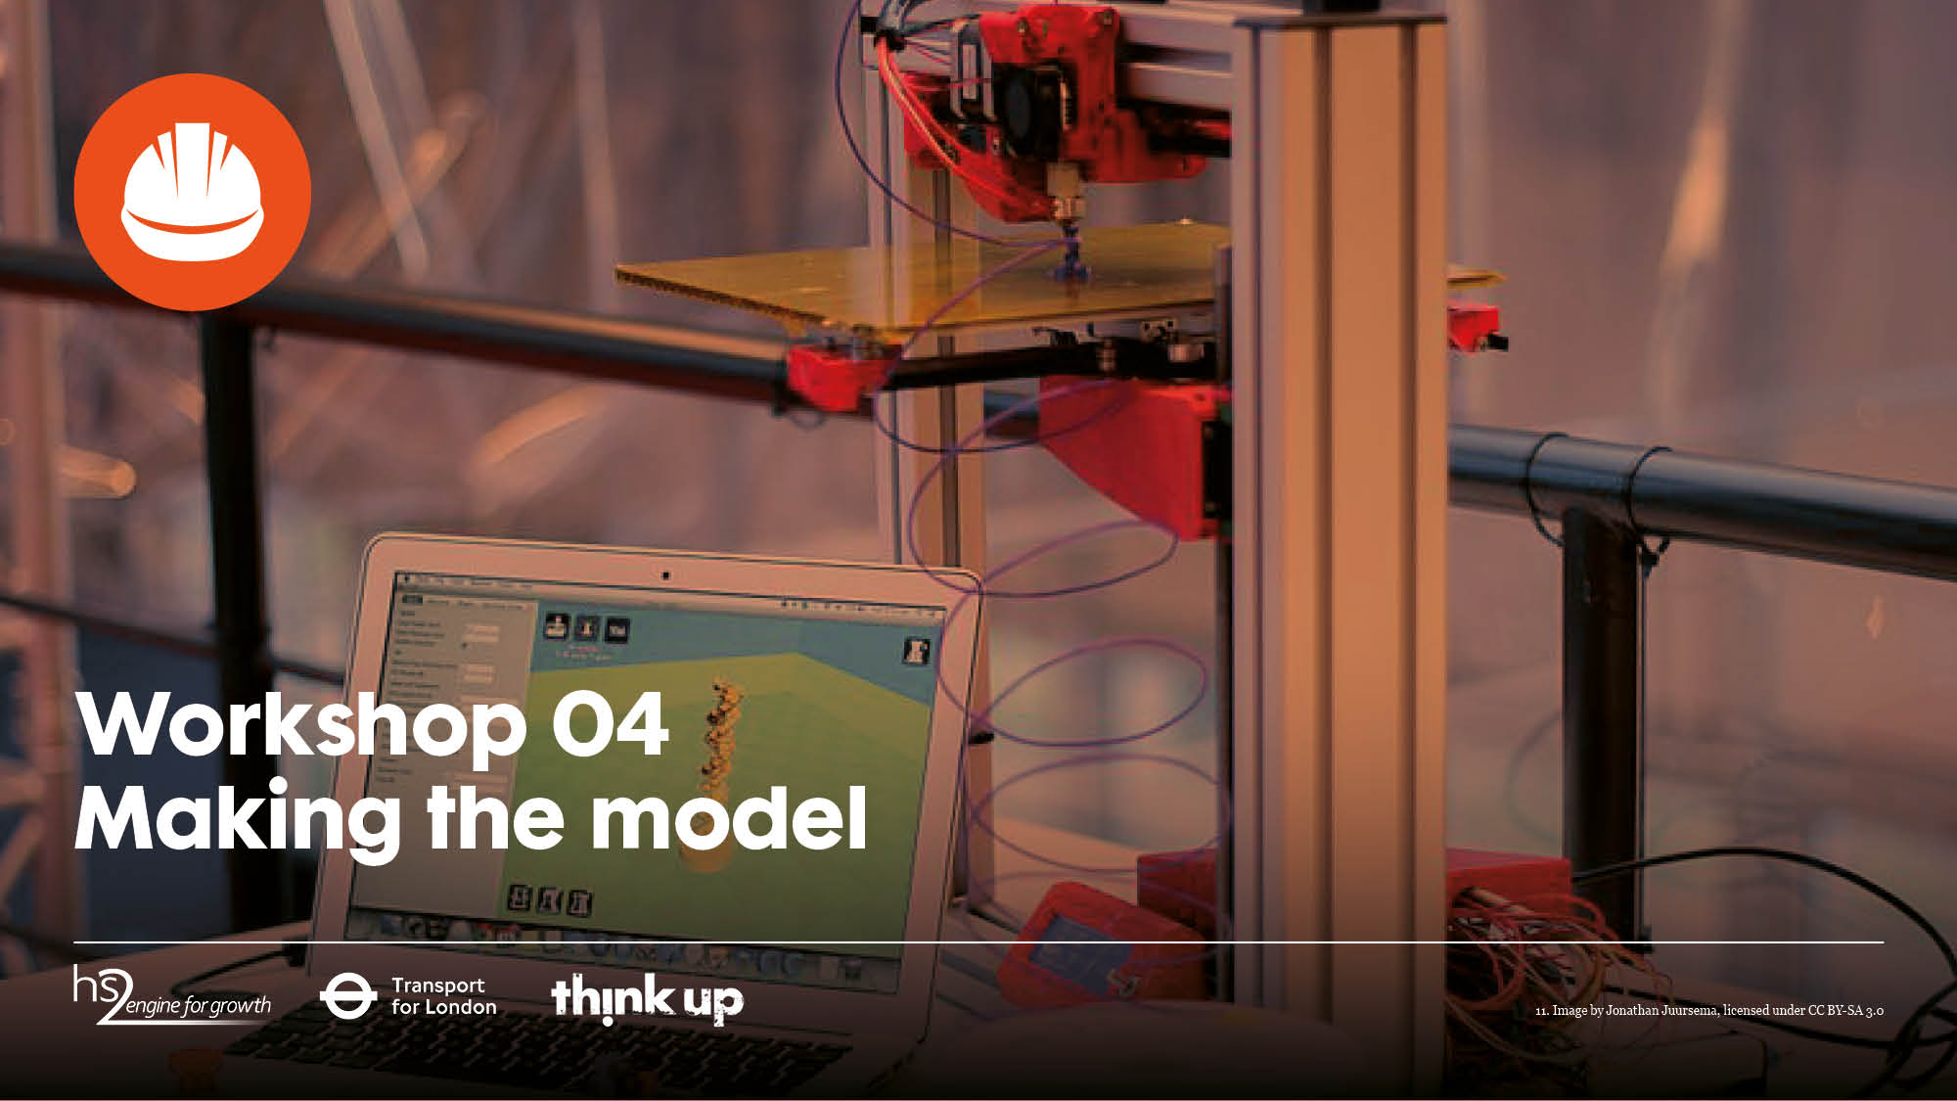
Making the model

Slide 27

Starter
Below are the first three workshop titles and the workshop objectives. Match the objectives to the titles:
Welcome to Smeaton
Understanding the environment
Designing a crossing
Investigate different options for river crossings
Produce a plan and cross-section of the proposed crossing
Evaluate environmental factors, and existing site conditions. Then identify constraints resulting from these
Identify and understand the need for links between infrastructure and communities
Identify a type for the proposed crossing
Preliminary sketch proposals

Slide 28
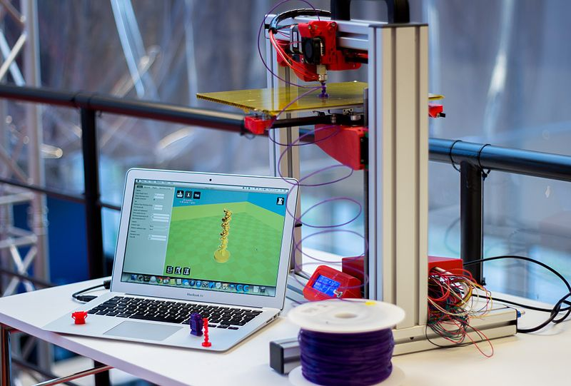
Making the model
Workshop objective
Make a model to scale using your chosen materials.
Image by Jonathan Juursema, licensed under CC BY-SA 3.0

Slide 29
Making the model
You should aim for your model to be visually accurate.
The model should be at a scale of 1:200.
The materials you can use have a price per unit length. You will need to record how much material you use. Any unused material can be sold back at the end.
Prices
Timber (suggested 9x9mm) £15,000 per cm
Rigid plastic tubes (suggested 10mm diameter) is £10,000 per cm
Straws (£1,000 per cm)
String (£500 per cm)
Corrugated cardboard (£500 per cm²)

Slide 30
Workshop roundup
Consider one of the materials you have used today.
Give an advantage and a disadvantage of making a model from that material.

Slide 31
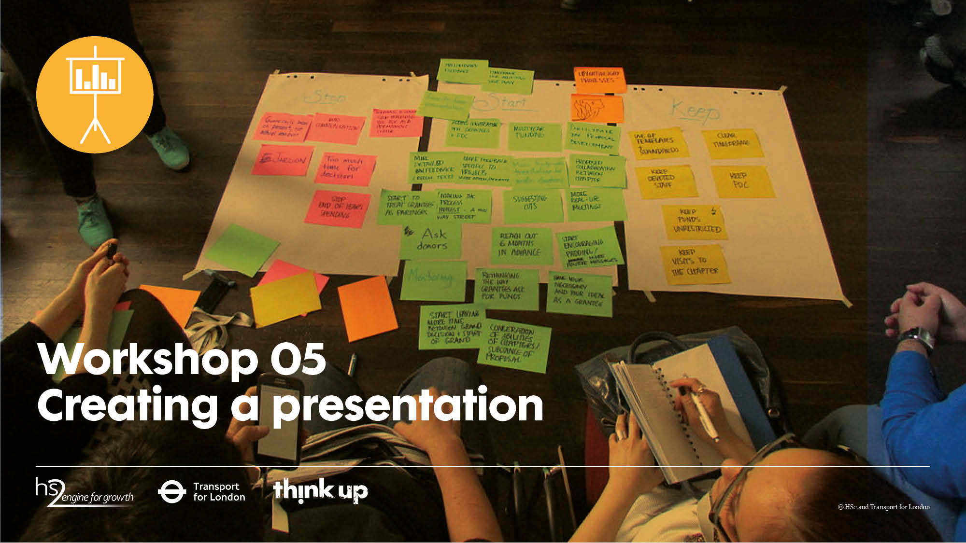
Creating a presentation

Slide 32


Starter
Each group should come-up with examples of three great pitches that they have seen or heard. Think: adverts, a deal on The Apprentice, Dragons’ Den, or a strong brand.
Workshop objectives
Summarise design decisions to present to others
Employability skills
Summarising; brainstorming; team working.
© Transport for London

Slide 33
A great pitch
Before creating your presentation, we are going to look at what makes a great pitch.
For each example that you came up with in the Starter exercise, brainstorm what made it great.

Slide 34
A great pitch
As a class we will now come up with 5 rules when making a great pitch.

Slide 35
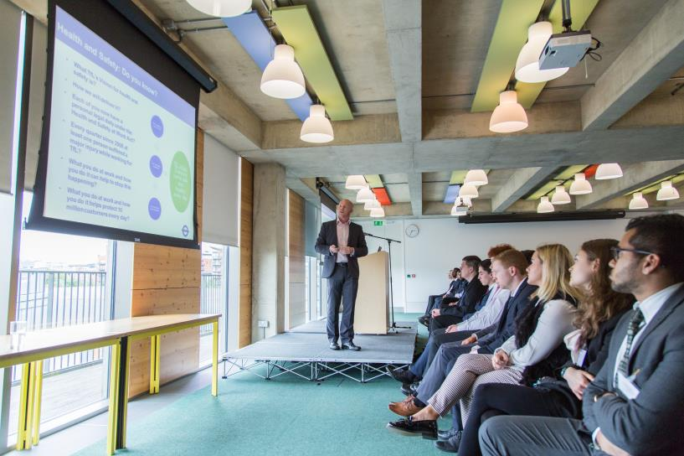
What is a community consultation?
A community consultation is an opportunity for stakeholders to have their say on proposed designs.
It is also for the project team to learn from local people about local issues and history; the things you can’t learn from a map or a survey.
© Transport for London

Slide 36
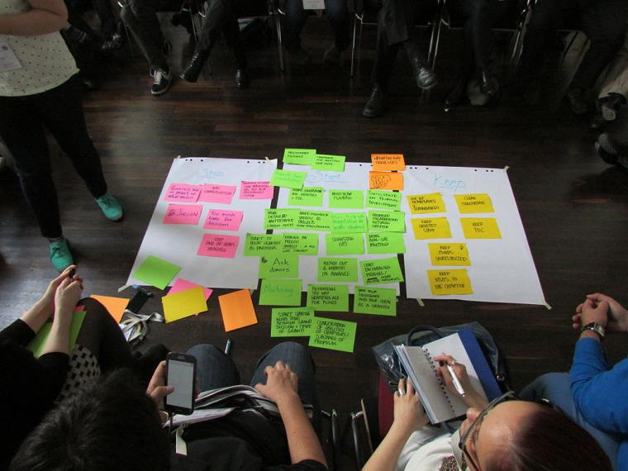
Getting your message right
Next lesson will be the community consultation. The audience will be role-playing the stakeholders from the first workshop:
You each will have to explain and defend the decisions that you took in the design of this project, specifically anything relevant to your job roles
Look back to your brief and decide what the main points of your presentation must be
Show how you have followed majority-held views but that you have made concessions to minority views
'Feedback session' is licensed under CC BY-SA 3.0

Slide 37
Creating the presentation
You will now produce a five-minute presentation of your crossing proposal
Think about using visuals to bring your presentation to life.
If you use PowerPoint you can use a maximum of five slides.

Slide 38
Workshop roundup
Name one way that you have made your presentation engaging.

Slide 39
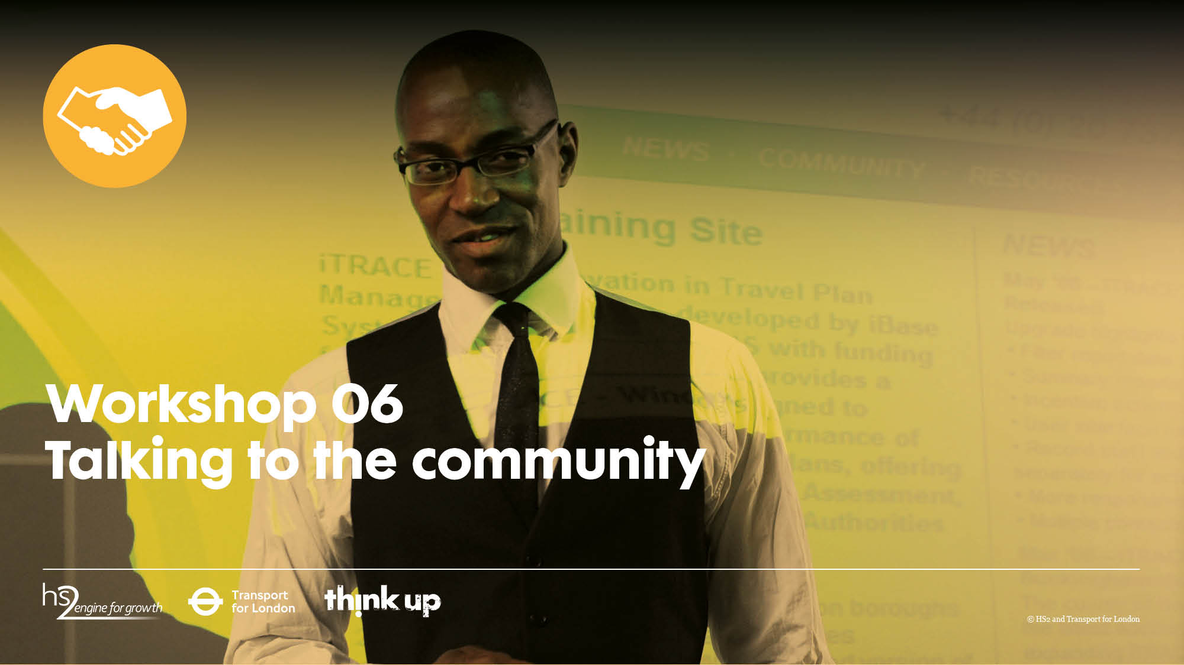
CCC

Slide 40

Starter
Think back to the first workshop and the stakeholder you role-played. On a scrap piece of paper write down three things that your stakeholder was concerned about or hopeful for.
Read these to someone who doesn’t know which stakeholder group you were in.
The other person should try to guess your stakeholder group before you finish reading.
Workshop objectives
Understand the different stakeholders and their perspectives in relation to an infrastructure project
Be able to present the new crossing project and explain the reasoning behind it
Employability skills
Communication; summarising.

Slide 41
Assessment sheet
Soon you will receive one of the resource sheets 6.1 to 6.5. You need to remember which stakeholder group you were in in the first workshop.
On the sheet write down three things the stakeholder was concerned about or hopeful for.
If you are unsure you can read the posters from Workshop 01.

Slide 42
Community consultation
In today’s workshop we will carry out a community consultation.
Each team will present for 5 minutes followed by 2 minutes for questions from the audience.
When you are not presenting you are taking notes from the point of view of a local stakeholder.
At the end we will vote for the best crossing proposal.
© Transport for London

Slide 43

Voting
Discuss in your stakeholder groups which project you liked the most and why
Each stakeholder group should choose their preferred crossing proposal
Have ready a few quick reasons as to why
You should mention any compromises made between the majority and minority-held views
Image by Leslie Landrachuk, is in the Public Domain

Slide 44
Next steps
Although we leave the project here, in a real project this would be the beginning of a second phase of design.
Zoom Rail and Transport for Smeaton would take the preferred crossing design and adjust it to the comments made during the community consultation.
For very large projects they may even have a second round community consultation.
Finally the process of building can begin!

Slide 45
Workshop roundup
Think of a key concept you will take away from this project.

