Slide 1
Connected Economy
Notes:
Welcome
This slide introduces the Connected Economy activity.

Slide 2
Learning Objectives
In this lesson you will learn to:
Explain how railway connections can benefit the local economy;
Understand how engineering projects such as railways impact on individuals, society and the environment;
Describe the role of Community Engagement Officers.
You will focus on the essential skills of speaking, listening and teamwork.
Notes:
Learning Objectives
Introduce the learning objectives for today’s session by reading through this slide.
Ensure that your students understand the key terminology of the lesson:
Economy – How people spend or accumulate money in an area.
Communities – The local people in a place.
In addition, you may wish to define the essential skills of speaking, listening and teamwork. This lesson will focus on speaking, listening and teamwork steps 6-10 from the Skills Builder framework and, most significantly, adopting appropriate language and tone of voice for an audience.

Slide 3
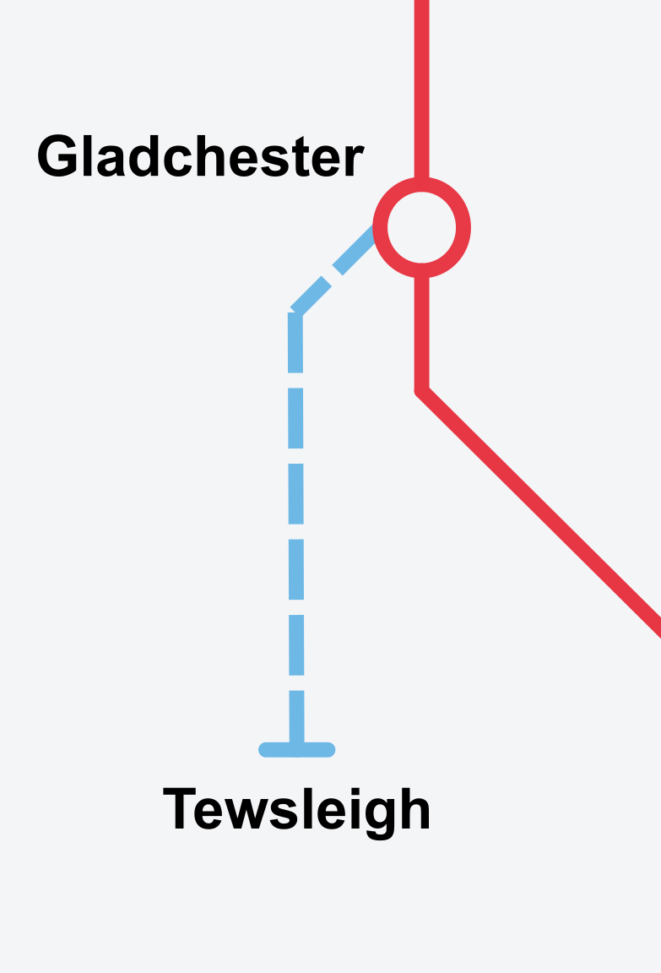
Economic Benefits of Rail
Railways are about more than just rails, trains and stations. In this lesson you are going to be examining the economic benefits of connecting places by rail.
Use the sources on your worksheet to find out how a new railway, the Tewsleigh Valley Extension, will benefit the town of Tewsleigh.
Complete Challenge 1: Case Study of Tewsleigh Valley.
Read the following articles and statements from Tewsleigh residents and then answer the questions.
Notes:
Economic Benefits of Rail
Use this slide to introduce the themes of the lesson and the fictional Tewsleigh Valley Extension, which is a new railway being built between Tewsleigh and Gladchester.
Students should complete Challenge 1 where they read statements from the local people in Tewsleigh about the impact that the railway will have on their everyday lives, and the town. Students should answer questions a) to g) using full sentences.

Slide 4
Community Presentation
As a Community Engagement Officer for the Tewsleigh Valley Extension, it is your job to address the needs and concerns of the local stakeholders who live or work close to the new railway.
Complete Challenge 2: Community Presentation
You must create a five-minute presentation explaining to the local people of Tewsleigh how they stand to benefit from the new Tewsleigh Valley Extension.
You should include:
The economic benefits for different groups within the community;
The wider benefits for the economy and development of the town;
How the rail company plans to address the concerns of local people.
Notes:
Community Presentation
Introduce Challenge 2, where students will take on the role of Community Engagement Officers for the Tewsleigh Valley Extension. It’s their job to deliver a five-minute presentation explaining how they will benefit from the new Tewsleigh Valley Extension. Students should work in groups of three, and all students should speak.
They should include:
The economic benefits for different groups within the community;
The wider benefits for the economy and development of the town;
How the rail company plans to address the concerns of local people.
Your students should use the information from the Challenge 1 to help them to form their presentation.
Ensure that your students understand all the key words from this slide:
Stakeholders – People, businesses and organisations that will be impacted by the new railway.

Slide 5
Plenary
How can a place being connected by rail provide economic advantages?
Who benefits from these advantages?
Are there other benefits?
What was difficult about speaking and working in a team?
What did you enjoy about speaking and working in a team?
What is enjoyable about working in community engagement?
Notes:
Challenge 3: Evaluation and Plenary
Use these questions to review the learning and return to the objectives set at the beginning of the lesson. This also provides students with a chance to show off what they have learned and to share ideas and skills.
Use the question on speaking and teamwork skills to review the students’ improvement of their essential skills. You may wish to pick up on any common problems that can happen when working as a team, or doing public speaking, and ask students how they would solve them.
The last question is an opportunity for students to share their enthusiasm about the careers linked aspect of Challenge 2. Students may have enjoyed speaking to a group or sharing information about a complex new project.

