Slide 1
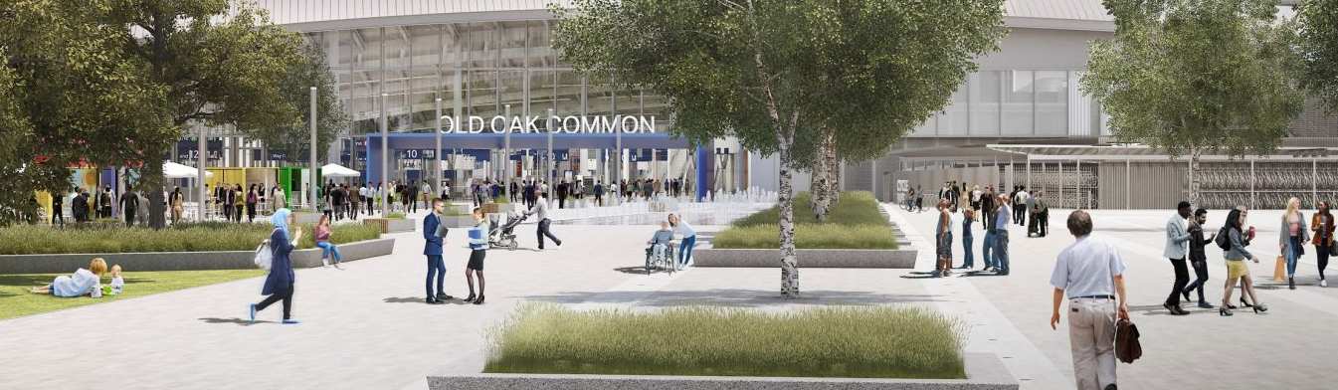
Public Spaces and Urban Design
Notes:
Welcome
This slide introduces the Public Spaces and Urban Design activity.

Slide 2
Learning Objectives
In this lesson you will learn to:
Create a design for a new public space;
Use research to create a successful design;
Understand how Urban Designers shape our urban environments.
You will focus on the essential skills of problem solving and creativity.
Notes:
Learning Objectives
Introduce the learning objectives for todays session by reading through this slide.
Ensure that your students understand the key terminology of the lesson. You may have to recap the meaning of the following words from your students previous learning:
create a design for a new public space
use research to create a successful design
understand how urban designers shape our urban environments
In addition, you may wish to define problem solving and creativity for the purposes of this session. This lesson will focus on the problem-solving steps 7-10 from the Skills Builder framework, and most specifically on the importance of research in solving complex problems. This lesson also focuses on the creativity steps.

Slide 3
Urban Design and HS2
The design of a new train station is about more than just the building. The public spaces around the station must be designed too. Designing these spaces is the job of Urban Designers.
Urban Designers work to make:
Useful spaces that all people can benefit from and enjoy;
Spaces that create a sense of ‘place’ and integrate with their surroundings;
Spaces that will stand the test of time.
In today’s lesson you will be Urban Designers, designing a public space that will be outside a station in your local city, town or village.
Notes:
Urban Design and HS2
Use this slide to introduce the themes of the lesson, the lesson challenge and the job role of Urban Designers. Check that your students understand the key terminology on this slide. You will expand on the terms ‘place’ and ‘public space’ in the next slide:
Urban – Built up areas such as towns or cities.
Place – An area with unique characteristics.
Public space – An area that is open to all people.

Slide 4
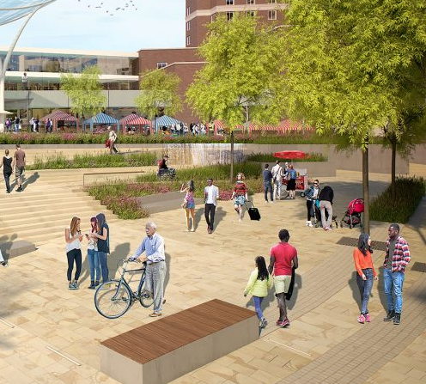
Public Spaces
There are many types of public space in our villages, towns and cities.
What examples of public space can you think of?
How do people use these public spaces?
What sort of things do you find in public spaces?
What makes a public space a ‘place’?
Notes:
Public Spaces
Use this slide to stimulate your students’ ideas about public spaces. You could create a mind map or list on the board. For each answer ask how the spaces are used. Examples could include:
Parks – relaxing, playing sports, picnics, meeting friends, viewing wildlife.
Village green – relaxing, playing sports, holding fairs.
Public square – meeting friends, relaxing, eating, attending events such as outdoor concerts or theatre, protests, ceremonies, viewing public art or memorials, travelling, waiting for a train.
Market square – holding markets and fairs, meeting friends, relaxing.
Streets – travelling, walking, holding markets.

Slide 5
Activity
You will design a new public square for your town or city. It is to be built outside a new train station. The space must be be 60m x 60m (3600m2) and have an entrance on each side.
Your public square must meet the following criteria:
People: It must be designed for everyone to benefit from and enjoy.
Place: It must be designed for a sense of place and it must celebrate your local area.
Time: It must stand the test of time.
At the end of the activity, you will present your research and a design proposal.
You should focus on the essential skills of problem solving and creativity.
Notes:
Activity
Use this slide to introduce the worksheet activities and the associated essential skills that your students will be using. To add depth and realism to the activity, give your students a local location for where the new public square will be built. This will help your students to focus their research and design with a real-life context in mind. You could draw the site on the whiteboard or provide the students with a map.
You could also create your own fictional site if there is not a suitable site nearby.

Slide 6
Challenge 1: Research
Challenge 1: Research
To produce a successful design, Urban Designers must have a good understanding of the people and environment around the site that they are working on.
You must produce:
A mood board with the theme of ‘People, Place and Time’.
A user interview with a friend or relative who might use the square.
You should then answer questions a to c) on your worksheet.
Notes:
Research
Use this slide to introduce Challenge 1. The students should produce focused research to help them to create a successful design proposal.
You may wish to provide an example of a mood board. You should explain that the purpose of a mood board is to provide the designer with inspiration, and that it should include annotated images on the theme of ‘People, Place and Time’. Students may use the Internet to find images and to create their mood board.
You may wish to provide an example of user interview or create a worked list of questions on the classroom whiteboard with the students.

Slide 7
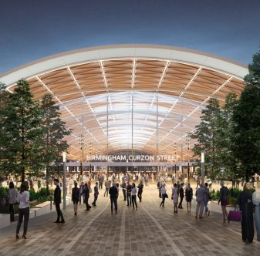
Challenge 2: Design Proposal
You are to create a detailed design proposal for your public square. It should include:
An annotated, top-down plan or map of the square showing its design features.
Further sketches to show design features such as street furniture, gardens or public art.
Notes:
Activity
Use this slide to introduce Challenge 2. Ensure that you have a wide range of materials for your students to use including white and coloured A2 or A3 paper, colouring pens, pencils and rulers.
You could create an example to demonstrate to your students how to sketch, annotate and present their ideas. You should emphasise that they should draw in pencil.
Use the following questions to stimulate the students’ thoughts:
How can you ensure that everyone can access and use your public square?
How can you create different zones in your square for different activities e.g. eating lunch, relaxing, waiting for a train or meeting a friend?
How can you encourage biodiversity within your design?
How can you make sure that everyone feels safe and comfortable in your public square?
Who or what do you think should be the subject of public art in your public square?

Slide 8
Challenge 3: Evaluation and Plenary
How did it go? Answer questions a) to c) on your worksheet to evaluate your proposal.
How did your square meet the three key criteria of people, place and time?
How did your research help you to create a successful proposal?
If you had more time, what would you improve about your research, your idea or its presentation?
Notes:
Challenge 3: Evaluation and Plenary
Ask the students to evaluate their design by completing Challenge 3. Use the evaluation questions as a ‘jumping off’ point for the plenary.
You could then use the following questions to review learning in the lesson and provide students with a chance to show off what they have learned and to share ideas and skills:
What was the hardest thing about this challenge? How did you overcome this?
What did you enjoy about this challenge?
What makes for a good public space?
How did the research process help you to create a successful design?
How did you use your skill of creativity in this challenge?
Why is it important to design for all people?
How can you create a ‘place’?
Why is it important to create a design that will last?
How do urban designers shape our urban environments?
Use the question on creativity and research skills to review the students’ improvement of their essential skills. You may wish to go through some common problems that individuals encountered and then ask the group how they would overcome them.

