Slide 1
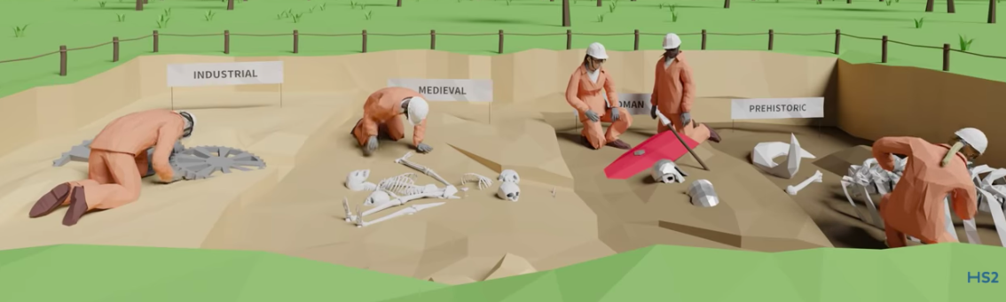
Making History
Notes:
Welcome
This slide introduces the Making History activity.

Slide 2
Learning Objectives
In this lesson you will learn how:
Archaeological processes help us to understand how habitats change;
To interpret archaeological data to to find out how humans lived in the past and impacted on their surroundings.
You will focus on the essential skill of problem-solving.
Notes:
Learning Objectives
Introduce the learning objectives for today’s session by reading through this slide.
Ensure that your students understand the key terminology of the learning objectives.
Habitats – The life supporting natural environment in an area.
In addition, you may wish to define problem solving for the purposes of this session. This lesson will focus on the problem-solving steps 4-9 from the Skills Builder framework.

Slide 3
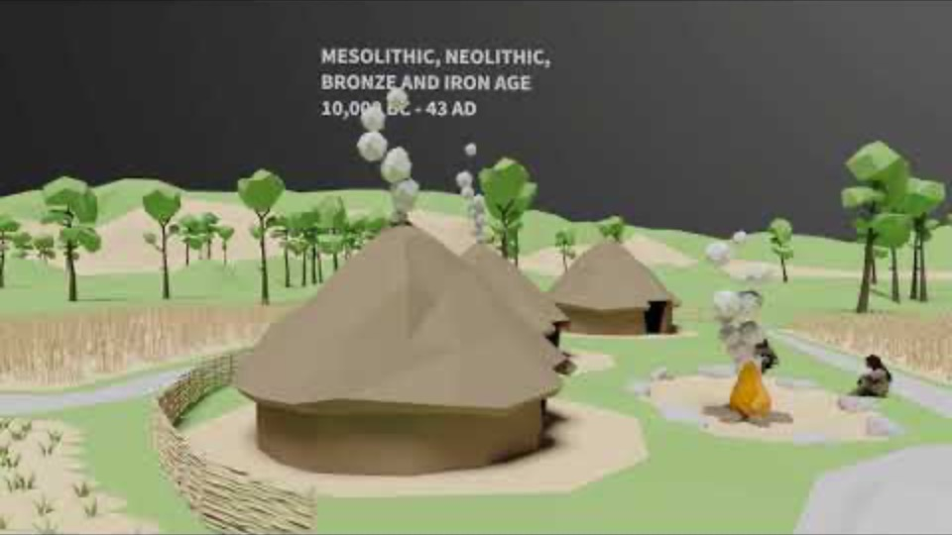
Archaeology and HS2
Watch the video to find out how HS2 is making history with the UK’s largest archaeological dig.
How do Archaeologists find out about the past?
Why is archaeology important?
Why is HS2 a unique opportunity for Archaeologists?
Notes:
Archaeology and HS2
Use this slide to explain the work of Archaeologists on HS2. Watch the video and then ask the students the questions below:
Archaeologists find out about the past by digging up objects and analysing their position and depth in the soil, materials and construction methods.
Archaeology is important as it helps us to understand the past and how our culture and way of life has changed and evolved.
HS2 is a unique opportunity for Archaeologists as it is such a huge project, enabling large excavation sites across the UK.

Slide 4
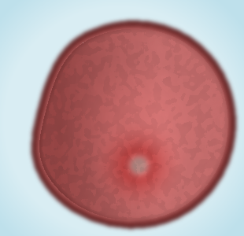
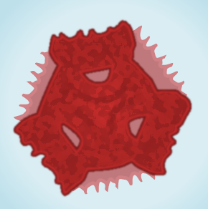
Pollen Analysis
As you will have seen in the video, Archaeologists find out how we lived in the past. They also find out how our environment changes over time.
Archaeologists can see how the varieties and number of plants has changed by measuring the variety and number of pollen grains as they dig deeper into the soil.
Complete Challenge 1: Using Pollen Analysis
Read the diagram and then answer questions a) and b) on the worksheet.
Example 1
Example 2
Notes:
Pollen Analysis
Use this slide to introduce pollen analysis and Challenge 1.
Make sure that students are secure in their knowledge of what pollen is i.e. The male gametes of a plant. Students should be aware that flowers produce pollen as part of plant reproduction and that pollen can be spread by wind and by insects.
The two examples are unlabelled so that you can ask students to identify them from their worksheets. The top pollen grain is grass, the bottom is dandelion.
Pollen is measured for variety and number of grains. As this varies deeper into the soil, so we can see how the plant life changed through time. It is like measuring a footprint of the plants that were there.
Students do not need to have a full knowledge of plant succession for this activity, only that the UK is a temperate woodland biome and that areas of grass and meadows will in general succeed toward deciduous woodland, the ‘climax community’. The aim of this activity is for students to explain that process using pollen.
Succession is motivated by the impact of the organisms at each stage and the competition by subsequent colonies.

Slide 5
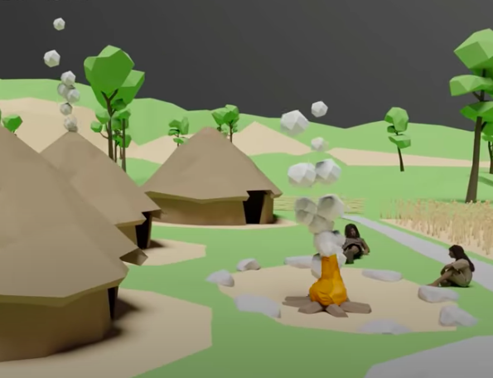
Making history
In Challenge 1 we saw how habitats change over time due to the natural process of succession.
Human activity can also have an impact on habitats. Pollen analysis can help us understand how humans have changed the environment. Using this data we can also better understand how objects were used and how people lived.
Complete Challenge 2: Making History
Answer questions a) to f) by interpreting the graph and data on the worksheet.
Notes:
Making History
Use this slide to introduce Challenge 2.
Students will be interpreting the data and objects to understand the human activity that occurred from the late Neolithic to the medieval age.
Once students have completed the questions use the next slide to mark the answers.

Slide 6
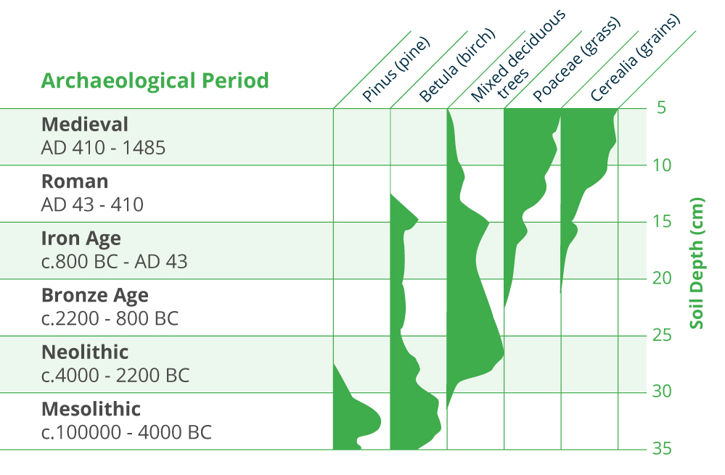
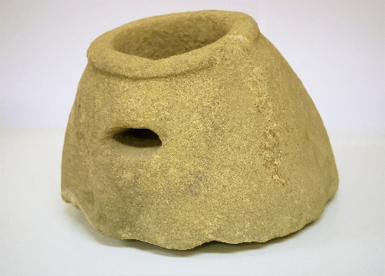
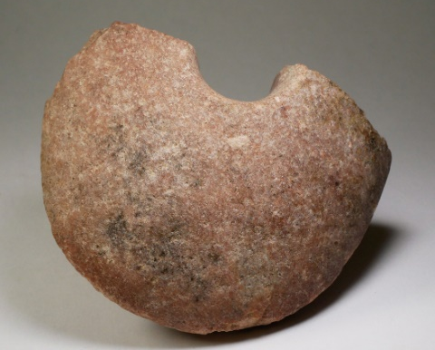
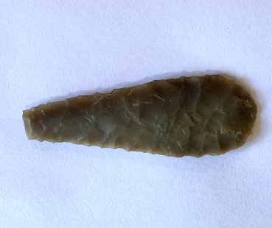
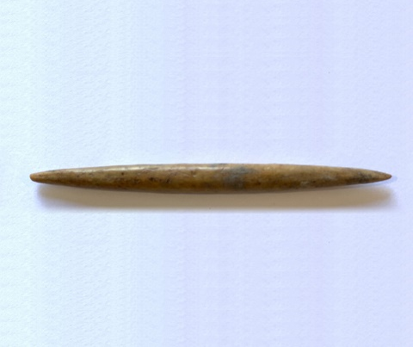
Making history
Notes:
Making History
Use this slide to run through the answers to Challenge 2 or explain any misconceptions about how to use the graph.

Slide 7
Plenary
How do archaeological processes help us to understand the past?
How did you use problem-solving as an Archaeologist?
What role does science play in understanding history?
From which other subjects did you use subject knowledge?
Did you enjoy being an Archaeologist?
Notes:
Plenary
Use these questions to review the learning and return to the objectives set at the beginning of the lesson. This also provides students with a chance to show off what they have learned and to share ideas and skills.
Use the question on problem solving skills to review the student's improvement of their essential skills. Students will have learned to interpret different kinds of data to conclude about how we lived.
The last question is an opportunity for students to share their enthusiasm for archaeology. For additional notes, please see the teachers notes.
In addition, at this point try to highlight how cross-curricular STEM is. Students may have used subject knowledge from Science, Geography, Cooking and Nutrition, Textiles, History and Maths, all in an Engineering context!

