Slide 1
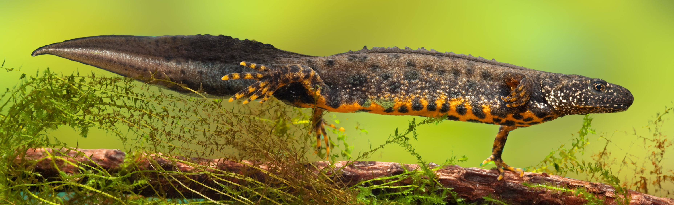
Great Crested Newts
Notes:
Welcome
This slide introduces the Great Crested Newt activity.

Slide 2
Learning Objectives
In this lesson you will learn to:
Describe the lifecycle and adaptations of great crested newts;
Explain the feeding relationships between great crested newts and other organisms in their ecosystem;
Understand the activities of Ecologists in conserving great crested newt populations in the UK.
You will focus on the essential skill of problem solving.
Notes:
Learning Objectives
Introduce the learning objectives for today’s session by reading through this slide.
Ensure that your students understand the key terminology of the lesson. You may have to recap the meaning of the following words from your students previous learning:
Adaptations – The specific features of an organism that enable it to be successful in an environment.
Feeding relationships – What animals eat in a food web/chain.
Ecologists – People who study ecosystems and the inter-relationships between plants, animals and the environment.
In addition, you may wish to define problem solving for the purposes of this session. This lesson will focus on the problem-solving steps 7-10 from the Skills Builder framework, and most specifically on the importance of research in solving complex problems.

Slide 3
Ecology and HS2
Part of an Ecologists job is to work on large civil engineering projects such as HS2. It is the Ecologist’s job to minimise the impact of construction on the surrounding ecosystems.
Ecologists work to:
Where possible redesign the project to avoid any ecological impact;
Minimise and compensate for the ecological impact of construction where it cannot be avoided;
Design and build networks of new habitats for animals that need to be translocated as a result of construction.
Notes:
Ecology and HS2
Use this slide to explain the work of Ecologists in civil engineering. You may wish to give examples for each of the bullet points.
Examples of how an Ecologist could avoid ecological impact might be by adjusting the route or situation of part of a project.
Examples of how the ecological impact of construction could be minimised might involve mitigation, such as minimising the loss of habitat required for the construction of a new structure, or by employing controls to limit dust deposits on habitats.
Designing and building new habitats could include a new pond for great crested newts.
In general, Ecologists try to ensure that a project puts back more than it takes away by capitalising on the opportunities of improving biodiversity and habitat conservation. An example of this is HS2’s green corridor which will include a network of new wildlife habitats.

Slide 4
Great Crested Newts
One of the animals found along HS2’s route is great crested newts. They are widespread across the England and Wales, but their numbers are in decline due to habitat loss and other factors.
As amphibians, they live on land and in water.
They are the UK’s largest newt, growing up to 16cm long.
They can regrow lost limbs, tails and eyes.
Even as larvae they are aggressively carnivorous, even eating other newts.
They are a protected species, meaning that a special license is required if construction work will affect their habitats.
In the next activity, you will be finding out more about great crested newts in order to help with the translocation of a population of great crested newts to a newly built habitat.
Notes:
Great Crested Newts
Use this slide to introduce great crested newts.
The students will be researching the lifecycle, adaptations and ecology of great crested newts as part of the worksheet challenges. Their final challenge will be to choose a suitable area for the translocation site for great crested newts. Translocation is the process of moving a population of animals to a new habitat site because their previous site may be affected by works.

Slide 5
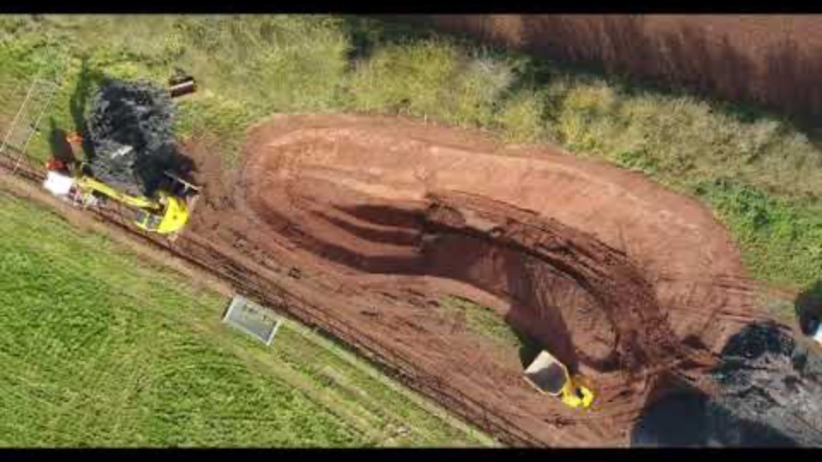
What is translocation?
Translocation is the process of moving existing populations of animals or plants from a site where they will be affected by construction work to a new, purpose-built habitat.
Watch the video opposite to see how new habitats are being created for great crested newts at Finham Brook.
Notes:
What is translocation?
Show the students the video to see an example of the building of a new habitat.
Ask your students:
Why it is important to translocate animals from an affected site?
Why is it important to build new habitats?

Slide 6
Activity
In this activity you will take on the role of an Ecologist to research the lifecycle, diet and ecology of great crested newts. You will then use this knowledge to decide on a habitat plan for an area where great crested newts will be translocated.
Complete challenges 1 - 4 on your worksheet.
You may use a computer or smart device to research your answers.
You should answer in full sentences.
You should focus on the essential skill of problem solving.
Notes:
Activity
Use this slide to introduce the worksheet. Ensure that each of you students has access to a computer or smart device. Adjust the timings of this section to match your lesson length.
Explain what is meant by problem solving and take examples from your students on what makes for good research skills.

Slide 7
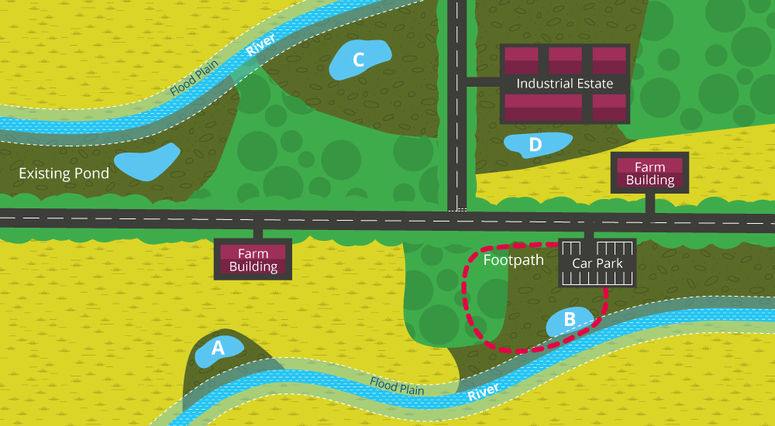
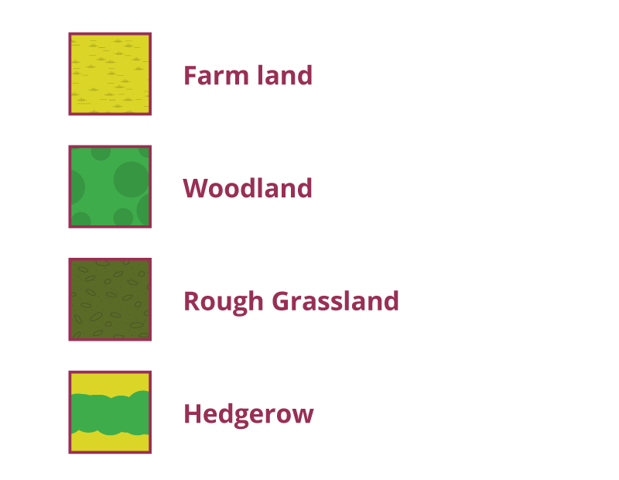
Answer to Challenge 4: Translocation
Notes:
Answers
Use this slide to show the map, and to discuss which site would be best for the new pond and translocated great crested newts.

Slide 8
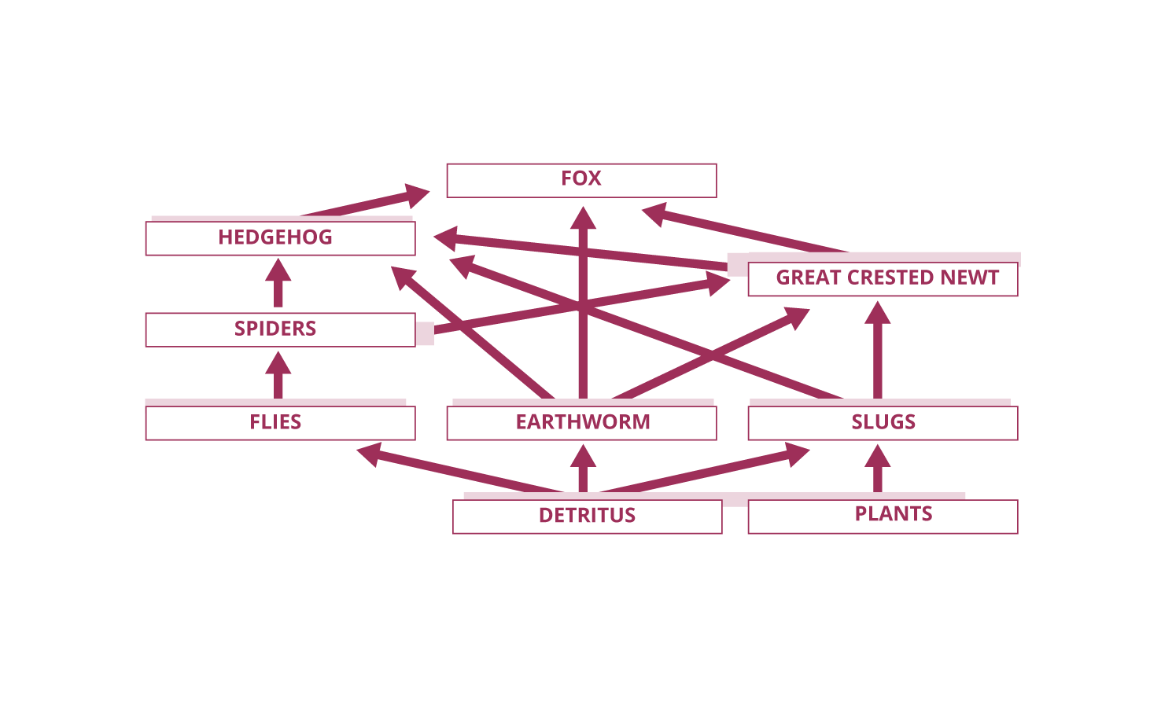
Answer to Challenge 3: Food Web
Notes:
Answers
Use this slide to explain the answer to Challenge 3 Food Web. Note that this slide only includes the organisms found in a great crested newts’ terrestrial habitat, and it is limited to the feeding relationships of adult great crested newts. Larval great crested newts feed exclusively in an aquatic habitat and are highly predatory, feeding on tadpoles, insects, small fish and other newts. Juveniles feed in both aquatic and terrestrial habitats.

Slide 9
Plenary
What are the the lifecycle and adaptations of great crested newts?
What are the feeding relationships between great crested newts and other organisms in their ecosystem?
How are Ecologists working to conserving great crested newt populations in the UK?
How did you improve on your research skills this lesson?
Did you enjoy being an Ecologist?
Notes:
Plenary
Use these questions to review the learning and return to the objectives set at the beginning of the lesson. This also provides students with a chance to show off what they have learned and to share ideas and skills.
Use the question on research skills to review the students’ improvement of their essential skills. Students will have learned to gather information from several different sources, and to transfer their research from one format to another.
The last question is an opportunity for students to share their enthusiasm for ecology. For additional notes, see the teachers notes.

