Slide 1
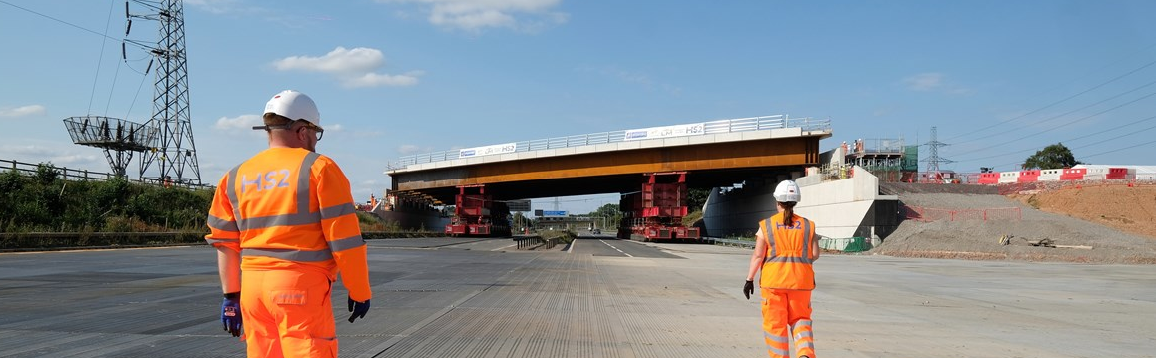
Motorway Bridge Challenge
Notes:
Welcome
This slide introduces the Motorway Bridge Challenge.

Slide 2
Learning Objectives
In this lesson you will learn to:
Describe how working mathematically is used in civil engineering to make decisions and solve problems;
Understand the role that Project Managers play in planning civil engineering and construction projects.
You will focus on the essential skills of problem solving and teamwork.
Notes:
Learning Objectives
Introduce the learning objectives for today’s session by reading through this slide.
Ensure that your students understand the key terminology of the lesson. You may have to recap the meaning of the following words from your students previous learning:
Civil Engineering – The design, construction and maintenance of infrastructure systems such as the transport system.
Project Managers – The professionals who’s job it is to control and manage projects, ensuring that they are delivered on time, on budget and to a high quality.
In addition, you may wish to define problem solving and teamwork for the purposes of this session. This lesson will focus on the problem solving and teamwork steps 6-10 from the Skills Builder framework.

Slide 3
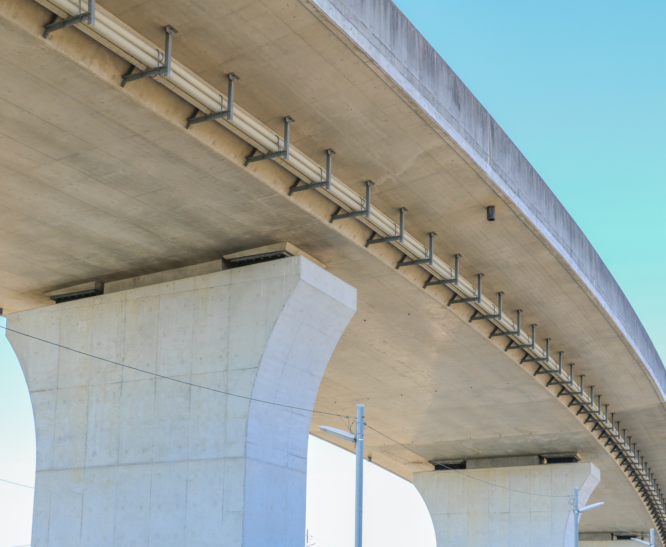
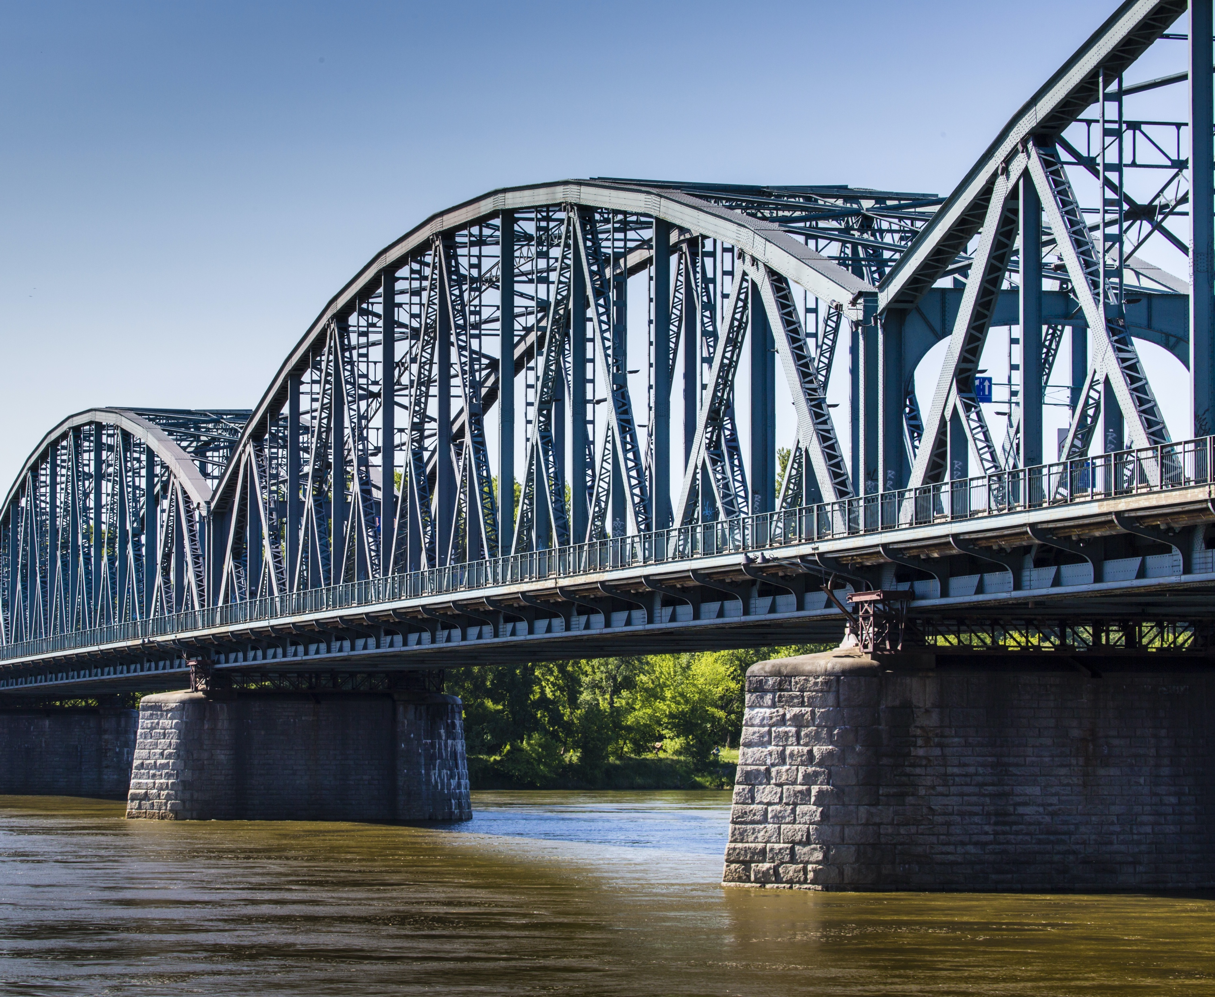
Motorway Bridge Challenge
In this activity you will be working as a Project Manager to plan the construction of a road bridge crossing a motorway.
It is your job to decide the site where the bridge will be built as well as the type of bridge:
Pre-cast concrete bridge
Steel truss bridge
Notes:
Motorway Bridge Challenge
Use this slide to introduce the main themes of the lesson. Students will be working as Project Managers to plan the construction of a road bridge that will cross a motorway. Students will have to choose the site where it will be built and the type of bridge.
Pre-cast concrete bridges are made from slabs of concrete cast off-site.
Steel truss bridges are built using a steel frame.
Students will decide which bridge to build based on the cost, environmental impact and time taken to build.

Slide 4
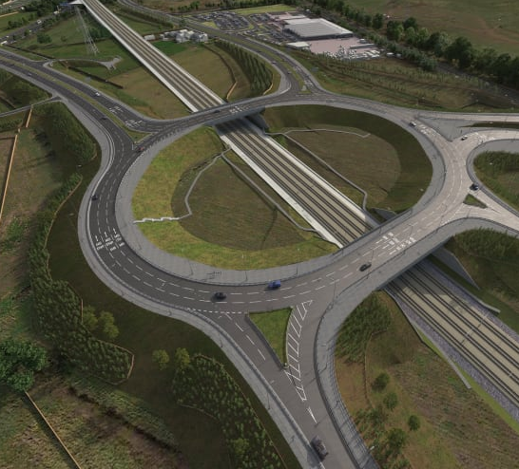
Why is the bridge being built?
The bridge that you are building today is to connect a new station to the road network. There are lots of other reasons why bridges might need to be built for HS2:
So that the HS2 line can cross a road, water or another railway;
To improve the traffic flow in areas where there are new stations;
To replace a road bridge that has had to be moved.
Notes:
Motorway Bridge Challenge
Use this slide to help students understand why they are building a road bridge. You could ask students what types of things they would need to consider when building a road bridge. They might suggest:
It must be the correct span to cross the motorway;
It must be the right cost;
It must be the right width for the traffic that is crossing it;
It must be strong enough to carry the traffic;
It must withstand the weather, such as rain, snow etc;
It must have a low environmental impact.

Slide 5
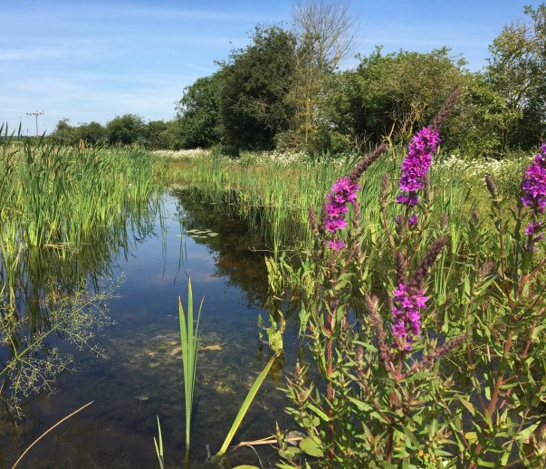
Challenge 1: Choose a Site
There are three potential sites for building the motorway bridge. You must choose to build on the site that has the lowest ecological value, meaning that building there will have the smallest possible impact on the environment.
Read the description of the sites in Table 1 on the worksheets and then calculate a score for its ecological value using the scoring system.
Which site did you choose?
Notes:
Challenge 1: Choose a Site
Introduce Challenge 1. Students must read the descriptions of the three sites and decide which site should be built on. Students should use the ecological value scorings system to decide which site should be used. Students should work in groups of three and should try to complete this activity quickly.
Ask students to feedback their answers. You could use a show of hands to vote for each site. Ask students to explain their answers. Site 1 is the site with the lowest ecological value, and so constructing here will have the smallest possible environmental impact.

Slide 6
Challenge 2: Choose a Bridge
There are two potential designs for the bridge; a pre-cast concrete bridge or a steel truss bridge. You must decide which bridge will be most suitable based on:
Total cost including materials and construction;
CO2 produced by the production of the materials;
The time it will take to build.
Complete challenges a) to d) on your worksheet. You must decide by the end of the session. Make sure that you check your answers.
Notes:
Challenge 2: Choose a Bridge
Introduce Challenge 2. This is a long-form problem solving activity where students will have to work in a group, under a time limit, to solve a complicated mathematical problem. Tell the students how long they have according to your planning, and that they must present their answer at the end of the session.
Encourage your students to organise their teams to solve the problem. They can split up different sections of the challenge between themselves and they do not have to complete the activity in a linear order.
At the end of this session, ask students to justify their choices. They should have chosen the pre-cast concrete bridge as it takes less time to build, produces less CO₂ and is more cost effective.

Slide 7
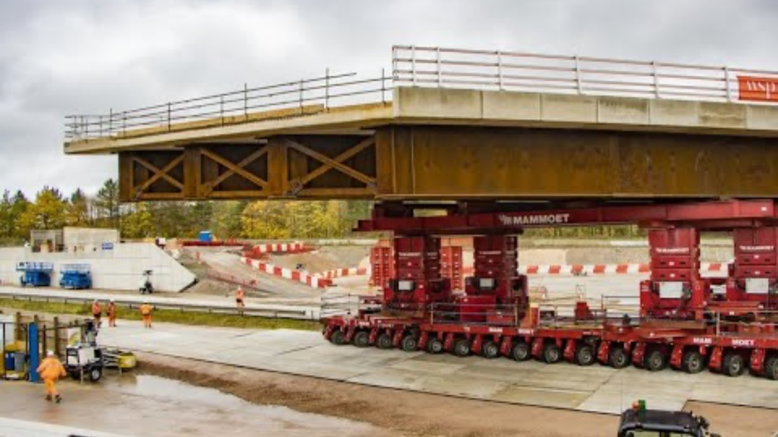
A446 Bridge
Here is an example of how a real pre-cast concrete bridge has been constructed. This 908 tonne bridge was pre-assembled next to the motorway, and then moved into place. The move took just 45 minutes.
What are the benefits of building in this way?
How is it better for road users?
How is it better for the civil engineers?
Notes:
A446 Bridge
This road bridge built by HS2 is a marvel of civil engineering. Preassembled at the road-side from pre-cast reinforced concrete blocks, it was then moved into place in just 45 minutes.
Ask the students the questions on the presentation.
The advantages are that it causes less disruption than closing a major motorway and will reduce the costs of hiring equipment and workers over a longer period.

Slide 8
Plenary
Were you surprised by the answer to Challenge 2?
Were you surprised by the A446 Bridge?
What was difficult about this challenge?
What other factors would you need to think about if you were building a bridge in real life?
What did you enjoy about it?
What is the role of a Project Manager in a civil engineering project such as this one?
What examples of good teamwork can you tell me about from this lesson?
What examples of good problem solving can you tell me about from this lesson?
Notes:
Plenary
Use these questions to review the learning and return to the objectives set at the beginning of the lesson. This also provides students with a chance to show off what they have learned and to share ideas and skills.
For the other real-life bridge building factors that students would have to think about, consider:
The weight of the traffic, such as trains, cars, lorries or people;
Weather and climate factors such as the effect of temperature, moisture or sunshine on materials, as well as the additional load from wind, rain, snow etc;
The impact of natural disasters such as earthquakes, floods, hurricanes or tornadoes;
The geology and ground conditions, and how they might affect the structure;
The impact of rushing water if the bridge is built over water;
How the bridge will be maintained, and accessed for maintenance;
The historic and and natural environmental impact of the bridge;
The aesthetic design of the bridge, e.g. does it have to be unique or beautiful;
Time constraints.
Use the question on problem solving and teamwork to review the students’ improvement of their essential skills. Students will have had to use the team working skill of group organisation to complete this challenge in the time limit.

