Slide 1
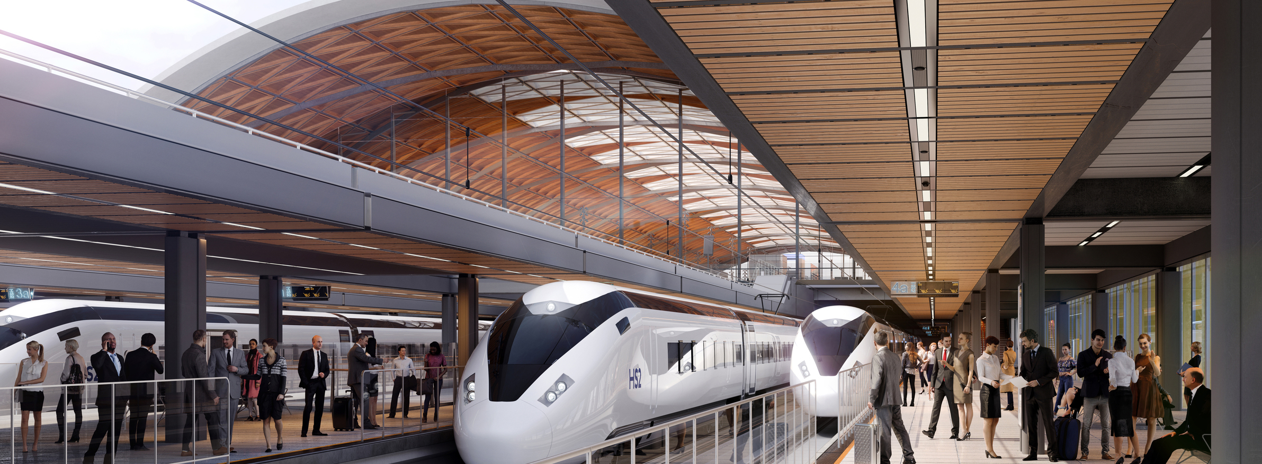

Slide 2
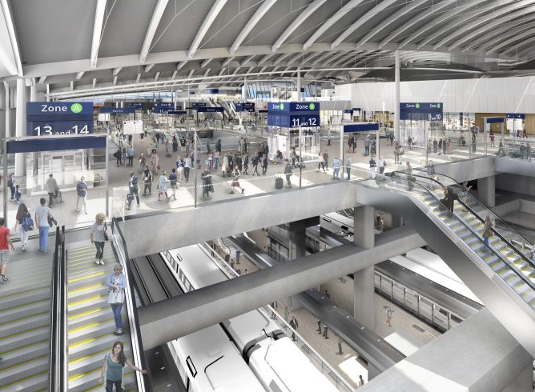
Travelling by Train
What does the picture show?
Have you travelled by train before?
Where did you travel to?
Notes:
Welcome
This slide introduces the Travelling by Train activity.
Ask students the starter questions to stimulate their thoughts about train travel.

Slide 3

Learning objectives
In this lesson you will learn to:
Think about the information needed
to travel by train;
Describe good customer service;
Describe good interview skills.
You will focus on the essential skills of speaking and listening.
Notes:
Learning objectives
Introduce the learning objectives for today’s session by reading through this slide.
In addition, you may wish to define speaking and listening for the purposes of this session. You could ask the students what makes good speaking or listening. You could ask students to rate their skills of speaking and listening with thumbs up, thumbs down or thumbs to the side. Aim for more thumbs up by the end of the lesson.

Slide 4




Travel information
You are planning a train journey from your local train station.
What information do you need to find out to plan your journey?
Notes:
Challenge 1: Travelling by train
Outline the scenario to the students.
What information do they need to find out to plan the journey?
Use the clues to prompt the following answers:
The time that the train is leaving.
The time that the train will arrive.
The duration of the journey.
The cost of the ticket.
The platform that the train leaves from or arrives at.

Slide 5
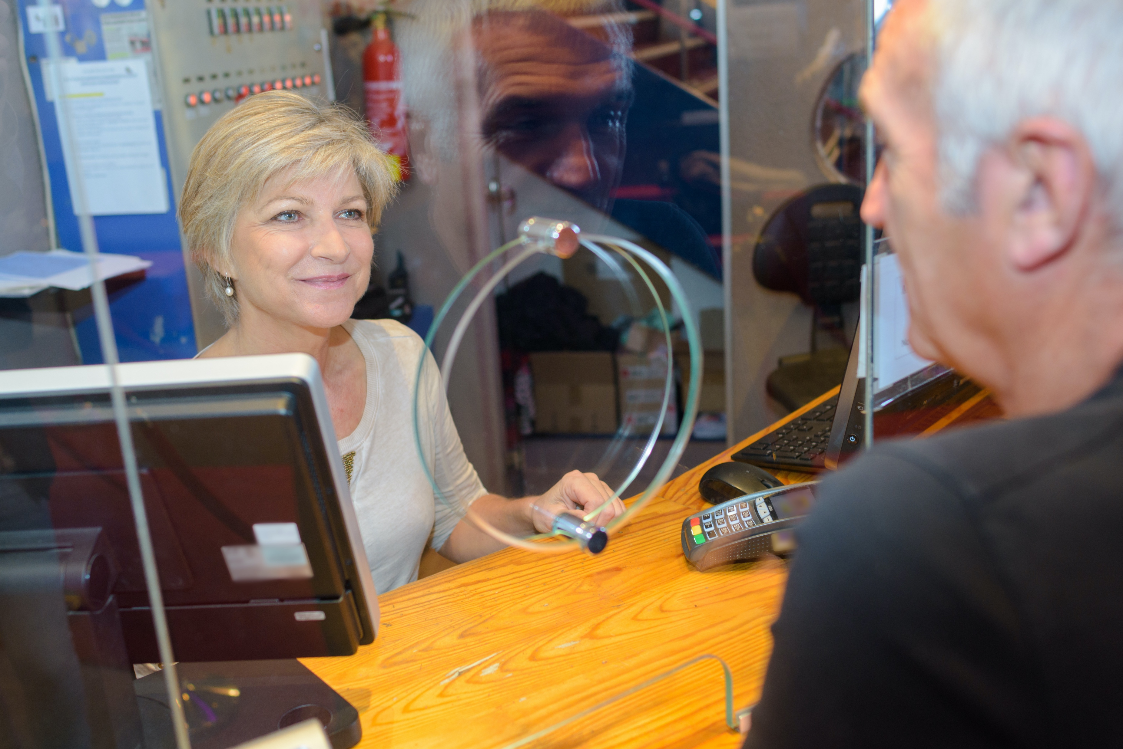

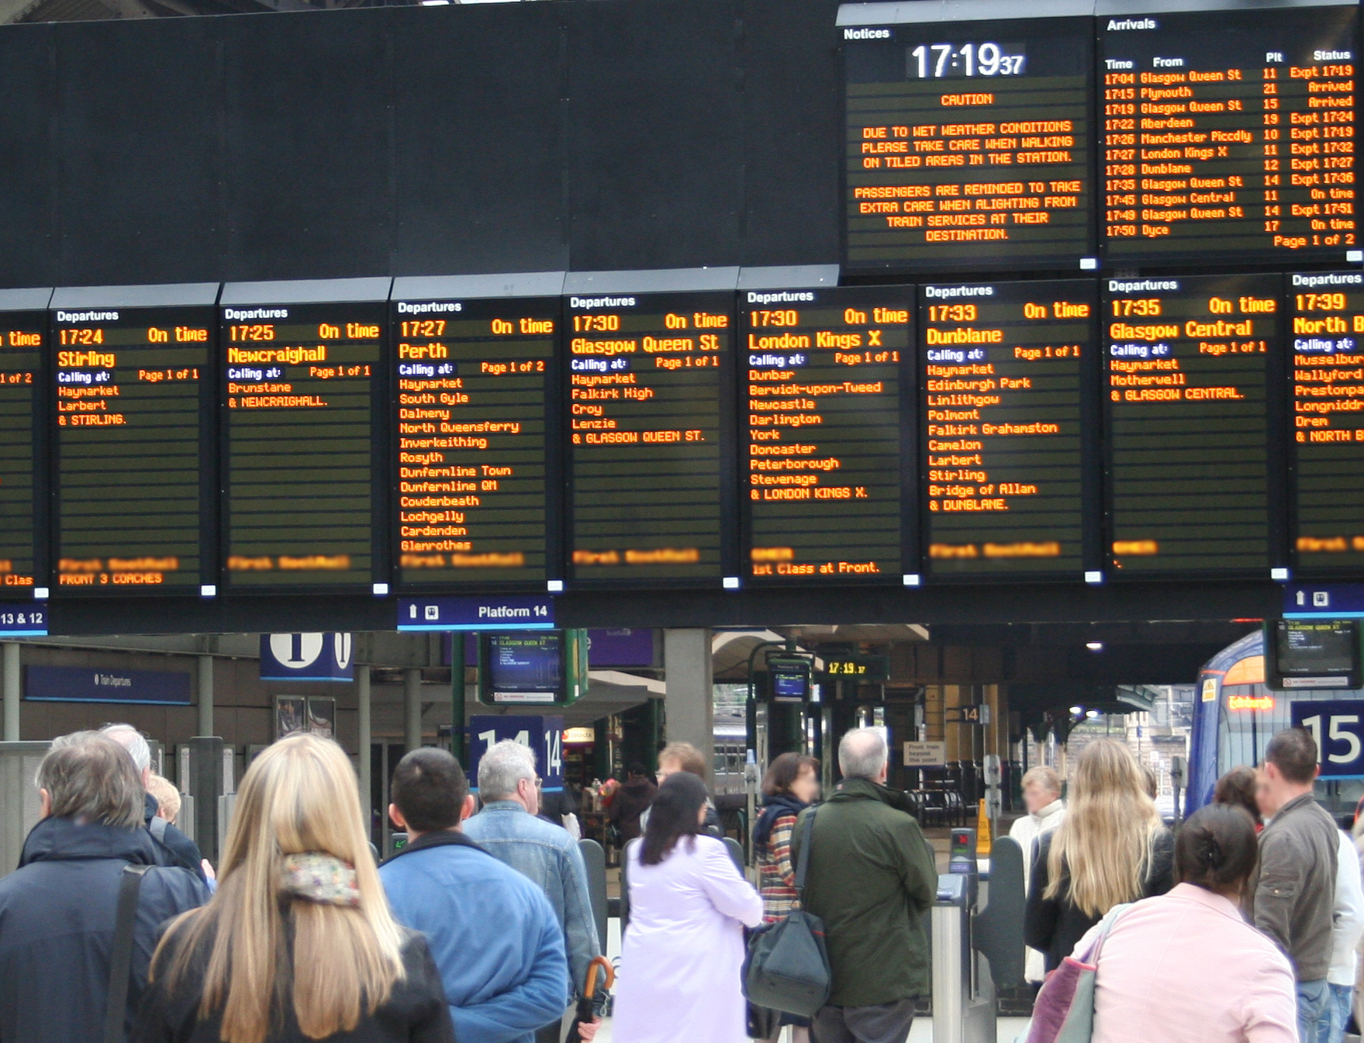
Finding out
How would you find the information out?
Notes:
Finding out
Ask the students:
How could you find the information out?
Who could you ask? Perhaps point to some different people in the image. Who is it safe to ask? Who is it not safe to ask?
Where else could you look?
Students could find the information out by asking the station staff at the information desk or ticket desk, or by reading the information board or timetables. They could also use the Internet on a Smart Device.

Slide 6
Challenge 1: Train timetable
Look at the train timetable that you have been given. What questions could you ask to find out the missing information?
Destination | Departure Time | Platform Number | Arrives at Destination | Single Ticket Price
Chesterfield
East Midlands Hub | 12:20 | 8 | 12:40 | £7.50
Wigan | 12:24 | 9 | 13:00 | £10.20
Notes:
Train timetable
Hand out the Train Timetable Cards. There are four different cards each with different missing information. Explain to the students that they are going to practice asking for the different pieces of information to complete their card. Use the example table to demonstrate and fill in the answers for Chesterfield as a group. Explain the key words including ‘destination’, ‘departure’, ‘destination’ and ‘single ticket’. Students have the answers for Chesterfield on their sheet, so you can model asking the questions and them answering. The other destinations on the board do not match their sheets, as this would give them the answers to the next activity.
Ask the students how they would ask for each answer. Model answers:
What time does the train to Chesterfield depart?
Which platform does the train to Chesterfield leave from?
When does the train arrive in Chesterfield?
How much is a single ticket to Chesterfield?
You could write these model answers on a whiteboard if you feel your students would benefit from it.

Slide 7
Challenge 1: Train timetable
Find the missing information on your timetables by asking your classmates.
You must fill all of the blank boxes on your sheet.
You must find out each piece of information from a different person.
Take it in turns to ask each other questions.
You must not show anyone else your sheet.
Notes:
Train timetable
Students should now circulate the room in order to fill out the answers on their sheets. Alternatively they could work in pairs or small groups of three to four students.
Circulate the room to check that students are doing the activity properly. Encourage students to be specific in how they ask questions. For example, ‘how long is the journey’ could elicit an answer in time or distance.
Stop the students once they have completed their sheets. Was the challenge easy or difficult? How would they feel asking these questions in real life?

Slide 8

Challenge 2: Help desk game
We are now going to combine the questions and answers into a role-play.
One student will be the customer, who will need all of the information about a train journey.
One student will a Train Station Attendant. Use your timetable to find the information.
For the first round, the customer will be taking a trip to Manchester.
Notes:
Challenge 2: Help desk game
In this game students will turn their questions and answers into a role play. There are two ways that you can run this game. Either:
Put the students into pairs and have them take it in turns to play the role of customer or Train Station Attendant.
Workshop the activity with two students at the front of the room, swapping out the actors as you progress.
In both situations, the customer should turn over their Timetable Sheet so that they cannot see the answers, and the Train Station Attendant should use their Timetable Sheet as a prompt card for the answers.
In the first round of the game, each pair should role play as if the customer would like to travel to Manchester.
Ask the students afterwards how they felt asking and answering the questions. What was easy about it? What was hard?

Slide 9

Challenge 2: Help desk game
We will now repeat the role-play, but this time we will change where
the customer wants to go and the attitude of the Train Station Attendant.
Destination | Train Station Attendant
London | Angry
York | Polite
Manchester | Nervous
Durham | Confident
Sheffield | Lazy
Leeds | Helpful
Notes:
Challenge 2: Help desk game
Students will now ask for information about different rail journeys using the list above. For each round the Train Station Attendant should have a different attitude. Stop the students between each and ask the following questions:
How did it feel to the customer in each situation?
How did the Train Station Attendant’s voice, manners, language and body language change for each?
Ask students to consider eye contact, posture, and what they do with their hands whilst talking.

Slide 10
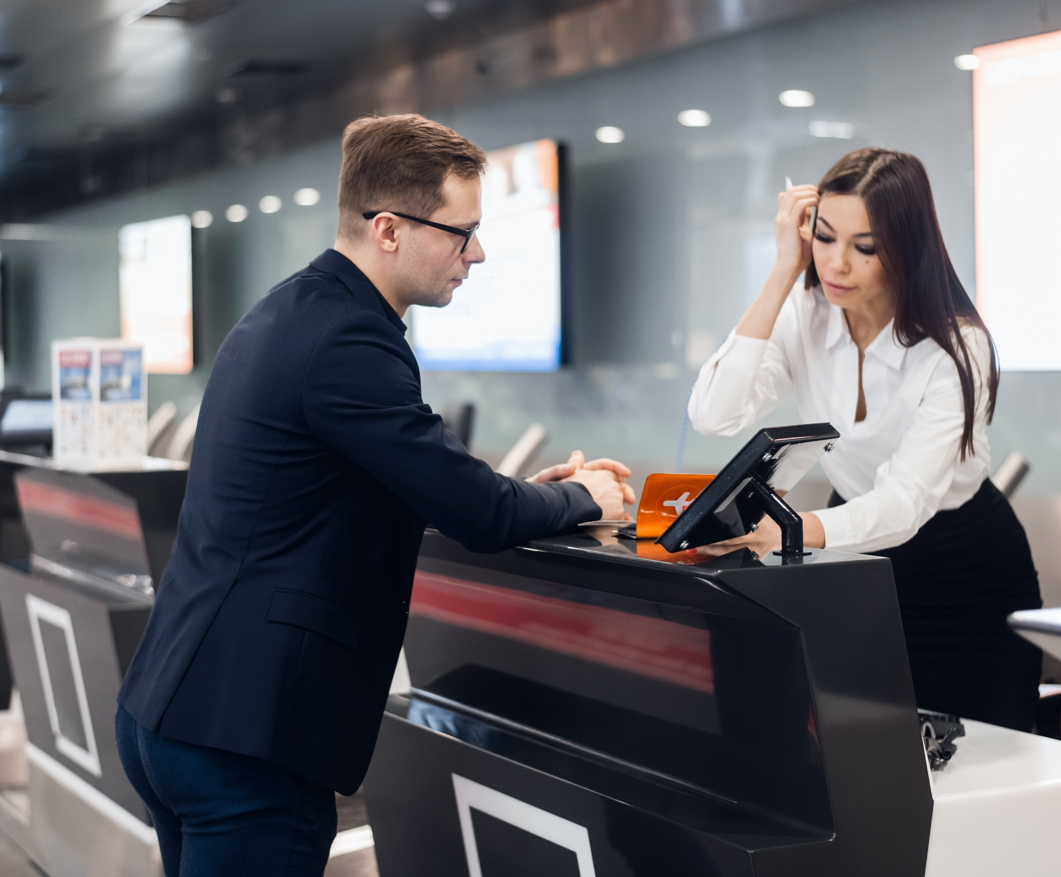
Challenge 2: Help desk game
What have you learned about good customer service? Think about:
Tone of voice
Manners
Language
Body language
Helpfulness
Notes:
Challenge 2: Help desk game
Explain to the students that having tried out different styles of customer service, which behaviours make for good customer service? Which behaviours make for bad customer service?
Can you be too confident, too helpful or too friendly?
What might it mean to behave professionally?
Ask them if there is anything else they should consider, such as clothing, personal hygiene?
Try the game one more time, focussing on a trip to Chesterfield. Students should now try out their best customer service skills.
You could extend the activity at this point and change the attitude of the customer. They could be upset, angry, rude, or overly friendly. The Train Station Attendant should attempt to maintain their professional composure.

Slide 11

Challenge 3: Job interview
Imagine that you are applying for a job interview to become a Train Station Attendant.
What questions might the interviewers ask?
In pairs, write a question on the slip of paper.
Notes:
Challenge 3: Job interview.
Explain that having tried out being a Train Station Attendant, they will now be interviewing for the job.
Put the students into pairs and give each pair a slip of paper. Ask them to write an interview question on it. Alternatively, students can put up their hands instead of writing.
Collect the slips of paper and read each question out. Allow each pair a short time to discuss an answer before putting up their hand. Write each question on the whiteboard and discuss the answer.
After workshopping each answer, ask for volunteers to role play a job interview. You could do this in three different ways, depending on what is best for the students:
Students could interview each other in pairs.
A pair of students could interview each other at the front of the room.
You could interview a student at the front of the room.
They could interview you.
You could interview another staff member.
Make sure that students can see the questions that you have written on the board. Alternatively provide them with the Interview Questions Support Sheet.
Freeze the interview at different points to discuss the interviewees answers, tone of voice, body language etc. If you are playing the interviewee, perhaps act out a good interview and a bad interview.
You could ask students to prepare answers to each question on the Interview Questions Support Sheet, if you wish to extend the time of the session.
Example Interview questions include:
Why do you want this job?
What skills and qualities do you have that would make you suitable for this job?
How do you give good customer service?
Give me an example of a time when you received good customer service.
Give me an example of bad customer service.
Do you work well in a team? Give me an example of when you have worked in a team well.
How would you respond to a customer who was rude or angry?

Slide 12
Challenge 3: Job interview
How did it feel to be interviewed? What makes a good interviewee? What makes a bad interviewee?
Think about:
Tone of voice
Manners
Language
Body language
What else should you consider before going to a job interview?
Notes:
Job interview.
Discuss what makes a good interviewee and how it felt to be interviewed. Other considerations include dress, personal hygiene, how the interviewee greets and leaves their interviewers. Discuss how first impressions are important.

Slide 13

Which essential skills did you use today?
Which essential skills did you use as a customer?
Which essential skills did you use as a train station attendant?
Why is speaking and listening important in these scenarios?
Notes:
Which Essential Skills did you use today?
Ask the students which essential skills they used today. Focus on how they used and improved on speaking and listening. Use the Skillsbuilder Extended Framework for essential skills to structure your discussion.

Slide 14
Plenary
What information do you need to plan a journey?
How do you feel about planning a train journey now?
What makes good customer service?
What makes a good interviewee?
Notes:
Plenary
Use these questions to review the learning and return to the objectives set at the beginning of the lesson.
Ask your students to rate their speaking and listening again. Hopefully, you have more thumbs up than at the start!

Slide 15
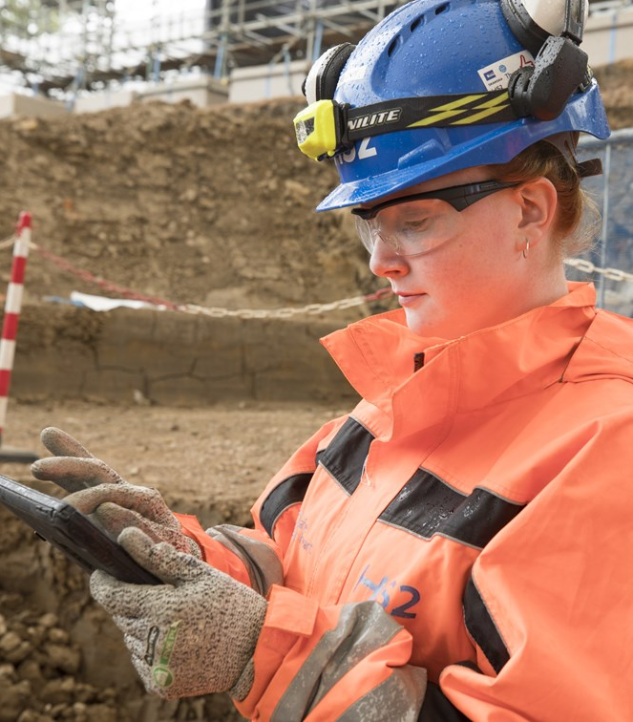
Careers Link: Rail Careers
There are lots of other careers in rail to match
your interests:
Construction and civil engineering;
Ecology and environmental advising;
Customer Experience Design;
Operations roles such as driving trains or signalling.
Find out how you could start your career at HS2 at:
https://www.hs2.org.uk/careers/future-talent/
Notes:
Careers Link: Rail Careers
Use this slide to explain the different types of careers available in rail. Explain each job roll as follows:
Construction – Construction workers or plant operators help to build stations, tunnels and bridges.
Civil Engineers – Oversee the design, construction and maintenance of stations, tunnels and bridges.
Ecologists – Ecologists survey the wildlife around where the railway will be built and help to build new habitats.
Environmental Advisors – Make sure that the construction site and build minimises its impact on the environment.
Customer Experience Design – Designs the features of the railway that customers interact with such as websites, station interiors, train compartments.
Train driving – Operates the trains and gets customers to their destination.
Signalling Operator – Operating the signalling systems to make sure that trains run on time and safely.
Try to relate these careers to your students’ interests. For example:
If you know a student likes construction toys or computer games, suggest construction or civil engineering.
If they like nature documentaries, consider ecology.
If they like designing or making things for their friends, consider customer experience design.

