Slide 1
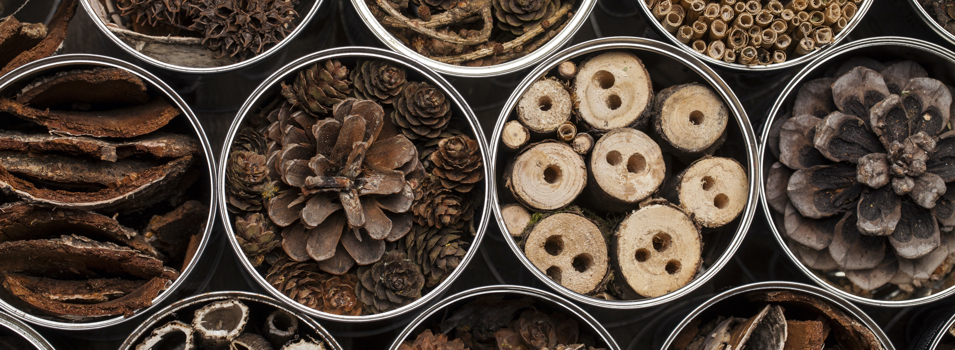

Slide 2
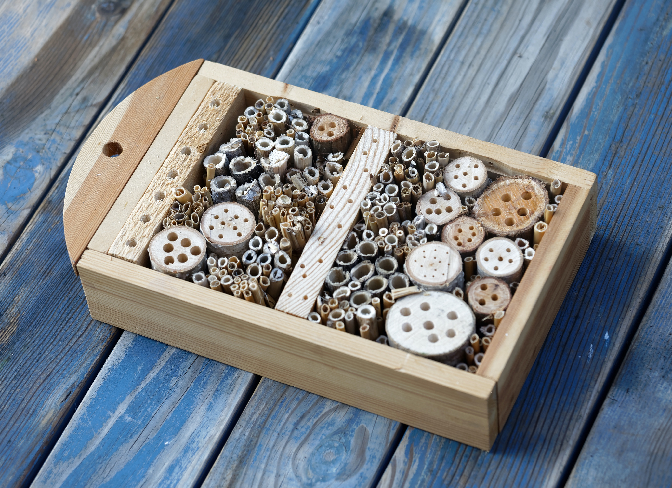
Insect hotel
What do you think an insect hotel might be?
Why might insects need somewhere to stay?
What might an insect need for their stay?
Notes:
Welcome
This slide introduces the Insect Hotel activity.
Ask the students the introduction questions.

Slide 3

Learning objectives
In this lesson you will learn to:
Understand why insects are important;
Build an insect hotel.
You will focus on the essential skills of listening and problem solving.
Notes:
Learning Objectives
Introduce the learning objectives for today’s session by reading through this slide. Explain to the students that they will be learning the basics about insects and then making an insect hotel.
Ensure that your students understand the key terminology of the learning objectives.
In addition, you may wish to define problem solving and listening for the purposes of this session. You could ask the students what makes good listening or problem solving. You could ask students to rate their skills of listening and problem solving with thumbs up, thumbs down or thumbs to the side. Aim for more thumbs up by the end of the lesson.

Slide 4
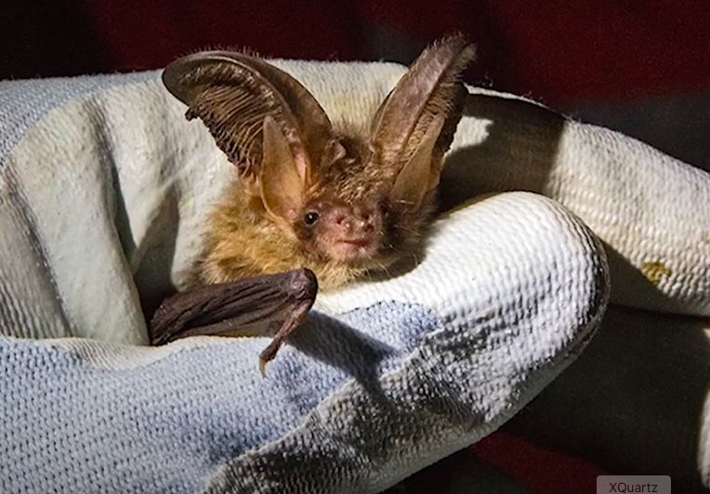
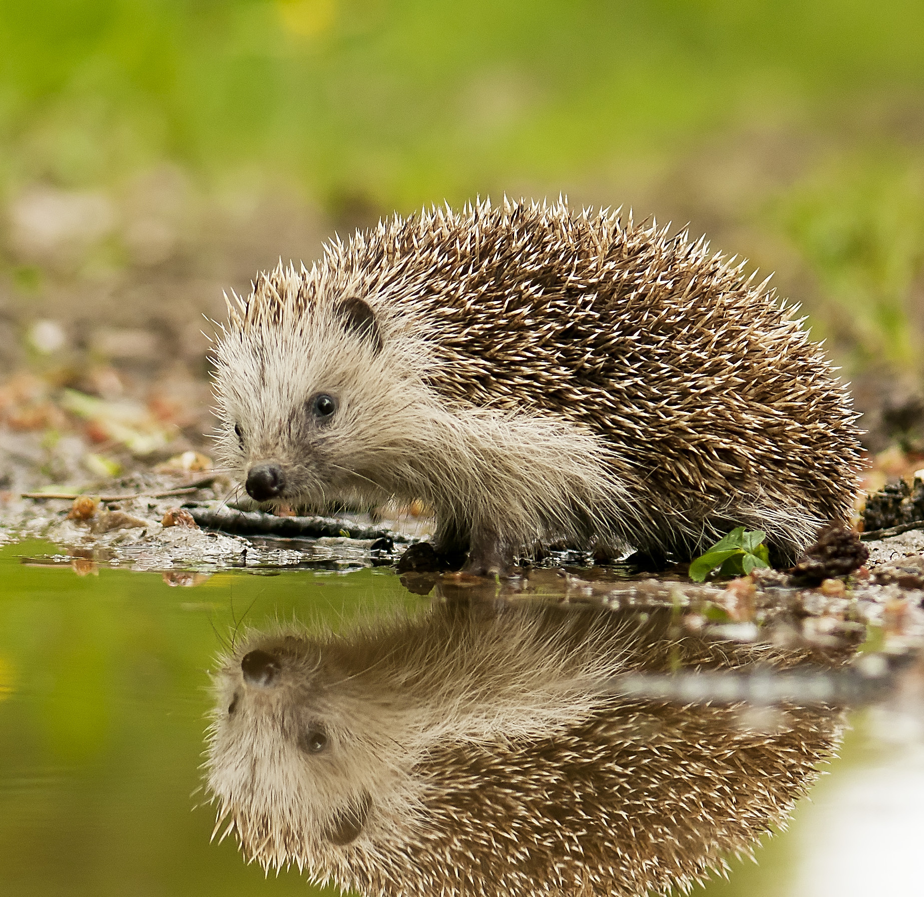
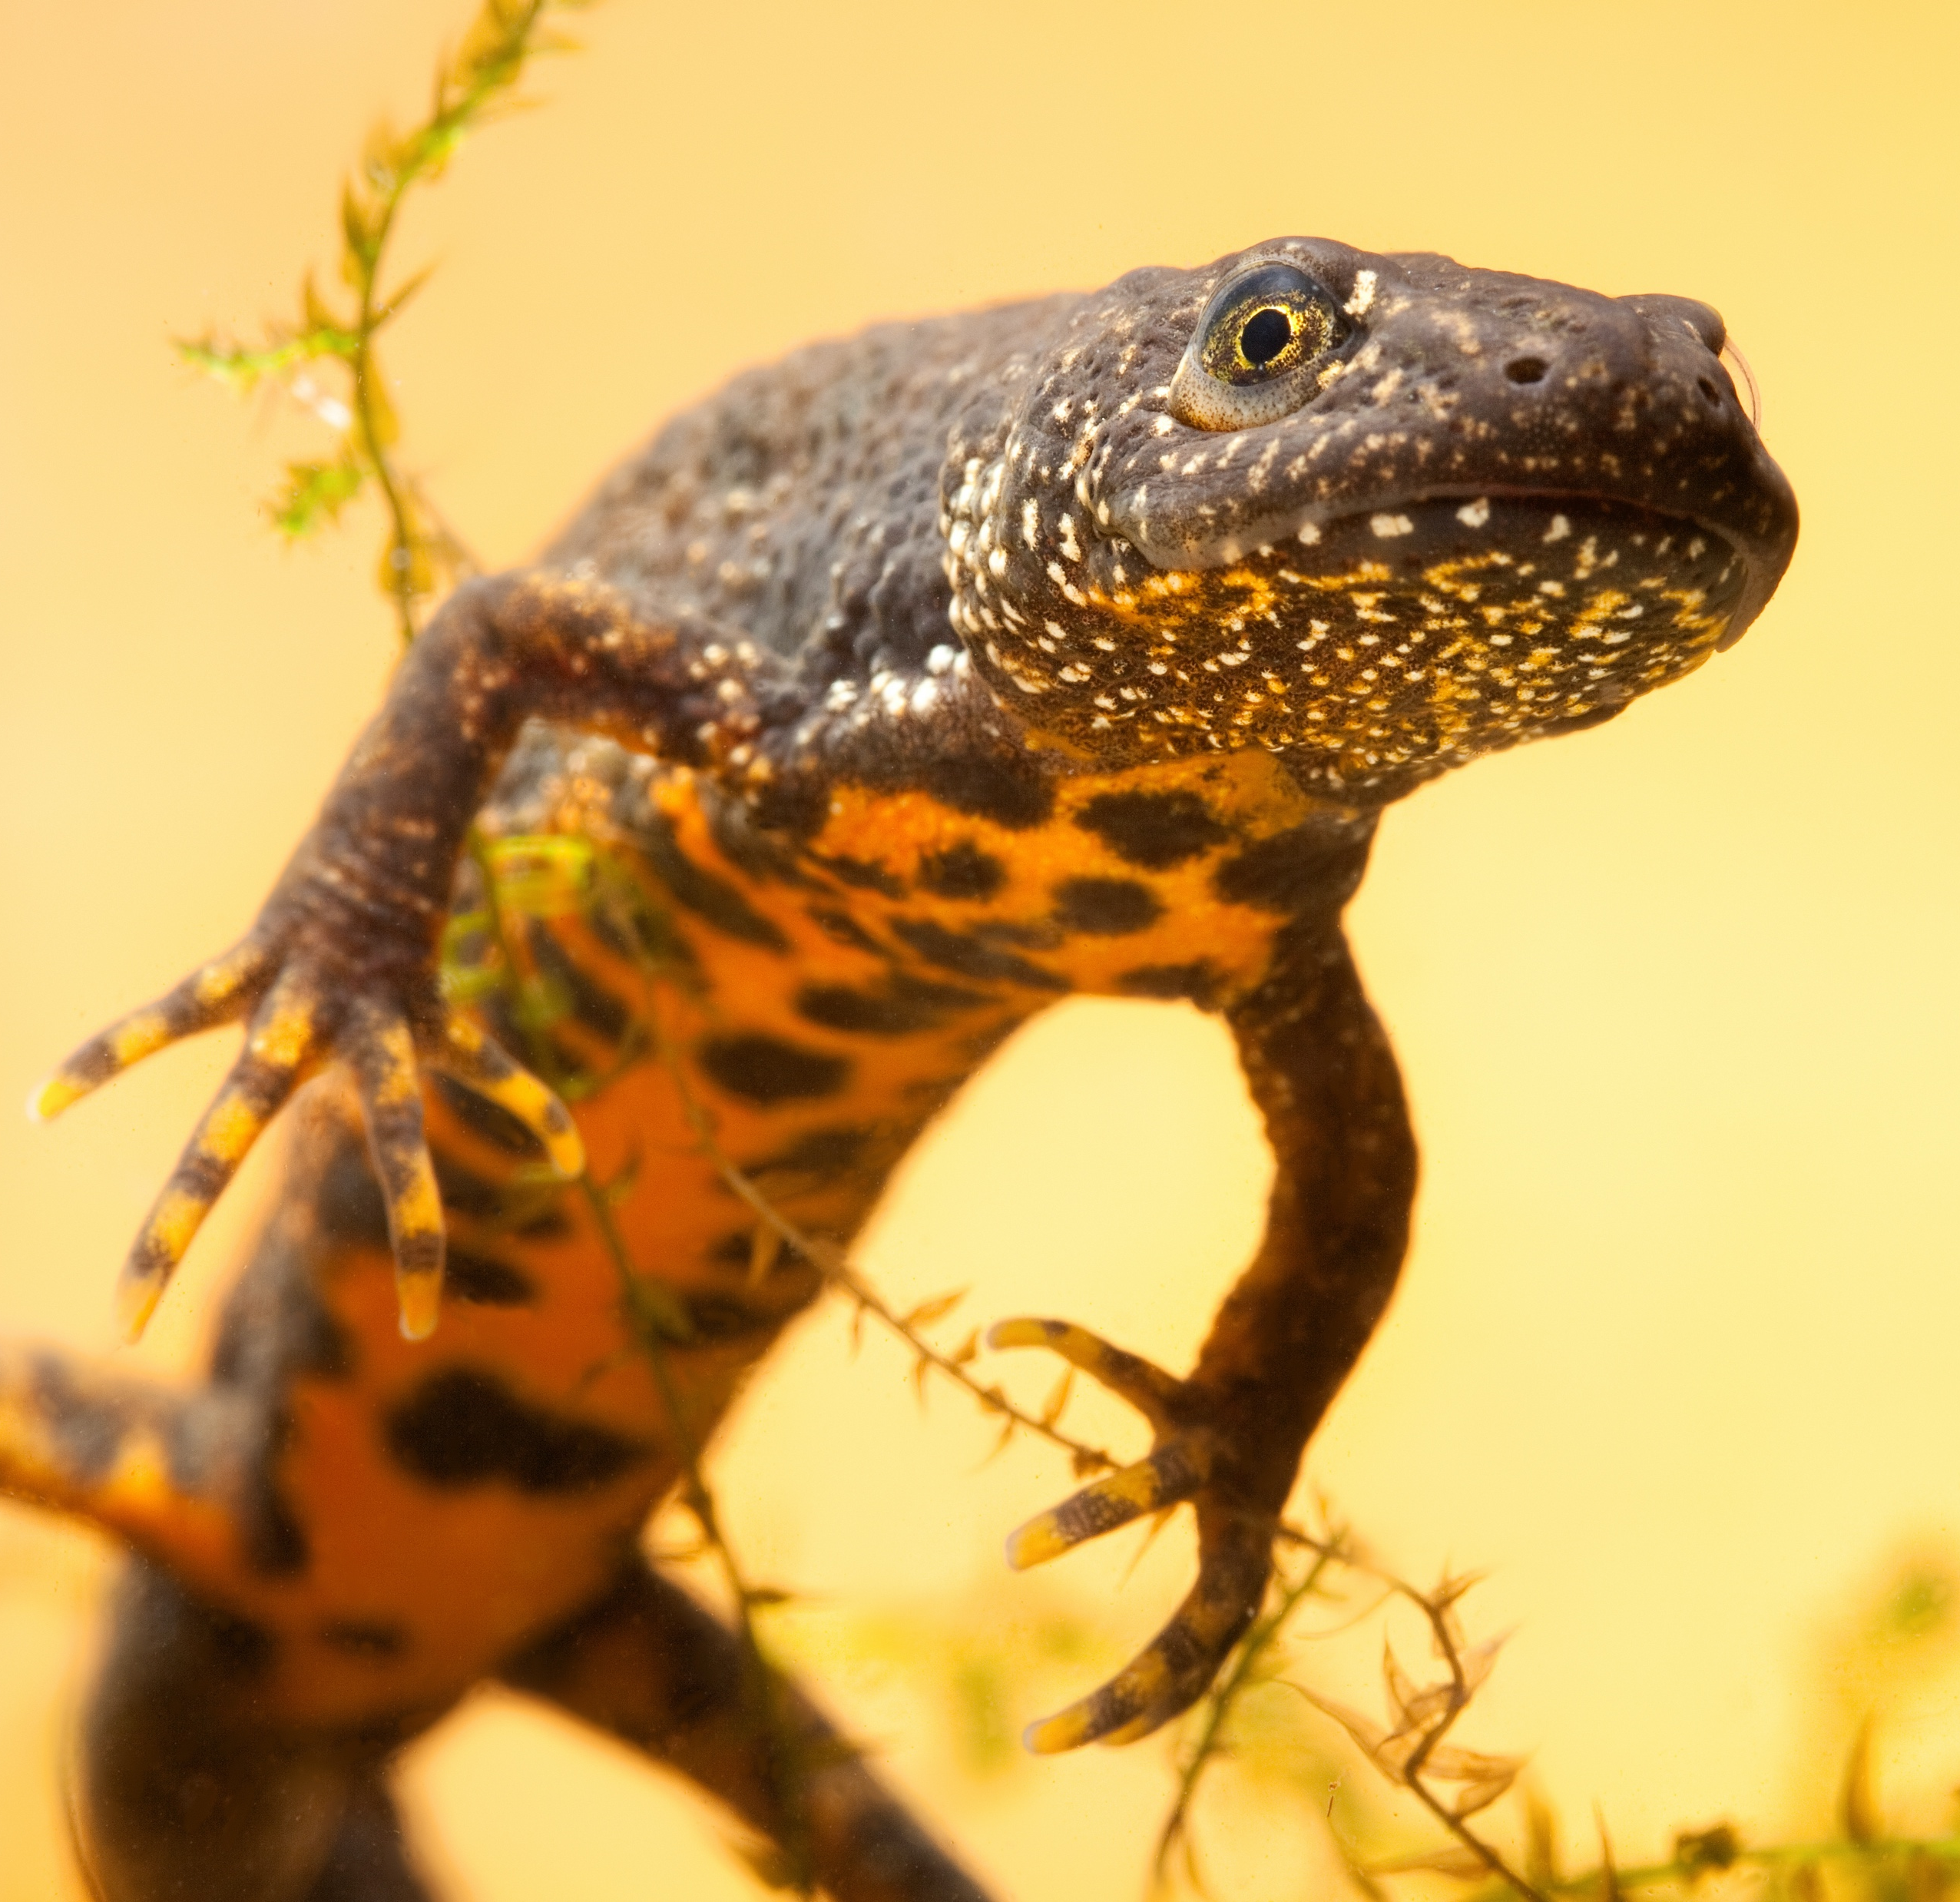
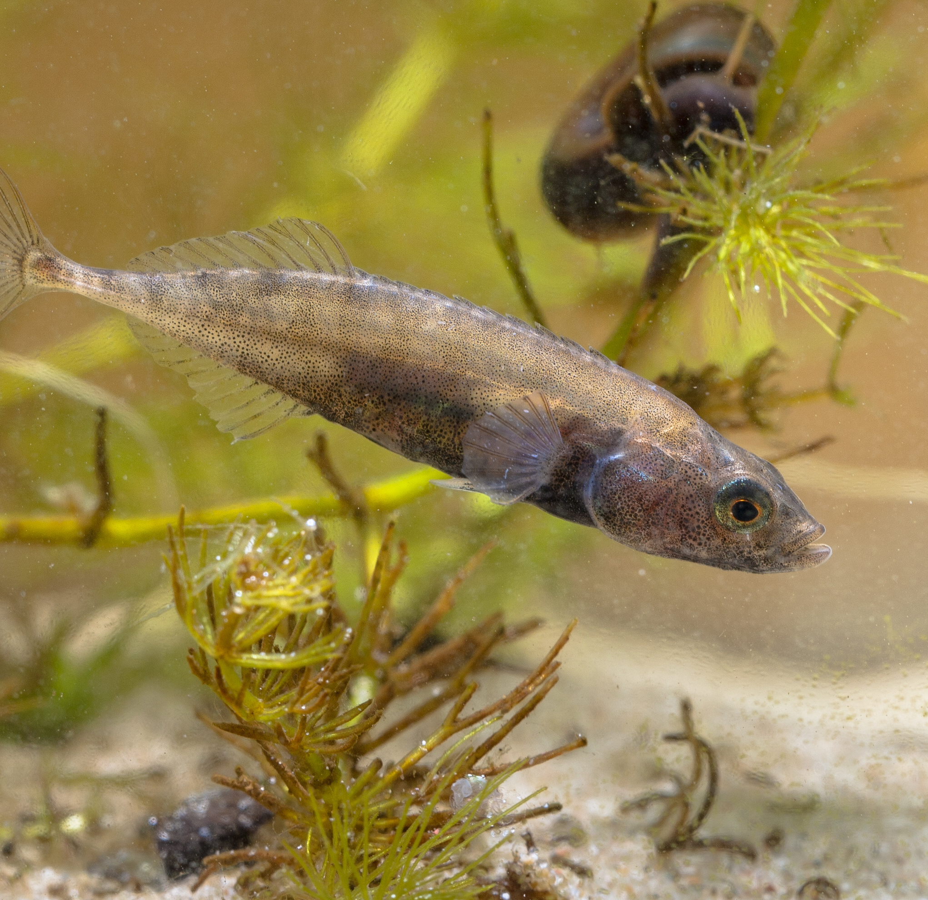
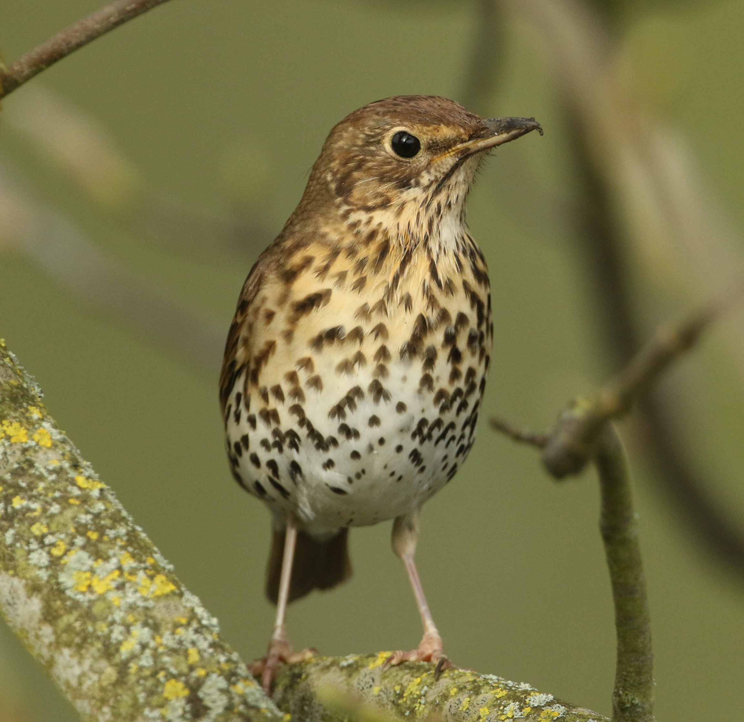
Tasty critters
Insects provide tasty meals to many different animals including:
Bats
Hedgehogs
Newts
Fish
Birds
Notes:
Tasty Critters
Explain how insects are tasty meals for many different animals, providing energy and nutrients.
For example, bats can sometimes eat up to 3,000 insects in a single night, and hedgehogs like to eat all kinds of creepy crawlies such as spiders, slugs, earwigs and millipedes.

Slide 5
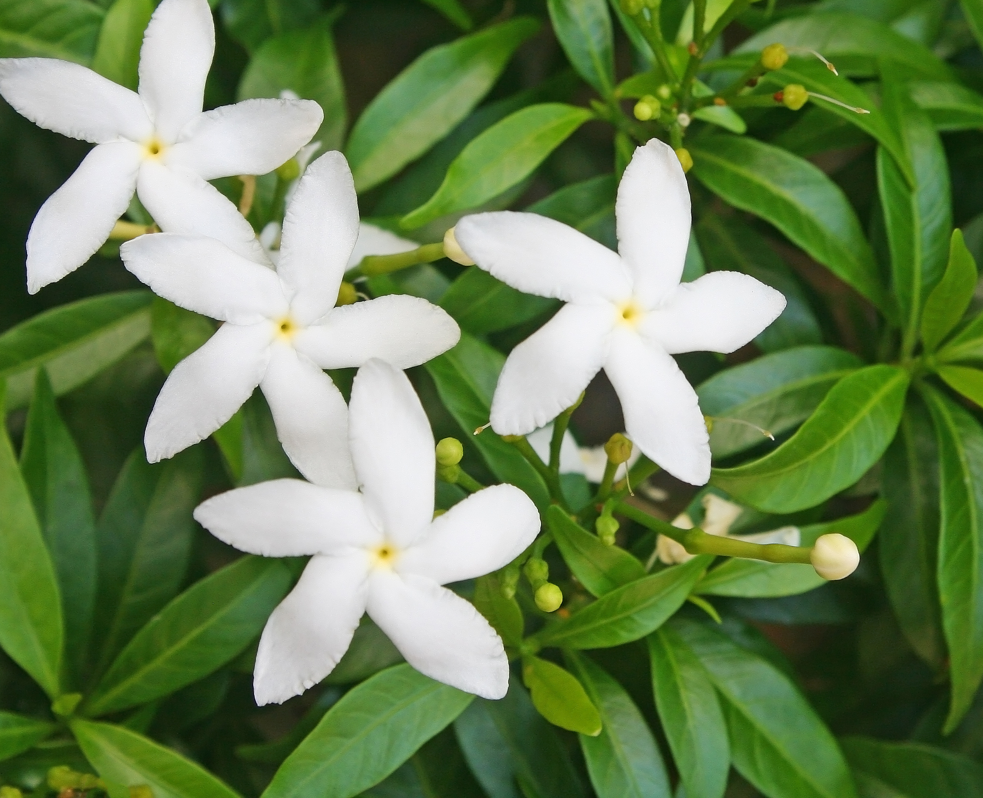
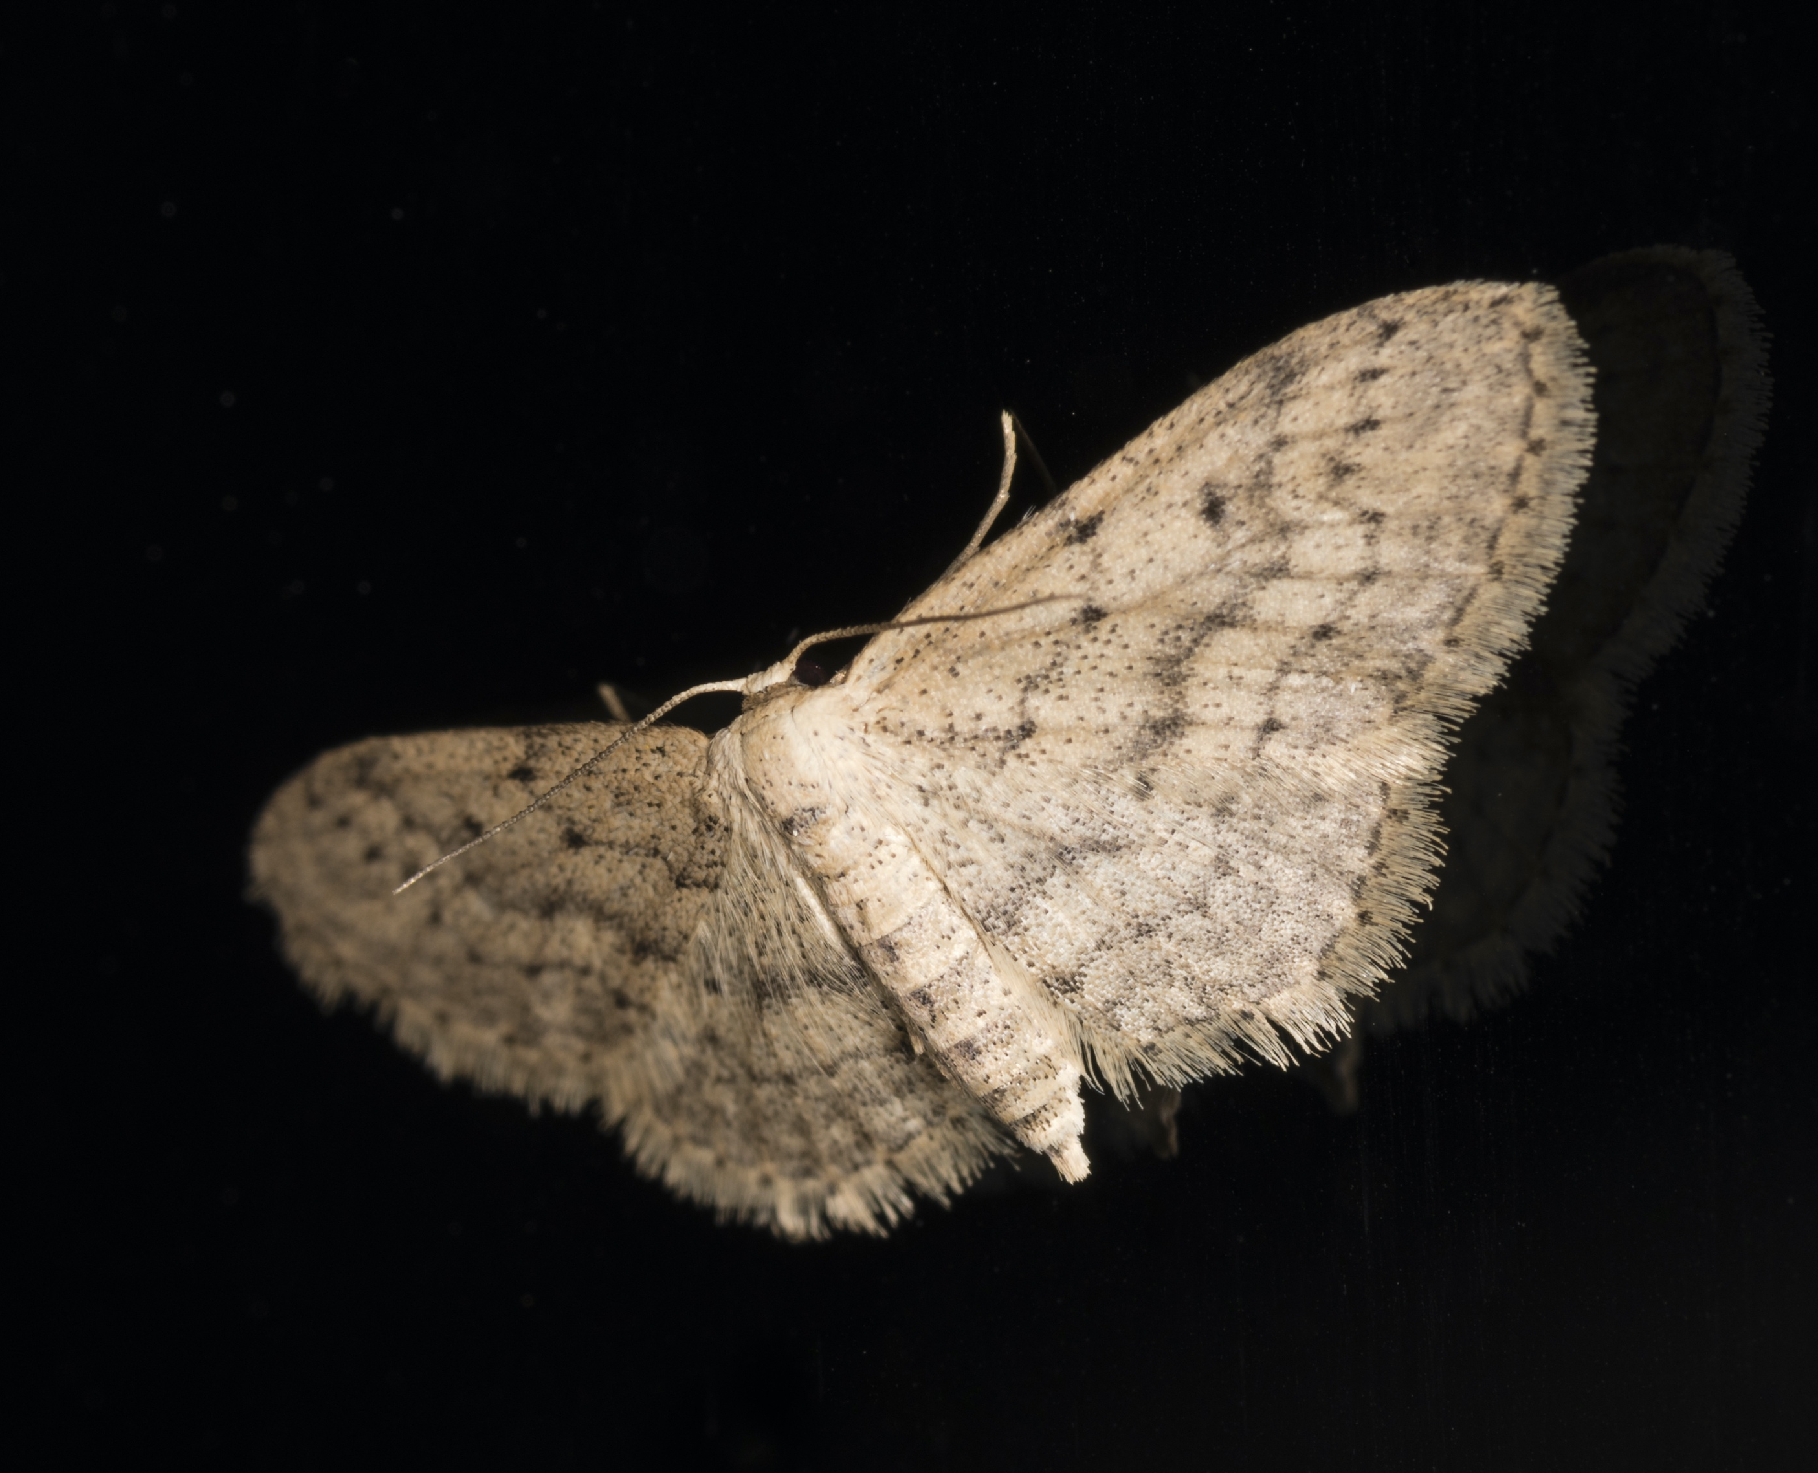
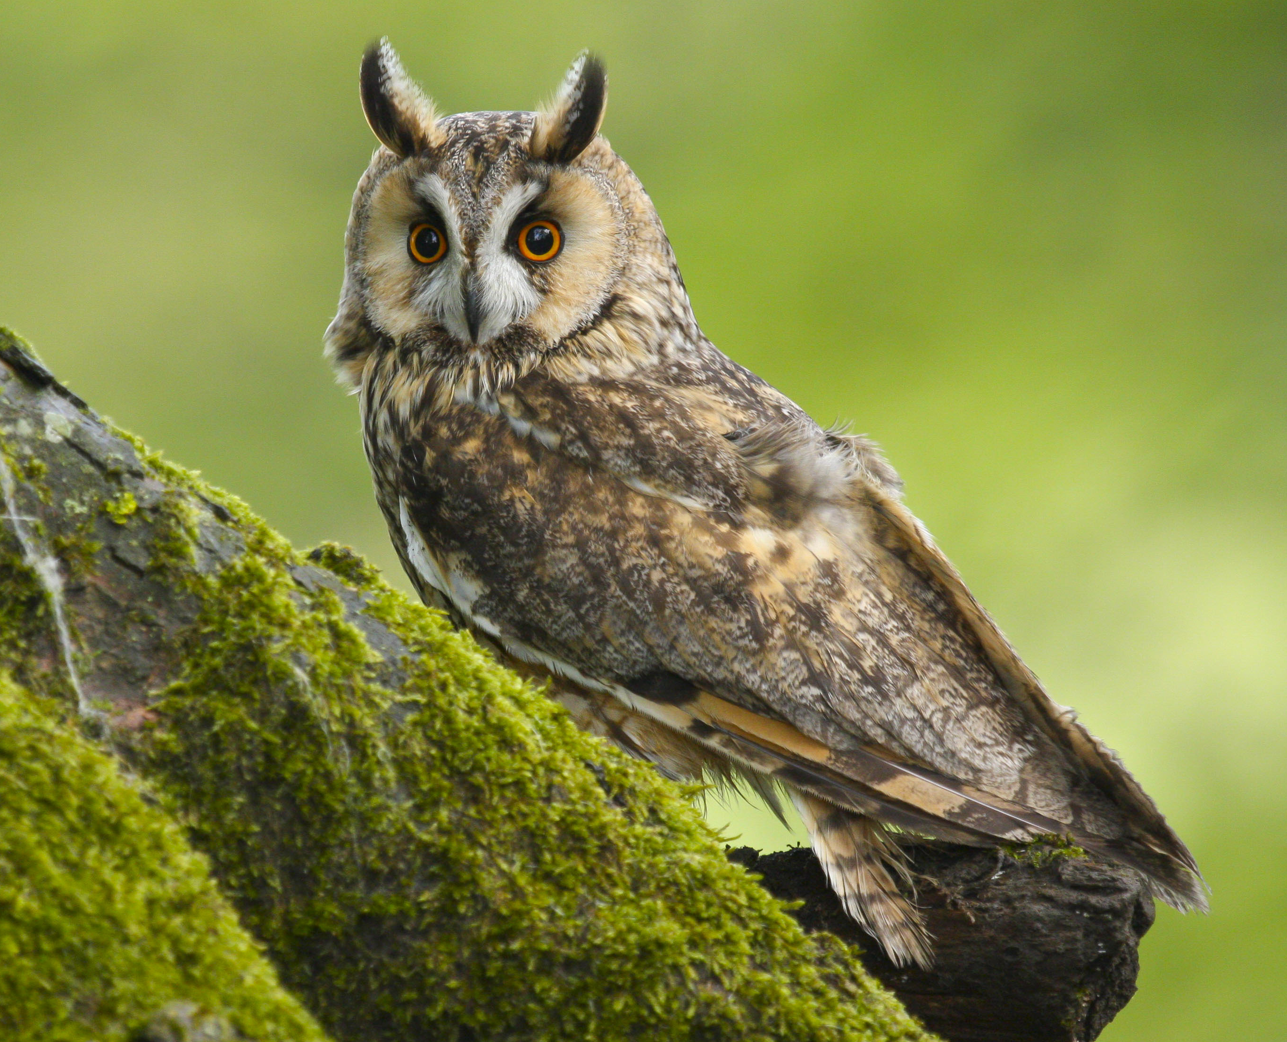
Food chains
We can show these feeding relationships as a food chain:
Jasmine Flowers
➔
Moths
➔
Bats
➔
Owls
What would happen if there were no insects?
Notes:
Food Chains
Explain how we can represent who eats who as a food chain.
If the students have not seen a food chain before, explain that the arrows always start from the plants (producers) up through the primary, secondary and tertiary consumers. The arrow represents the flow of energy.
Ask the students what would happen in the food chains above if there were no insects.
The bats would have less food and could die out, as could the owls because of this.

Slide 6
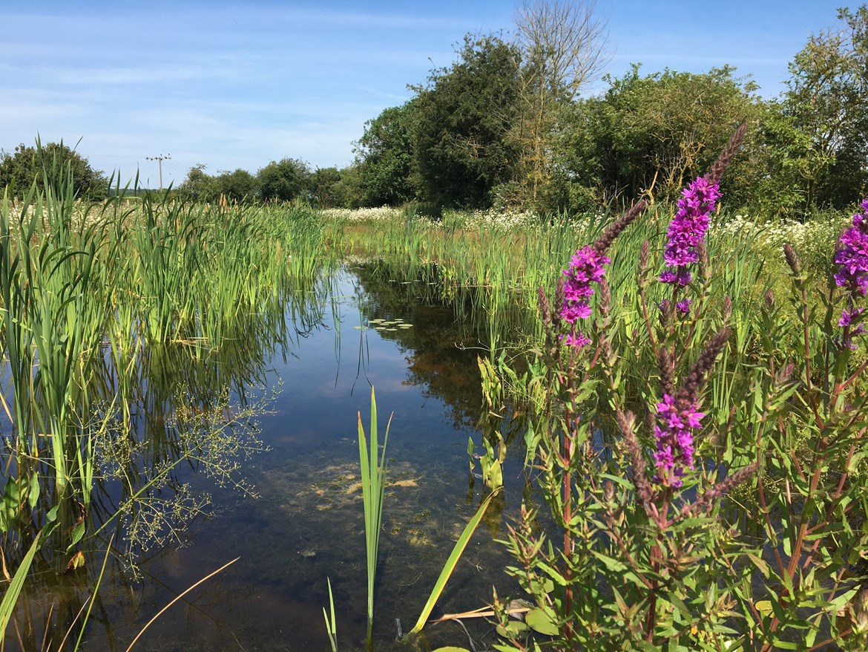
Insect pollination
Insects also help us by pollinating plants/crops.
They are attracted by the sweet scent and colour of flowers, taking pollen from one plant to another, and helping the plants to reproduce.
Notes:
Pollinating Plants
Explain to students how insects help to pollinate plants using the slide text.
Explain that some pollinating insects are in decline. Ask students why they think that some are in decline and what would happen if they were lost altogether.
Insects such as bees are in decline due to climate change, habitat destruction and a loss of biodiversity.
There would be no insects to pollinate the plants that form habitats.
There would be no insects to pollinate our crops, causing there to be less food for us and other animals.
Note that a detailed explanation of insect pollination is beyond the scope of this lesson. Students would need to have established knowledge about the parts of a flower and the gametes, and this is best covered in a lesson or two of its own.

Slide 7
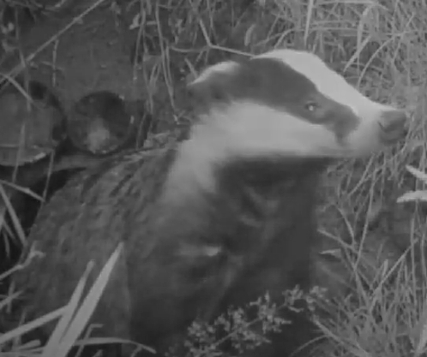
Challenge 1:
Why are insects important?
Complete Challenge 1:
Why are are insects important?
Complete the food chains.
Fill the blanks in the paragraph.
Focus on the essential skill of listening.
Notes:
Challenge 1: Why are insects important?
Ask students to complete Challenge 1. You could complete question a) as a worked example on the board. Go through the answers once complete.
An interesting point to highlight here is to question what would happen if there were no spiders. This could lead to hedgehogs having less food, and there being more flies.

Slide 8
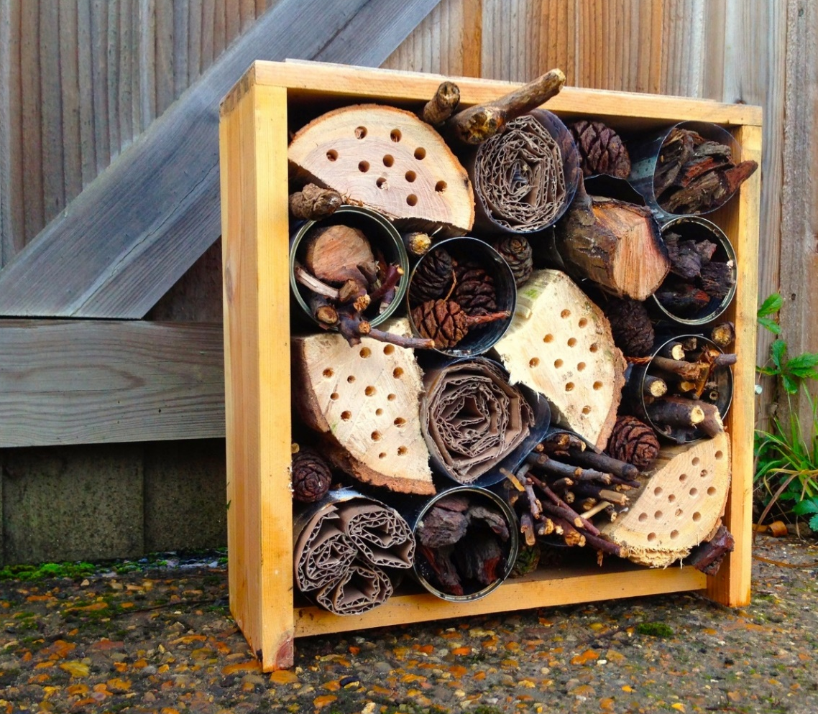
Challenge 2:
Build an insect hotel
Complete Challenge 2: Build an insect hotel
Use the supplied materials to help build
an insect hotel where insects can shelter.
Focus on the essential skill of problem
solving.
Notes:
Challenge 2: Build an insect hotel
Introduce the idea of an insect hotel to students. Explain that they help insects to thrive by giving them somewhere to shelter, by reproducing the natural spaces where insects like to live; under leaves, rocks or logs or between bundles of twigs.
Demonstrate how to build one ‘room’ of the hotel by filling the container with materials. Show students how to stack their container in the wooden crate or other structure.
Supply the students with tubes of different sizes along with a supply of materials such as bamboo, sticks, reeds or straw cut into short pieces or bee nesting tubes.
Students should pack their tubes with materials and then bring them to the front of the room to be stacked into the crate box.

Slide 9
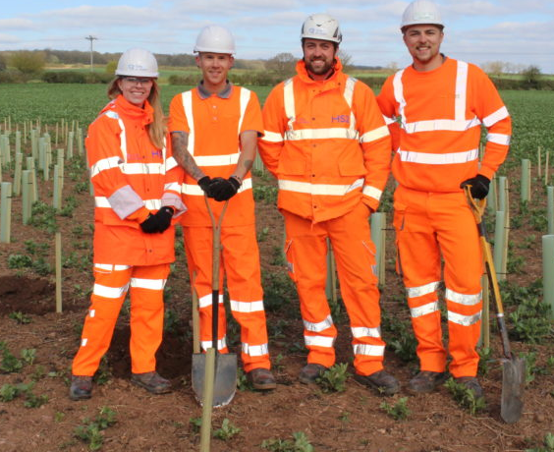
Plenary
Why are insects important?
How easy or difficult was it to build part of a bug hotel?
Why is it important that we protect the environment?
In what types of jobs might you need to understand about the environment?
How else can we protect insects?
Notes:
Plenary
Use these questions to review the learning and return to the objectives set at the beginning of the lesson. This also provides students with a chance to show off what they have learned and to share ideas and skills.
Use the final question to introduce a careers element to the activity. The aim is to relate the skills from today’s session to a career. See what jobs students suggest – you could link this to all types of jobs and careers including Gardeners, Ecologists, Environmental Advisors and Civil Engineers, all of whom work on HS2.
Ask your students to rate their listening and problem solving again. Hopefully, you have more thumbs up than at the start!

Slide 10
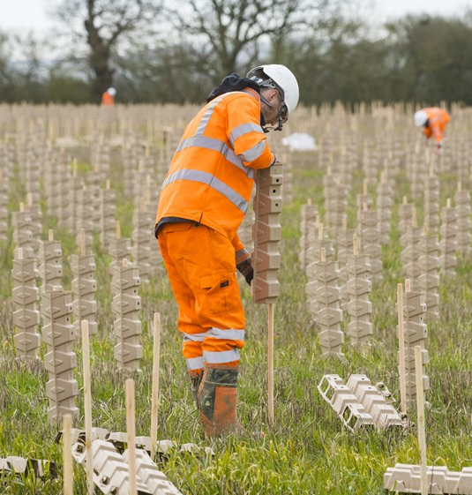
Careers Link: Ecologist
Study the natural world including plants,
animals and the environment.
Work with Civil Engineers and construction teams to reduce the effects of construction
on wildlife and conserve habitats.
Find out how you could start your career at HS2 at:
https://www.hs2.org.uk/careers/future-talent/
Notes:
Careers Link: Ecologist
Explain to the students that if they enjoyed today’s activity, then they should think about a career in Ecology. Ecologists at HS2 survey the plants and animals on and around the route, and work with Civil Engineers and construction teams to minimise the impact of the build on their habitats.
Ecologists are also helping to build the green corridor, a network of habitats that will run along the railway.

