Slide 1
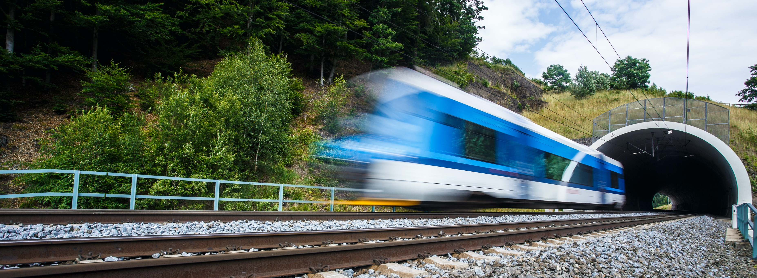
Notes:
Welcome
This slide introduces the Tunnel Structures Challenge activity.
Ask the students some starter discussion questions:
What is a tunnel?
Where have you seen one?
Why do we need tunnels?

Slide 2

Learning objectives
In this lesson you will learn to:
Work together as a team;
Follow instructions to create a model, or create your own;
Discover the strengths and weaknesses of different types of structure.
You will focus on the essential skills of problem solving and teamwork.
Notes:
Learning objectives
Introduce the learning objectives for today’s session by reading through this slide.
Ensure that your students understand the key terminology of the learning objectives.
In addition, you may wish to define problem solving and teamwork for the purposes of this session. You could ask students what makes somebody a good team member or good at problem solving. You could ask students to rate their skills of problem solving and teamwork with thumbs up, thumbs down or thumbs to the side. Aim for more thumbs up by the end of the lesson.

Slide 3
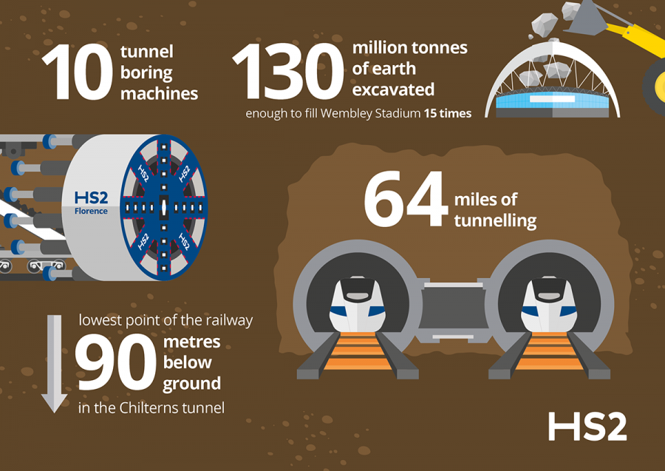
Tunnels at HS2
Tunnels are an important part of HS2. They enable trains to travel through hills and under cities.
Tunnels are normally built from steel-reinforced concrete, which is very strong and can resist the movements of the ground and the weight above.
Notes:
Tunnels at HS2
Use this slide to introduce tunnels. Use the facts and information on the infographic to get students thinking about why and how we build tunnels.

Slide 4
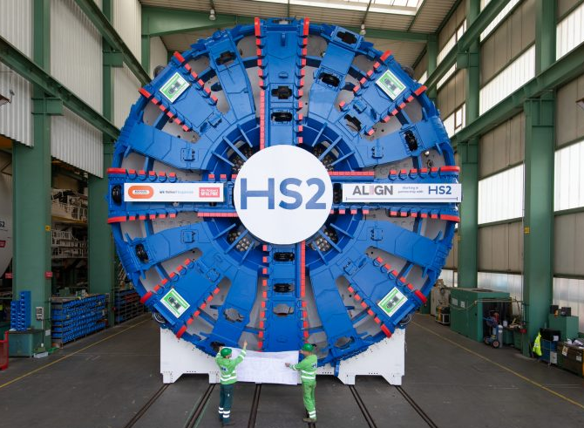
Tunnel Boring Machines
Some of the tunnels built by HS2 will be excavated and constructed by Tunnel Boring Machines (TBMs). Watch the video to find out more about them.
https://youtu.be/R7goBihzjEM
Notes:
Tunnel Boring Machines
HS2 will use one Tunnel Boring Machine to build its 64 miles of tunnels. Tunnel Boring Machines are huge machines, around the height of a school hall, and excavate the soil by grinding it up with the front cutterhead of the machine, liquefying it and pumping it away. The machine also uses robot arms to build the tunnel as it moves forward.
Tunnel boring machines are much safer and faster than historical tunnel building methods, as the tunnel face is not open during excavation and construction.

Slide 5
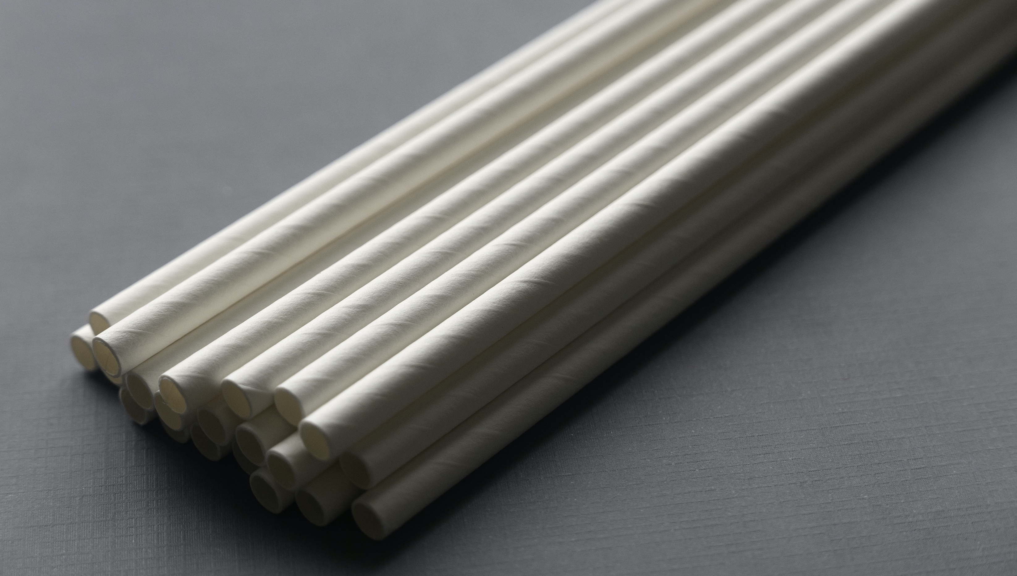

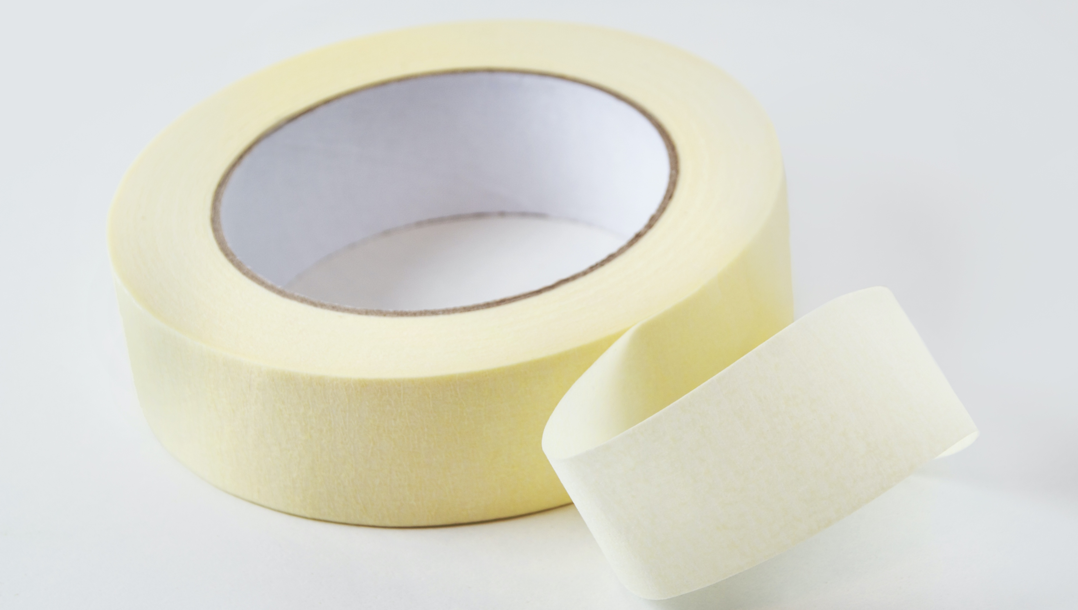
Challenge 1: Tunnel building
Today you will be building a train tunnel which will be tested at the end of the lesson.
You will use:
Focus on your essential skills of problem solving and teamwork.
Notes:
Challenge 1: Tunnel building
Introduce the challenge. Explain to students that they will be building a tunnel just like the one on the introduction slide and will be working in groups. Show your students the examples. Explain to your students that they will be building a tunnel just like your examples. Alternatively, show students the next slide.
They can choose from the designs that there are instructions for or design their own, however it must survive the following tests at the end of the lesson:
It must fit on the testing poster
The train must fit through
It must survive the weighted bag being dropped on it.
Show students the testing apparatus. Alternatively show them slide 7, which shows the test process.
Ask the students what they think the bag represents? It represents the weight of the earth or ground pressure.

Slide 6
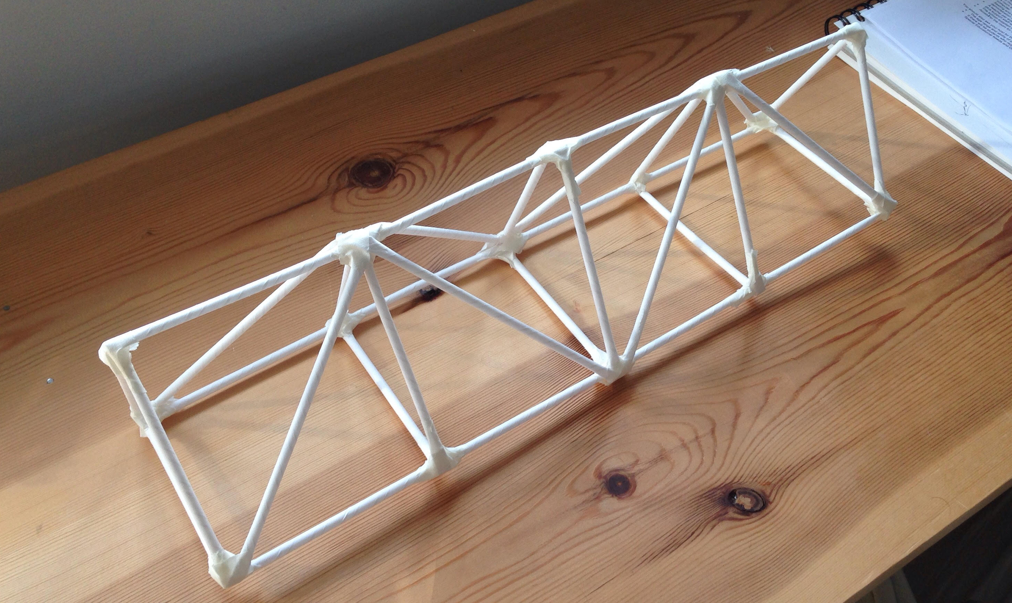
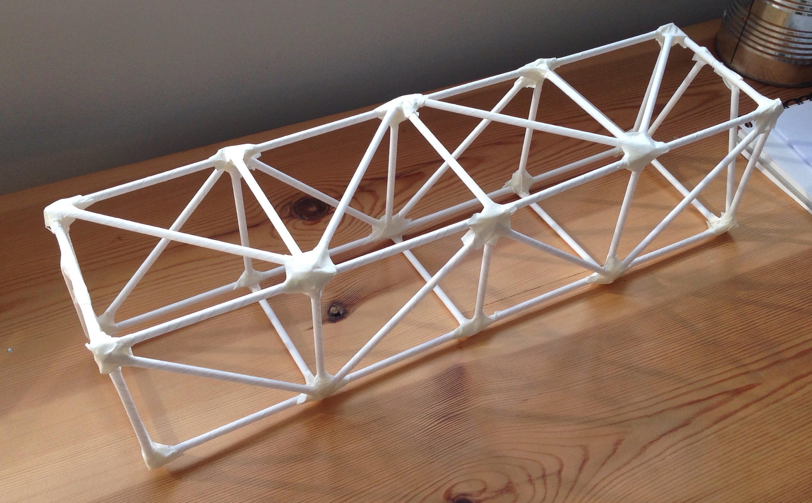
Tunnel examples
You will create a tunnel structure. Here are some examples.
Notes:
Tunnel examples
The following are examples of how students could build their tunnels using the instruction sheets.
Ask students which they think would be better.
Explain that students may use their own design instead.

Slide 7

Testing
We will now test the tunnels. Which tunnels will survive?
Notes:
The Challenge
Collect all the structures and bring them to your testing area. Alternatively test each structure on the group’s table.
Reintroduce the tests for each structure.
It must fit on the testing poster
The train must fit through
It must survive the weighted bag being dropped on it.
For each tunnel, ask the students to vote whether it will be a success or be crushed. Ask individual students why they think this.
Make sure that each structure gets a polite round of applause for effort.
You could optionally introduce the Essential skill here of staying positive.

Slide 8
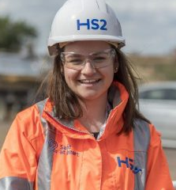
Plenary
How well did you work as a team? Did you improve your teamwork skills today?
Did you manage to follow the instructions? Was it easy or hard to build your structure? Why?
Why did some structures collapse? Why were some successful?
In what types of jobs might you need to use teamwork or problem solving? Why are they useful?
Notes:
Plenary
Use these questions to review the learning and return to the objectives set at the beginning of the lesson. This also provides students with a chance to show off what they have learned and to share ideas and skills.
Use the final question to introduce a careers element to the activity. The aim is to relate the skills from today’s session to a career. Explain how Construction Workers who build real life tunnels need to use teamwork and that the Civil Engineers must use problem solving.
Additionally, ask students to re-assess their teamwork or problem solving with thumbs up, thumbs down or thumbs to the side. Hopefully, you have more thumbs up!

Slide 9
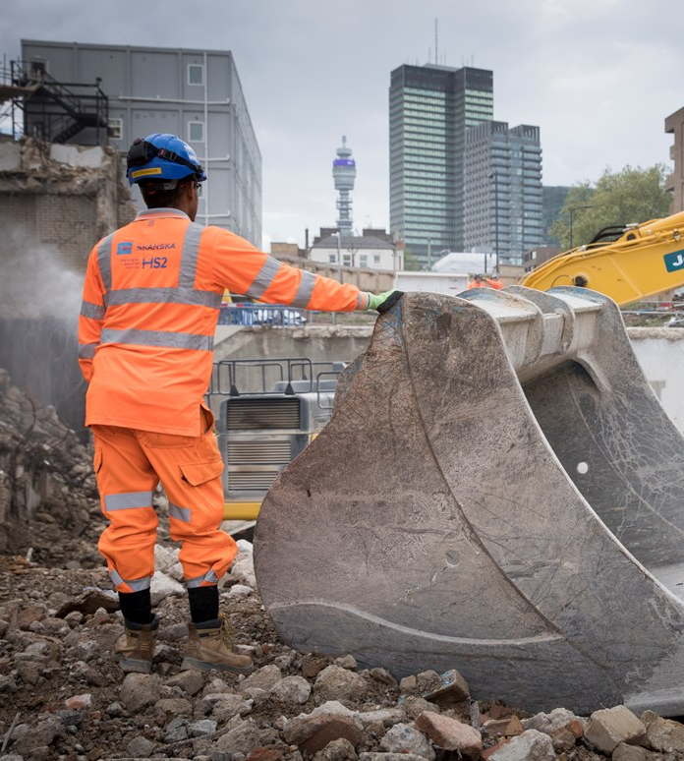
Careers link:
Construction Plant Operator
Use your making skills to build full size structures.
Drive and operate exciting machines such as excavators, cranes, bulldozers, concrete pumps, dumpers and loaders.
Find out how you could start your career at HS2 at:
https://www.hs2.org.uk/careers/future-talent/
Notes:
Careers link: Construction
Explain to the students that if they enjoyed today’s activity, then they should think about a career in Construction as a Construction Plant Operator. Construction Plant Operators at HS2 are the people who build the tunnels, bridges and stations, using heavy machinery.

