Slide 1

Notes:
Welcome
This slide introduces the Innovating the Future, a CREST-accredited HS2 activity that can go towards students earning a CREST Discovery Award.

Slide 2

What is Innovation?
Innovation is the process of creating ideas for new products, systems and services.
HS2 has the following areas of focus:
Environment
Construction and Design
Customer Experience
Process
Today you will be innovating to improve customer experience.
Notes:
What is Innovation?
Use this slide to introduce the concept of innovation at HS2. Explain that innovation is the process of creating ideas for new products, systems and services, and that the aim of this project is to innovate a product that improves ‘customer experience’. Explain that you will come back to that term later.

Slide 3

Your challenge
In today’s workshop you will innovate a new product to be used when travelling by train.
You will design, model and present your idea to investors. Each product will have the possibility of winning £100,000 worth of investment.
Notes:
Your Challenge
Introduce the challenge. Students will be designing a new product to be used when travelling by train. Students will design, model and present their idea in a pitch for £100,000 investment.
Explain that each project will have the chance to win (so every group could win) and that students should know that they will still be eligible for their bronze award whether they win the activity or not.

Slide 4
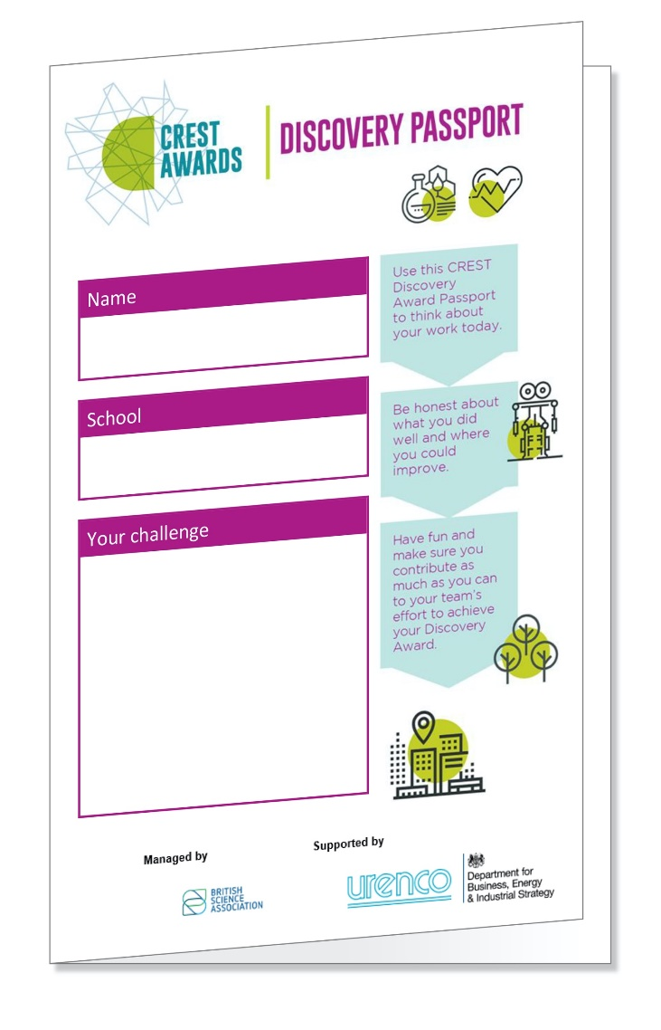
CREST Discovery Passport
Fill out your CREST Discovery Passport throughout the day to show your learning and earn your CREST Award.
Write your name, school, and challenge on the front, then read through the questions.
Your challenge today is ‘Innovating the Future’.
Notes:
CREST Discovery Passport
Introduce the CREST Discovery Passport. Explain to the students that it is their responsibility to fill out their passport over the session. Ask students to write their names on their passports. Without this they will not get their Discovery Award.
Allow them to look through their passport for a couple of minutes and answer any questions that they may have about the questions.

Slide 5

Timetable
Introduction to Innovating the Future
Introduction to the Challenge
Setting the Scene
Ideation and Design Development
Preparing to Present
Presentations
Notes:
Timetable
Explain the order of the day.

Slide 6
The Brief
In today’s workshop you will create a new product to be used when travelling by train.
You will design, model and present your idea.
Your product must:
Solve a problem;
Be used by train customers or staff;
Improve the customer experience of travelling by train.
It can be a physical product used in real life or a digital product such as an app or website.
To complete the challenge you will use the essential skills of teamwork, creativity
and speaking.
Notes:
The Brief
Explain the project challenge in more detail using the text on the slide. Make sure that students understand that this must be a new product, or a significantly improved existing product with at least one new feature.
Explain the essential skills that the students will be using over the day. Ask if the students have any questions.

Slide 7

Workshop 1: Setting the Scene
To create a successful product we need to think about the other items that people carry with them when travelling.
Complete Challenge 1: Packing for a Long Journey.
What would you pack for a long train journey? Imagine that you are travelling across the country by train.
In your student pack, list the items that you would bring with you and explain why you might need them.
Notes:
Workshop 1: Setting the Scene
Ask students to complete Challenge 1: Packing for a Long Journey. Students should create a list of items that they would take with them on a long train journey, and explain their answers. After ten minutes ask the students for their answers. You could create a list or mind map on a whiteboard if you have access to one.

Slide 8

Workshop 1: Setting the Scene
We also need to think about the context in which the product will be used and how it will improve the customer experience of the user.
Complete Challenge 2: Customer Experience Map.
In your student pack you will meet Jan who is going on a journey. Number each stage of Jan’s journey to create a customer experience map.
How might Jan’s customer experience be different if they were a wheelchair-user?
How might Jan’s customer experience be different if she was travelling with a baby or young children?
Notes:
Workshop 1: Setting the Scene
Explain that the customer experience of travelling by rail covers everything from booking a ticket to arriving at the destination. Ask students to complete Challenge 2: Customer Experience Map. They may discuss their answers with their team. After 15 minutes ask the students to feedback their answers.
Ask the students how the customer experience would be different for people who have a disability, such as the impairments listed in question b). Ask how the customer experience would be different if they were travelling with young children or a baby in a buggy, in question c).
Discuss the students’ answers. Answers for this challenge can be found in the Workshop Answers section of this Guide.

Slide 9
Workshop 2: Research & Specification
Research is an important part of designing a product. Your research should aim to identify:
A problem for your team’s product to solve;
The users who will benefit from it;
The technologies you might use to solve the problem.
Complete Challenge 1: Research
Read and discuss the statements from rail customers and rail staff found in your Student Pack. Which problems interest you to solve them?
Note that there is no writing necessary for this challenge, but you may sketch or take notes on the plain paper provided.
Notes:
Workshop 2: Research & Specification
Explain to the students that research is an important part of the design process. In this workshop they will be using research to locate a problem for their product to solve and a user who will benefit from the product. Ask the students to complete Challenge 1: Research. Note that there is no writing necessary for this challenge, but students may sketch or take notes if they wish.
Explain to the students that they have fifteen minutes to read.

Slide 10
Workshop 2: Research & Specification
Complete Challenge 2: Problem & Specification
Answer the questions in your Student Pack. You must decide:
Which problem your team’s product will solve;
Who will use and benefit from your product.
You should then create a list of five things that your product must do to be successful. This might be:
A function of the product; e.g. it must stand up without falling over.
A quality of the product or it’s materials, e.g. it must be an appealing colour for the user.
Try to justify each point, e.g. it must be an appealing colour so that users will want to buy it.
Notes:
Workshop 2: Research & Specification
After 15 minutes ask the students to progress to Challenge 2: Problem & Specification. After deciding as a team which problem they will solve they should answer questions a) and b) in their Student Packs. Question b) asks the students to write a list of success statements. This is a 'product specification'. The statements should refer to what the product must do, or qualities that it must have. These should not restrict the design too much at this stage. Note that students may come up with their own problem beyond those mentioned in the customer statements.
If students cannot pick a problem, use the following guidance:
If they are a lower ability group, suggest that they choose to solve the problem of creating the perfect overnight travel case, or a way of preventing drinks from falling over.
If they are a higher ability group, suggest that they choose to solve the problem of children getting separated from their parents in stations, navigating a station when visually impaired, or monitoring customer wellbeing.

Slide 11
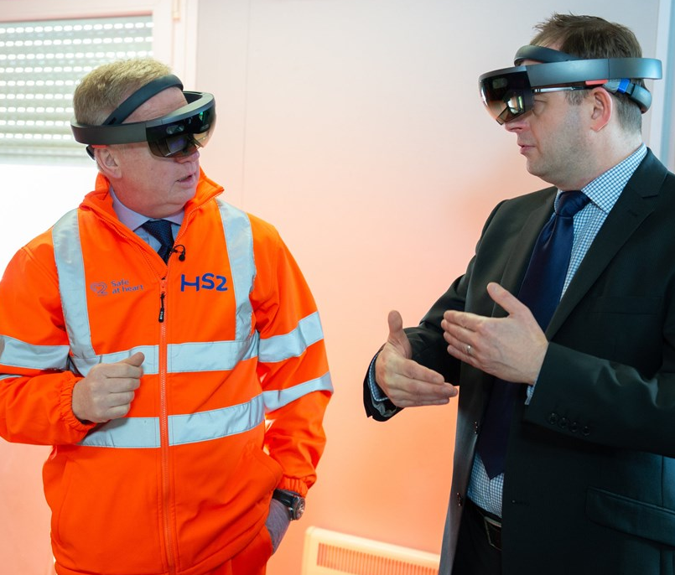
Workshop 2:
Research & Specification
Complete Challenge 3: Inspiring Technologies
Read the information and answer the
questions in your Student Pack.
How could your product use these inspiring
technologies to solve the problem?
Mark Thurston, HS2 CEO
using an Augmented Reality headset.
Notes:
Workshop 2: Research & Specification
Students should spend the last five minutes of this workshop reading about the inspiring technologies and deciding which technologies they could incorporate into their product.
Note that students are not making any design decisions at this point, they are just thinking how one or more of these technologies could help to solve problem.

Slide 12
Ideation & Design Development
Ideation is the process of coming up with ideas. In this part of the workshop you should produce a series of ideas, and then choose a single idea to develop and present.
You should decide as a team the best way to do this. You may want to:
Work separately on different design ideas for a set period of time, then review all the ideas together and choose one idea to develop and improve.
Create a mind-map of ideas or features to be combined.
Top Tip
Use your essential skill of creativity by sharing ideas and innovating as a group.
Notes:
Ideation & Development
Explain the process of ideation to students. For the first 15 to 20 minutes, students should work on producing a variety of design ideas. Students may wish to work separately, then come together to decide which idea to bring forward or work more collaboratively on developing one or two ideas. Students should concentrate on their essential skill of creativity during this period; sharing and developing ideas. Encourage students to think outside the box and to take risks. It doesn't matter if ideas are ‘wacky’ at this point.
If you have set up a table for students to collect materials and equipment, explain that it must remain tidy and that only one student from each group should collect at once.

Slide 13
Ideation & Design Development
Once you have decided on the single idea to develop you must then work towards producing:
A detailed, annotated presentation drawing of your product;
A model of the product;
A marketing plan.
Top tip
Use your essential skill of teamwork by being organised to complete all parts of the activity.
Notes:
Ideation & Development
Students should now have decided on a final idea. The rest of this session should be devoted to the key outcomes of the project: a detailed, annotated drawing, a model, and a marketing plan. Set high expectations; students should produce presentation-quality work.
Introduce the students to the modelling materials. Explain to the students that they should feel free to experiment but that they should not waste materials. Their model does not have to be to scale but should represent how they imagine the finished product would look and function.
The marketing plan should be a written document. It should explain all the criteria listed in their Student Packs. Lined A4 paper is available should they need it.

Slide 14
Preparing to Present
In this part of the workshop you and your team must get ready to present your idea. You may also add finishing touches to your model, drawing or marketing plan.
You will be presenting to a group of investors who are looking to finance a new product related to train travel. They are offering £100,000 investment.
You will have five minutes to present your idea, including your drawing, model
and marketing plan. Everyone in your group must speak.
Top tip
Use your essential skill of speaking. Think about how you can adapt your language, tone and gestures to engage the audience.
Notes:
Preparing to Present
Use the slide to explain that they must prepare a presentation to be presented to a group of investors offering £100,000. Explain that these are people who will help to fund the product and at the end of each presentation they will vote with a show of hands whether the investment will be awarded.
Explain to students that they have one hour to prepare their presentations and that everyone in the group should have a speaking part.
Students may use this time to add finishing touches to their drawings, models, or marketing plans. They may also use the modelling materials to make any props that they need for their presentations. Stop the students five minutes before the end of the session to tidy up. Recycle any materials that you can.

Slide 15

Presentations
Each group will now have five minutes to present their idea. Make sure that you include:
  The problem that your product aims to solve, as well as how the product does this;
  The intended audience for your product and your marketing strategy to reach them;
  Why your product is worth investing in.
Notes:
Presentations
Invite each group to the front of the room to present their product idea. Try to keep the pace up between presentations. Explain that after each presentation there will be a short period of time for questions, and then the investors (the students watching) will vote. If more than 50% of students vote in favour of investment, it is awarded. Each team will then receive a polite round of applause. Note that more than one team can be granted an investment.
During the presentations, make sure that the students watching are quiet, and think of your own question whilst you are watching. Use your questioning to help students to answer the brief if they haven’t already. Further questions could include:
What materials will the product be made from?
What safety considerations are there for the product?
Are there applications for your product outside of rail travel?
Ask students to vote based on whether they think the product fulfills the initial brief, and whether they think it is a good product that they would invest in.

Slide 16


Plenary
Reflect on your project and fill out any gaps in your CREST Discovery Passport in order to earn your CREST Award.
Notes:
Plenary
Ask students to complete their CREST Discovery Passports neatly and in full sentences. Ask the students to fold their Passports and to make sure that their names are on them and the rest of their work from the session.

