Slide 1
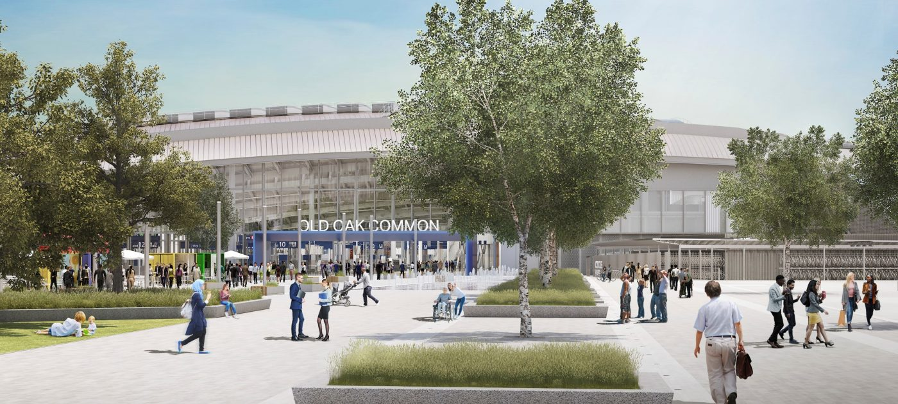
Notes:
Starter
This slide is a starter. Ask students:
What can you see?
What type of building or structure is this?
What might be inside?
Where do you think the people are going?
Note that the title is intentionally missing and will load with the next slide.

Slide 2
Train Station Design Challenge
Notes:
Welcome
This slide introduces the Train Station Design Challenge.
Reveal that the image shows a train station, and that today they will be designing their own. Ask the students:
Who guessed correctly?
How did they know it was a train station?
What experiences do they have of visiting a train station?
Were these positive or negative experiences? Why?

Slide 3

Learning objectives
this lesson you will learn to:
Work together as a team;
Follow instructions to create a model,
or create your own;
Discover the strengths and weaknesses of different types of structure.
You will focus on the essential skills of creativity and speaking.
Notes:
Learning objectives
Introduce the learning objectives for today’s session by reading through this slide.
Ensure that your students understand the key terminology of the learning objectives.
Structure – a thing that stands up on its own.
In addition, you may wish to define creativity and speaking for the purposes of this session. You could ask the students what makes good creativity or speaking. You could ask students to rate their skills of creativity and speaking with thumbs up, thumbs down or thumbs to the side. Aim for more thumbs up by the end of the lesson.

Slide 4
Thinking about train stations
In todays lesson you will be designing a train station.
Look at the following station examples.
Think about the following:
What do you like about this station?
What don’t you like?
How would you improve it?
What specific features would you include in your train station?
Notes:
Thinking about train stations
Look at the following images. Try to get your students to discuss what they like and what they don’t like. Ask them about specific features such as the signage, natural lighting, plants, colours, and overall environment.

Slide 5
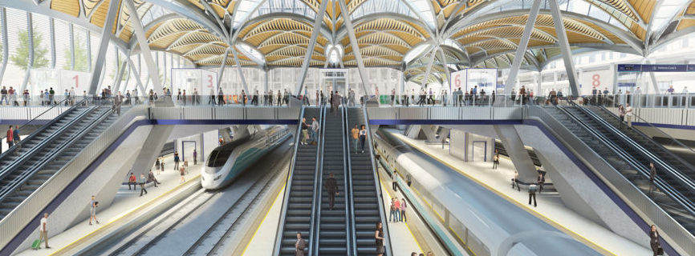
Concept of Euston Station redevelopment
Notes:
Station example: Euston Station
Ask your students the following questions:
What do you like about this station?
What don’t you like?
How would you improve it?
What specific features would you include in your train station?

Slide 6
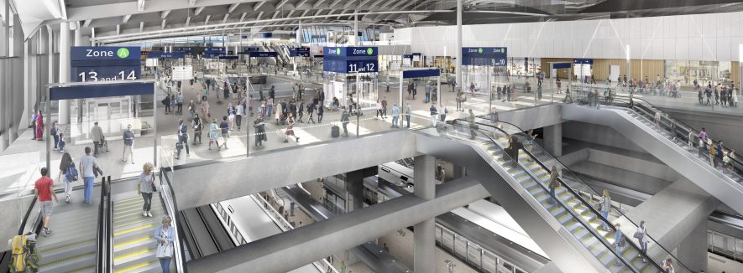
Concept design for Old Oak Common
Notes:
Station example: Old Oak Common
Ask your students the following questions:
What do you like about this station?
What don’t you like?
How would you improve it?
What specific features would you include in your train station?

Slide 7
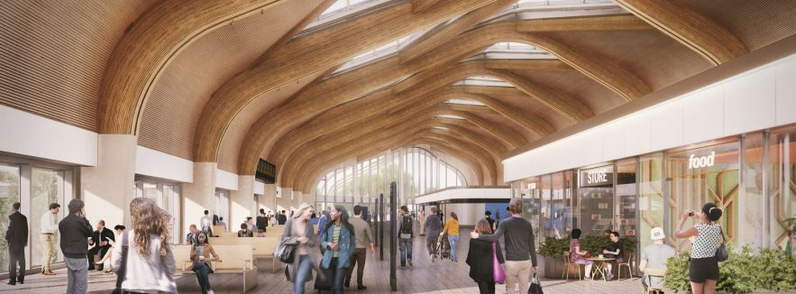
Concept design for Birmingham Interchange
Notes:
Station example: Old Oak Common
Ask your students the following questions:
What do you like about this station?
What don’t you like?
How would you improve it?
What specific features would you include in your train station?

Slide 8
Challenge 1: Station design
Today you will design a train station. You should present your design as a map
or top-down view.
Cut out the station features and arrange them on the station map.
Add additional features such as shops, gardens, etc.
Name your station and decorate it with colour.
Add labels and annotation to explain your ideas.
You may draw your own station map and add additional drawings if you wish.
Focus on your essential skill of creativity.
Notes:
Challenge 1: Station design
Introduce the challenge. Explain to students that they will be designing a train station, just like the one on the introduction slide. Explain to your students that they will be working in groups. Emphasise that it is for their local area.
Demonstrate cutting out the station features and sticking them down onto the station map, and adding more features. You may wish to create a finished example to show the students.
You could award a prize for the most creative train station, check with your host first if this is appropriate and state this before the students start.

Slide 9

Challenge 2: Presentations
You will now present your designs.
How does your station help people?
What is your favourite feature?
Focus on your essential skill of speaking.
Speak clearly.
Try to put your ideas in a logical order.
Notes:
Challenge 2: Presentations
Ask students to stop working on their designs. It is now time for the students to present to the rest of the group.
Number each student in a group ‘one’, ‘two’ and ‘three’. In a group of 15 there would be five tables/groups each with three students.
Inform student ‘one’ from each group that they will soon be visiting the other groups to hear about their station designs.
Inform students ‘two’ and ‘three’ that for now they will stay at their tables and present their design to the visiting student ‘one’.
Try and rotate students at a regular interval – this may change depending on time remaining in the session, however a suggested time would be every 90 seconds.
Once the first student has been to the four other groups, change which student is moving.
Encourage the moving students to ask questions.
If there are students with mobility impairment, staff members should rotate between the groups instead of students and be presented to instead.
You could award a prize for the best speaking. If so, check with the host if this would be appropriate and state this before the students start.
We have included prompt questions on the slide to help students when talking.
How does your station help people.
What is your favorite feature?
Additionally students could answer:
How does your station help the environment?
How do people find their way around the station?
How does your station meet everybody’s needs?

Slide 10

Plenary
Who improved their creativity skills today?
What did you do?
Was it easy or hard to design your station? Why?
How easy or difficult was it to present your idea?
In what types of jobs might you need to use creativity or speaking? Why are they useful skills?
Notes:
Plenary
Use these questions to review the learning and return to the objectives set at the beginning of the lesson. This also provides students with a chance to show off what they have learned and to share ideas and skills.
Use the final question to introduce a careers element to the activity. The aim is to relate the skills from today’s session to a career. Explain how a project like HS2 relies on lots of people working together. In most workplaces you will have to work in a team, speaking and sharing ideas with others and working together to get the job done (just like in the photo).
Ask your students to rate their creativity and speaking skills again. Hopefully, you have more thumbs up than at the start!

Slide 11
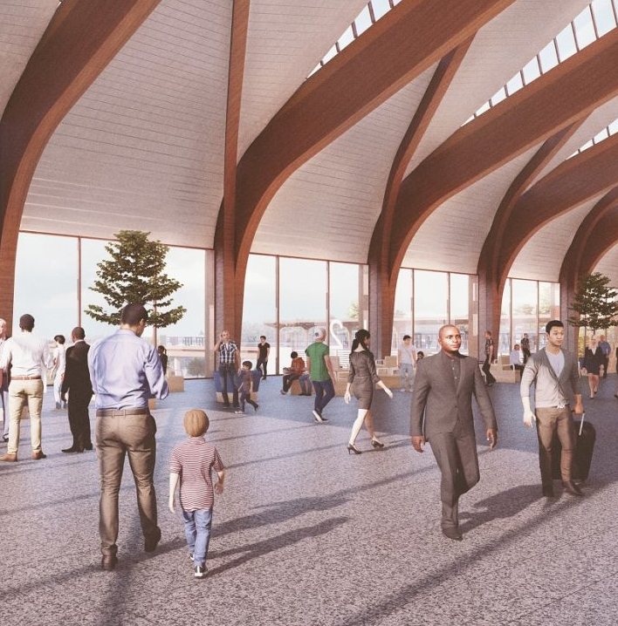
Careers link:
Customer Experience (CX) Design
Use your skills to help design real-life stations
that work well for everybody.
Help shape the future of rail travel with the
latest technology and design styles.
Find out how you could start your career at HS2 at:
https://www.hs2.org.uk/careers/future-talent/
Notes:
Careers link: Customer Experience Design
Explain to the students that if they enjoyed today’s activity, then they should think about a career in Customer Experience (CX) Design. CX Designers work to improve customer satisfaction by mapping and improving their experiences of a service. In the rail industry, this includes the door-to-door journey as well as the process of booking a ticket. It includes everything from the food options at the station to the interior design of the stations and trains.

