Slide 1
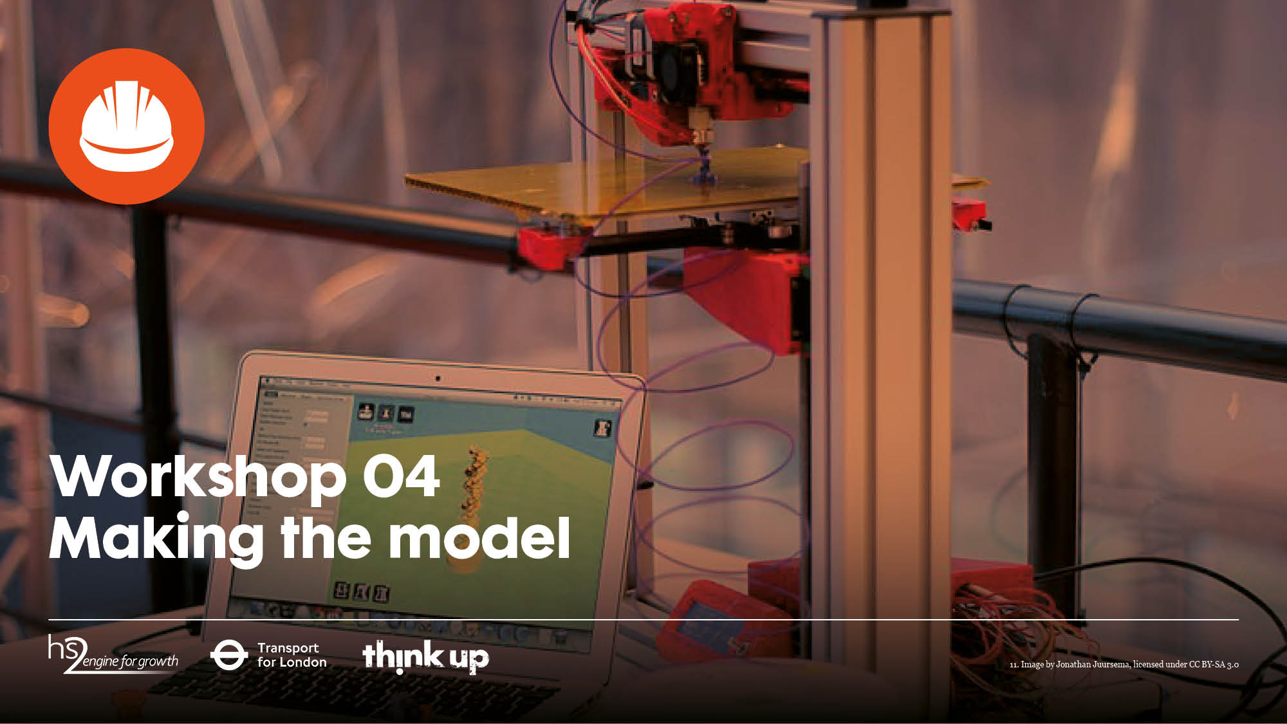
Making the model

Slide 2

Starter
Below are the first three workshop titles and the workshop objectives. Match the objectives to the titles:
Welcome to Smeaton
Understanding the environment
Designing a crossing
Investigate different options for river crossings
Produce a plan and cross-section of the proposed crossing
Evaluate environmental factors, and existing site conditions. Then identify constraints resulting from these
Identify and understand the need for links between infrastructure and communities
Identify a type for the proposed crossing
Preliminary sketch proposals

Slide 3
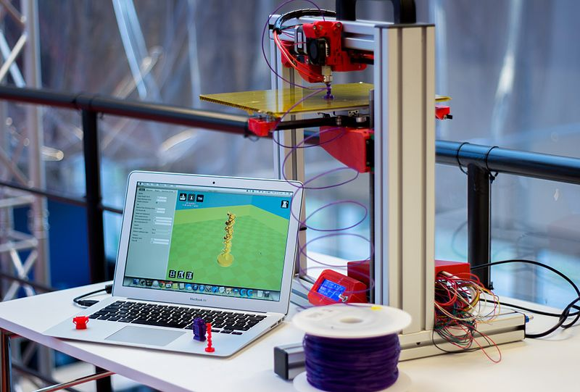
Making the model
Workshop objective
Make a model to scale using your chosen materials.
Image by Jonathan Juursema, licensed under CC BY-SA 3.0

Slide 4
Making the model
You should aim for your model to be visually accurate.
The model should be at a scale of 1:200.
The materials you can use have a price per unit length. You will need to record how much material you use. Any unused material can be sold back at the end.
Prices
Timber (suggested 9x9mm) £15,000 per cm
Rigid plastic tubes (suggested 10mm diameter) is £10,000 per cm
Straws (£1,000 per cm)
String (£500 per cm)
Corrugated cardboard (£500 per cm²)

Slide 5
Workshop roundup
Consider one of the materials you have used today.
Give an advantage and a disadvantage of making a model from that material.

