Slide 1


Slide 2

Starter
Think of a famous building that most people will know the name of.
Without saying the name of the building describe it to your partner, see if they can guess the name.
Workshop objectives
Preliminary sketch proposals
Produce a plan and cross-section of the proposed crossing
Gain an understanding of different materials
Employability skills
Team working; brainstorming.

Slide 3
Designing your crossing
Having chosen your crossing, you need to design how it will look, and how it will attach to the existing infrastructure. This is an opportunity to make compromises to minority -held views.
Use the plans and cross-sections on Resources 3.1 – 3.11 to design your crossing.
Spend:
5 minutes recapping your brief
5 minutes discussing ideas
10 minutes sketching ideas
Afterwards your team will have a design team meeting
where you will choose a design.
Image courtesy of Expedition Engineering

Slide 4
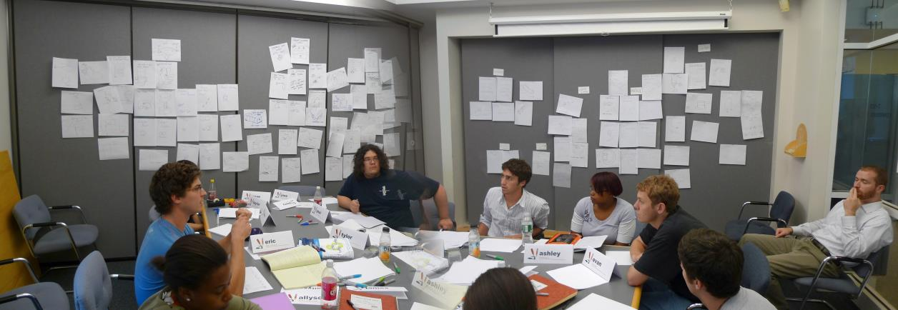
Design team meeting
You now have 10 minutes to decide on a design.
Remember your job role!
The project director has the final say!
Image by Juhan Sonin, licensed under CC BY 2.0

Slide 5
Workshop roundup
Write down two advantages and one disadvantage of your design.

